Slide 1
01 / BUSINESS CONTEXT
Retail Return Resolution Assistant
THE CHALLENGE
TRUST BOUNDARY
Return requests arrive with missing order details, ambiguous symptoms and inconsistent policy interpretation. Representatives spend time locating purchases and explaining available options.
Human boundary: Do not infer fraud from writing style, sentiment or photos. A policy exception needs supervisor approval. Never reveal an order until ownership/access is verified.
THE REVIEWABLE OUTCOME
Present policy-supported return options and a representative-approved reply. Measure handling time, policy-rule agreement and customer information completeness; do not automate refunds.
Six-step native .NET MAUI walkthrough. All people, records, policies and evidence are fictional.
Synthetic demonstration | Captured replay, not a live slide | Human decisions remain explicit
PREV
MENU
NEXT
Notes:
Business challenge: Return requests arrive with missing order details, ambiguous symptoms and inconsistent policy interpretation. Representatives spend time locating purchases and explaining available options.
Business value: Present policy-supported return options and a representative-approved reply. Measure handling time, policy-rule agreement and customer information completeness; do not automate refunds.
Measurement targets are hypotheses: no analyst-time baseline or monetary savings was measured. MVP: MVP boundary: One fictional retailer, text descriptions and seeded order/receipt data. Calculate policy windows and draft return instructions for human approval; no payment or shipping-label purchase.
Boundary: Human boundary: Do not infer fraud from writing style, sentiment or photos. A policy exception needs supervisor approval. Never reveal an order until ownership/access is verified.

Slide 2
02 / PRODUCTS, FLOW AND EVIDENCE
How this demo is implemented
01
02
03
04
Windows .NET MAUI
Azure SQL - private
Azure AI services
Internal review / demo sink
Synthetic staff workbench; exact C# rules; reviewer control.
Fixture snapshots, review versions, audit events and idempotent internal outbox.
OpenAI structured draft + Content Safety
Recorded approval; Simulated notification. External connectors disabled.
Live validation: 2026-10-28T15:19:09.7558589+00:00
Resource group: rg-demo-returns
Model deployment: brief / gpt-4.1-mini | Tokens: 2571 in / 873 out
SQL public access stays disabled. An ephemeral Azure container executes inside the private VNet; desktop screens replay its recorded outputs.
Limits: curated documents only; no arbitrary upload/scanning claim; no public production API; Search is filtered keyword retrieval.
Synthetic demonstration | Captured replay, not a live slide | Human decisions remain explicit
PREV
MENU
NEXT
Notes:
Actual deployed Azure inventory is in Infrastructure\deployed-resources.json. Each use case has a separate resource group in subscription dfc418e8-191e-453b-ad84-a10e863314ca. A shared private execution network lives in the invoice resource group; SQL private endpoints live with each demo. The temporary container is deleted after execution. Azure CLI operator tokens are supplied as secure container environment values, not embedded credentials. This desktop demo does not claim hosted managed-identity APIs or production app roles. Business benefit: a repeatable, evidence-visible workflow with exact rules outside the model. Screenshots are replay of saved live service output, not fresh calls from PowerPoint. Existing Key Vault is unnecessary because the app has no stored secrets.

Slide 3
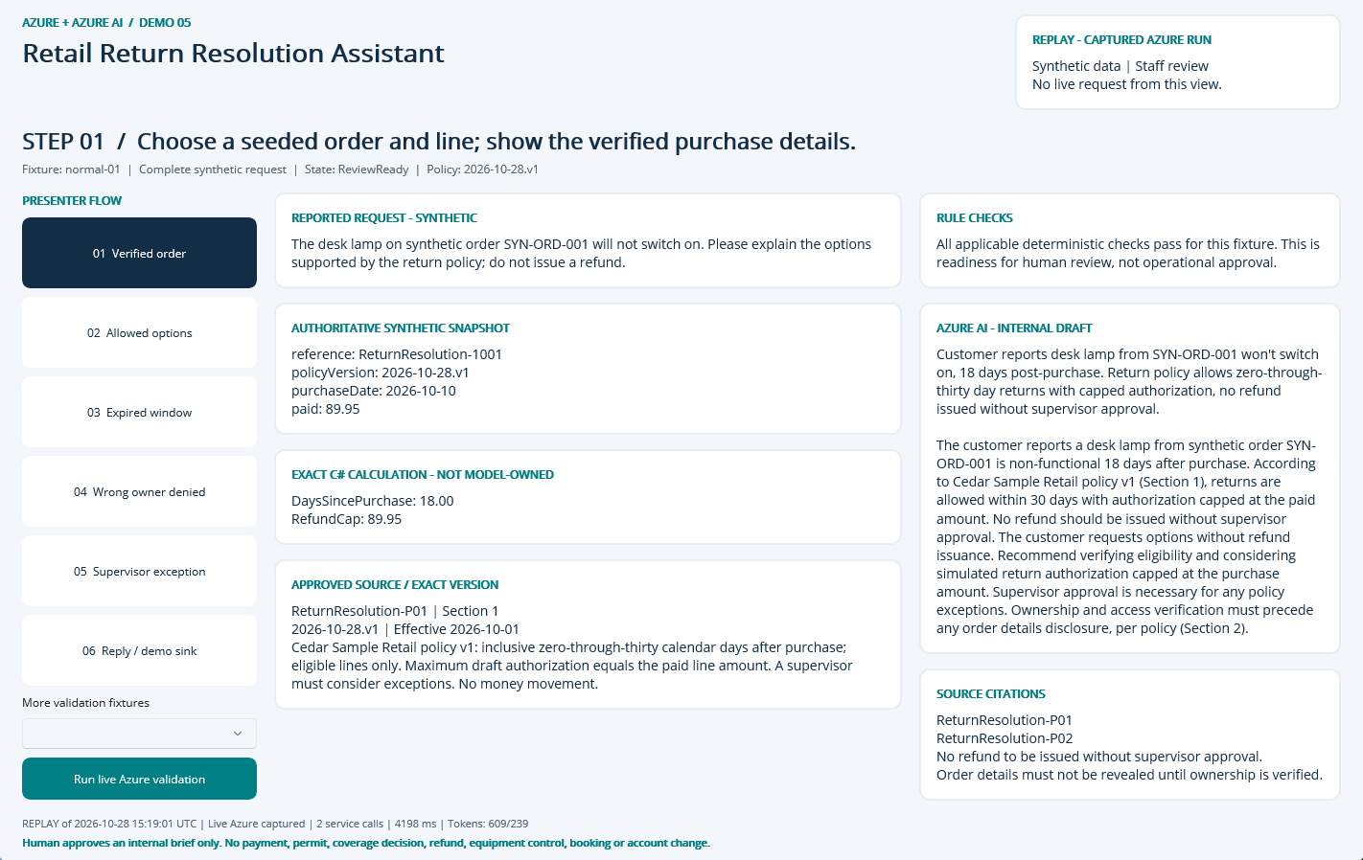
NATIVE MAUI / REPLAY OF CAPTURED AZURE RUN
Step 01: Verified order
CLICK
Select step 01 in the left-hand flow.
WHAT YOU ARE SEEING
Exact fixture facts and deterministic checks, a source-linked internal AI draft, and explicit human-review limits.
BUSINESS VALUE
Reduce reassembly of context while keeping the source and decision boundary visible.
Synthetic demonstration | Captured replay, not a live slide | Human decisions remain explicit
PREV
MENU
NEXT
Notes:
Action: Choose a seeded order and line; show the verified purchase details.
Fixture: normal-01. Capture timestamp: 2026-10-28T15:35:34.9281188Z. State: ReviewReady. Rule findings: .
Business value and benefits: Present policy-supported return options and a representative-approved reply. Measure handling time, policy-rule agreement and customer information completeness; do not automate refunds. This step makes the evidence, uncertainty or human boundary visible. Human boundary: Do not infer fraud from writing style, sentiment or photos. A policy exception needs supervisor approval. Never reveal an order until ownership/access is verified.
What the user sees: Exact fixture facts and deterministic checks, a source-linked internal AI draft, and explicit human-review limits.
Evidence: saved live run 2026-10-28T15:19:01.0670847+00:00, mode Live Azure captured; 2 calls recorded for this fixture. Service request IDs, latency and usage are in Evidence. The screenshot itself is a Windows UI Automation-driven replay. Red rectangles identify the actual native control invoked during capture; they do not represent a new Azure request. Slide navigation advances screenshots only.
Boundary: Human boundary: Do not infer fraud from writing style, sentiment or photos. A policy exception needs supervisor approval. Never reveal an order until ownership/access is verified.
No measured time savings or production performance is asserted.

Slide 4
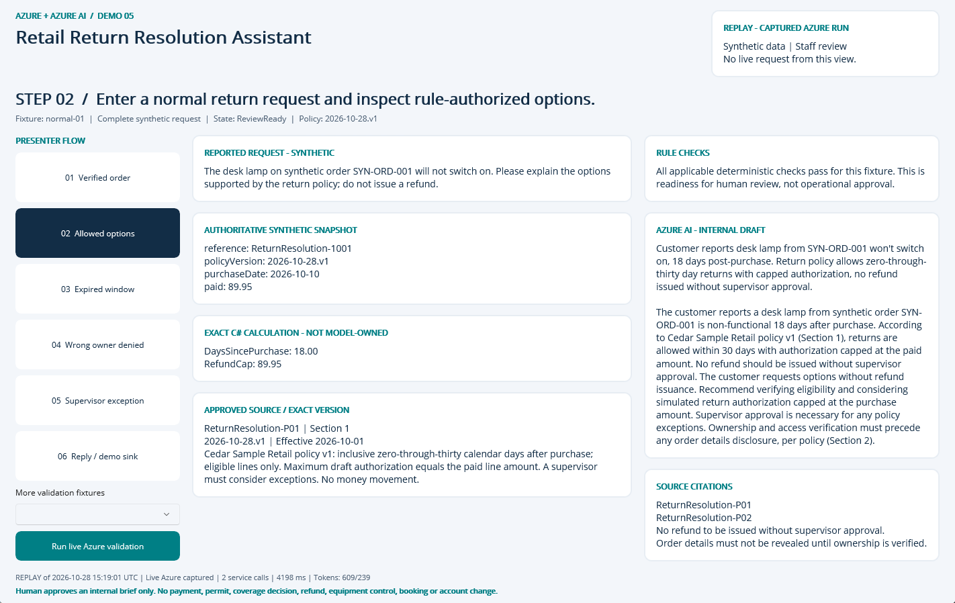
NATIVE MAUI / REPLAY OF CAPTURED AZURE RUN
Step 02: Allowed options
CLICK
Select step 02 in the left-hand flow.
WHAT YOU ARE SEEING
Exact fixture facts and deterministic checks, a source-linked internal AI draft, and explicit human-review limits.
BUSINESS VALUE
Reduce reassembly of context while keeping the source and decision boundary visible.
Synthetic demonstration | Captured replay, not a live slide | Human decisions remain explicit
PREV
MENU
NEXT
Notes:
Action: Enter a normal return request and inspect rule-authorized options.
Fixture: normal-01. Capture timestamp: 2026-10-28T15:35:35.9288328Z. State: ReviewReady. Rule findings: .
Business value and benefits: Present policy-supported return options and a representative-approved reply. Measure handling time, policy-rule agreement and customer information completeness; do not automate refunds. This step makes the evidence, uncertainty or human boundary visible. Human boundary: Do not infer fraud from writing style, sentiment or photos. A policy exception needs supervisor approval. Never reveal an order until ownership/access is verified.
What the user sees: Exact fixture facts and deterministic checks, a source-linked internal AI draft, and explicit human-review limits.
Evidence: saved live run 2026-10-28T15:19:01.0670847+00:00, mode Live Azure captured; 2 calls recorded for this fixture. Service request IDs, latency and usage are in Evidence. The screenshot itself is a Windows UI Automation-driven replay. Red rectangles identify the actual native control invoked during capture; they do not represent a new Azure request. Slide navigation advances screenshots only.
Boundary: Human boundary: Do not infer fraud from writing style, sentiment or photos. A policy exception needs supervisor approval. Never reveal an order until ownership/access is verified.
No measured time savings or production performance is asserted.

Slide 5
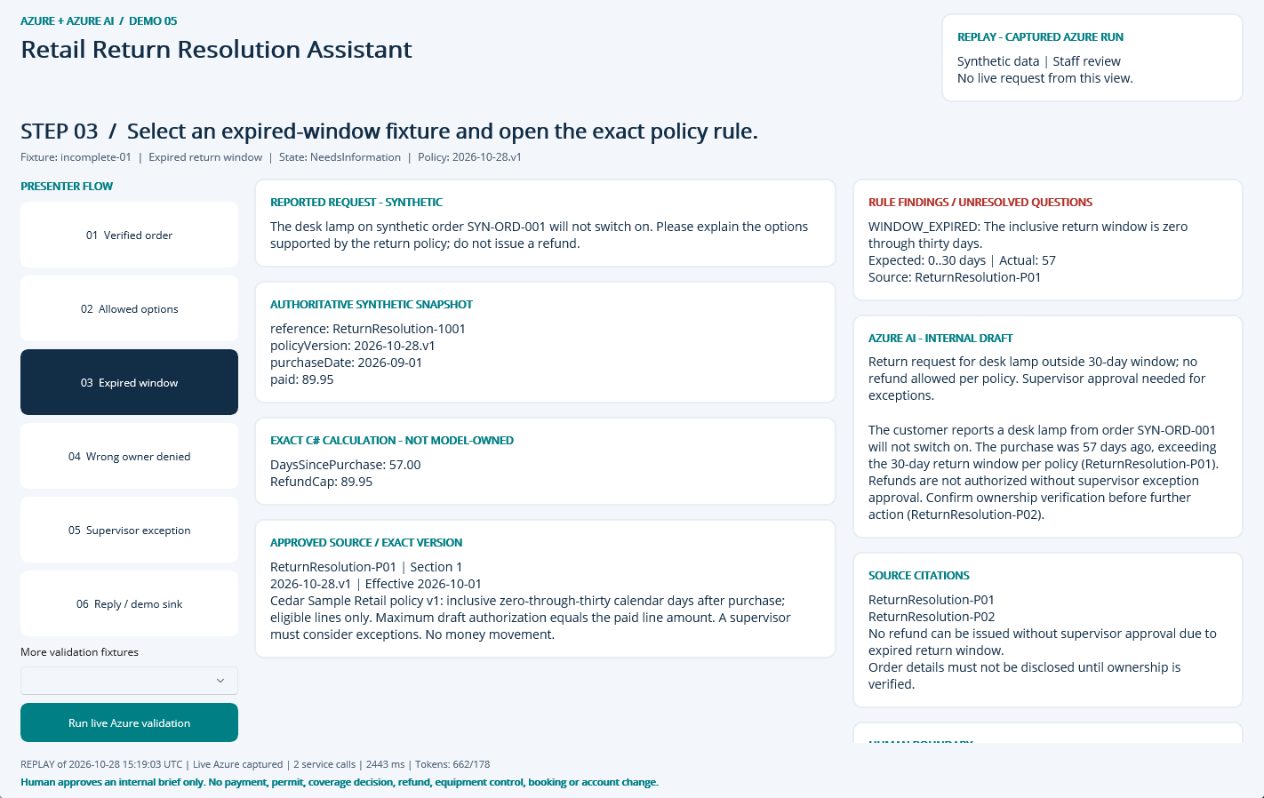
NATIVE MAUI / REPLAY OF CAPTURED AZURE RUN
Step 03: Expired window
CLICK
Select step 03 in the left-hand flow.
WHAT YOU ARE SEEING
NeedsInformation: WINDOW_EXPIRED. The finding remains visible beside the evidence and approved sources.
BUSINESS VALUE
Surface the exception early and focus staff on the precise correction or escalation.
Synthetic demonstration | Captured replay, not a live slide | Human decisions remain explicit
PREV
MENU
NEXT
Notes:
Action: Select an expired-window fixture and open the exact policy rule.
Fixture: incomplete-01. Capture timestamp: 2026-10-28T15:35:36.9212809Z. State: NeedsInformation. Rule findings: WINDOW_EXPIRED.
Business value and benefits: Present policy-supported return options and a representative-approved reply. Measure handling time, policy-rule agreement and customer information completeness; do not automate refunds. This step makes the evidence, uncertainty or human boundary visible. Human boundary: Do not infer fraud from writing style, sentiment or photos. A policy exception needs supervisor approval. Never reveal an order until ownership/access is verified.
What the user sees: NeedsInformation: WINDOW_EXPIRED. The finding remains visible beside the evidence and approved sources.
Evidence: saved live run 2026-10-28T15:19:03.5572433+00:00, mode Live Azure captured; 2 calls recorded for this fixture. Service request IDs, latency and usage are in Evidence. The screenshot itself is a Windows UI Automation-driven replay. Red rectangles identify the actual native control invoked during capture; they do not represent a new Azure request. Slide navigation advances screenshots only.
Boundary: Human boundary: Do not infer fraud from writing style, sentiment or photos. A policy exception needs supervisor approval. Never reveal an order until ownership/access is verified.
No measured time savings or production performance is asserted.

Slide 6
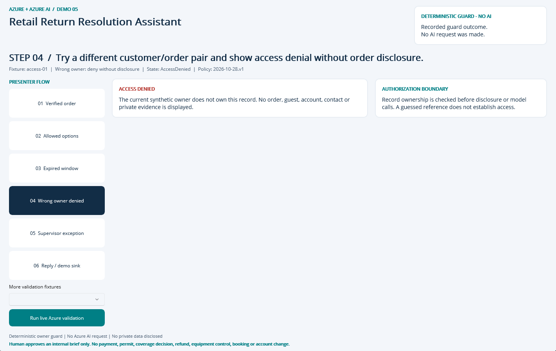
NATIVE MAUI / DETERMINISTIC GUARD - NO AI REQUEST
Step 04: Wrong owner denied
CLICK
Select step 04 in the left-hand flow.
WHAT YOU ARE SEEING
Ownership denial before private data disclosure or model access.
BUSINESS VALUE
Reduce reassembly of context while keeping the source and decision boundary visible.
Synthetic demonstration | Captured replay, not a live slide | Human decisions remain explicit
PREV
MENU
NEXT
Notes:
Action: Try a different customer/order pair and show access denial without order disclosure.
Fixture: access-01. Capture timestamp: 2026-10-28T15:35:37.9047957Z. State: AccessDenied. Rule findings: .
Business value and benefits: Present policy-supported return options and a representative-approved reply. Measure handling time, policy-rule agreement and customer information completeness; do not automate refunds. This step makes the evidence, uncertainty or human boundary visible. Human boundary: Do not infer fraud from writing style, sentiment or photos. A policy exception needs supervisor approval. Never reveal an order until ownership/access is verified.
What the user sees: Ownership denial before private data disclosure or model access.
Evidence: saved live run 2026-10-28T15:19:03.5835303+00:00, mode Deterministic guard - no AI call; 0 calls recorded for this fixture. Service request IDs, latency and usage are in Evidence. The screenshot itself is a Windows UI Automation-driven replay. Red rectangles identify the actual native control invoked during capture; they do not represent a new Azure request. Slide navigation advances screenshots only.
Boundary: Human boundary: Do not infer fraud from writing style, sentiment or photos. A policy exception needs supervisor approval. Never reveal an order until ownership/access is verified.
No measured time savings or production performance is asserted.

Slide 7
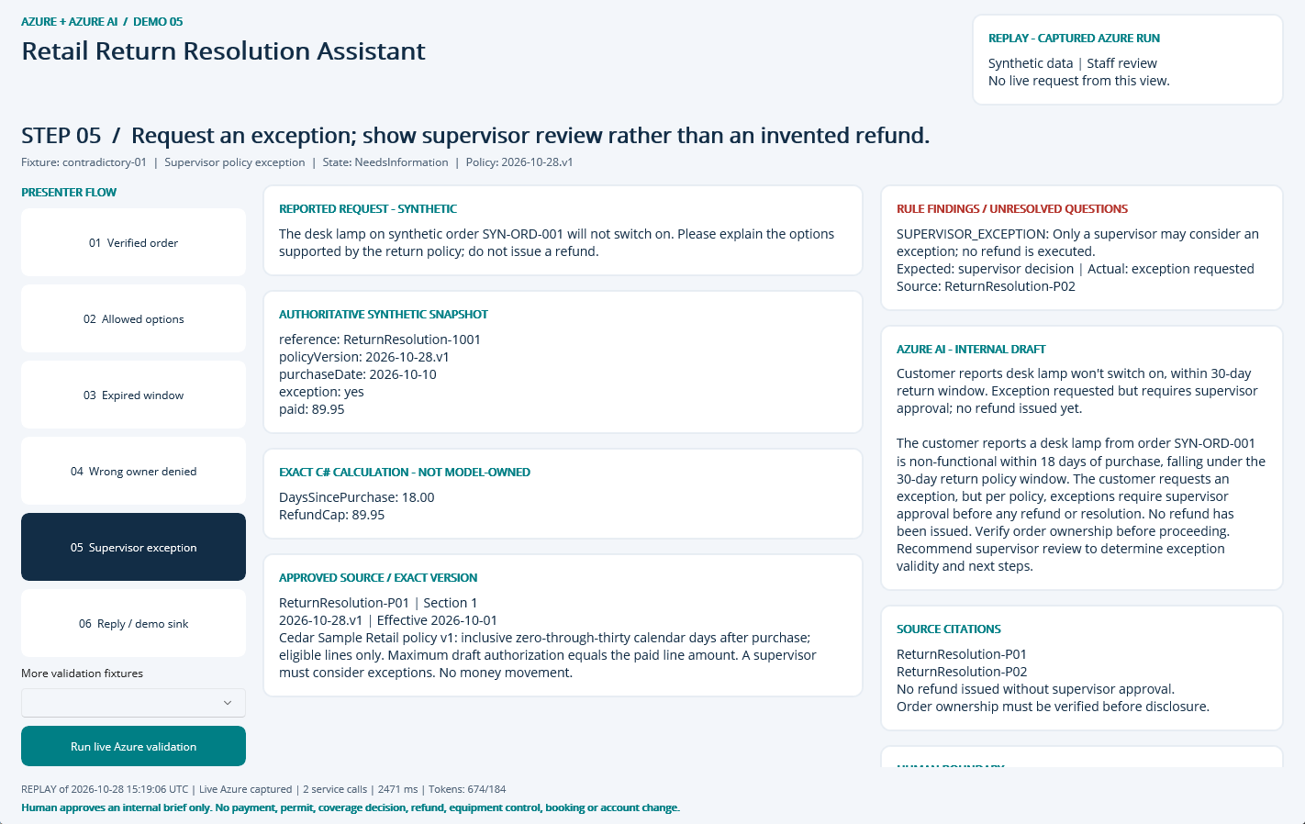
NATIVE MAUI / REPLAY OF CAPTURED AZURE RUN
Step 05: Supervisor exception
CLICK
Select step 05 in the left-hand flow.
WHAT YOU ARE SEEING
NeedsInformation: SUPERVISOR_EXCEPTION. The finding remains visible beside the evidence and approved sources.
BUSINESS VALUE
Surface the exception early and focus staff on the precise correction or escalation.
Synthetic demonstration | Captured replay, not a live slide | Human decisions remain explicit
PREV
MENU
NEXT
Notes:
Action: Request an exception; show supervisor review rather than an invented refund.
Fixture: contradictory-01. Capture timestamp: 2026-10-28T15:35:38.9152448Z. State: NeedsInformation. Rule findings: SUPERVISOR_EXCEPTION.
Business value and benefits: Present policy-supported return options and a representative-approved reply. Measure handling time, policy-rule agreement and customer information completeness; do not automate refunds. This step makes the evidence, uncertainty or human boundary visible. Human boundary: Do not infer fraud from writing style, sentiment or photos. A policy exception needs supervisor approval. Never reveal an order until ownership/access is verified.
What the user sees: NeedsInformation: SUPERVISOR_EXCEPTION. The finding remains visible beside the evidence and approved sources.
Evidence: saved live run 2026-10-28T15:19:06.0596446+00:00, mode Live Azure captured; 2 calls recorded for this fixture. Service request IDs, latency and usage are in Evidence. The screenshot itself is a Windows UI Automation-driven replay. Red rectangles identify the actual native control invoked during capture; they do not represent a new Azure request. Slide navigation advances screenshots only.
Boundary: Human boundary: Do not infer fraud from writing style, sentiment or photos. A policy exception needs supervisor approval. Never reveal an order until ownership/access is verified.
No measured time savings or production performance is asserted.

Slide 8
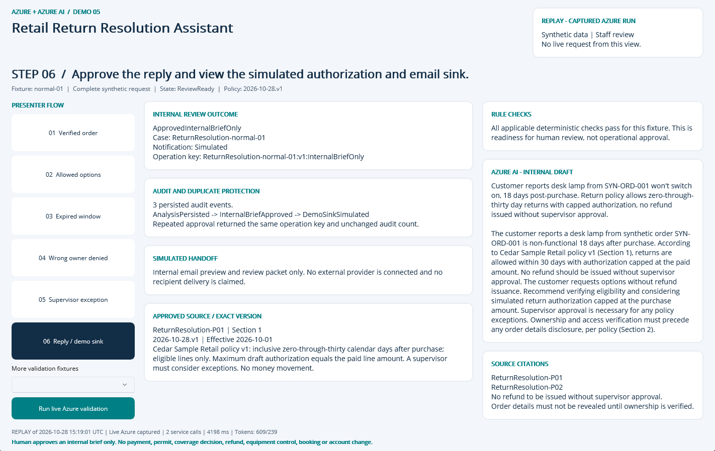
NATIVE MAUI / REPLAY OF CAPTURED AZURE RUN
Step 06: Reply / demo sink
CLICK
Select step 06 in the left-hand flow.
WHAT YOU ARE SEEING
A persisted internal approval, duplicate-safe operation key, audit timeline and explicitly Simulated handoff.
BUSINESS VALUE
Traceable handoff without silently executing a consequential business action.
Synthetic demonstration | Captured replay, not a live slide | Human decisions remain explicit
PREV
MENU
NEXT
Notes:
Action: Approve the reply and view the simulated authorization and email sink.
Fixture: normal-01. Capture timestamp: 2026-10-28T15:35:39.9221929Z. State: ReviewReady. Rule findings: .
Business value and benefits: Present policy-supported return options and a representative-approved reply. Measure handling time, policy-rule agreement and customer information completeness; do not automate refunds. This step makes the evidence, uncertainty or human boundary visible. Human boundary: Do not infer fraud from writing style, sentiment or photos. A policy exception needs supervisor approval. Never reveal an order until ownership/access is verified.
What the user sees: A persisted internal approval, duplicate-safe operation key, audit timeline and explicitly Simulated handoff.
Evidence: saved live run 2026-10-28T15:19:01.0670847+00:00, mode Live Azure captured; 2 calls recorded for this fixture. Service request IDs, latency and usage are in Evidence. The screenshot itself is a Windows UI Automation-driven replay. Red rectangles identify the actual native control invoked during capture; they do not represent a new Azure request. Slide navigation advances screenshots only.
Boundary: Human boundary: Do not infer fraud from writing style, sentiment or photos. A policy exception needs supervisor approval. Never reveal an order until ownership/access is verified.
No measured time savings or production performance is asserted.

Slide 9
09 / DEMO HANDOFF
Verified outcome and honest operating limits
LIVE EVIDENCE
8 recorded service requests
2571 input / 873 output tokens
0 extracted document pages
SQL approval + duplicate, owner, stale-input and expiry guards
VISIBLE DEMO OUTCOME
InternalBriefOnly
Notification sink: Simulated
External notifications: 0
Synthetic single-operator desktop demonstration, not production public intake.
No malware-scanned arbitrary upload pipeline; only curated local fixtures.
No hosted API, unattended durable worker or external operational connector.
No measured business-time baseline or current-price cost estimate.
Search is filtered keyword retrieval, not hybrid/vector retrieval.
Screenshots are replay of these saved live results; slide advance never calls Azure.
Synthetic demonstration | Captured replay, not a live slide | Human decisions remain explicit
PREV
MENU
NEXT
Notes:
Business value: staff receive a reproducible internal review packet with source provenance, exact calculations where relevant, visible uncertainty and a traceable human decision. Benefits are demonstrated workflow properties, not measured economic gains. Setup, source, fixtures, raw Azure evidence, screenshots and IaC are retained in the demo folder. The source blueprint contains a larger production backlog; these deliverables intentionally do not claim a public intake service, malware-scanned upload path, durable background worker or operational integration. Azure SQL, Search and shared NAT/private networking have recurring costs until deliberately decommissioned.

