Slide 1
01 / BUSINESS CONTEXT
Logistics Shipment Exception Coordinator
THE CHALLENGE
TRUST BOUNDARY
Delayed, damaged or incomplete shipments generate fragmented carrier events and customer emails. Teams need one consistent timeline and a defensible next update without inventing delivery promises.
Human boundary: A model cannot create carrier facts, promise an arrival date or accuse a carrier/customer of fraud. Event playback and any estimated timeline must be clearly labeled.
THE REVIEWABLE OUTCOME
Create an exception timeline, next-action checklist and customer-update draft. Measure duplicate-event suppression, exception detection and time to prepare an update.
Six-step native .NET MAUI walkthrough. All people, records, policies and evidence are fictional.
Synthetic demonstration | Captured replay, not a live slide | Human decisions remain explicit
PREV
MENU
NEXT
Notes:
Business challenge: Delayed, damaged or incomplete shipments generate fragmented carrier events and customer emails. Teams need one consistent timeline and a defensible next update without inventing delivery promises.
Business value: Create an exception timeline, next-action checklist and customer-update draft. Measure duplicate-event suppression, exception detection and time to prepare an update.
Measurement targets are hypotheses: no analyst-time baseline or monetary savings was measured. MVP: MVP boundary: Two simulated carriers, seeded orders and JSON event playback. No live carrier tracking, routing optimization, customs advice or guaranteed arrival estimates.
Boundary: Human boundary: A model cannot create carrier facts, promise an arrival date or accuse a carrier/customer of fraud. Event playback and any estimated timeline must be clearly labeled.

Slide 2
02 / PRODUCTS, FLOW AND EVIDENCE
How this demo is implemented
01
02
03
04
Windows .NET MAUI
Azure SQL - private
Azure AI services
Internal review / demo sink
Synthetic staff workbench; exact C# rules; reviewer control.
Fixture snapshots, review versions, audit events and idempotent internal outbox.
OpenAI structured draft + Content Safety
Recorded approval; Simulated notification. External connectors disabled.
Live validation: 2026-10-28T15:22:08.9540248+00:00
Resource group: rg-demo-logistics
Model deployment: brief / gpt-4.1-mini | Tokens: 3987 in / 1176 out
SQL public access stays disabled. An ephemeral Azure container executes inside the private VNet; desktop screens replay its recorded outputs.
Limits: curated documents only; no arbitrary upload/scanning claim; no public production API; Search is filtered keyword retrieval.
Synthetic demonstration | Captured replay, not a live slide | Human decisions remain explicit
PREV
MENU
NEXT
Notes:
Actual deployed Azure inventory is in Infrastructure\deployed-resources.json. Each use case has a separate resource group in subscription dfc418e8-191e-453b-ad84-a10e863314ca. A shared private execution network lives in the invoice resource group; SQL private endpoints live with each demo. The temporary container is deleted after execution. Azure CLI operator tokens are supplied as secure container environment values, not embedded credentials. This desktop demo does not claim hosted managed-identity APIs or production app roles. Business benefit: a repeatable, evidence-visible workflow with exact rules outside the model. Screenshots are replay of saved live service output, not fresh calls from PowerPoint. Existing Key Vault is unnecessary because the app has no stored secrets.

Slide 3
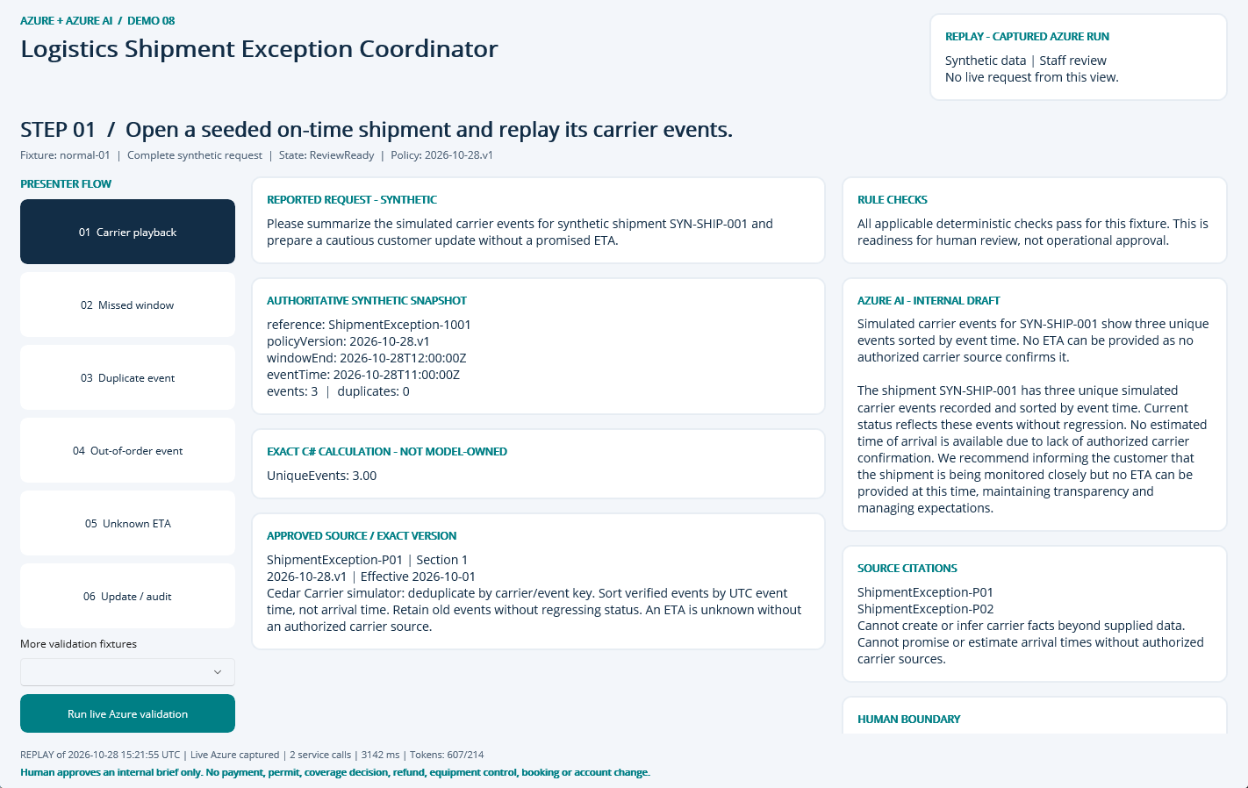
NATIVE MAUI / REPLAY OF CAPTURED AZURE RUN
Step 01: Carrier playback
CLICK
Select step 01 in the left-hand flow.
WHAT YOU ARE SEEING
Exact fixture facts and deterministic checks, a source-linked internal AI draft, and explicit human-review limits.
BUSINESS VALUE
Reduce reassembly of context while keeping the source and decision boundary visible.
Synthetic demonstration | Captured replay, not a live slide | Human decisions remain explicit
PREV
MENU
NEXT
Notes:
Action: Open a seeded on-time shipment and replay its carrier events.
Fixture: normal-01. Capture timestamp: 2026-10-28T15:36:07.3757157Z. State: ReviewReady. Rule findings: .
Business value and benefits: Create an exception timeline, next-action checklist and customer-update draft. Measure duplicate-event suppression, exception detection and time to prepare an update. This step makes the evidence, uncertainty or human boundary visible. Human boundary: A model cannot create carrier facts, promise an arrival date or accuse a carrier/customer of fraud. Event playback and any estimated timeline must be clearly labeled.
What the user sees: Exact fixture facts and deterministic checks, a source-linked internal AI draft, and explicit human-review limits.
Evidence: saved live run 2026-10-28T15:21:55.9555996+00:00, mode Live Azure captured; 2 calls recorded for this fixture. Service request IDs, latency and usage are in Evidence. The screenshot itself is a Windows UI Automation-driven replay. Red rectangles identify the actual native control invoked during capture; they do not represent a new Azure request. Slide navigation advances screenshots only.
Boundary: Human boundary: A model cannot create carrier facts, promise an arrival date or accuse a carrier/customer of fraud. Event playback and any estimated timeline must be clearly labeled.
No measured time savings or production performance is asserted.

Slide 4
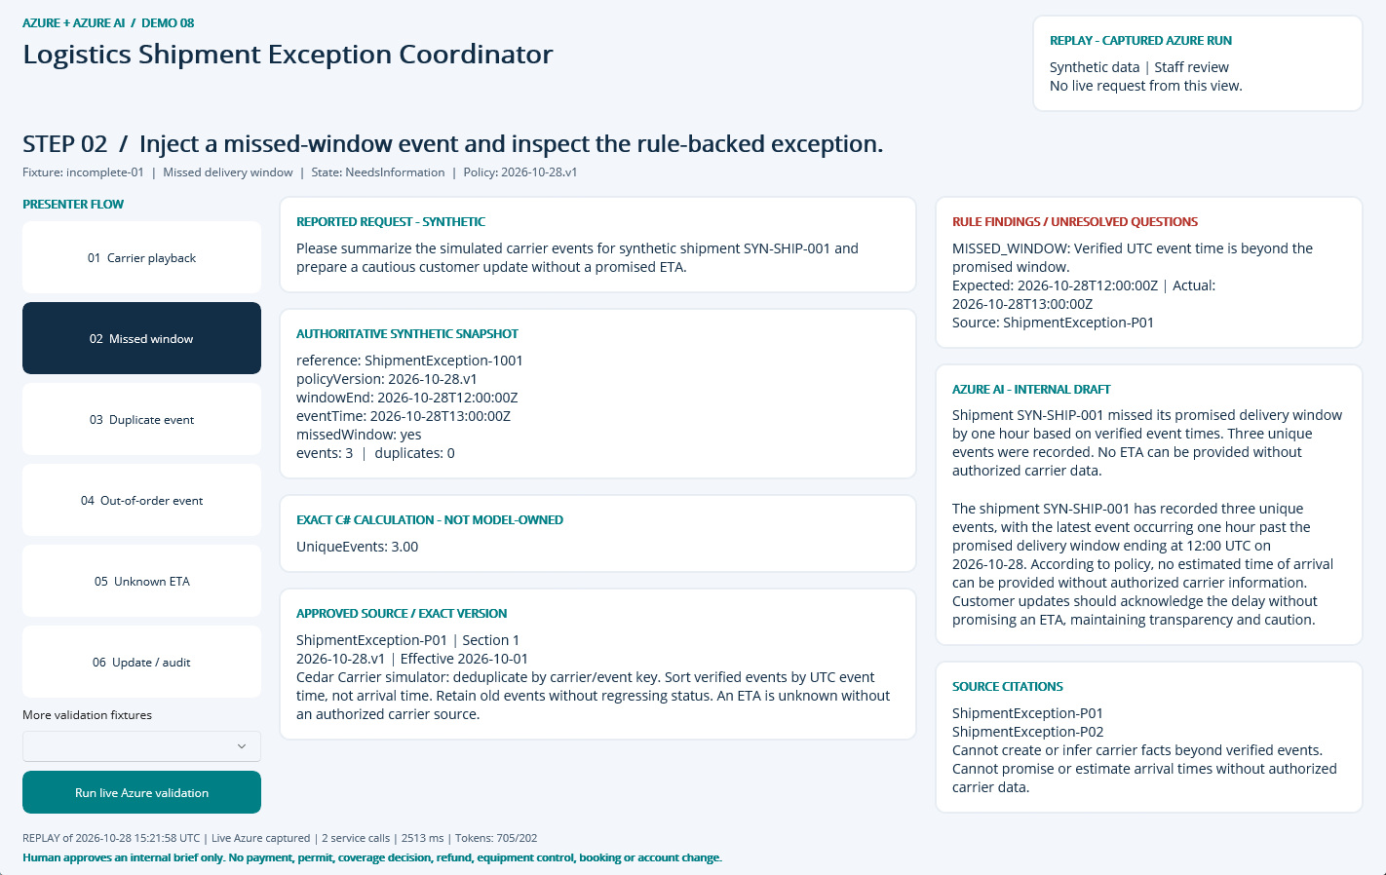
NATIVE MAUI / REPLAY OF CAPTURED AZURE RUN
Step 02: Missed window
CLICK
Select step 02 in the left-hand flow.
WHAT YOU ARE SEEING
NeedsInformation: MISSED_WINDOW. The finding remains visible beside the evidence and approved sources.
BUSINESS VALUE
Surface the exception early and focus staff on the precise correction or escalation.
Synthetic demonstration | Captured replay, not a live slide | Human decisions remain explicit
PREV
MENU
NEXT
Notes:
Action: Inject a missed-window event and inspect the rule-backed exception.
Fixture: incomplete-01. Capture timestamp: 2026-10-28T15:36:08.3655948Z. State: NeedsInformation. Rule findings: MISSED_WINDOW.
Business value and benefits: Create an exception timeline, next-action checklist and customer-update draft. Measure duplicate-event suppression, exception detection and time to prepare an update. This step makes the evidence, uncertainty or human boundary visible. Human boundary: A model cannot create carrier facts, promise an arrival date or accuse a carrier/customer of fraud. Event playback and any estimated timeline must be clearly labeled.
What the user sees: NeedsInformation: MISSED_WINDOW. The finding remains visible beside the evidence and approved sources.
Evidence: saved live run 2026-10-28T15:21:58.5064291+00:00, mode Live Azure captured; 2 calls recorded for this fixture. Service request IDs, latency and usage are in Evidence. The screenshot itself is a Windows UI Automation-driven replay. Red rectangles identify the actual native control invoked during capture; they do not represent a new Azure request. Slide navigation advances screenshots only.
Boundary: Human boundary: A model cannot create carrier facts, promise an arrival date or accuse a carrier/customer of fraud. Event playback and any estimated timeline must be clearly labeled.
No measured time savings or production performance is asserted.

Slide 5
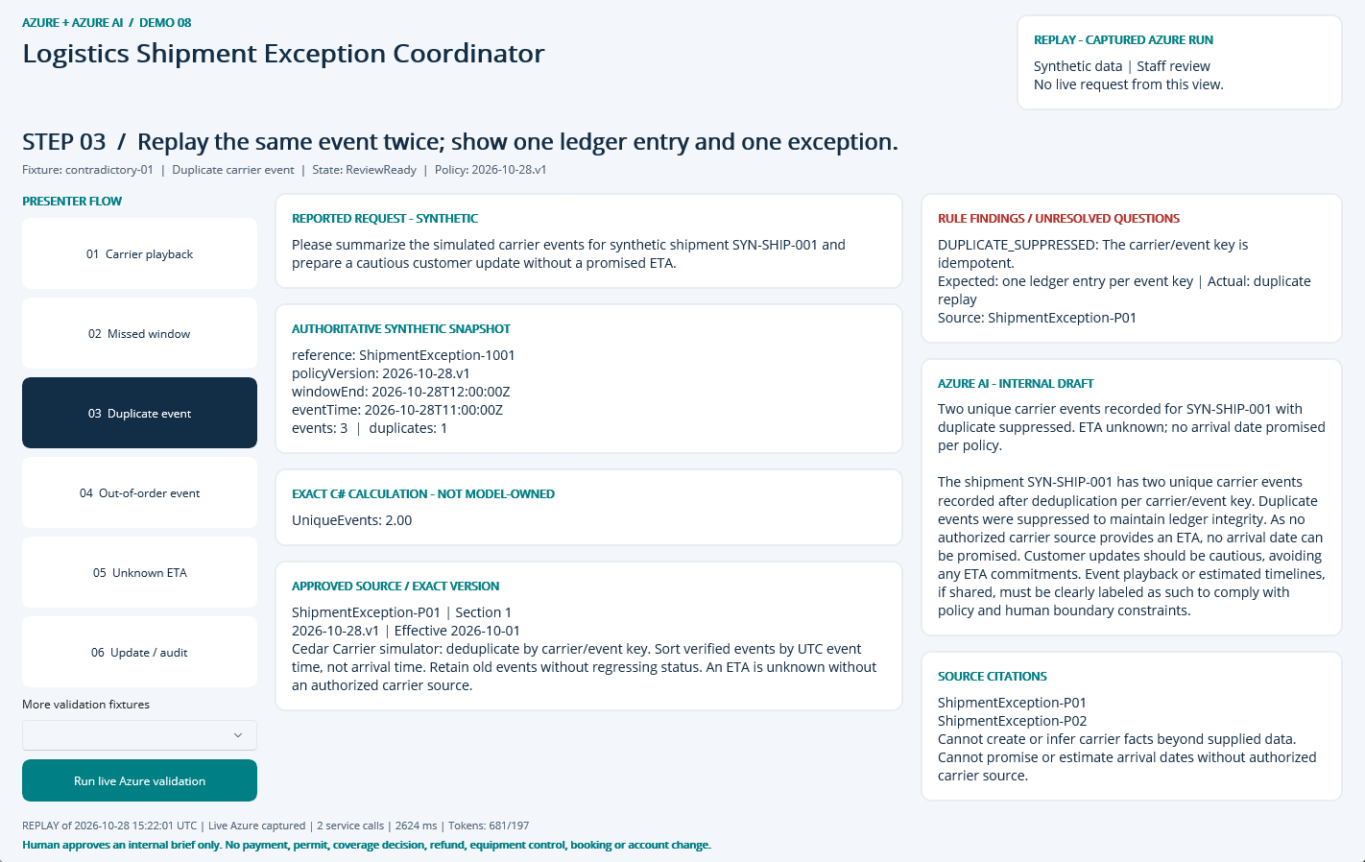
NATIVE MAUI / REPLAY OF CAPTURED AZURE RUN
Step 03: Duplicate event
CLICK
Select step 03 in the left-hand flow.
WHAT YOU ARE SEEING
ReviewReady: DUPLICATE_SUPPRESSED. The finding remains visible beside the evidence and approved sources.
BUSINESS VALUE
Surface the exception early and focus staff on the precise correction or escalation.
Synthetic demonstration | Captured replay, not a live slide | Human decisions remain explicit
PREV
MENU
NEXT
Notes:
Action: Replay the same event twice; show one ledger entry and one exception.
Fixture: contradictory-01. Capture timestamp: 2026-10-28T15:36:09.3566271Z. State: ReviewReady. Rule findings: DUPLICATE_SUPPRESSED.
Business value and benefits: Create an exception timeline, next-action checklist and customer-update draft. Measure duplicate-event suppression, exception detection and time to prepare an update. This step makes the evidence, uncertainty or human boundary visible. Human boundary: A model cannot create carrier facts, promise an arrival date or accuse a carrier/customer of fraud. Event playback and any estimated timeline must be clearly labeled.
What the user sees: ReviewReady: DUPLICATE_SUPPRESSED. The finding remains visible beside the evidence and approved sources.
Evidence: saved live run 2026-10-28T15:22:01.1676694+00:00, mode Live Azure captured; 2 calls recorded for this fixture. Service request IDs, latency and usage are in Evidence. The screenshot itself is a Windows UI Automation-driven replay. Red rectangles identify the actual native control invoked during capture; they do not represent a new Azure request. Slide navigation advances screenshots only.
Boundary: Human boundary: A model cannot create carrier facts, promise an arrival date or accuse a carrier/customer of fraud. Event playback and any estimated timeline must be clearly labeled.
No measured time savings or production performance is asserted.

Slide 6
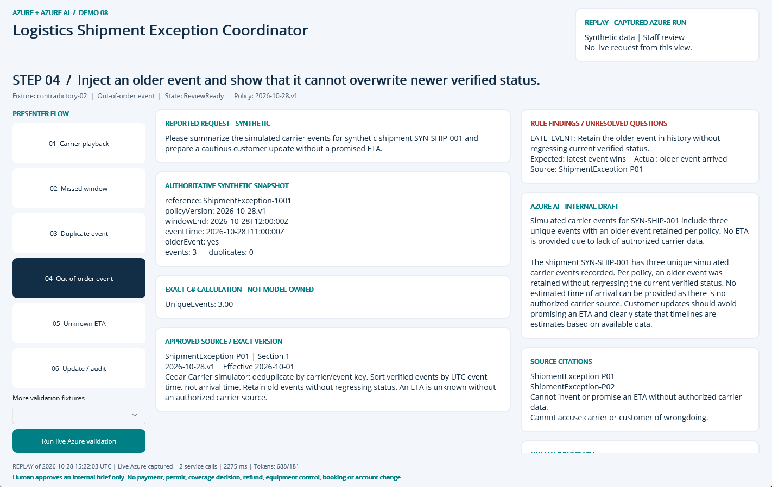
NATIVE MAUI / REPLAY OF CAPTURED AZURE RUN
Step 04: Out-of-order event
CLICK
Select step 04 in the left-hand flow.
WHAT YOU ARE SEEING
ReviewReady: LATE_EVENT. The finding remains visible beside the evidence and approved sources.
BUSINESS VALUE
Surface the exception early and focus staff on the precise correction or escalation.
Synthetic demonstration | Captured replay, not a live slide | Human decisions remain explicit
PREV
MENU
NEXT
Notes:
Action: Inject an older event and show that it cannot overwrite newer verified status.
Fixture: contradictory-02. Capture timestamp: 2026-10-28T15:36:10.3639065Z. State: ReviewReady. Rule findings: LATE_EVENT.
Business value and benefits: Create an exception timeline, next-action checklist and customer-update draft. Measure duplicate-event suppression, exception detection and time to prepare an update. This step makes the evidence, uncertainty or human boundary visible. Human boundary: A model cannot create carrier facts, promise an arrival date or accuse a carrier/customer of fraud. Event playback and any estimated timeline must be clearly labeled.
What the user sees: ReviewReady: LATE_EVENT. The finding remains visible beside the evidence and approved sources.
Evidence: saved live run 2026-10-28T15:22:03.4648487+00:00, mode Live Azure captured; 2 calls recorded for this fixture. Service request IDs, latency and usage are in Evidence. The screenshot itself is a Windows UI Automation-driven replay. Red rectangles identify the actual native control invoked during capture; they do not represent a new Azure request. Slide navigation advances screenshots only.
Boundary: Human boundary: A model cannot create carrier facts, promise an arrival date or accuse a carrier/customer of fraud. Event playback and any estimated timeline must be clearly labeled.
No measured time savings or production performance is asserted.

Slide 7
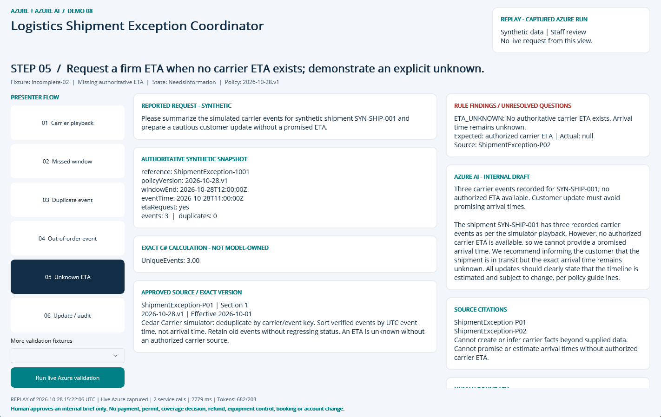
NATIVE MAUI / REPLAY OF CAPTURED AZURE RUN
Step 05: Unknown ETA
CLICK
Select step 05 in the left-hand flow.
WHAT YOU ARE SEEING
NeedsInformation: ETA_UNKNOWN. The finding remains visible beside the evidence and approved sources.
BUSINESS VALUE
Surface the exception early and focus staff on the precise correction or escalation.
Synthetic demonstration | Captured replay, not a live slide | Human decisions remain explicit
PREV
MENU
NEXT
Notes:
Action: Request a firm ETA when no carrier ETA exists; demonstrate an explicit unknown.
Fixture: incomplete-02. Capture timestamp: 2026-10-28T15:36:11.3932333Z. State: NeedsInformation. Rule findings: ETA_UNKNOWN.
Business value and benefits: Create an exception timeline, next-action checklist and customer-update draft. Measure duplicate-event suppression, exception detection and time to prepare an update. This step makes the evidence, uncertainty or human boundary visible. Human boundary: A model cannot create carrier facts, promise an arrival date or accuse a carrier/customer of fraud. Event playback and any estimated timeline must be clearly labeled.
What the user sees: NeedsInformation: ETA_UNKNOWN. The finding remains visible beside the evidence and approved sources.
Evidence: saved live run 2026-10-28T15:22:06.2651637+00:00, mode Live Azure captured; 2 calls recorded for this fixture. Service request IDs, latency and usage are in Evidence. The screenshot itself is a Windows UI Automation-driven replay. Red rectangles identify the actual native control invoked during capture; they do not represent a new Azure request. Slide navigation advances screenshots only.
Boundary: Human boundary: A model cannot create carrier facts, promise an arrival date or accuse a carrier/customer of fraud. Event playback and any estimated timeline must be clearly labeled.
No measured time savings or production performance is asserted.

Slide 8
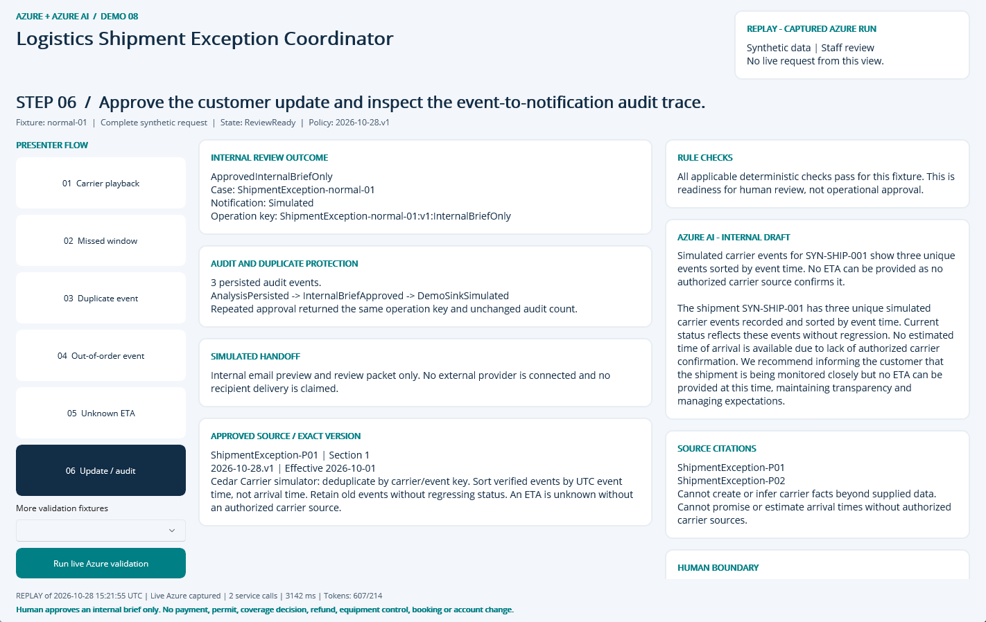
NATIVE MAUI / REPLAY OF CAPTURED AZURE RUN
Step 06: Update / audit
CLICK
Select step 06 in the left-hand flow.
WHAT YOU ARE SEEING
A persisted internal approval, duplicate-safe operation key, audit timeline and explicitly Simulated handoff.
BUSINESS VALUE
Traceable handoff without silently executing a consequential business action.
Synthetic demonstration | Captured replay, not a live slide | Human decisions remain explicit
PREV
MENU
NEXT
Notes:
Action: Approve the customer update and inspect the event-to-notification audit trace.
Fixture: normal-01. Capture timestamp: 2026-10-28T15:36:12.4203238Z. State: ReviewReady. Rule findings: .
Business value and benefits: Create an exception timeline, next-action checklist and customer-update draft. Measure duplicate-event suppression, exception detection and time to prepare an update. This step makes the evidence, uncertainty or human boundary visible. Human boundary: A model cannot create carrier facts, promise an arrival date or accuse a carrier/customer of fraud. Event playback and any estimated timeline must be clearly labeled.
What the user sees: A persisted internal approval, duplicate-safe operation key, audit timeline and explicitly Simulated handoff.
Evidence: saved live run 2026-10-28T15:21:55.9555996+00:00, mode Live Azure captured; 2 calls recorded for this fixture. Service request IDs, latency and usage are in Evidence. The screenshot itself is a Windows UI Automation-driven replay. Red rectangles identify the actual native control invoked during capture; they do not represent a new Azure request. Slide navigation advances screenshots only.
Boundary: Human boundary: A model cannot create carrier facts, promise an arrival date or accuse a carrier/customer of fraud. Event playback and any estimated timeline must be clearly labeled.
No measured time savings or production performance is asserted.

Slide 9
09 / DEMO HANDOFF
Verified outcome and honest operating limits
LIVE EVIDENCE
12 recorded service requests
3987 input / 1176 output tokens
0 extracted document pages
SQL approval + duplicate, owner, stale-input and expiry guards
VISIBLE DEMO OUTCOME
InternalBriefOnly
Notification sink: Simulated
External notifications: 0
Synthetic single-operator desktop demonstration, not production public intake.
No malware-scanned arbitrary upload pipeline; only curated local fixtures.
No hosted API, unattended durable worker or external operational connector.
No measured business-time baseline or current-price cost estimate.
Search is filtered keyword retrieval, not hybrid/vector retrieval.
Screenshots are replay of these saved live results; slide advance never calls Azure.
Synthetic demonstration | Captured replay, not a live slide | Human decisions remain explicit
PREV
MENU
NEXT
Notes:
Business value: staff receive a reproducible internal review packet with source provenance, exact calculations where relevant, visible uncertainty and a traceable human decision. Benefits are demonstrated workflow properties, not measured economic gains. Setup, source, fixtures, raw Azure evidence, screenshots and IaC are retained in the demo folder. The source blueprint contains a larger production backlog; these deliverables intentionally do not claim a public intake service, malware-scanned upload path, durable background worker or operational integration. Azure SQL, Search and shared NAT/private networking have recurring costs until deliberately decommissioned.

