Slide 1
01 / BUSINESS CONTEXT
Utility Bill Explanation and Dispute Desk
THE CHALLENGE
TRUST BOUNDARY
Customers struggle to understand usage changes, rate components and adjustments. Billing specialists must reconstruct the calculation and separate explanation from a genuine dispute.
Human boundary: Never infer hardship, eligibility or customer reliability from writing style or demographics. A disputed bill cannot trigger a payment demand, adverse action or automatic adjustment.
THE REVIEWABLE OUTCOME
Show a reproducible bill calculation, a grounded plain-language explanation and a reviewable dispute packet. Measure numeric fidelity and clarification completeness, not automatic dispute resolution.
Six-step native .NET MAUI walkthrough. All people, records, policies and evidence are fictional.
Synthetic demonstration | Captured replay, not a live slide | Human decisions remain explicit
PREV
MENU
NEXT
Notes:
Business challenge: Customers struggle to understand usage changes, rate components and adjustments. Billing specialists must reconstruct the calculation and separate explanation from a genuine dispute.
Business value: Show a reproducible bill calculation, a grounded plain-language explanation and a reviewable dispute packet. Measure numeric fidelity and clarification completeness, not automatic dispute resolution.
Measurement targets are hypotheses: no analyst-time baseline or monetary savings was measured. MVP: MVP boundary: One fictional utility, one tariff version and synthetic meter/billing snapshots. Explain charges and route disputes; no collections, disconnections, credit decisions or account adjustments.
Boundary: Human boundary: Never infer hardship, eligibility or customer reliability from writing style or demographics. A disputed bill cannot trigger a payment demand, adverse action or automatic adjustment.

Slide 2
02 / PRODUCTS, FLOW AND EVIDENCE
How this demo is implemented
01
02
03
04
Windows .NET MAUI
Azure SQL - private
Azure AI services
Internal review / demo sink
Synthetic staff workbench; exact C# rules; reviewer control.
Fixture snapshots, review versions, audit events and idempotent internal outbox.
OpenAI structured draft + Content Safety + filtered AI Search
Recorded approval; Simulated notification. External connectors disabled.
Live validation: 2026-10-28T15:22:14.3071789+00:00
Resource group: rg-demo-utility
Model deployment: brief / gpt-4.1-mini | Tokens: 6353 in / 1227 out
SQL public access stays disabled. An ephemeral Azure container executes inside the private VNet; desktop screens replay its recorded outputs.
Limits: curated documents only; no arbitrary upload/scanning claim; no public production API; Search is filtered keyword retrieval.
Synthetic demonstration | Captured replay, not a live slide | Human decisions remain explicit
PREV
MENU
NEXT
Notes:
Actual deployed Azure inventory is in Infrastructure\deployed-resources.json. Each use case has a separate resource group in subscription dfc418e8-191e-453b-ad84-a10e863314ca. A shared private execution network lives in the invoice resource group; SQL private endpoints live with each demo. The temporary container is deleted after execution. Azure CLI operator tokens are supplied as secure container environment values, not embedded credentials. This desktop demo does not claim hosted managed-identity APIs or production app roles. Business benefit: a repeatable, evidence-visible workflow with exact rules outside the model. Screenshots are replay of saved live service output, not fresh calls from PowerPoint. Existing Key Vault is unnecessary because the app has no stored secrets.

Slide 3
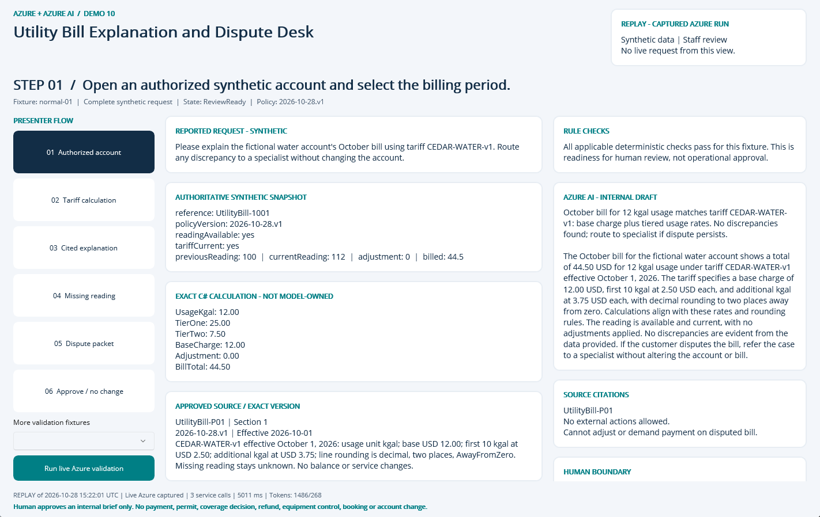
NATIVE MAUI / REPLAY OF CAPTURED AZURE RUN
Step 01: Authorized account
CLICK
Select step 01 in the left-hand flow.
WHAT YOU ARE SEEING
Exact fixture facts and deterministic checks, a source-linked internal AI draft, and explicit human-review limits.
BUSINESS VALUE
Reduce reassembly of context while keeping the source and decision boundary visible.
Synthetic demonstration | Captured replay, not a live slide | Human decisions remain explicit
PREV
MENU
NEXT
Notes:
Action: Open an authorized synthetic account and select the billing period.
Fixture: normal-01. Capture timestamp: 2026-10-28T15:36:33.6990527Z. State: ReviewReady. Rule findings: .
Business value and benefits: Show a reproducible bill calculation, a grounded plain-language explanation and a reviewable dispute packet. Measure numeric fidelity and clarification completeness, not automatic dispute resolution. This step makes the evidence, uncertainty or human boundary visible. Human boundary: Never infer hardship, eligibility or customer reliability from writing style or demographics. A disputed bill cannot trigger a payment demand, adverse action or automatic adjustment.
What the user sees: Exact fixture facts and deterministic checks, a source-linked internal AI draft, and explicit human-review limits.
Evidence: saved live run 2026-10-28T15:22:01.7747067+00:00, mode Live Azure captured; 3 calls recorded for this fixture. Service request IDs, latency and usage are in Evidence. The screenshot itself is a Windows UI Automation-driven replay. Red rectangles identify the actual native control invoked during capture; they do not represent a new Azure request. Slide navigation advances screenshots only.
Boundary: Human boundary: Never infer hardship, eligibility or customer reliability from writing style or demographics. A disputed bill cannot trigger a payment demand, adverse action or automatic adjustment.
No measured time savings or production performance is asserted.

Slide 4
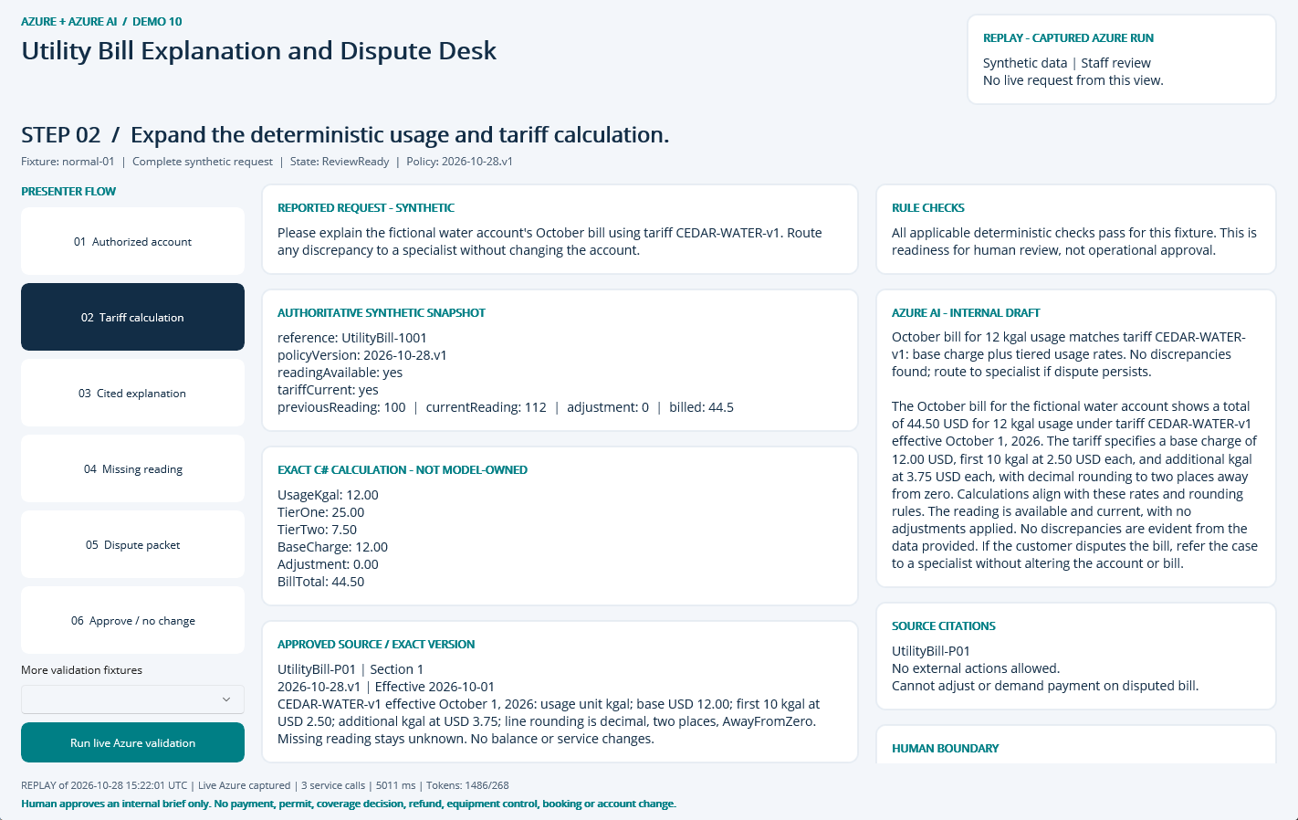
NATIVE MAUI / REPLAY OF CAPTURED AZURE RUN
Step 02: Tariff calculation
CLICK
Select step 02 in the left-hand flow.
WHAT YOU ARE SEEING
Exact fixture facts and deterministic checks, a source-linked internal AI draft, and explicit human-review limits.
BUSINESS VALUE
Reduce reassembly of context while keeping the source and decision boundary visible.
Synthetic demonstration | Captured replay, not a live slide | Human decisions remain explicit
PREV
MENU
NEXT
Notes:
Action: Expand the deterministic usage and tariff calculation.
Fixture: normal-01. Capture timestamp: 2026-10-28T15:36:34.7060239Z. State: ReviewReady. Rule findings: .
Business value and benefits: Show a reproducible bill calculation, a grounded plain-language explanation and a reviewable dispute packet. Measure numeric fidelity and clarification completeness, not automatic dispute resolution. This step makes the evidence, uncertainty or human boundary visible. Human boundary: Never infer hardship, eligibility or customer reliability from writing style or demographics. A disputed bill cannot trigger a payment demand, adverse action or automatic adjustment.
What the user sees: Exact fixture facts and deterministic checks, a source-linked internal AI draft, and explicit human-review limits.
Evidence: saved live run 2026-10-28T15:22:01.7747067+00:00, mode Live Azure captured; 3 calls recorded for this fixture. Service request IDs, latency and usage are in Evidence. The screenshot itself is a Windows UI Automation-driven replay. Red rectangles identify the actual native control invoked during capture; they do not represent a new Azure request. Slide navigation advances screenshots only.
Boundary: Human boundary: Never infer hardship, eligibility or customer reliability from writing style or demographics. A disputed bill cannot trigger a payment demand, adverse action or automatic adjustment.
No measured time savings or production performance is asserted.

Slide 5
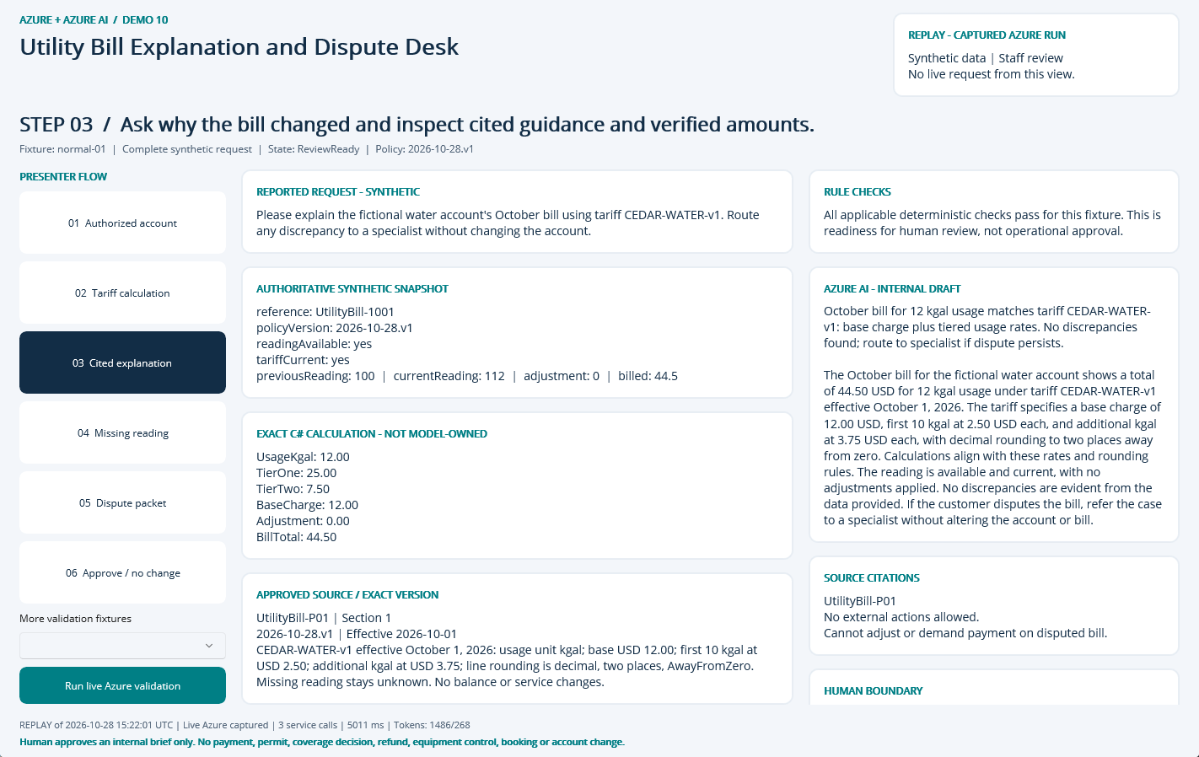
NATIVE MAUI / REPLAY OF CAPTURED AZURE RUN
Step 03: Cited explanation
CLICK
Select step 03 in the left-hand flow.
WHAT YOU ARE SEEING
Exact fixture facts and deterministic checks, a source-linked internal AI draft, and explicit human-review limits.
BUSINESS VALUE
Reduce reassembly of context while keeping the source and decision boundary visible.
Synthetic demonstration | Captured replay, not a live slide | Human decisions remain explicit
PREV
MENU
NEXT
Notes:
Action: Ask why the bill changed and inspect cited guidance and verified amounts.
Fixture: normal-01. Capture timestamp: 2026-10-28T15:36:35.7070502Z. State: ReviewReady. Rule findings: .
Business value and benefits: Show a reproducible bill calculation, a grounded plain-language explanation and a reviewable dispute packet. Measure numeric fidelity and clarification completeness, not automatic dispute resolution. This step makes the evidence, uncertainty or human boundary visible. Human boundary: Never infer hardship, eligibility or customer reliability from writing style or demographics. A disputed bill cannot trigger a payment demand, adverse action or automatic adjustment.
What the user sees: Exact fixture facts and deterministic checks, a source-linked internal AI draft, and explicit human-review limits.
Evidence: saved live run 2026-10-28T15:22:01.7747067+00:00, mode Live Azure captured; 3 calls recorded for this fixture. Service request IDs, latency and usage are in Evidence. The screenshot itself is a Windows UI Automation-driven replay. Red rectangles identify the actual native control invoked during capture; they do not represent a new Azure request. Slide navigation advances screenshots only.
Boundary: Human boundary: Never infer hardship, eligibility or customer reliability from writing style or demographics. A disputed bill cannot trigger a payment demand, adverse action or automatic adjustment.
No measured time savings or production performance is asserted.

Slide 6
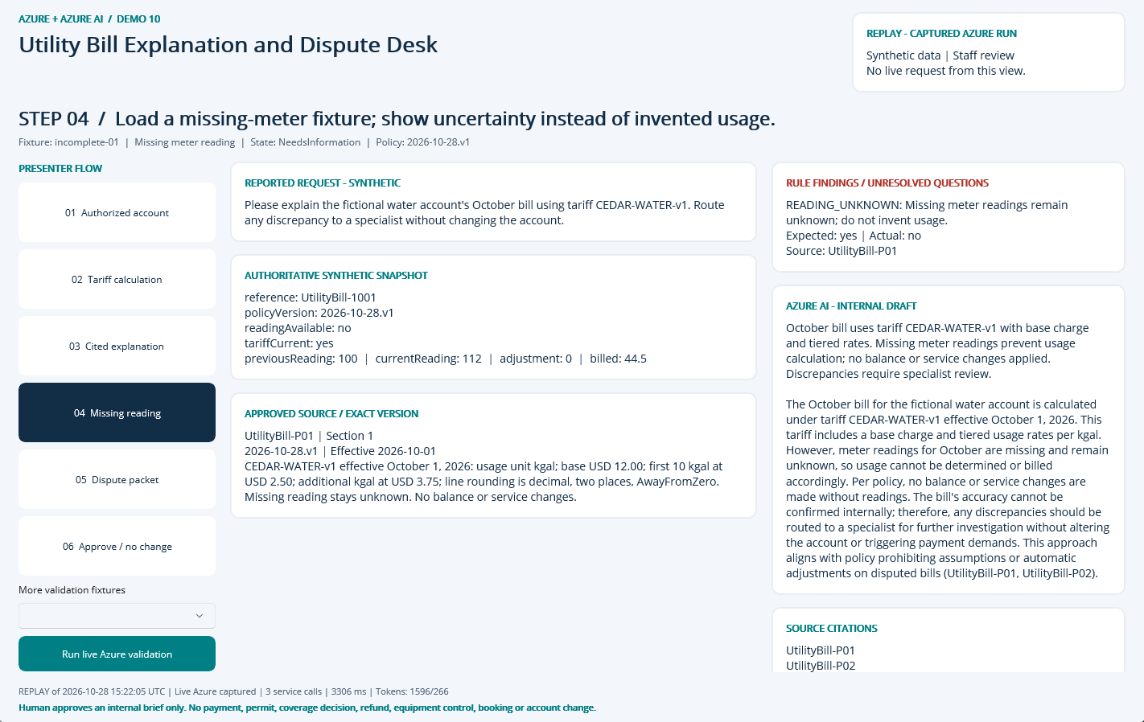
NATIVE MAUI / REPLAY OF CAPTURED AZURE RUN
Step 04: Missing reading
CLICK
Select step 04 in the left-hand flow.
WHAT YOU ARE SEEING
NeedsInformation: READING_UNKNOWN. The finding remains visible beside the evidence and approved sources.
BUSINESS VALUE
Surface the exception early and focus staff on the precise correction or escalation.
Synthetic demonstration | Captured replay, not a live slide | Human decisions remain explicit
PREV
MENU
NEXT
Notes:
Action: Load a missing-meter fixture; show uncertainty instead of invented usage.
Fixture: incomplete-01. Capture timestamp: 2026-10-28T15:36:36.7048866Z. State: NeedsInformation. Rule findings: READING_UNKNOWN.
Business value and benefits: Show a reproducible bill calculation, a grounded plain-language explanation and a reviewable dispute packet. Measure numeric fidelity and clarification completeness, not automatic dispute resolution. This step makes the evidence, uncertainty or human boundary visible. Human boundary: Never infer hardship, eligibility or customer reliability from writing style or demographics. A disputed bill cannot trigger a payment demand, adverse action or automatic adjustment.
What the user sees: NeedsInformation: READING_UNKNOWN. The finding remains visible beside the evidence and approved sources.
Evidence: saved live run 2026-10-28T15:22:05.1245291+00:00, mode Live Azure captured; 3 calls recorded for this fixture. Service request IDs, latency and usage are in Evidence. The screenshot itself is a Windows UI Automation-driven replay. Red rectangles identify the actual native control invoked during capture; they do not represent a new Azure request. Slide navigation advances screenshots only.
Boundary: Human boundary: Never infer hardship, eligibility or customer reliability from writing style or demographics. A disputed bill cannot trigger a payment demand, adverse action or automatic adjustment.
No measured time savings or production performance is asserted.

Slide 7
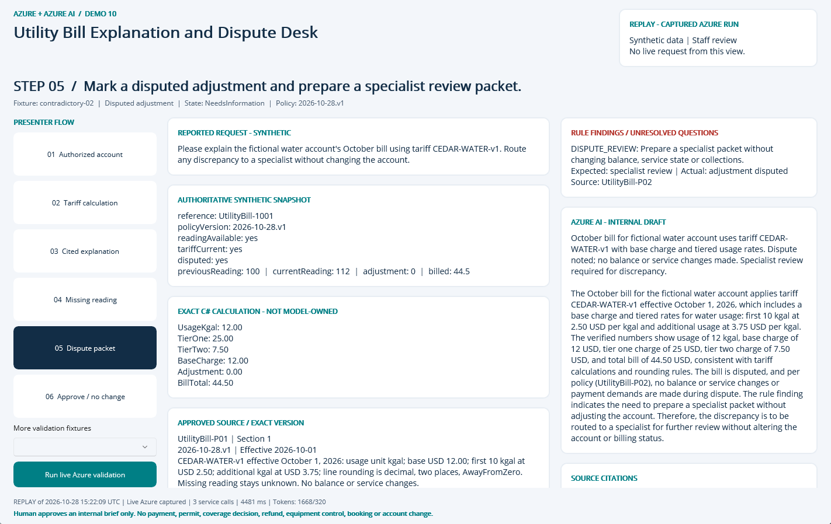
NATIVE MAUI / REPLAY OF CAPTURED AZURE RUN
Step 05: Dispute packet
CLICK
Select step 05 in the left-hand flow.
WHAT YOU ARE SEEING
NeedsInformation: DISPUTE_REVIEW. The finding remains visible beside the evidence and approved sources.
BUSINESS VALUE
Surface the exception early and focus staff on the precise correction or escalation.
Synthetic demonstration | Captured replay, not a live slide | Human decisions remain explicit
PREV
MENU
NEXT
Notes:
Action: Mark a disputed adjustment and prepare a specialist review packet.
Fixture: contradictory-02. Capture timestamp: 2026-10-28T15:36:37.7409497Z. State: NeedsInformation. Rule findings: DISPUTE_REVIEW.
Business value and benefits: Show a reproducible bill calculation, a grounded plain-language explanation and a reviewable dispute packet. Measure numeric fidelity and clarification completeness, not automatic dispute resolution. This step makes the evidence, uncertainty or human boundary visible. Human boundary: Never infer hardship, eligibility or customer reliability from writing style or demographics. A disputed bill cannot trigger a payment demand, adverse action or automatic adjustment.
What the user sees: NeedsInformation: DISPUTE_REVIEW. The finding remains visible beside the evidence and approved sources.
Evidence: saved live run 2026-10-28T15:22:09.6407003+00:00, mode Live Azure captured; 3 calls recorded for this fixture. Service request IDs, latency and usage are in Evidence. The screenshot itself is a Windows UI Automation-driven replay. Red rectangles identify the actual native control invoked during capture; they do not represent a new Azure request. Slide navigation advances screenshots only.
Boundary: Human boundary: Never infer hardship, eligibility or customer reliability from writing style or demographics. A disputed bill cannot trigger a payment demand, adverse action or automatic adjustment.
No measured time savings or production performance is asserted.

Slide 8
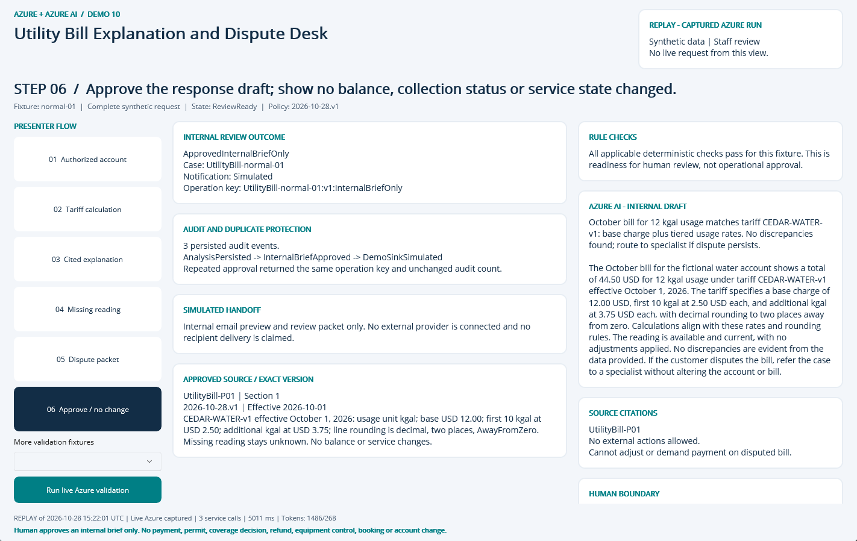
NATIVE MAUI / REPLAY OF CAPTURED AZURE RUN
Step 06: Approve / no change
CLICK
Select step 06 in the left-hand flow.
WHAT YOU ARE SEEING
A persisted internal approval, duplicate-safe operation key, audit timeline and explicitly Simulated handoff.
BUSINESS VALUE
Traceable handoff without silently executing a consequential business action.
Synthetic demonstration | Captured replay, not a live slide | Human decisions remain explicit
PREV
MENU
NEXT
Notes:
Action: Approve the response draft; show no balance, collection status or service state changed.
Fixture: normal-01. Capture timestamp: 2026-10-28T15:36:38.7601562Z. State: ReviewReady. Rule findings: .
Business value and benefits: Show a reproducible bill calculation, a grounded plain-language explanation and a reviewable dispute packet. Measure numeric fidelity and clarification completeness, not automatic dispute resolution. This step makes the evidence, uncertainty or human boundary visible. Human boundary: Never infer hardship, eligibility or customer reliability from writing style or demographics. A disputed bill cannot trigger a payment demand, adverse action or automatic adjustment.
What the user sees: A persisted internal approval, duplicate-safe operation key, audit timeline and explicitly Simulated handoff.
Evidence: saved live run 2026-10-28T15:22:01.7747067+00:00, mode Live Azure captured; 3 calls recorded for this fixture. Service request IDs, latency and usage are in Evidence. The screenshot itself is a Windows UI Automation-driven replay. Red rectangles identify the actual native control invoked during capture; they do not represent a new Azure request. Slide navigation advances screenshots only.
Boundary: Human boundary: Never infer hardship, eligibility or customer reliability from writing style or demographics. A disputed bill cannot trigger a payment demand, adverse action or automatic adjustment.
No measured time savings or production performance is asserted.

Slide 9
09 / DEMO HANDOFF
Verified outcome and honest operating limits
LIVE EVIDENCE
14 recorded service requests
6353 input / 1227 output tokens
0 extracted document pages
SQL approval + duplicate, owner, stale-input and expiry guards
VISIBLE DEMO OUTCOME
InternalBriefOnly
Notification sink: Simulated
External notifications: 0
Synthetic single-operator desktop demonstration, not production public intake.
No malware-scanned arbitrary upload pipeline; only curated local fixtures.
No hosted API, unattended durable worker or external operational connector.
No measured business-time baseline or current-price cost estimate.
Search is filtered keyword retrieval, not hybrid/vector retrieval.
Screenshots are replay of these saved live results; slide advance never calls Azure.
Synthetic demonstration | Captured replay, not a live slide | Human decisions remain explicit
PREV
MENU
NEXT
Notes:
Business value: staff receive a reproducible internal review packet with source provenance, exact calculations where relevant, visible uncertainty and a traceable human decision. Benefits are demonstrated workflow properties, not measured economic gains. Setup, source, fixtures, raw Azure evidence, screenshots and IaC are retained in the demo folder. The source blueprint contains a larger production backlog; these deliverables intentionally do not claim a public intake service, malware-scanned upload path, durable background worker or operational integration. Azure SQL, Search and shared NAT/private networking have recurring costs until deliberately decommissioned.

