Slide 1
MSE806 ASSESSMENT 2
Secure Intelligent Traffic
Congestion Prediction
and Monitoring System
PART 1
Xiaotong Sun 270876224
Data and Model Engineer
PART 2
Jingbiao Geng 270686148
API and Security Engineer
Three person group presentation
PART 3
Han Jia 270902385
Evaluation and Communication Lead
MSE806 Assessment 2 Group Project

Slide 2
PART 1
Xiaotong Sun 270876224
Project problem and objectives
Five-minute speed forecasting
Reproducible evidence
Generate data, train the model and save exact metrics
One synthetic city-centre road segment
Useful prediction
Beat a previous-speed persistence baseline
Forecast horizon
5 min
Reliable communication
Serve forecasts through a tested API and dashboard
Model, API, dashboard and security controls
Responsible scope
Make synthetic data and deployment limits explicit
02

Slide 3
PART 1
Xiaotong Sun 270876224
Open-source starting point and group contribution
Starting repository
Assessment contribution
TrafficPrediction
Luthando Candlovu
MIT licence
Commit cfd0058
Rebuilt data process
Deterministic traffic, weather and incident simulation
+
Measured performance
Chronological split, baseline and saved JSON evidence
Original concept, initial generator, model scripts, API example and dashboard
Secured communication
Authentication, validation, rate limits, logging and tests
Source: https://github.com/LuthandoCandlovu/TrafficPrediction
03

Slide 4
PART 1
Xiaotong Sun 270876224
Data and model methodology
01
02
03
04
Generate
Engineer
Split
Train
17,280 synthetic
five-minute records
Time, weather, incident
and three speed lags
First 80% training
last 20% validation
Histogram gradient
boosting regressor
Portability decision
The selected XGBoost binary required an unavailable OpenMP runtime. We used scikit-learn histogram gradient boosting and report the architecture change clearly.
Method reference: scikit-learn HistGradientBoostingRegressor documentation
04

Slide 5
PART 2
Jingbiao Geng 270686148
System architecture
01
Synthetic sensor data
Timestamp, volume, weather, incident and speed
02
Feature pipeline
Recent speeds, rolling mean and time features
03
Saved model
Five-minute gradient-boosted speed forecast
04
FastAPI service
Validated request and authenticated response
05
Browser dashboard
Inputs, forecast result and security summary
05

Slide 6
PART 2
Jingbiao Geng 270686148
Security design
Authentication
Validation
X-API-Key required for prediction
Strict fields and numeric ranges
Resource control
Browser boundary
30 requests per client each minute
Only two local dashboard origins
Traceability
Response safety
Request ID, status and duration log
No-store and nosniff headers
Sources: OWASP API Security Top 10 2023 and NIST AI RMF 1.0
06

Slide 7
PART 2
Jingbiao Geng 270686148
Security verification
✓
Public health endpoint responds
5 / 5
✓
Missing API key returns 401
automated tests passed
✓
Out-of-range hour returns 422
✓
Successful response includes security headers
Evidence boundary
Functional tests do not replace penetration testing or independent certification.
✓
Rate limiter blocks after the threshold
07

Slide 8
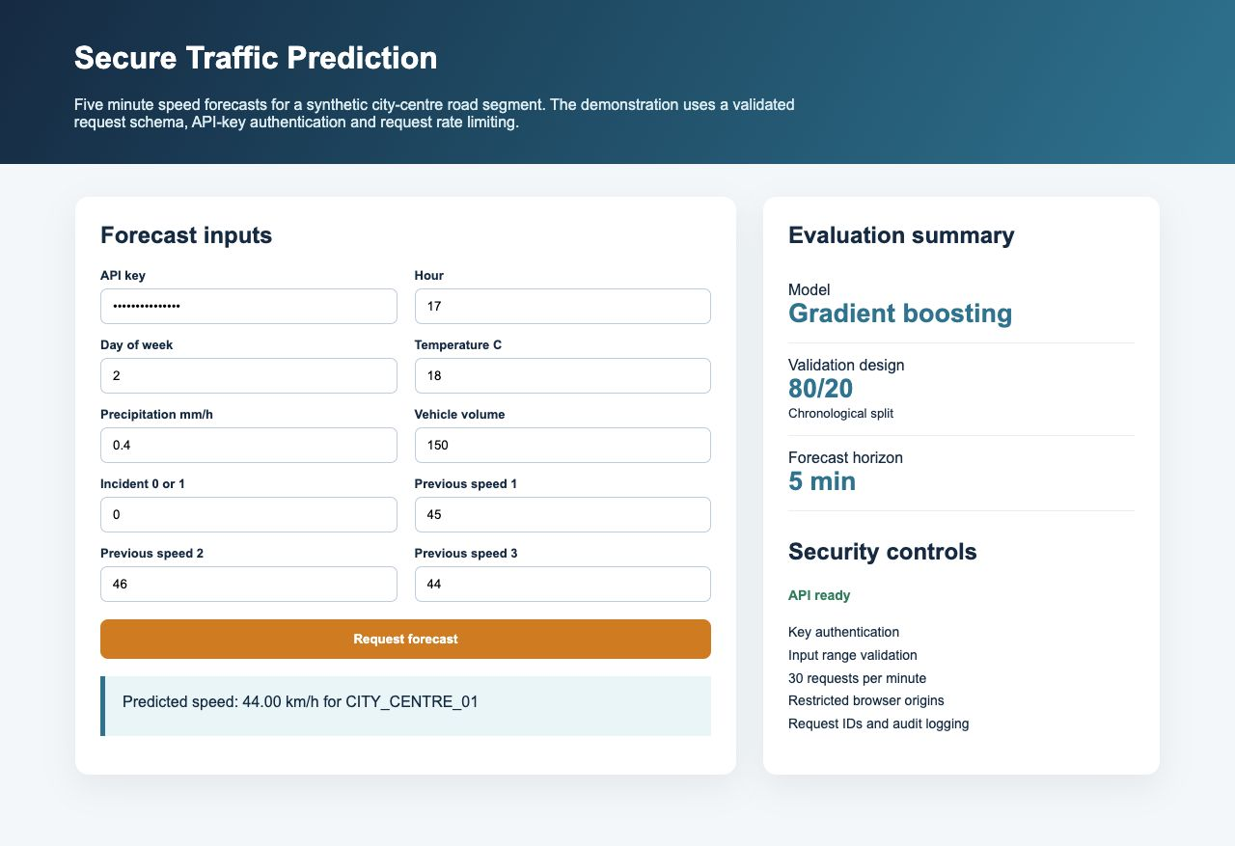
PART 2
Jingbiao Geng 270686148
Working dashboard demonstration
08

Slide 9
PART 3
Han Jia 270902385
Evaluation design
17,280
3,456
80 / 20
synthetic records
validation records
chronological split
MAE
Persistence baseline
Typical error in kilometres per hour
Previous speed becomes the next five-minute forecast
RMSE
Greater emphasis on larger errors
R squared
Variation explained within the validation period
09

Slide 10
PART 3
Han Jia 270902385
Gradient boosting reduces MAE by 40.39 percent
Model metrics
2.6083
MAE km/h
3.2803
RMSE km/h
R² 0.8247
Source: results/model_evaluation.json generated by the submitted code
10

Slide 11
PART 3
Han Jia 270902385
Limitations and next development steps
Current limits
Next steps
Synthetic relationships
Authorised real data
The generator defines patterns that the model later learns
Multiple segments and a final untouched test period
One road segment
Production security
No spatial spillover, signals or network effects
TLS, individual identity, shared limits and central monitoring
Single-process controls
Model assurance
Rate limits and logs are local to one API process
Drift monitoring, prediction intervals and fallback rules
11

Slide 12
PART 3
Han Jia 270902385
Conclusion and contributions
A useful ITS prototype needs reliable evidence, a protected communication path and clear limits.
Xiaotong Sun 270876224
Jingbiao Geng 270686148
Han Jia 270902385
Data and model
API and security
Evaluation and communication
Reproducible generator, features and training
Validation, authentication, limits, logs and tests
Metrics, dashboard, report and integration
Thank you
Three distinct roles with shared review responsibility
12

