Slide 1
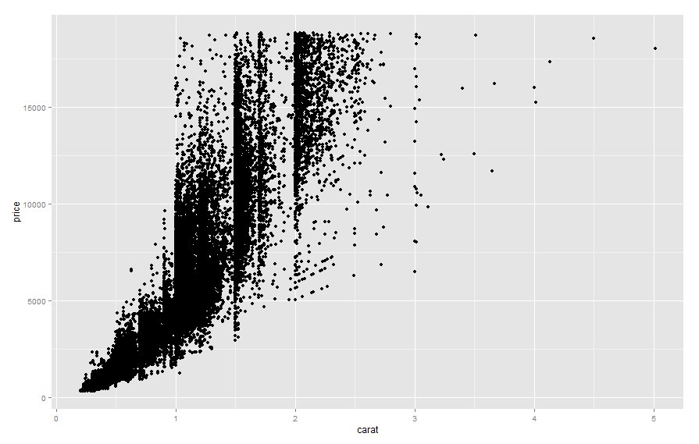
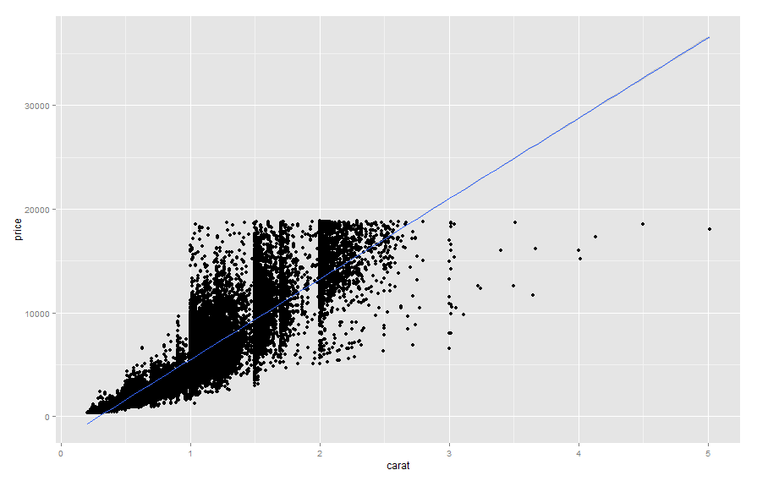
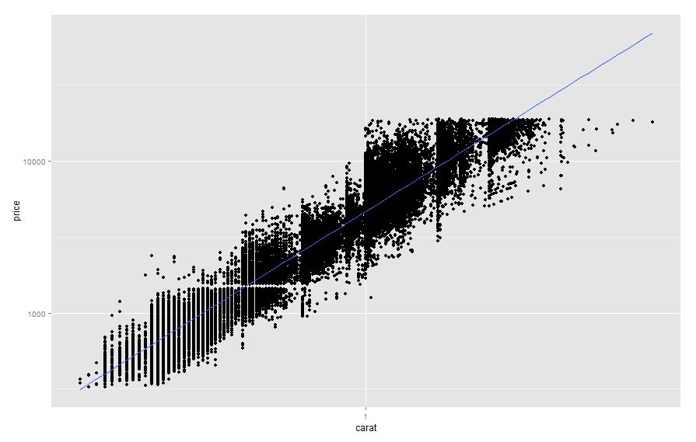
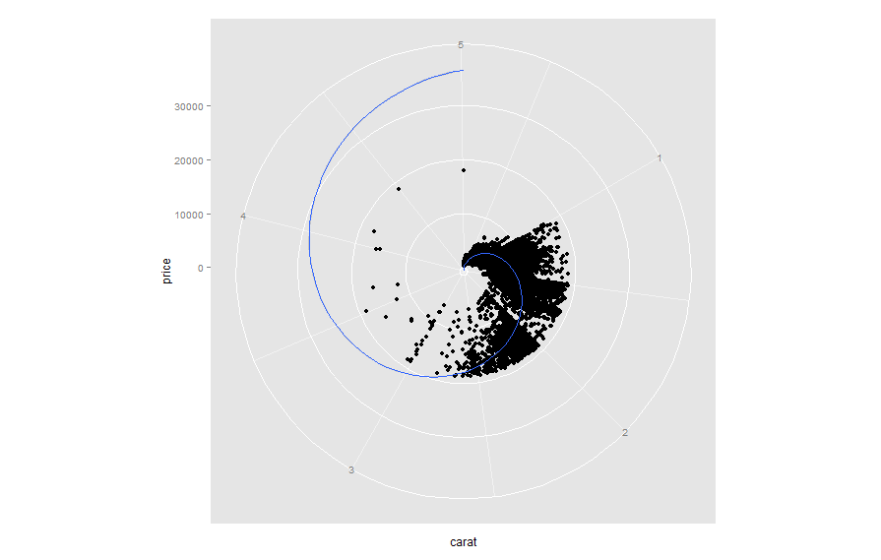
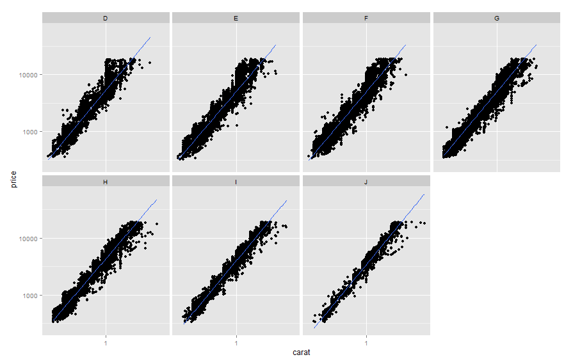
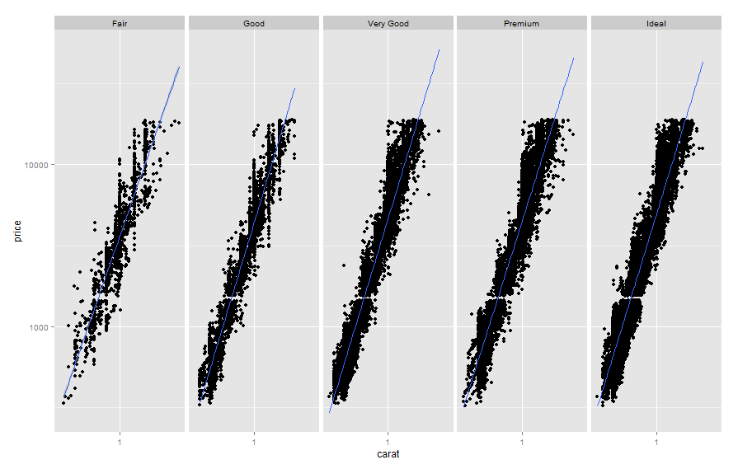
Visual Schematic of the Syntax of ggplot2::ggplot()
Plot
Layer 1
Layers
Scales
Coordinate system
Data + mapping of aesthetics
geom
stat
Position adjustment
Faceting
Layer 3
…etc
Position adjustment
stat
geom
Data + mapping of aesthetics
Layer 2
p <- p + layer(
data = diamonds, mapping = aes(x = carat, y = price) ,
geom = "point", stat = "identity" , position = "identity"
) +
Controlled by scales
p <- p + layer(
data = diamonds, mapping = aes(x=carat, y = price) ,
geom = "smooth" , position = "identity" , stat = "smooth" , method = lm
) +
p <- p + scale_x_log10() +
p <- p + scale_y_log10() +
p <- p + coord_polar()
p <- p + facet_grid(~cut)
p <- p + facet_wrap(~color, ncol = 4)
ggplot2: R package by Hadley Wickham, http://ggplot2.org/ Figure: Myfanwy Johnston, merowlands@ucdavis.edu

