Slide 1


Slide 2
Rpa champions advancing RPA maturity
What is RPA
Growing the RPA pipeline
Key checklist and Quick start guide
RPA use cases examples
1
2
3
4
Amgen Proprietary - For Internal Use Only

Slide 3
What is RPA?
RPA Is…
RPA Is Not…
Computer-coded software
Walking, talking robots
Programs that perform resource intensive and repetitive rules-based tasks
`
Physically existing machines processing paper
Cross-functional and cross-application macros
Artificial intelligence or voice recognition and chat software
What RPA can do…
Opening email and attachments
Integrating with applications: Sharepoint, Smartsheet
Scan email inbox and send email alerts
Connecting to system APIs
Moving files and folders
Making calculations
Filter and Select data (keywords)
Extracting structured data from documents
Filling in forms
Logging into web / enterprise applications
Reading / writing to databases
Following “if/then” decisions/rules
Amgen Proprietary - For Internal Use Only
Notes:
Resource intensive: automate manual, repeated cycles. Reduce manual effort
Processes that are well- defined, rule-based suitable for RPA

Slide 4
RPA – growing the automation pipeline
RPA Champion
Ideation
Functional Lead
Approve
RPA COE / RPA Citizen
Code
Checklist
Design
Assess
Review
Notes:
RPA Champion & Functional Lead could be different / same person
Key takeaway: Ideation and growing the RPA pipeline

Slide 5
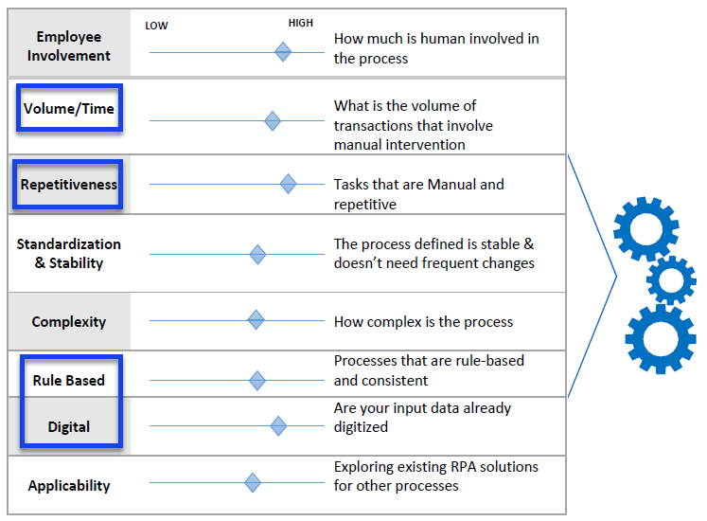
Rpa – ideation framework
Key attributes
Number of repeated steps / time taken
Rule- based
Structured data input (example: Excel spreadsheet)
Notes:
Key attributes of suitable RPA ideas (projects)

Slide 6



RPA quick start guide
CHECKLIST
Data is standardized, structured and in electronic form
Process is rule-based, well-defined business logic
Process is resource intensive (# man-hours)
RPA project scalable within Amgen (bonus)
Open mindset is key
SME to provide domain knowledge
Opportunity to learn new technology
Notes:
Checklist
Downloaded from Sharepoint, Smartsheet, Excel. Structured data, Excel, PDF format
Well-defined business logic & rule-based
Repeated cycles (example: copy & paste, transferring data to templates)

Slide 7
RPA scoring (RPA Champions)
RPA Potential Candidates screening (Smartsheet)
Process | Man Hours | Estimated time of Process | Automation Life Time Value | Total hours per week
ABC | 2 FTE | 2 hours for 2 FTE = 4 hours | FTE do this on 2 days = 8 | 8
Notes:
2 FTE x 2 hours = 4 hours / day. 4 hours x 2 days = 8 hours / week
Smartsheet to be shared with users, update RPA ideas and proposals

Slide 8
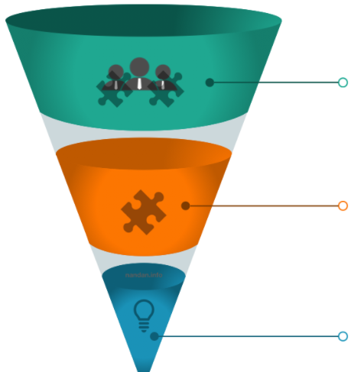



RPA process prioritization (RPA COE)
High volume, Manual processes
Repetitive (data filtering, updating)
Productivity, cost
Notes:
RPA process prioritization done by RPA COE

Slide 9
RPA checklist & score (RPA COE)
Simple scoring system
RPA Score
Benefits (volume of transactions: man -hours savings)
Rule based | Rule based | Both rule and judgement | Judgement based
 | 5 | 3 | 1
Structured Data | Structured | Mixed | Unstructured
 | 5 | 3 | 1
Exception Rates | Low | Medium | High
 | 5 | 3 | 1
Volume | High | Medium | Low
 | 5 | 3 | 1

Slide 10
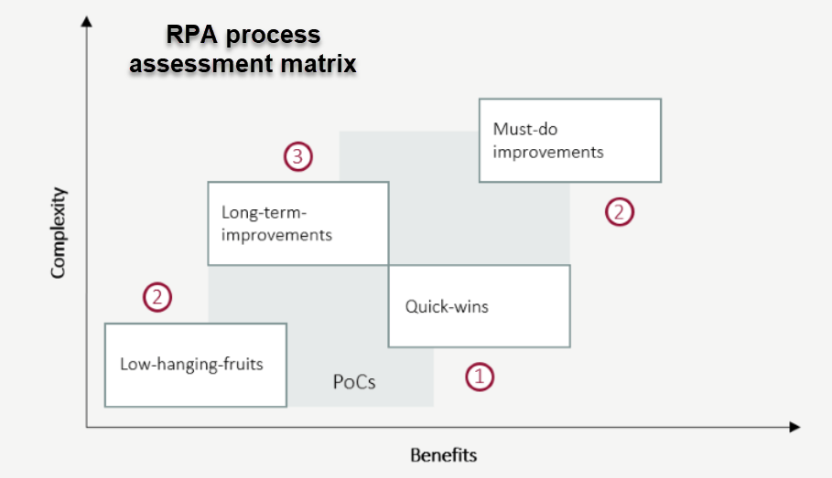
RPA process assessment matrix (RPA COE)
Low hanging fruits
Must-do improvements
Long term improvements
Technical considerations
16
18
20

Slide 11
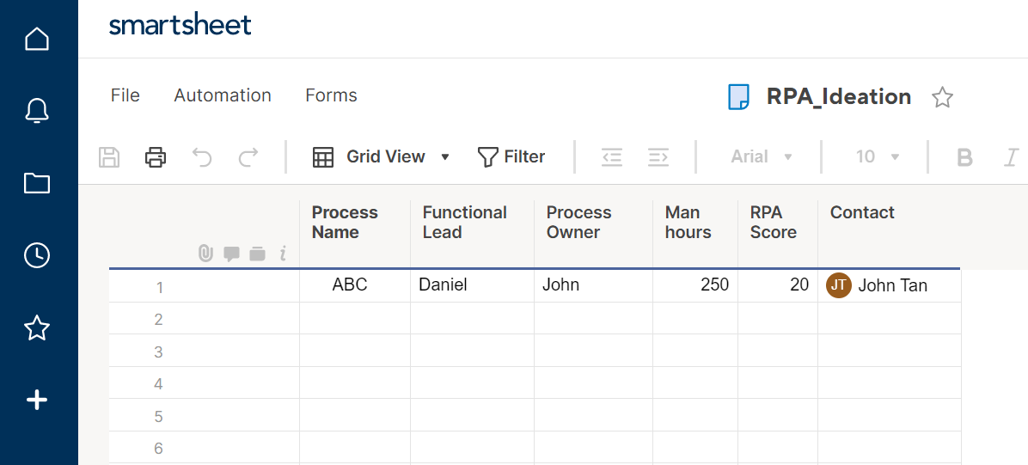
Smartsheet – RPA ideation (RPA Champions)

Slide 12
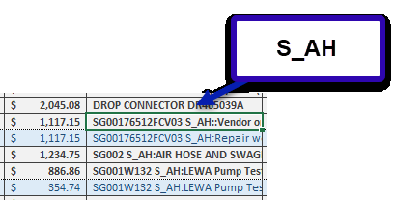
RPA use case – po expenses allocation
RPA filters and identifies Key Word ‘S_AH’ in ‘Line Description’ column
PO allocated to ‘Engineering Ad hoc’ expenses

Slide 13
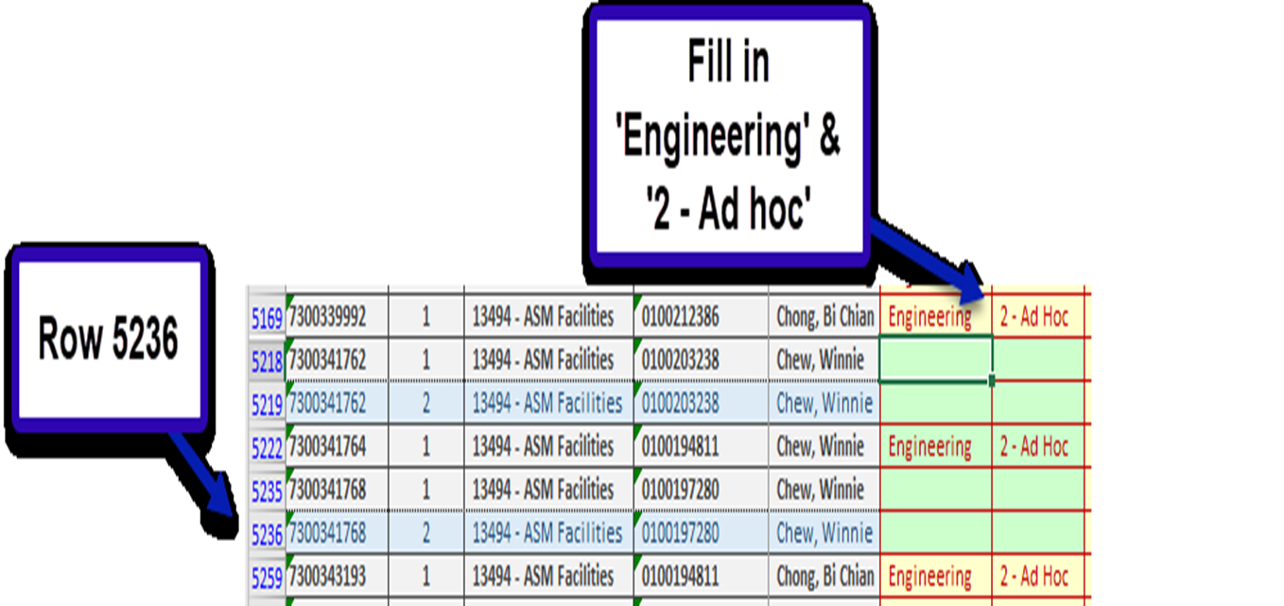
RPA use case – po expenses allocation
RPA scans and iterates through data Rows
RPA fills in ‘Engineering’ and ‘2 - Ad hoc’ in ‘Budget Owner’ and ‘Category’ columns respectively
Notes:
This Excel spreadsheet has 11,777 rows of PO data
Budget Owners – Engineering, Electrical, Facilities, F&E, Mechanical, Instrumentation

Slide 14
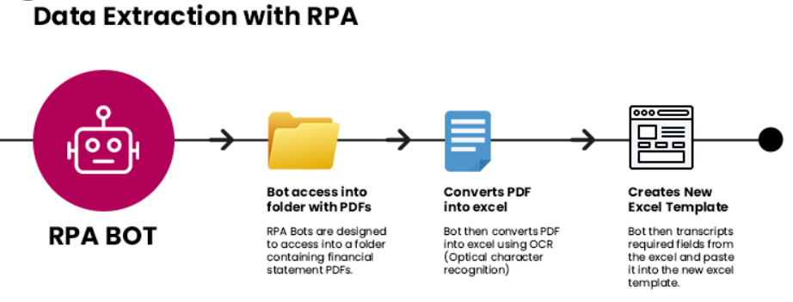
RPA use case example - Data retrieval. PDF to excel

Slide 15
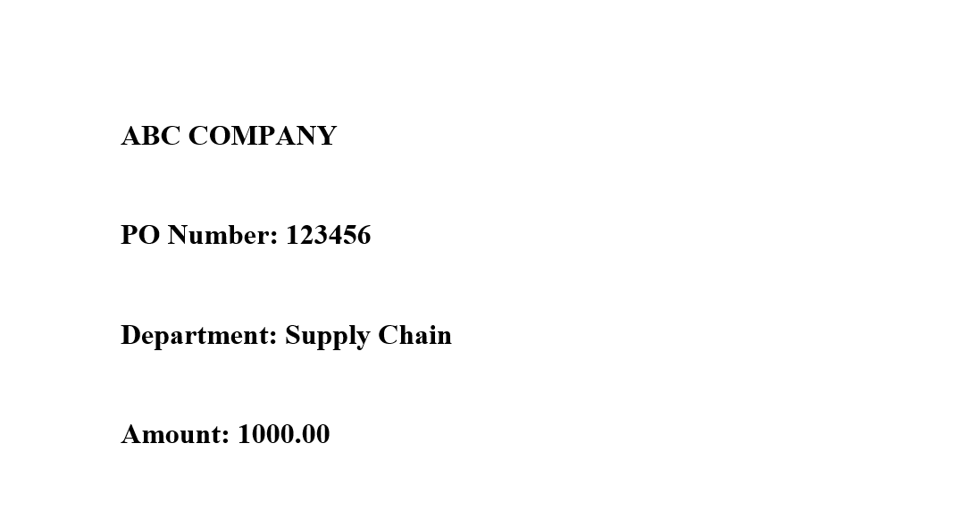
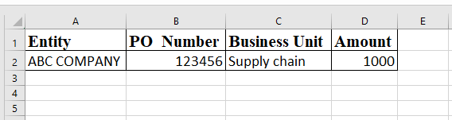
RPA use case example – Data retrieval. PDF to excel
RPA extracts structured data from PDF document
Data written to Excel / database
Data could be further processed (for example: group by Entity, Business Unit, Total Amount)
Process repeated for multiple PDF documents
Notes:
PDF documents saved into folder
RPA extracts key structured data from fixed positions in PDF documents
RPA updates key data to Excel spreadsheet (cycle could be repeated)

Slide 16


RPA use case – Data retrieval (global vehicle manufacturer)
Business Problem
Consolidation of data from multiple manufacturing plants for payments was challenging and repetitive
Subjected to potential human error
Multiple users transferring data into excel spreadsheets result in redundancies
Data documents sent to dedicated email address
RPA identifies relevant email. Retrieve details from multi-page documents
Routing exceptions to human agents for validation
Notes:
Handling of exceptions: RPA – human interaction

Slide 17

RPA use case – streamlined Invoice processing
Monitor folder for invoices (PDF documents)
Extracting data from PDF documents
Filling details in SAP
Send email alerts (exceptions)
https://youtu.be/10_MkXNMpVw

Slide 18
RPA Checklist – take away
1
Data is structured
2
Rule-based, well defined business logic
3
Minimal variations
4
Resource intensive

Slide 19
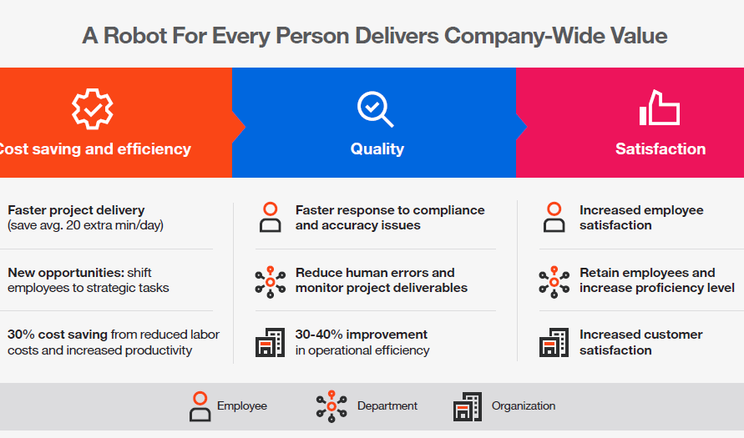
A robot for every person - Conclusion
Cost savings
Efficiency
Quality

Slide 20


Q & A

Slide 21
Backup slides
Amgen Proprietary - For Internal Use Only

Slide 22
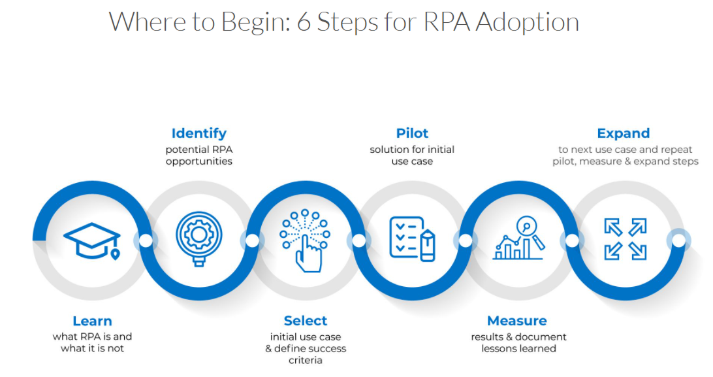
RPA Adoption
Notes:
Learn – what RPA can / cannot do
Identify / Ideation – potential RPA opportunities in daily business processes
Selection – simple selection criteria (RPA checklist, scoring system)
Pilot – initial use case
Measure & Expand

Slide 23
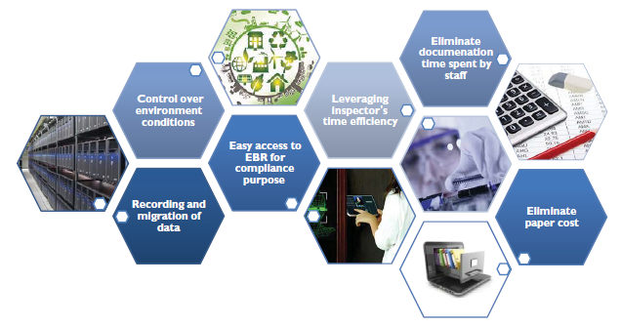
RPA potential use case – EBR
RPA reusable procedures (code) and programmed tasks greatly improve process accuracy
Automated data entry

Slide 24
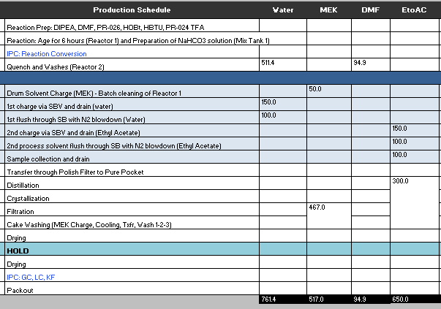
RPA use case – asm2 solvents monitoring
User input Water ‘Threshold’ level = 550
RPA iterates through all data rows
RPA sum values in column
Flag ‘Quench and Washes’ process
RPA sends email alert to user

Slide 25
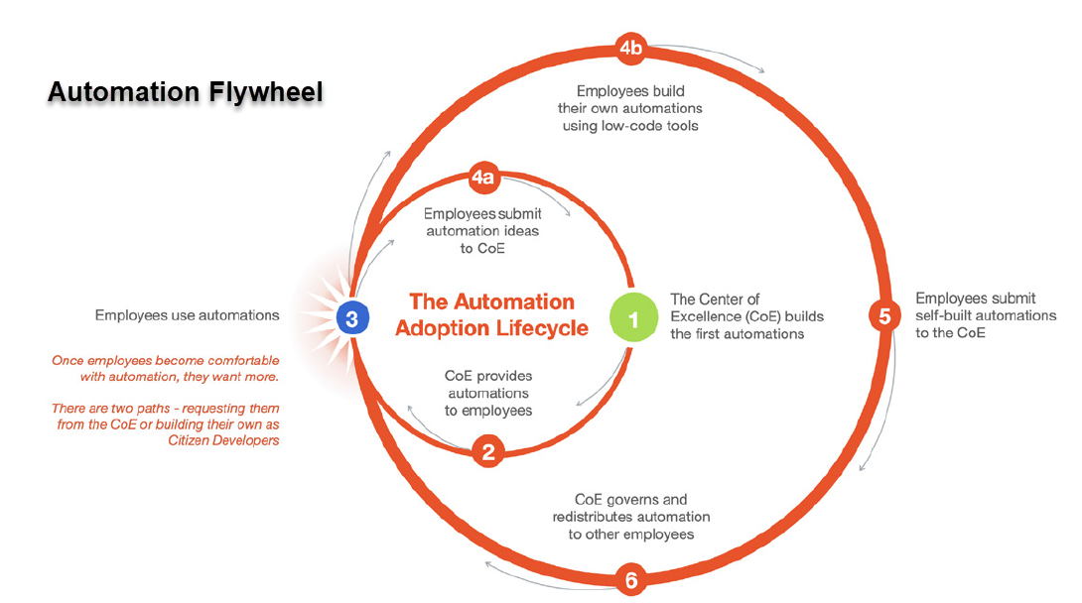
Accelerate returns with an automation flywheel
COE builds, tests, and deploy RPA automations
Users see benefits in day-to-day work
Users submit more ideas. COE validates / approves. COE / RPA Citizens build automations
Amgen Proprietary - For Internal Use Only

Slide 26











RPA – growing the automation pipeline
NEW
IN DEVELOPMENT
Functional Lead Approved
In Development
RPA Automation Champion / Functional Lead
ideation
New
(automatic)
Notify Functional Lead
Approve
Functional Lead Review
RPA COE
RPA Team / (Citizen Developer)
Approve
Reject
Create bot
Functional Lead
Reject
DEPRIORITIZED
COMPLETE
Functional Lead Rejected
Advise for Enterprise Platform
+
COE Re-assess
Complete
Amgen Proprietary - For Internal Use Only

Slide 28
RPA potential use case
Automating data collection

