Slide 1
Capstone Presentation
CTF Growth Strategy
Group 6 Members:
Edward
Eng Soon
Kester Leung
Michael Lam
Nick Chan
Suet Hong
Vie Ming (John)

Slide 2
Contents
0.Overall Sales dashboard?
1.Customer Segmentation
2.Product Bundling
3.Trip Driving Products
4.Impact Estimation
6.SKU Optimization
7.Final Recommendation/(Roadmap?)
MAIN QNS TO ANSWER:
1)understand Customer profiles more in depth
2)Which product to bundle is best and which associated to which more
3)Understand which customer revisits, which repeat customers buy what

Slide 3
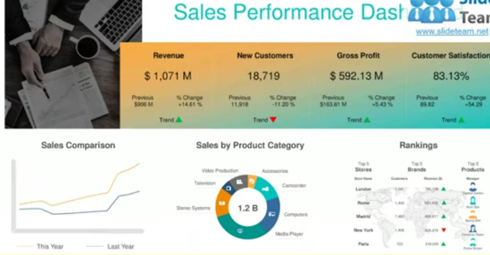
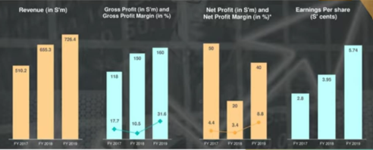
Overview (Sales Performance Dashboard Eg.)
· Sales Performance Dashboard (Overall)[PowerBI]
-Header: Gross sales, top sellers, new customers
-Donut chart (sales by product category)
-Ranking: Top 3 gross sales & net sales (2021/2022 & month) [Bar gross & net sales combined,]
-Clustered bar/Stacked Area Clustered Column/Ribbon[PowerBI] (for every quarter)
-Most discounted vs sales:Top 3 items bought w discount (in %) [Bar gross & net sales combined]
-Months with highest sales 2021 vs 2022 [Scatter timeline w trend line]
-Flagship products (Avg share basket value) [Card]
-Most revisited [Bar]

Slide 4
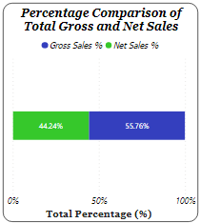

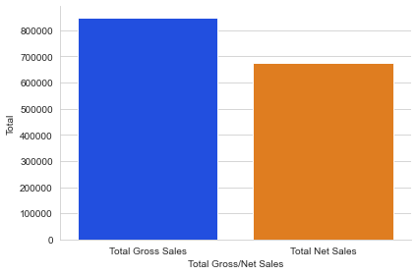
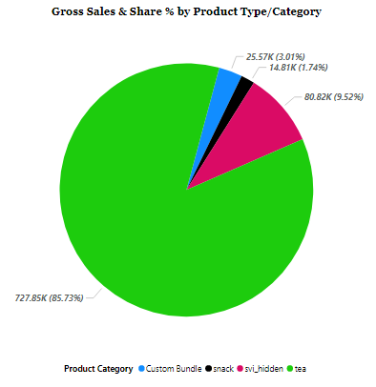
Overview (Sales Performance)
Total Gross & Net Sales

Slide 5
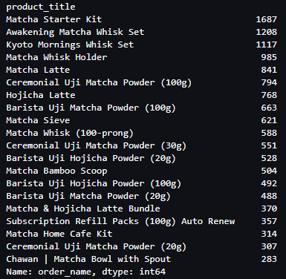
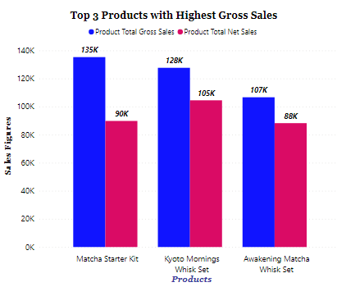
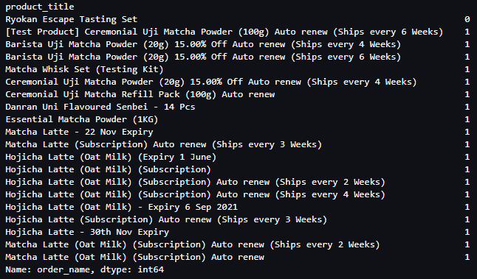
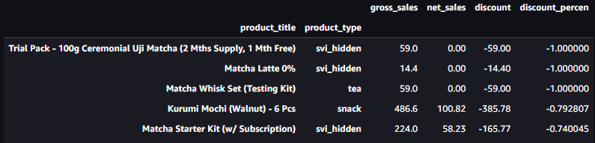
Overview (Sales Performance)
Most Ordered Products
Least Ordered Products
Top 5 Products with Most Discounts

Slide 6
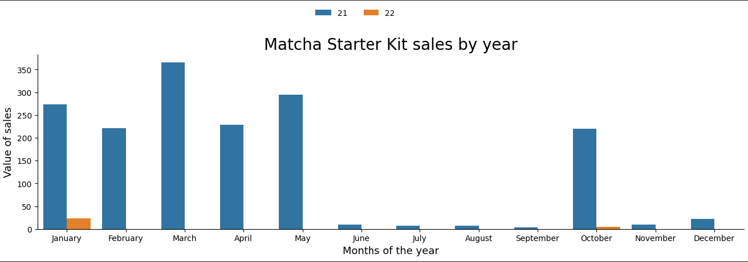
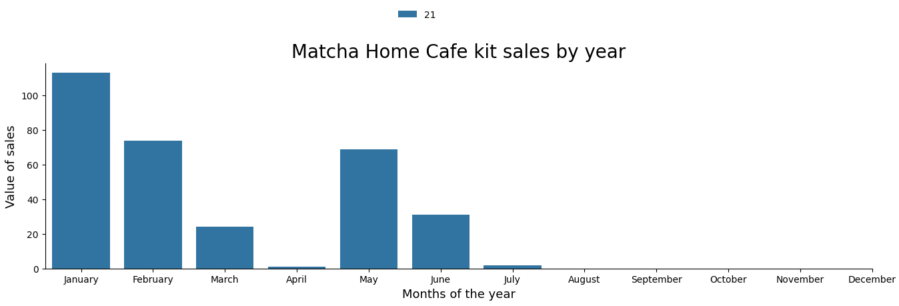
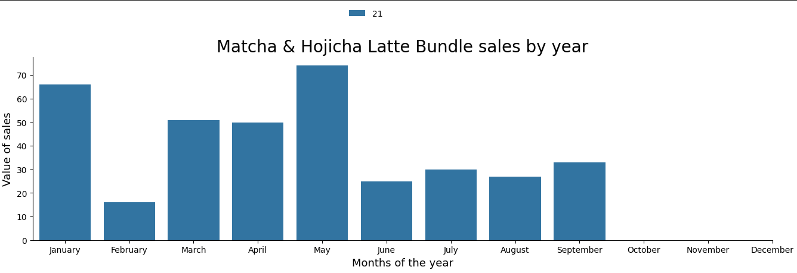
Overview (Sales Performance)

Slide 7
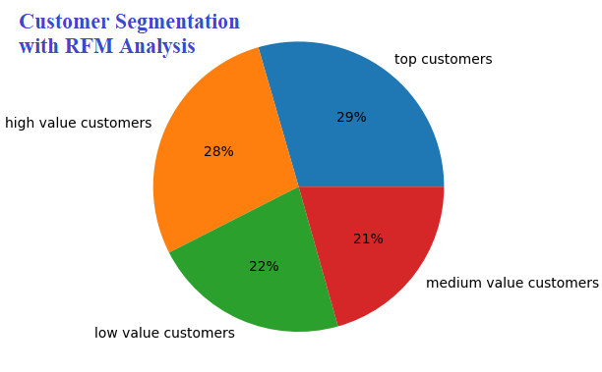
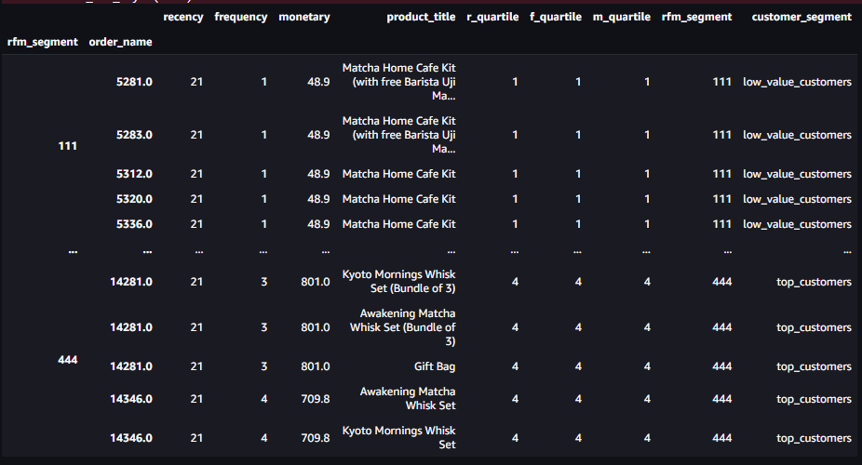
Customer Segmentation
Product Range by Customer Segments
Notes:
RFM - Recency, Frequency and Monetary (order value). For example, Top customers: lowest recency (bought recently), highest frequency, highest monetary.
RFM Analysis + Product Bundling = targeted sales pitch

Slide 8
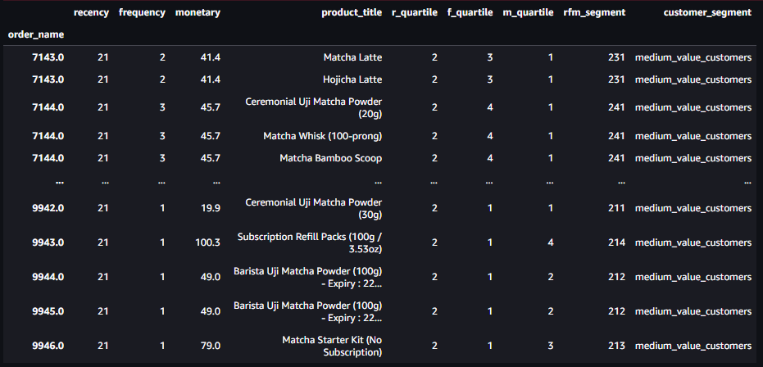
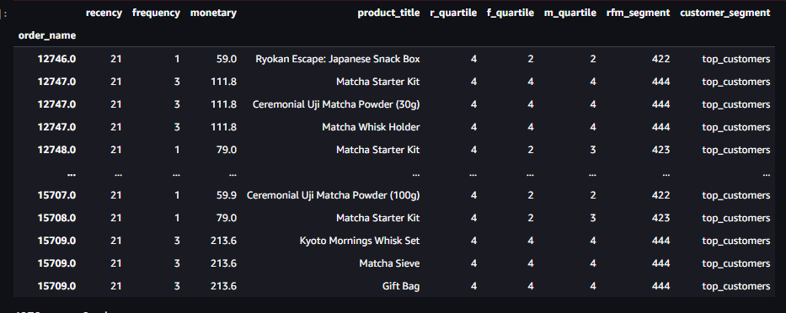
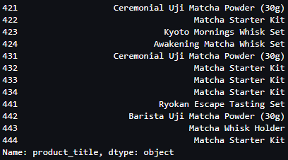
Customer Segmentation
Medium Value Customers Product Range
Top & High Value Customer Product Range
Top & High Value Customers Most Purchased
Notes:
RFM - Recency, Frequency and Monetary (order value). For example, Top customers: lowest recency (bought recently), highest frequency, highest monetary.
RFM Analysis + Product Bundling = targeted sales pitch

Slide 9
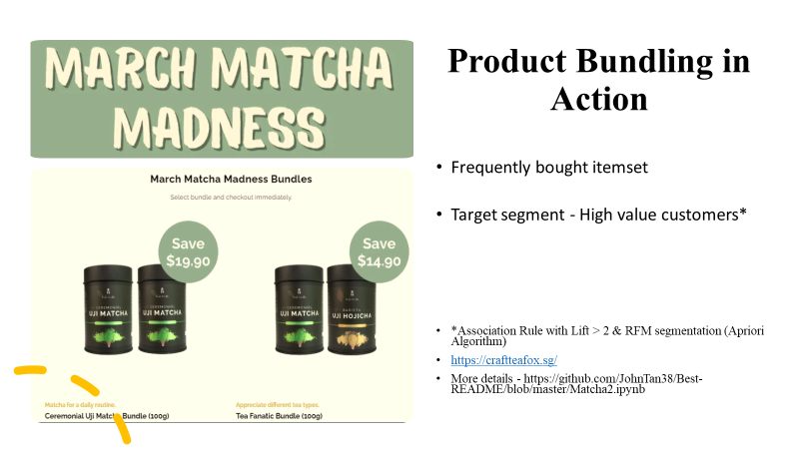
Notes:
On -going promotion bundle from Craft Tea Fox matches Product Bundle from Apriori Algorithm & Association rules. Product bundle targeted at high value customers segment (RFM Analysis)
Product Bundles at different price points are recommended to different customer segments for effective sales campaign

Slide 10
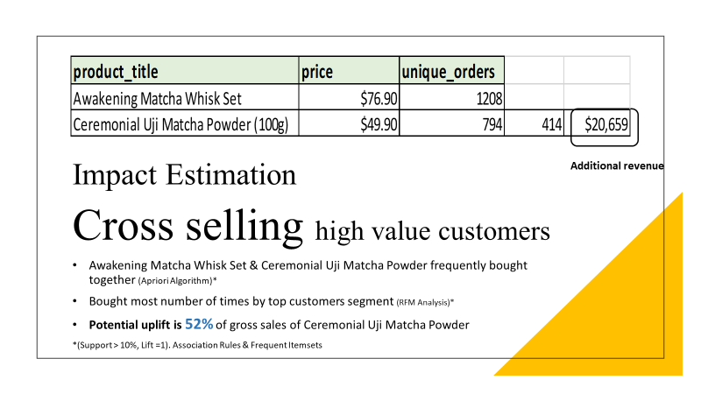
Notes:
Impact Estimation and Revenue gained. Uplift from product bundling leads to high potential uplift in gross sales for high value customer segment
Product bundles further fine- tuned with parameter optimization (example different combinations of Support and Lift)

Slide 11
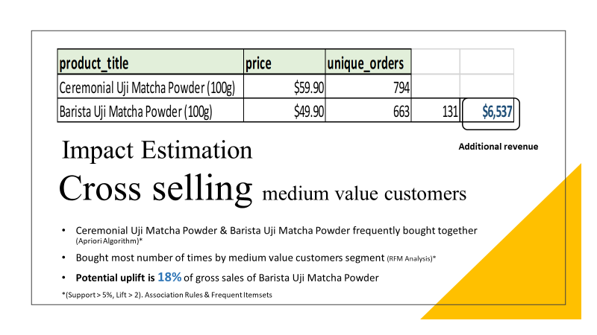

Slide 12
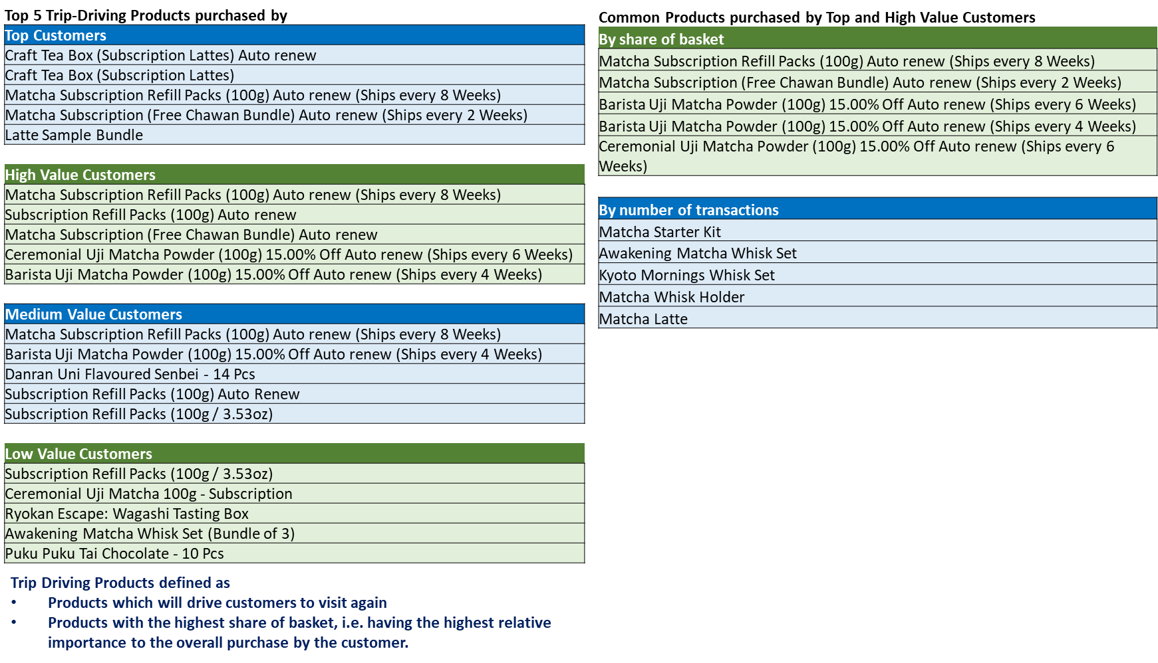
Trip Driving Products
To increase sales of Trip Driving Products through
Targeted advertisements to the different customer segments
Displaying products as recommended items
Product bundling
Discounts or promotions

Slide 13
Appendix - Trip Driving Products
Steps to Derive Trip-Driving Products
Identify number of baskets (n_baskets) a product appears in
Identify the number of unique products (nuniqueT) in each transaction
Join n_baskets and nunique to the dataset
Identify the sum of unique products (nunique) at product level
Calculate average share of basket (share_basket = n_baskets / nunique)
Calculate flagship to be the product with the largest share_basket in a basket
Calculate flagship_% = no. of times a product is the Flagship / total baskets

Slide 14
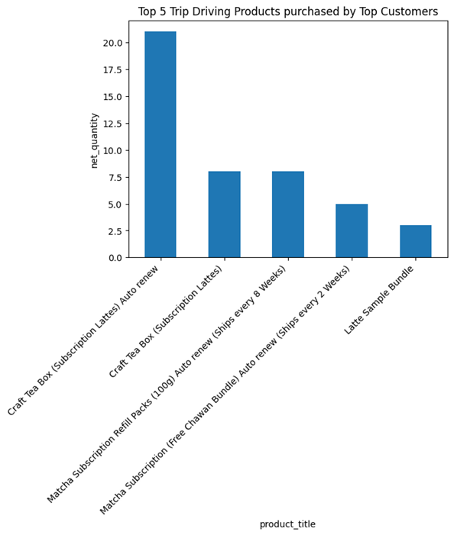
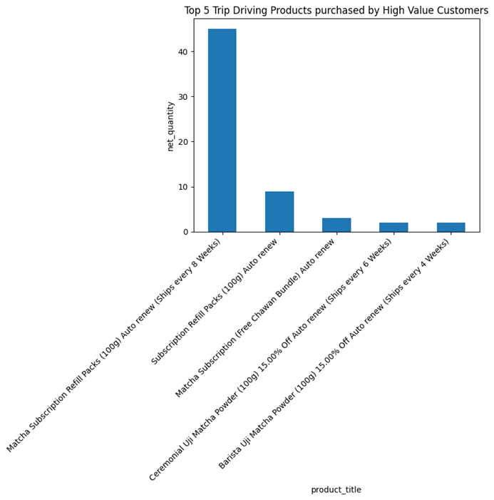
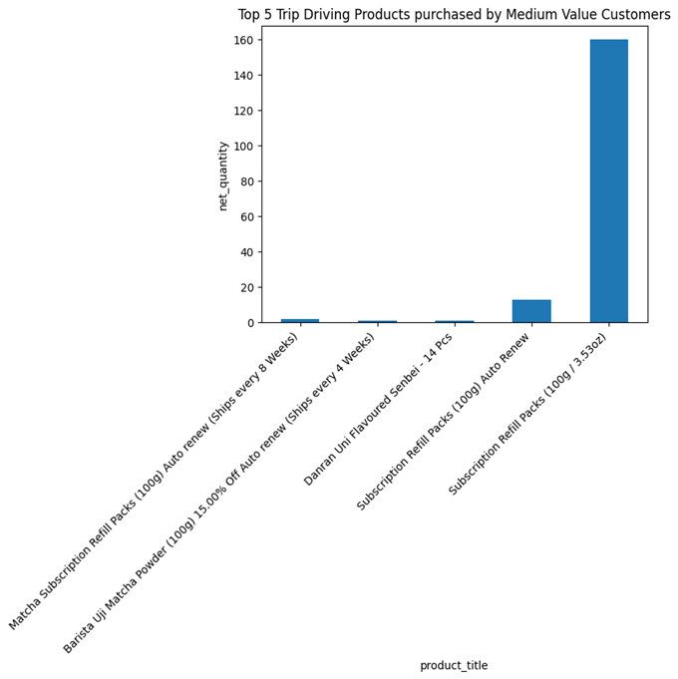
Appendix - Trip Driving Products
Top 5 Trip-Driving Products purchased by
Top Customers
High Value Customers
Medium Value Customers
Trip Driving Products defined as
•Products which will drive customers to visit again
•Products with the highest share of basket, i.e. having the highest relative importance to the overall purchase by the customer.
To increase sales of Trip Driving Products through
•Targeted advertisements to the different customer segments
•Product bundling
•Discounts or promotions
•Cross-merchandising

Slide 15
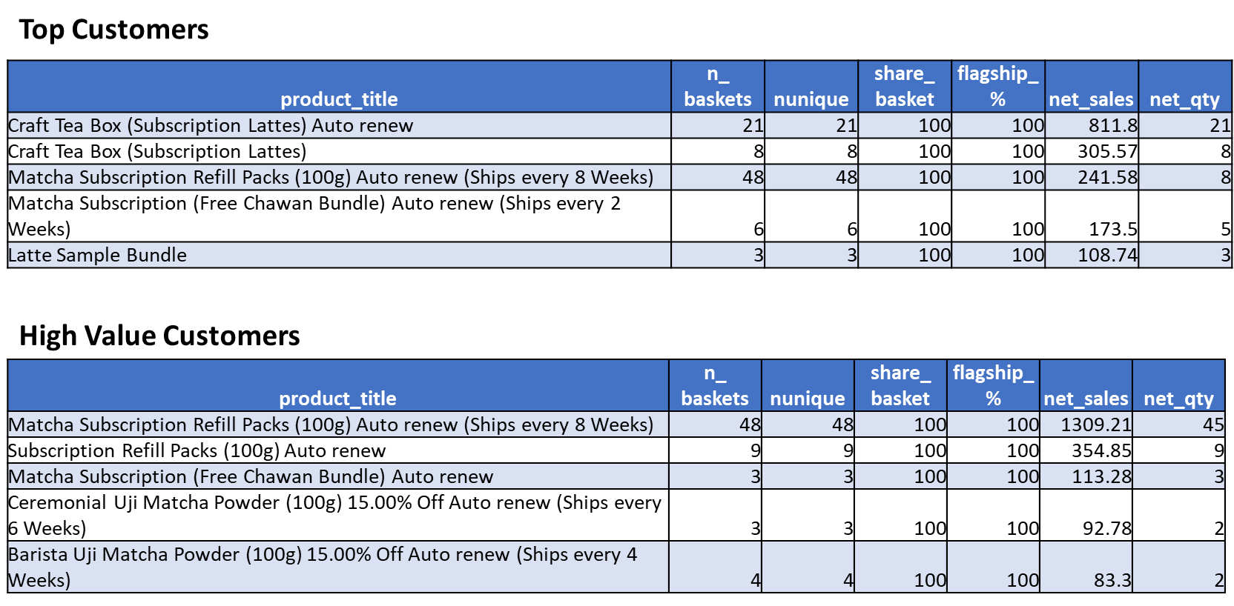
Appendix - Trip Driving Products
Top 5 Trip-Driving Products purchased by

Slide 16
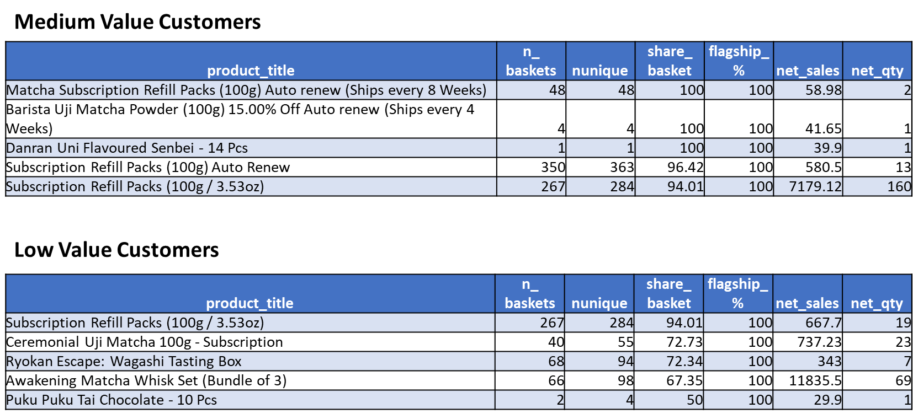
Appendix - Trip Driving Products
Top 5 Trip-Driving Products purchased by

Slide 17
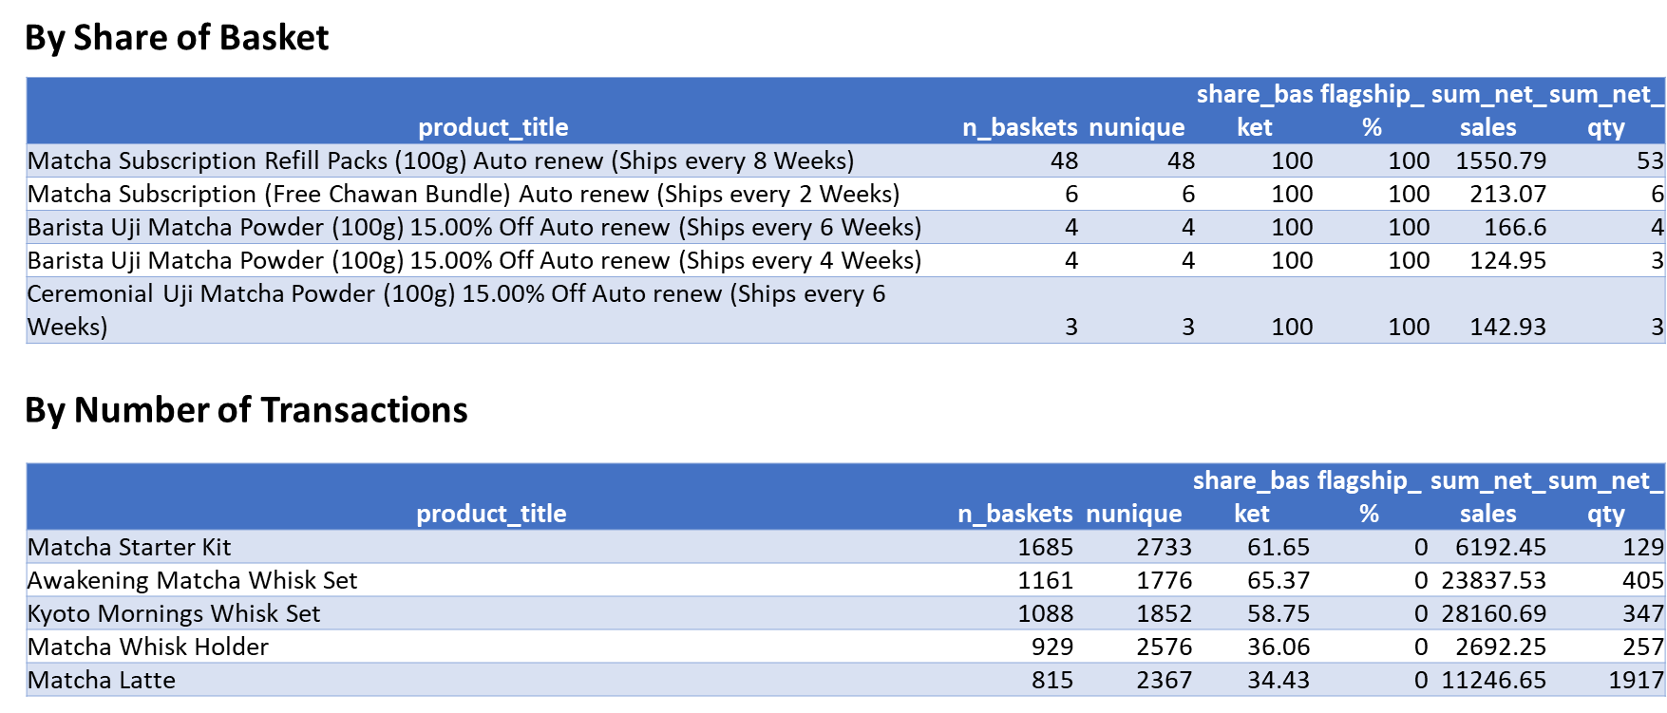
Appendix - Trip Driving Products
Common Trip Driving Products purchased by Top and High Value Customers

Slide 18
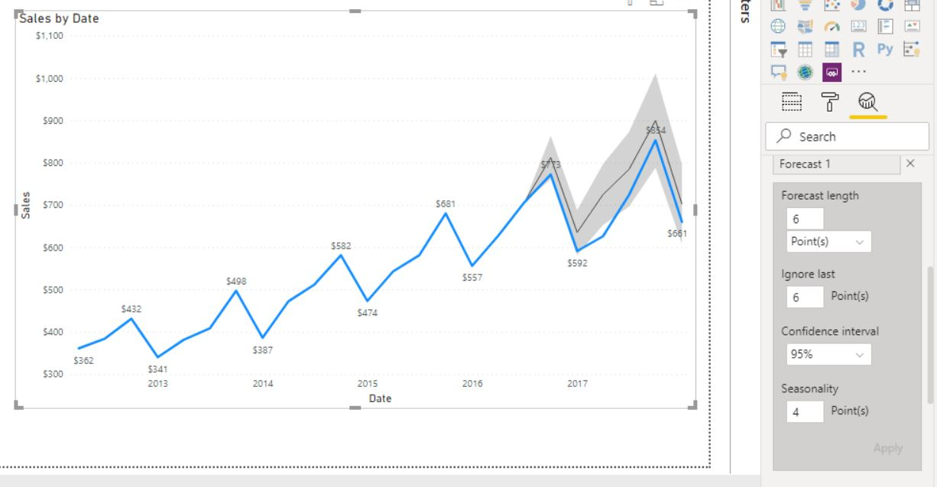
Impact Estimation (Appendix)
-Estimate revenue from cross selling(Individual if manage to recommend associated products.(Increase by X%, based from lift >1 values)
-Create methodology to estimate the $uplift in revenue that CTF can earn based from your product bundling recommendations. IIdea: use lift(>1) from Market Basket Analysis to derive additional revenue from all transactions that currently are purchasing one of the bundled products (Chart new vs current)
-Pivot table (Show association) Recommended cross selling upon checkout or bundles:-Products, gross sales, net sales, association value (colour code associated pairs), lift>1 , confidence, support, avg market basket share
-Forecasted 2023 based off 2021/2022-month sales- Postulated $uplift in revenue that CTF can earn based from your product bundling recommendations. Use lift(>1) from Market Basket Analysis to derive additional revenue from all transactions that currently are purchasing one of the bundled products (Current bundle vs new bundle % increase) [Timeline graph]

Slide 19
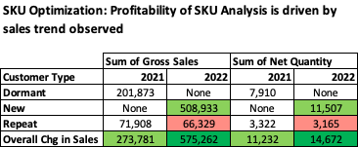
SKU Optimization

Slide 20
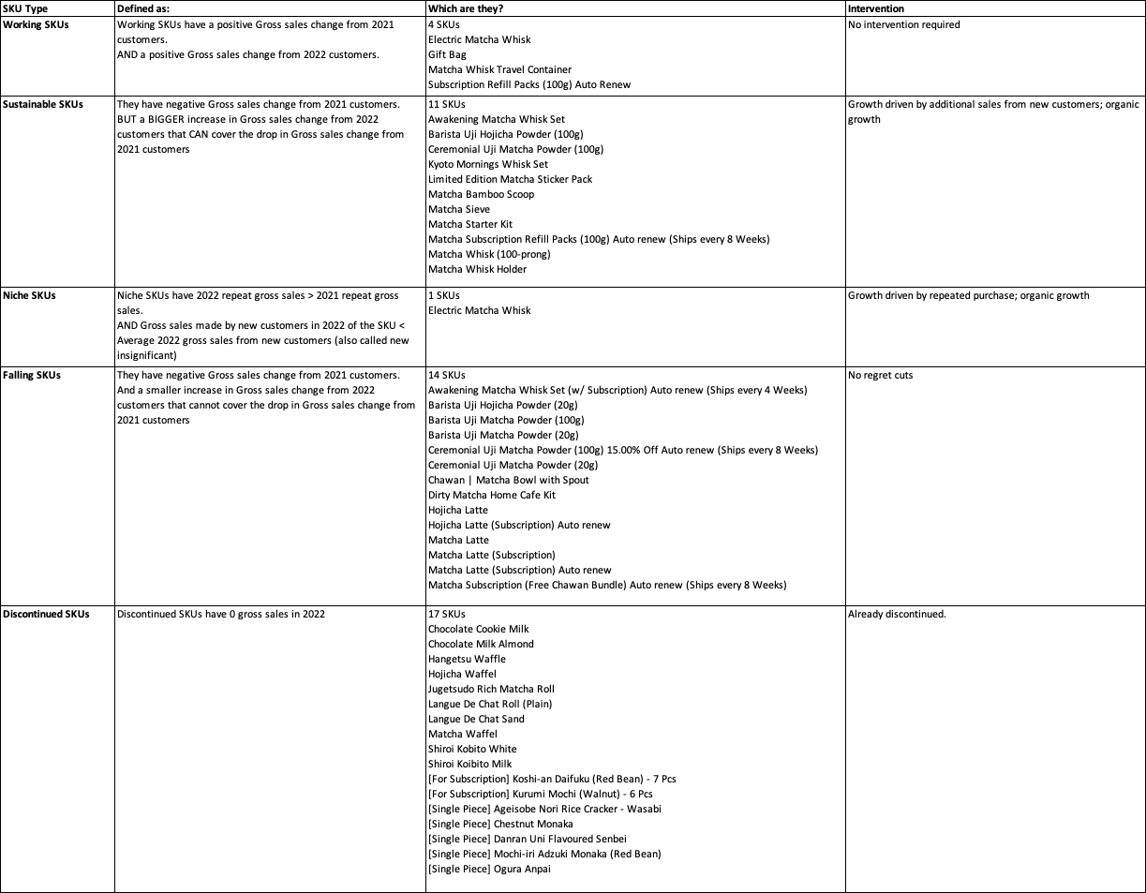
Final Recommendation

Slide 21
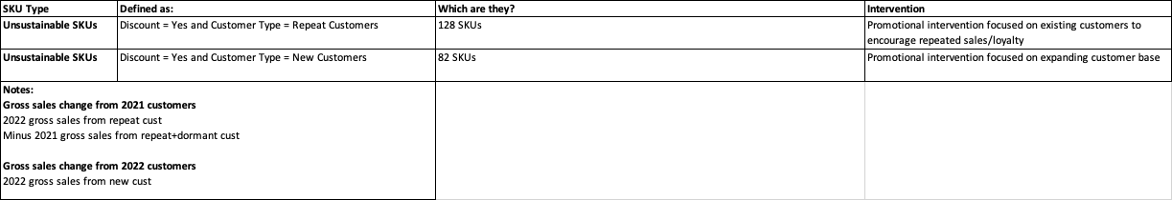
Final Recommendation

Slide 22
ROADMAP (NC)
Acquisition
Increase top of funnel. Japanese craft events/cafes collaboration
Sponsor corporate events with latte subscription as prizes to hook
Experiential marketing, revamp look/feel on website/instagram
Retention
Personalise experience. Target promo. Reward with higher value products to entice purchase (Ceremonial Uji powder 100 grams)
Encourage subscription plans purchases for non-sub customers
Upsell subscription plans (eg. to Subscription refill auto renew)
Expansion
Gift package subscription plans and other trip driving products
Introduce bundle offers to be shared with friends, families
Upsell Matcha starter kits to Kyoto Mornings Whisk set and Awakening Matcha Whisk set kits
Bundle subscription plans with Matcha starter kits as gifts

Slide 23
Roadmap/Final Recommendations (Contents?)
-Suggestions around discounting on recommended bundles
-Do personalization.
-Data Collection of XXX what else can do along the way that will help improve insights. (Survey on preferences(Age,demographics,what liked), product ratings)
-Changes to current website etc.
-Create strategies around campaigns that can be executed over multiple waves and also measure impact of these offers or campaigns.(Create IG adds/reels since targeting 30yo yoga women)

Slide 24
Final Recommendations
· 1) Cross-selling strategy.Optimised bundling and recommendation upon checkout
-For customer segment 1,2,3,4: list top 3 associated products. 4 pivot tables showing top three pairs associated
-Forecasted profits (Higher end, mid-range, low range will still give profits)
Min (35%,med(55%),max(80%)
· 2) Proposed Data Collection to provide further insights
-Customer Demographics [Gender, Age (Island wide delivery was high), Product Rating (Can derive customer satisfaction values).] Also for targeted marketing.
-Website traffic (Google Analytics data) to propose marketing campaigns blasted during peak hour visitations. Behavioural: Benefits sought, user status, usage/bounce, readiness to buy. Competitor data show what works doesn’t work
· 3)Personalisation
Purely data:
-Algorithm to recommend product based on customer purchase behaviour (related items you may like)
Custom:
-Personalised appreciation note listing down benefits of drinks, birthday discount
-loyalty programs (Discount for long-term customers. Recency) for customer retention
· Campaign Strategies: Targeted marketing using demographics and Google analytics website traffic dataset

Slide 25
Thank you

Slide 26
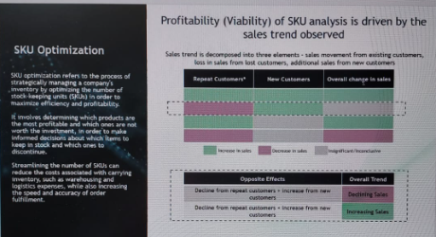
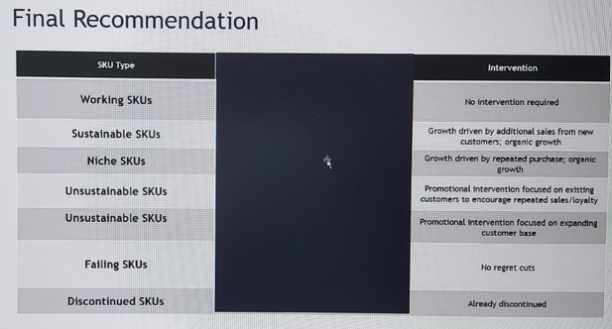
SKU Optimization
-SKU Optimization (which products do well focus/which to discontinue)
-Classify for final recommendations (working, sustainable, Niche, unsustaainable

