Slide 1
Search a Movie
s0239369 - Ioannis Tzortzakis

Slide 2
About the Engine
01.
Overview and Implementation
02.
Evaluation
03.
Limitations and Comments
04.
The problem.
Overview of dataset, libraries and technologies.
Explanations about the project.
Limitations and comments about aspects of the project.

Slide 3
01
About the Engine

Slide 4
About the Engine
Search a Movie
Searches a dataset of movies using queries and returns the most relevant results.

Slide 5
02
Overview and Implementation

Slide 6
“Java Lucene is full of shit.”
— Me

Slide 7
Structure of Project
Python flask web application:
Front-end: HTML, CSS, Javascript (Ajax)
Back-end: Python (Flask)
Information Retrieval: Python (Whoosh)
Dataset: Kaggle movie dataset

Slide 8
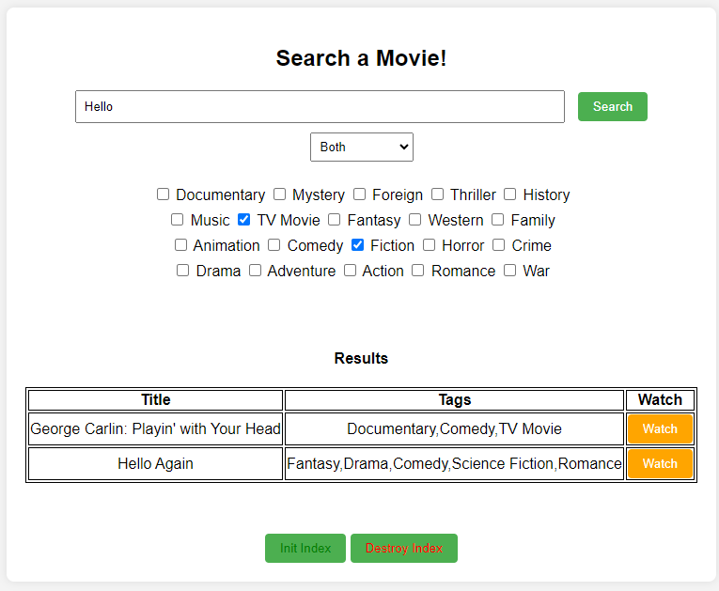
Implementation: Front-end

Slide 9
Implementation: Back-end
app.py: central file that calls other scripts. Comunicates with the front-end
indexing_script.py: creates the indexes
destroy_index.py: destroys the indexes
search_script.py: retrieves and returns information.

Slide 10
search_script.py
Make use of the Python Library Whoosh. Whoosh utilizes the Okapi BM25F ranking function.
Arguments: Query and flags.
Uses Multiparser that searches in up to 3 fields.
Retrieves max 2000 results (~5% of dataset). Filters them and then return the top 15 most suitable results.

Slide 11
03
Evaluation

Slide 12
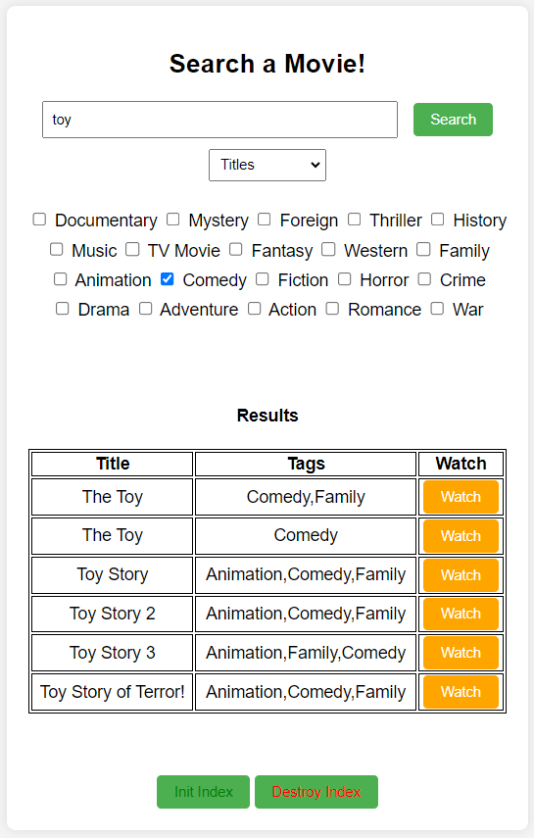
Example #1

Slide 13
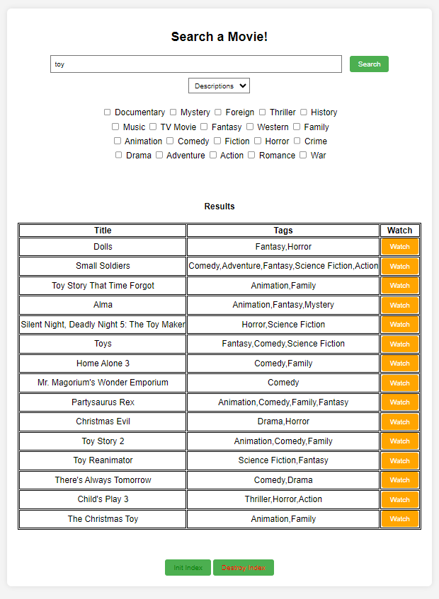
Example #2

Slide 14
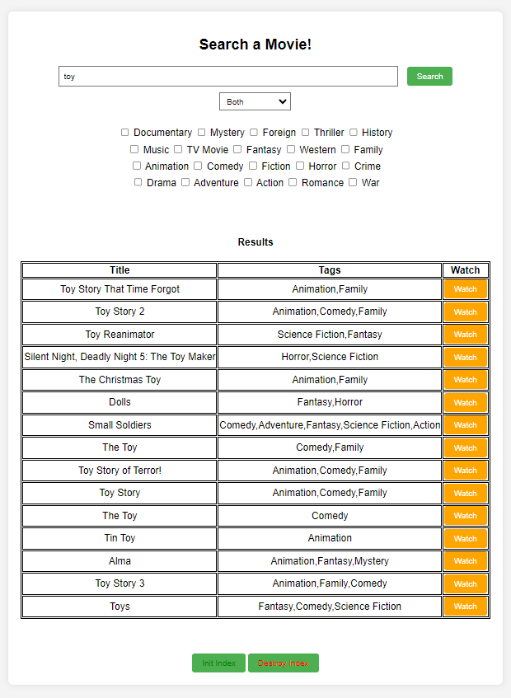
Example #3

Slide 15
Assumptions
The dataset contain true and correct information. (true always)
The algorithm work correctly. (true always)
There is not spelling mistakes in the query. (true/flase)
Therefore, as long the query is correct, the results will be relevant and true.

Slide 16
04
Limitations and comments

Slide 17
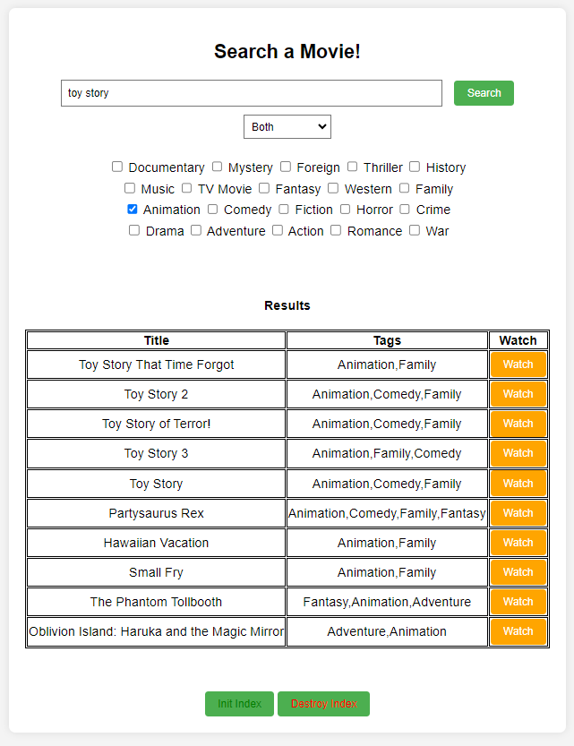
That’s not what I expected

Slide 18
More precise searching
Searching in more fields…
BUT
Exponential computing expense.
Custom parser for searching.
Utilize machine learning.

Slide 19
Don't judge a book by its cover
An interface can always be better.
At this phase it was better to focus rather in the IR part than the interface.

Slide 20
Summery
Things we saw in the class that I use in the project:
Queries
Okami MB25F ranking (probabilistic model)
Removing stop words from text.
Indexing and parsers.

Slide 21
Thanks!
Questions?
Please keep this slide for attribution.

