Slide 1

Team Name: Angels Challenge Name: Challenge 1 Idea Name: Angels “A food rescue and redistribution platform”
DELIVERABLE 2

Slide 2
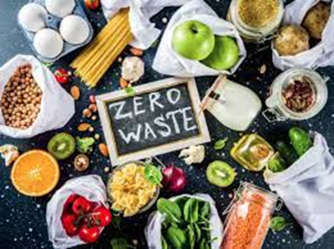
What is angels?
Angels is a platform whose purpose is to contribute to transforming goods and products from stores, food suppliers or restaurants to people in need. So, instead of this waste, the food stock can be given to those who need it with some volunteer effort, through Angels platform.

Slide 3


What is the problem Angels want to solve?
The goal of this platform is not only to reduce food waste by helping the poor, but to boost and highlight the values of volunteering, as well. Moreover, it is important that more and more businesses will change their functional habits and they will inspire others. As a result, the number of businesses that donate their food instead of throwing it away is expected to double by the end of 2024.

Slide 4
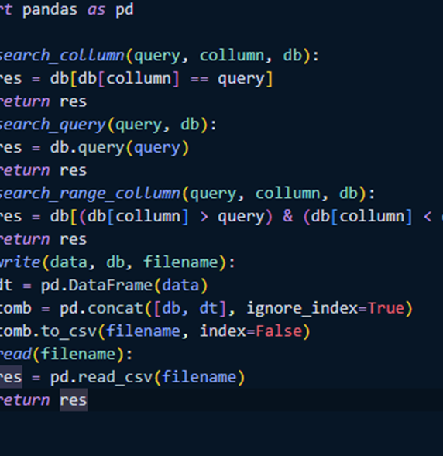
Functionality of the solution
The Angels’ members will do a research in order to enlist the places where non-profit organizations are to contact with them, informing them about our platform.
The volunteers will be greeted to a homepage that explains analytically Angels’ objectives by highlighting what we want to achieve and how volunteers can help us do it. Moreover, our homepage will encourage all our visitors to become volunteers as long as the values of volunteering and the disadvantages of food waste will be listed.
After they decide whether they want to provide their services, or not, there will be a sign-up button in the top right of the page. By tapping on it, volunteers will be transferred to the sign-up page where they will have two options: a) register as a business (The stores that are about to throw products away), b) as a volunteer (Basically the delivery personnel).

Slide 5
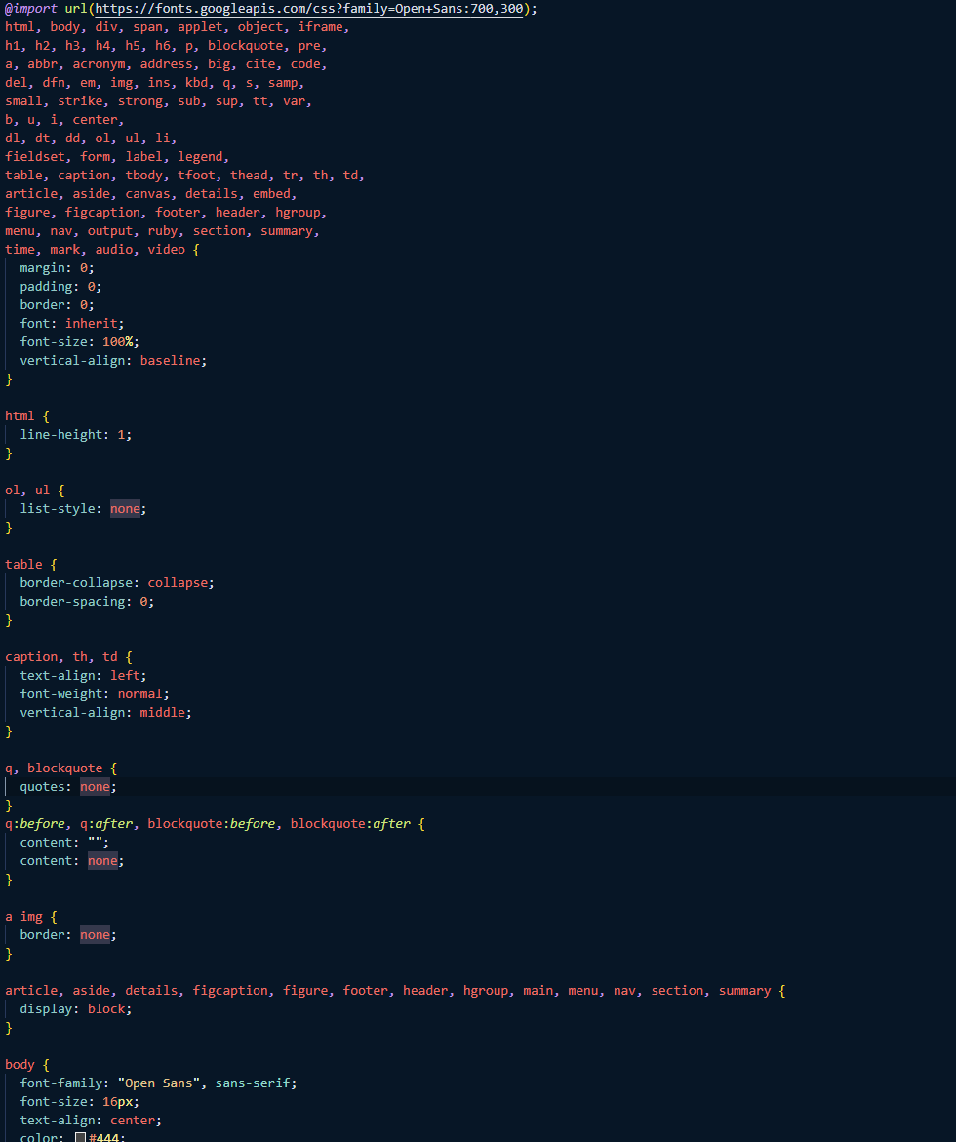
4. Businesses will be greeted with an «excess stock» button and then they will be asked to answer a questionnaire concerning the quality and the quantity of the stock.
5. After all the information is collected, the volunteers will be greeted with a map that presents all the stores that have a product or good ready for pick up within the next 12 hours. There will be a count down from the time the organizations will tap the “excess stock” button until the volunteers pick up the product and tap “done” at their delivery.
6. When the delivery is done the process is done over and over again ultimately stopping the problem of food getting thrown away for no reason.

Slide 6
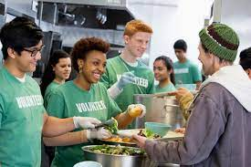
How Angels strands out?
Angels is a unique platform that doesn’t look like any other volunteering platform for several reasons
It contains a detailed map to help both volunteers and organizations
Angels encourages more and more people to provide their services through volunteering and sensitizes them, by informing them about the world’s problems. By 2024 volunteering personnel is expected to double.
Poor people are thankful, and more lives are improving as we give courage to these people. Our unique volunteers have saved people who were even dying from starvation.

Slide 7



Tools we used
Visual Studio Code: We used Visual Studio Code to modify our code and be able to test it at the same time.
Github: We used Github to collaborate and bring all our thoughts (files, photos) in one place
CSV: We used CSV files to keep in track all the businesses and volunteers (our database)

Slide 8




Python: We used Python to manage and read the database
Hypertext Markup Language (HTML): We used HTML to build the websites and make the webpages.
Cascading Style Sheets (CSS): We used CSS to complete the HTML site design.
Pyscript: We used pyscript in combination with HTML to create maps and other graphs using Python in HTML.

Slide 9
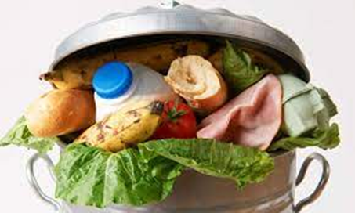



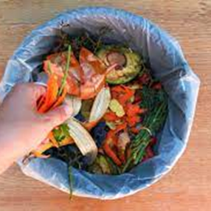
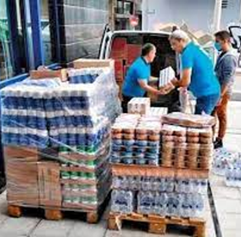
Thank you for your attention
Lefkothea Papapolizou
John Zioupos
Eriphyli Santi

