Slide 1
From Pandemic to Inflation
Europe’s Uneven Economic Recovery, 2019–2024
Ironhack Project 1 · EDA + SQL
Jonathan Weininger
Notes:
My project is called “From Pandemic to Inflation: Europe’s Uneven Economic Recovery, 2019–2024.”
I used World Bank data for the 27 EU countries to analyse how countries recovered from the pandemic and the subsequent inflation shock.

Slide 2
The question: did Europe recover evenly?
Analytical problem
Guiding hypotheses
Averages hide whether economic shocks hit countries in similar ways. The goal was to compare recovery, not just report EU-wide trends.
Most countries recovered, but not at the same speed.
Higher 2022 inflation may predict weaker 2023 growth.
Disinflation may coincide with rising unemployment.
Shocks may widen economic differences temporarily.
2019
2020
2022
2024
Baseline
Pandemic shock
Inflation shock
Recovery check
World Bank WDI · EU-27 · 2019–2024
2/10
Notes:
The main question was whether European countries recovered in a similar way or whether the shocks increased differences between them.
I focused on four hypotheses.
First, I expected most countries to recover their pre-pandemic GDP levels, but at different speeds.
Second, I tested whether higher inflation in 2022 was associated with weaker GDP growth in 2023.
Third, I examined whether falling inflation between 2022 and 2024 was associated with rising unemployment.
Finally, I looked at whether economic shocks temporarily increased differences between EU countries.

Slide 3
The data: a focused World Bank sample
World Development Indicators, filtered to EU-27, three indicators and six years.
27
3
6
486
EU countries
indicators
years
country–indicator–year rows
Indicators used
Cleaning choices:
• Kept missing economic values as NULL
• Converted years to integer and values to REAL
• Restricted to one consistent EU-27 sample
• Reshaped from wide to long format
GDP growth
NY.GDP.MKTP.KD.ZG
Inflation
FP.CPI.TOTL.ZG
Unemployment
SL.UEM.TOTL.ZS
Source: World Bank, World Development Indicators (selected CSV download).
World Bank WDI · EU-27 · 2019–2024
3/10
Notes:
The data comes from the World Bank World Development Indicators.
I selected the 27 EU countries, six years from 2019 to 2024, and three indicators: real GDP growth, inflation, and unemployment.
This resulted in 486 country-indicator-year observations.
For cleaning, I converted the data from wide to long format, standardised the data types, and kept missing economic observations as NULL rather than replacing them artificially.

Slide 4
Database design: three tables, two real relationships
The ERD was the core database-design deliverable.
1 → many
many ← 1
observations
countries
indicators
country_code FK
country_code PK
indicator_code FK
indicator_code PK
country_name
year
indicator_name
region
value
description
PK: country + indicator + year
unit
Design decision: metadata is stored once; measurements live in observations. This prevents repeated country and indicator text and makes joins explicit.
World Bank WDI · EU-27 · 2019–2024
4/10
Notes:
The database contains three tables.
The countries table stores country information, the indicators table stores information about each economic indicator, and the observations table contains the actual values by country, indicator and year.
The country code and indicator code act as foreign keys in the observations table.
I chose this structure because it avoids repeating the same country and indicator information for every observation and makes the relationships between the data explicit.

Slide 5
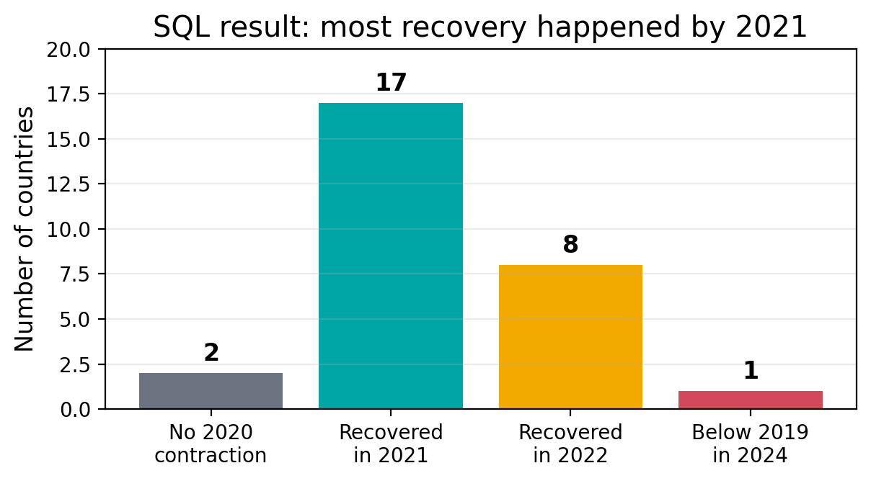
SQL insight: recovery timing mattered more than a yes/no status
One CTE classified recovery years; foreign-key checks prevented silent row loss.
Revealing query pattern
WITH recovery AS (...)
SELECT
country_name,
CASE WHEN gdp_2024 >= 100
THEN 'Recovered by 2024'
END AS recovery_status,
MIN(first_year_at_baseline)
FROM gdp_index_2019
GROUP BY country_name;
Biggest obstacle
A database can load while broken joins silently drop rows.
I checked primary keys, foreign keys and join counts before analysis.
The full join returned the same number of observations as the source table.
World Bank WDI · EU-27 · 2019–2024
5/10
Notes:
One of the more interesting SQL tasks was reconstructing a GDP index with 2019 equal to 100 and then identifying when each country returned to that level.
This allowed me to distinguish between simply saying that a country had recovered by 2024 and identifying the actual year in which it first recovered.
One important lesson was that a database can load successfully while incorrect joins still remove observations. I therefore checked primary keys, foreign keys and row counts before relying on the results.

Slide 6
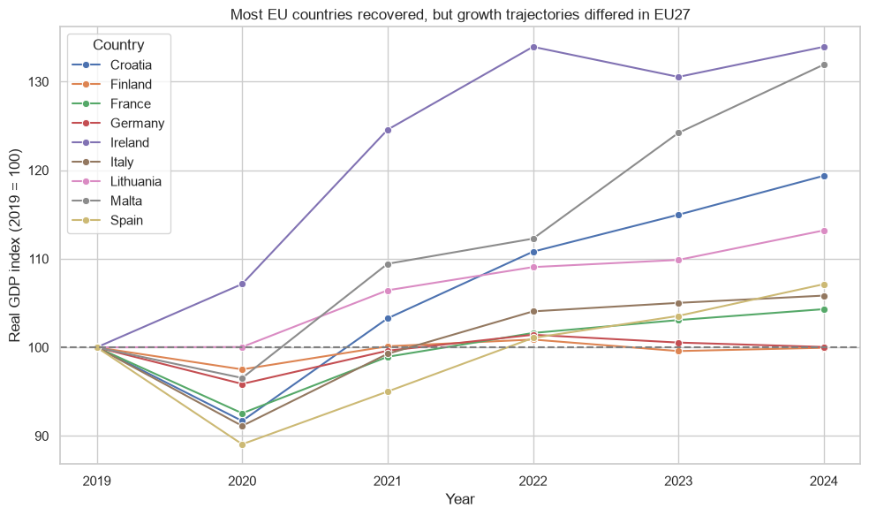
Finding 1: most countries recovered, but trajectories diverged
GDP index reconstructed from annual growth rates; 2019 = 100.
Results
25/27 countries contracted in 2020.
17 first recovered in 2021; 8 in 2022.
By 2024, 24 of the 25 were back at or above 2019 levels.
Finland was marginally below baseline at 99.95.
Hypothesis supported
World Bank WDI · EU-27 · 2019–2024
6/10
Notes:
The first hypothesis was supported.
Twenty-five of the 27 EU countries experienced a GDP contraction in 2020.
Of these, 17 recovered their 2019 GDP level in 2021 and another eight first recovered in 2022.
By 2024, 24 of the 25 countries that had contracted were at or above their 2019 GDP level.
However, the recovery was very uneven. Some countries grew substantially beyond their 2019 level, while countries such as Germany and Finland remained close to the baseline.

Slide 7
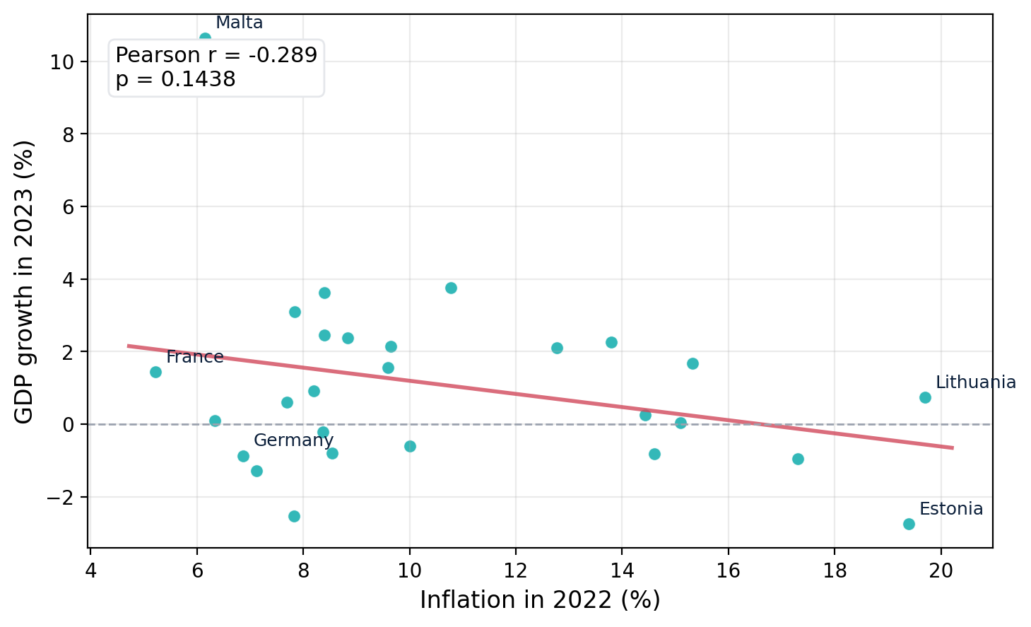
Finding 2: higher 2022 inflation did not reliably predict 2023 growth
The relationship was weak and not statistically significant.
Correlation results
Test
r / ρ
p-value
Pearson
-0.289
0.1438
Spearman
-0.112
0.5790
Above-average inflation group: 0.63% average GDP growth.
At/below-average group: 1.33%.
But Malta strongly influences this comparison.
Hypothesis not statistically supported
World Bank WDI · EU-27 · 2019–2024
7/10
Notes:
Explain that p-values are above 0.05. Say openly that this hypothesis did not hold statistically.
The second hypothesis was that higher inflation in 2022 would be associated with weaker GDP growth in 2023.
The Pearson correlation was negative, at minus 0.289, but the p-value was 0.1438.
The Spearman correlation was even weaker.
So although the direction was consistent with the hypothesis, the relationship was not statistically significant.
Countries with above-average inflation also had lower average growth, but this comparison was strongly influenced by Malta.
Therefore, this hypothesis was not statistically supported.

Slide 8
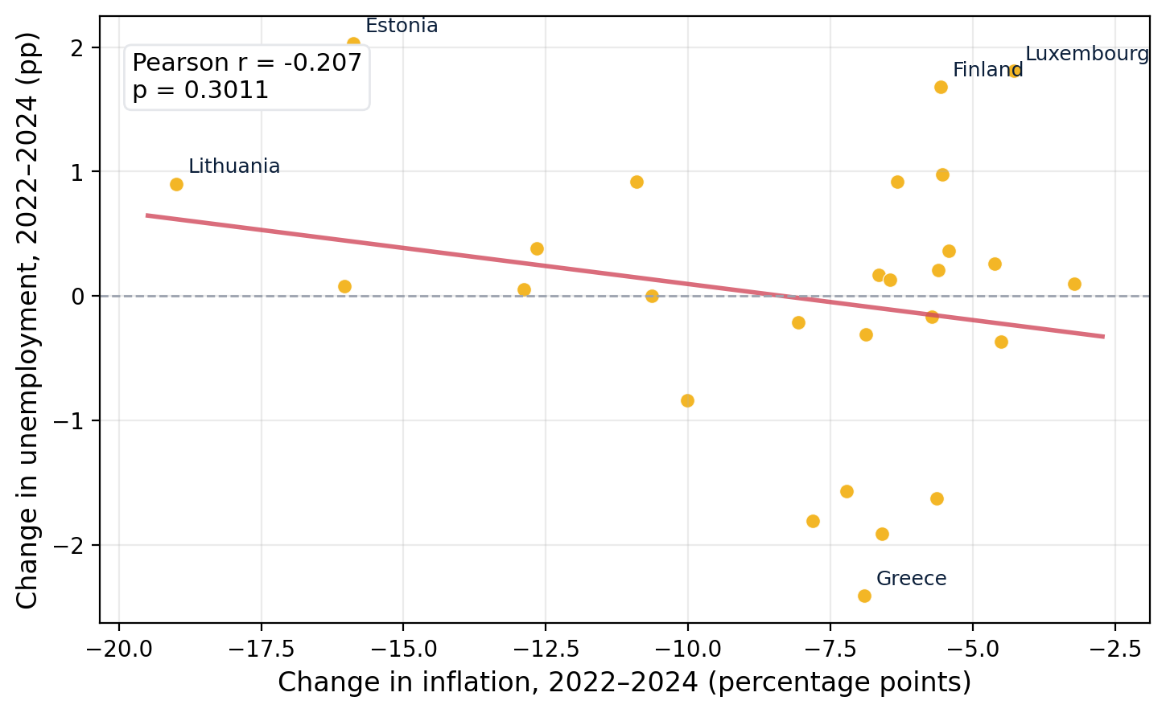
Finding 3: disinflation did not consistently raise unemployment
Inflation fell everywhere; labour-market outcomes were mixed.
What changed in unemployment?
16
10
1
increased
decreased
unchanged
Correlation results
Test
r / ρ
p-value
Pearson
-0.207
0.3011
Spearman
0.091
0.6507
Hypothesis not statistically supported
World Bank WDI · EU-27 · 2019–2024
8/10
Notes:
Stress that inflation declined in all countries but unemployment was mixed.
The third hypothesis was that larger reductions in inflation would be associated with greater increases in unemployment.
Inflation declined in every EU country between 2022 and 2024.
However, unemployment increased in 16 countries, decreased in 10, and remained unchanged in one.
The Pearson correlation was minus 0.207 and the Spearman correlation was close to zero. Neither was statistically significant.
So the data does not show a consistent relationship between stronger disinflation and rising unemployment.
This hypothesis was also not statistically supported.

Slide 9
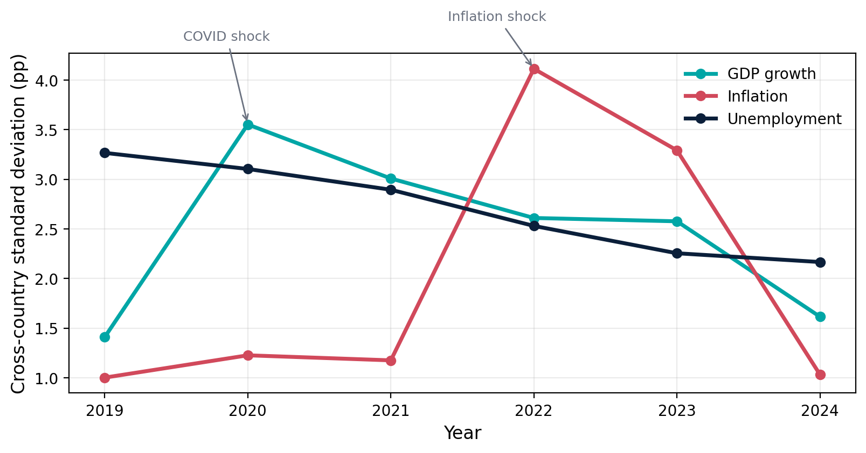
Finding 4: shocks created temporary divergence
GDP-growth and inflation dispersion spiked, while unemployment dispersion declined.
Sample variance highlights
Indicator
2019
Peak
2024
GDP growth
1.99
12.63
(2020)
2.61
Inflation
1.00
16.93
(2022)
1.07
Unemployment
10.67
10.67
(2019)
4.70
GDP growth diverged during COVID.
Inflation diverged during the 2022 shock.
Unemployment became more similar across countries.
Descriptive hypothesis supported
World Bank WDI · EU-27 · 2019–2024
9/10
Notes:
Make the nuance clear: convergence in rates is not convergence in GDP levels or living standards.
The fourth finding concerns differences between countries.
GDP-growth dispersion increased sharply during the pandemic, while inflation dispersion peaked during the inflation shock in 2022.
Both subsequently declined towards their earlier levels.
Unemployment behaved differently: its cross-country variance fell steadily between 2019 and 2024.
So the descriptive hypothesis was supported. Economic shocks temporarily increased differences in GDP growth and inflation, while unemployment rates became more similar across countries.

Slide 10
Conclusion: recovery happened, but simple inflation stories did not hold
Answers to the four questions
Limitations
RQ1
Supported
Most countries recovered by 2024, but paths varied.
27 observations in correlations: limited statistical power.
Correlation is not causation.
Unweighted countries, not EU-wide weighted economy.
GDP growth is not GDP per capita or living standards.
RQ2
Not statistically supported
Inflation–growth relationship was weak and non-significant.
RQ3
Not statistically supported
Disinflation coincided with mixed unemployment outcomes.
RQ4
Supported descriptively
Shocks produced temporary divergence in GDP and inflation.
Next steps
Add pre-2019 baseline years, GDP per capita, energy exposure and robustness checks for outliers such as Malta and Ireland.
Thank you
World Bank WDI · EU-27 · 2019–2024
10/10
Notes:
Close with the main message: the strongest finding is uneven recovery and temporary dispersion, not strong inflation correlations.
Overall, the main finding is that European economies largely recovered, but they did not follow the same path.
The simple inflation relationships I tested did not hold strongly. Higher inflation did not significantly predict weaker growth, and stronger disinflation did not significantly predict rising unemployment.
There are several limitations. The correlation analysis contains only 27 country observations, correlation does not establish causation, and all countries are weighted equally regardless of economic size.
With more time, I would extend the dataset further back before 2019, add indicators such as GDP per capita and energy exposure, and perform additional robustness tests for influential countries such as Malta and Ireland.
Thank you.

