Slide 1
Data modelling

Slide 2
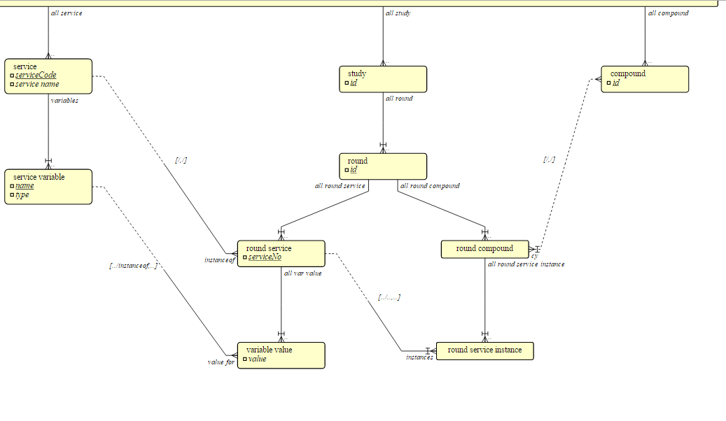
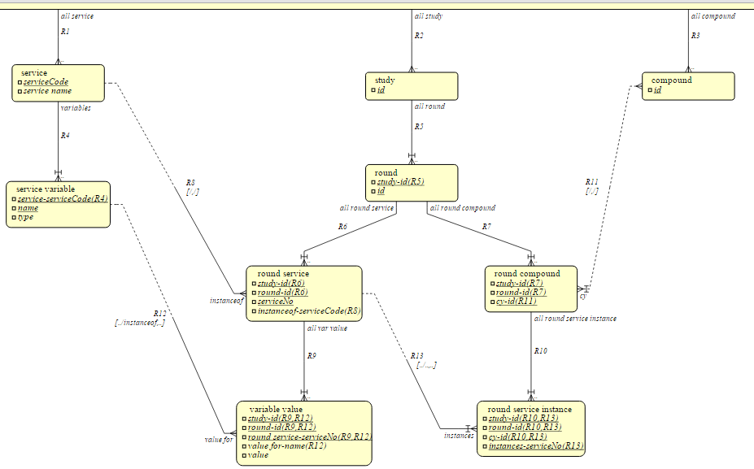
Traditional Data Design Process
Physical data model
gather conceptual requirements
case tool
normalisation
sql table
definitions
(automatic)
(manual)
(automatic)
Logical data model
Though process discarded
sql table
definitions
Physical model retained and incrementally developed

Slide 3
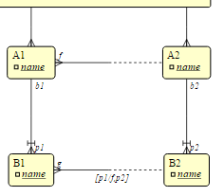
Model 1b - logical
Because this relationship is “identifying”
this name is unique within the scope of an A2 entity.
Both an A2 name and a B2 name must
be used to identify a B2 uniquely

Slide 4
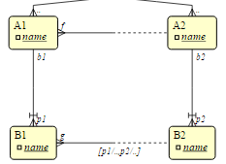
Model 1a , 1b - logical

Slide 5
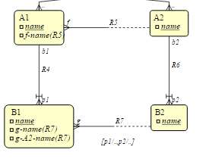
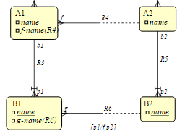
Model 1a, 1b physical - hierarchical

Slide 6
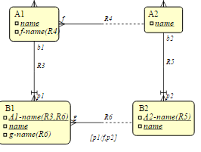
Model 1a, 1b - relational

Slide 7
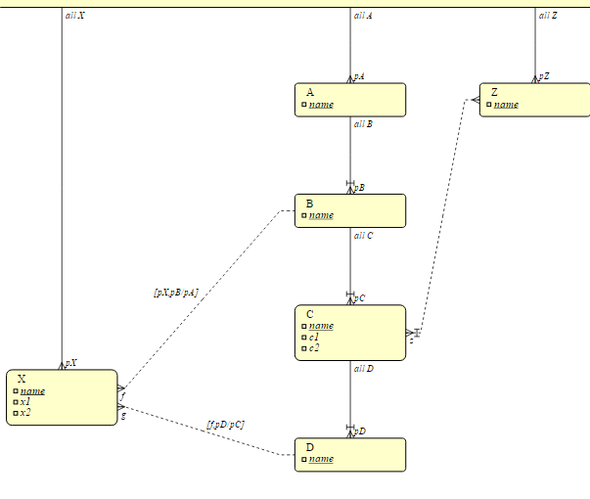
Model 2 logical

Slide 8
Model 3 - logical

Slide 9
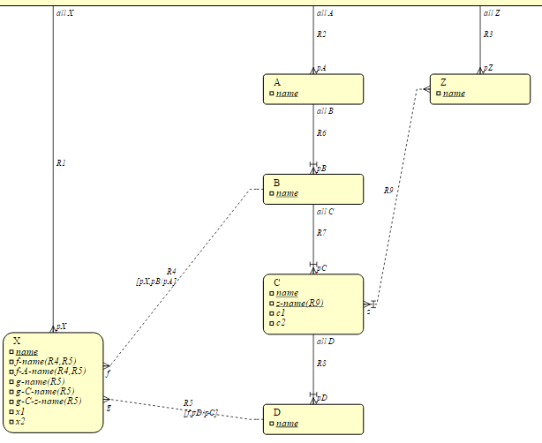
Model 2 hierarchical

Slide 10
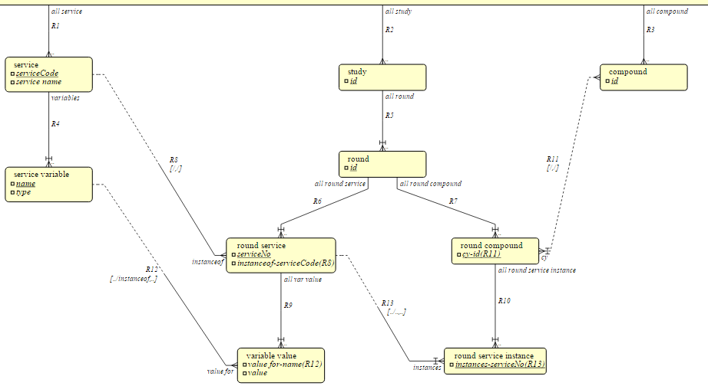
Model 3 - hierarchical

Slide 11
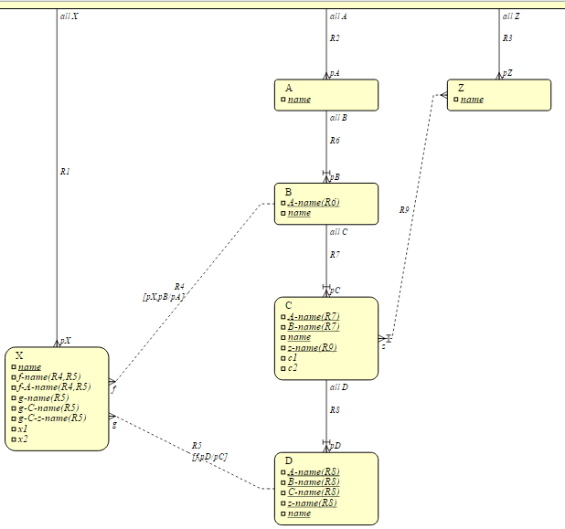
Model 2 relational

Slide 12
model 3 - relational
typeOfOrigin of cy-id is “compound”
attrOfOrigin is “id”

