Slide 1
Flappy BIRDS Project

Slide 2

INTRODUCING THE MEMBERS
Phan Minh Ân ITCSIU22006
Ngô Quang Thiên An
ITITIU20150
Lê Nhật Duy
ITITWE22143
Phạm Chấn Quân ITCSIU22313

Slide 3
TABLE OF CONTENTS
Introduction
Game Rules
01
02
Codes and Libraries
Gameplay
03
04
About the game
How to play game
Actual gameplay
How we do

Slide 4
01
INTRODUCTION

Slide 5
Flappy Birds
This is a game base on the famous Flappy Bird which was very famous in the 2014
You can choose skin for your bird

Slide 6
02
Game Rules

Slide 7
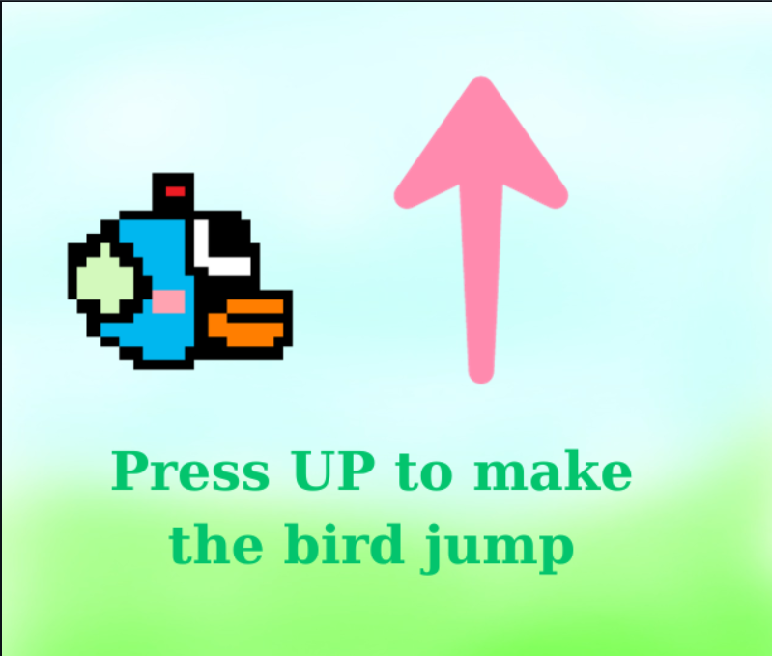

Slide 8
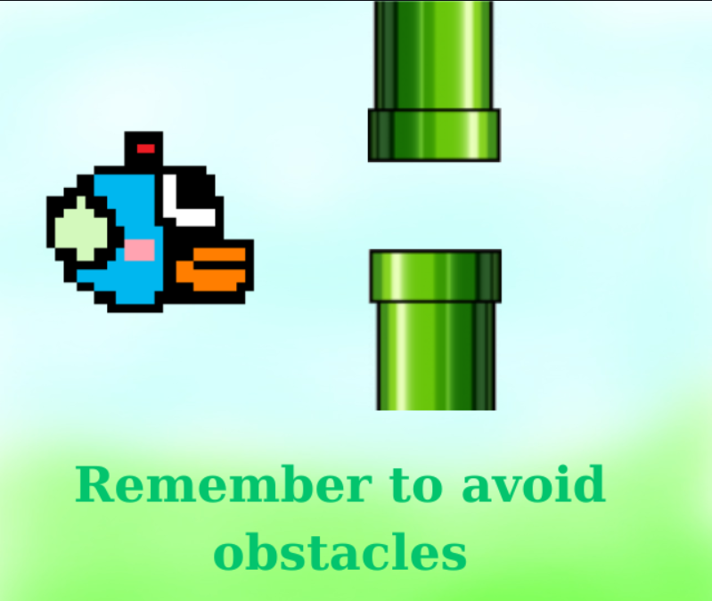

Slide 9
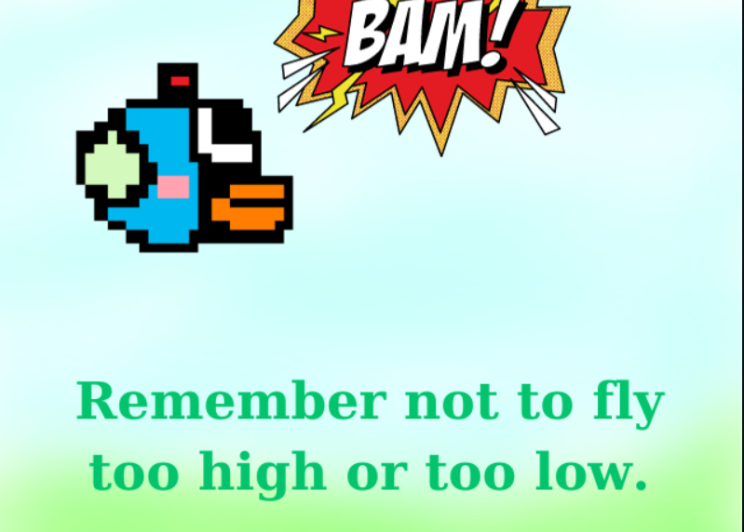

Slide 10
03
Gameplay

Slide 11
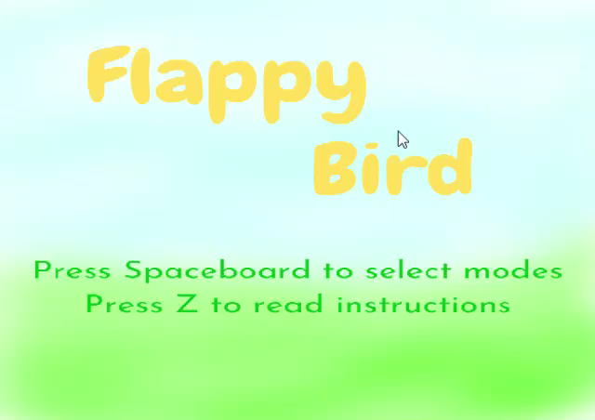

Slide 12
04
Codes and Libraries

Slide 13
Libraries for the bird
javax.sound.sampled.AudioInputStream;
javax.sound.sampled.AudioSystem;
javax.sound.sampled.Clip;
javax.sound.sampled.LineUnavailableException;
javax.sound.sampled.UnsupportedAudioFileException;
javax.imageio.ImageIO;
java.awt.*;
java.io.File;
java.io.IOException;

Slide 14
Libraries for the bird’s action
import javax.swing.*;
import java.awt.*;
import java.awt.event.ActionListener;
import java.awt.event.ActionEvent;
import java.awt.event.KeyEvent;
import java.awt.event.KeyListener;
import java.util.ArrayList;

Slide 15
Libraries for the game
javax.imageio.ImageIO;
javax.swing.*;
java.awt.*;
java.awt.geom.AffineTransform;
java.awt.image.BufferedImage;
java.io.File;
java.io.IOExeption;
java.until.ArrayList;

Slide 16
THANKS!
DO YOU HAVE ANY QUESTIONS?

Slide 17
ALTERNATIVE RESOURCES

