Slide 1
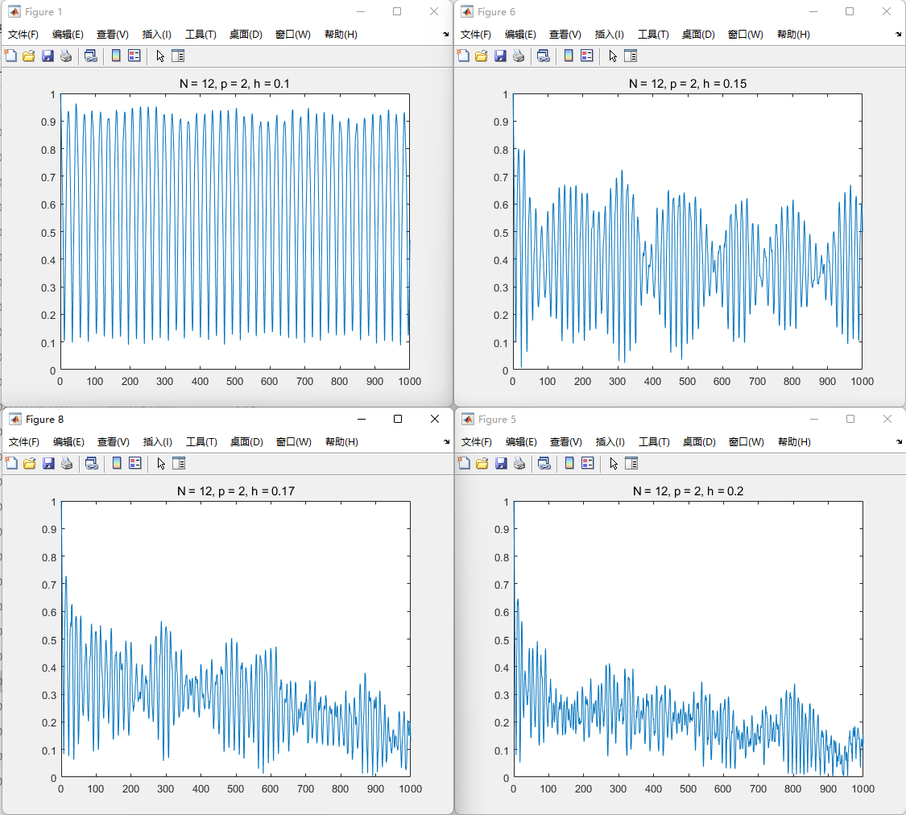
Dt = 0.1

Slide 2
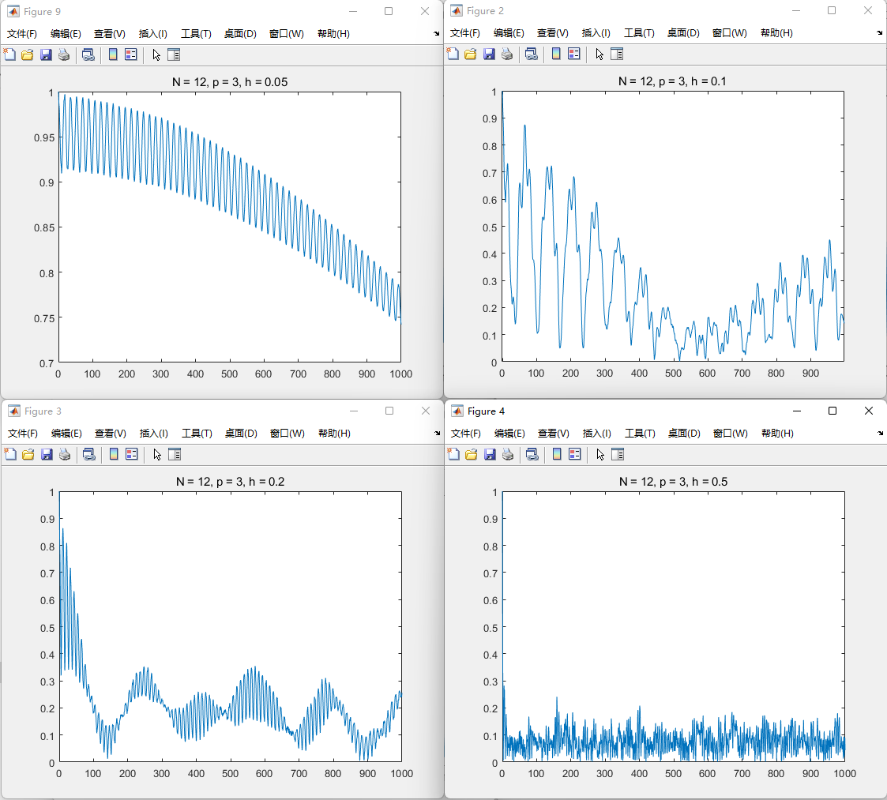
Dt = 0.1

