Slide 1
Result
2023.10

Slide 2

Without disorder
$ε=0.1$, single flip -> ballistic motion

Slide 3
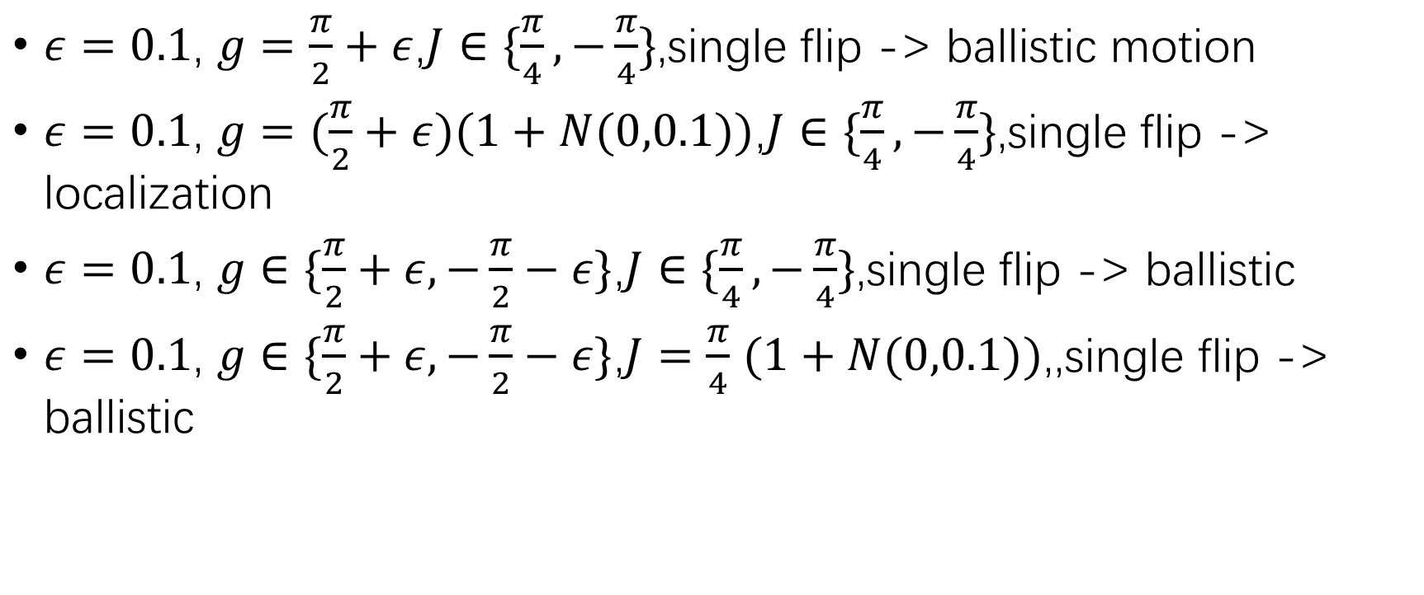
With disorder
$ε=0.1$, $g=\frac{π}{2}+ε$,$J∈\{\frac{π}{4},−\frac{π}{4}\}$,single flip -> ballistic motion
$ε=0.1$, $g=(\frac{π}{2}+ε)(1+N(0,0.1))$,$J∈\{\frac{π}{4},−\frac{π}{4}\}$,single flip -> localization
$ε=0.1$, $g∈\{\frac{π}{2}+ε,−\frac{π}{2}−ε\}$,$J∈\{\frac{π}{4},−\frac{π}{4}\}$,single flip -> ballistic
$ε=0.1$, $g∈\{\frac{π}{2}+ε,−\frac{π}{2}−ε\}$,$J=\frac{π}{4}$ $(1+N(0,0.1))$,,single flip -> ballistic

