Slide 1
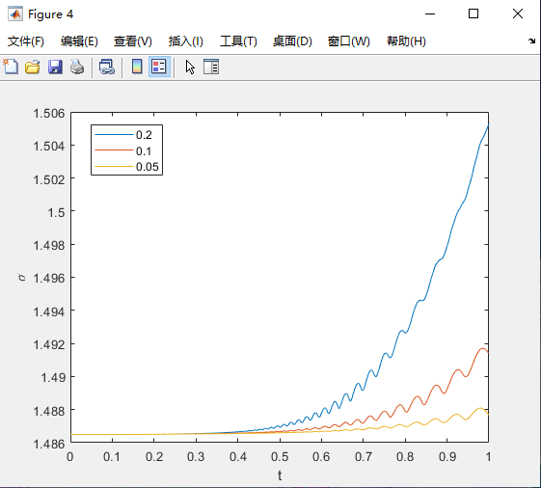
Sigma = 0.05
Dt = 0.001
Dx = 0.005
L = 10

Slide 2
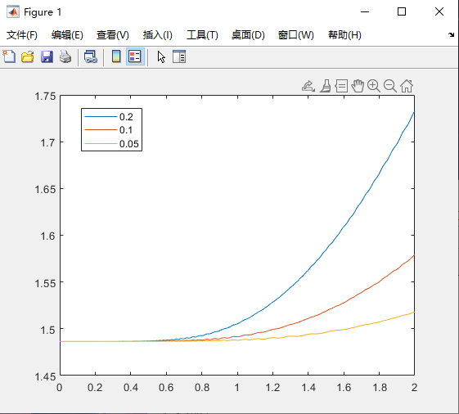
Sigma = 0.05
Dt = 0.001
Dx = 0.005
L = 10

Slide 3
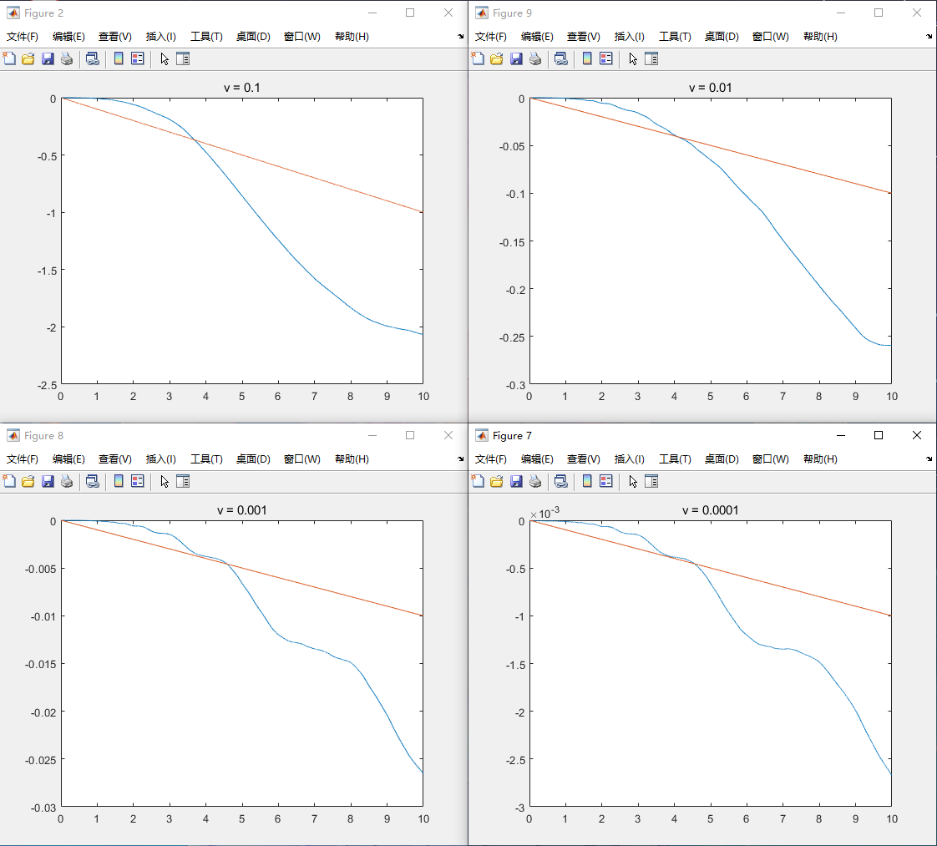
Sigma = 0.05
Dt = 0.001
Dx = 0.005
L = 10

Slide 4
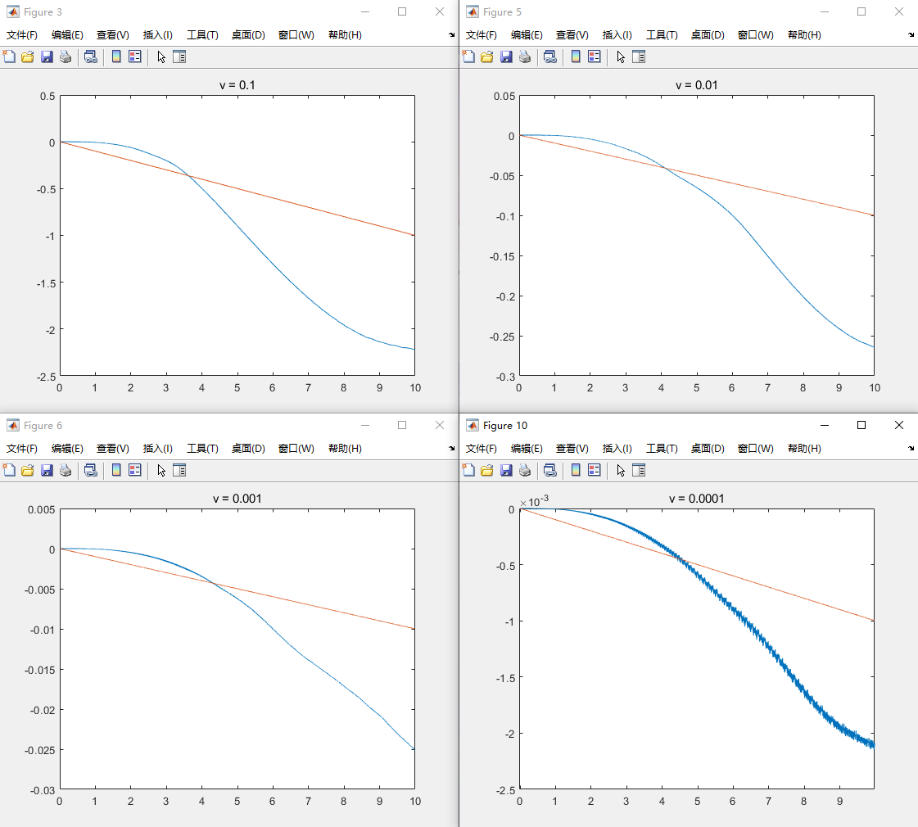
Sigma = 0.05
Dt = 0.001
Dx = 0.005
L = 20

Slide 5
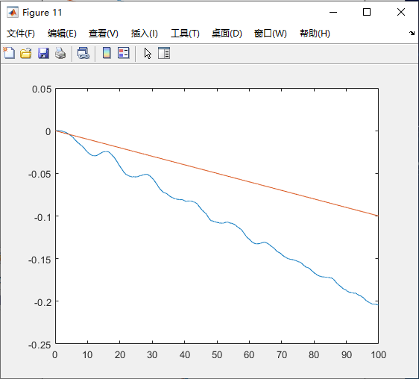
Sigma = 0.05
Dt = 0.001
Dx = 0.005
L = 20
V = 0.001

