Slide 1
Key scan using EZH is much faster
 | EZH | Cortex-M0+
IO Registers | Register based IO access GPO register for PIN write GPI register for PIN read 12 EZH cycles for scanning 4x4 key array = 8 GPO Write + 4 GPI Read | Memory based I/O access LDR/STR Instruction – 1 clock latency for I/O port
Architecture | Modified Harvard Architecture Dual AHB Bus(instruction and Data) | Von Neuman Architecture Single System Bus
Interrupt latency | Bit slice (no cycle penalty) for IO event | 15 cycles with 0-waitstate memory
Composite Key | Yes | Yes
Hardware Loop | No penalty on branch(Tight-Loop) | 1 cycle penalty

Slide 2
Compare Contents
Function | system frequence | MDK optimize | EZH (ns) | M0+ (ns) | Speed Improve
keyscan | 96MHz | level 0 | 490.0 | 5770.0 | 12x
 |  | level 3 | 490.0 | 2477.6 | 5x
 | 150MHz | level 0 | 311.6 | 3559.6 | 11x
 |  | level 3 | 311.6 | 1539.6 | 5x
toggle (M0+ take toggle task by SDK API) | 96MHz | level 0 | 20.6 | 314.0 | 15x
 |  | level 3 | 20.6 | 83.2 | 4x
 | 150MHz | level 0 | 13.2 | 200.0 | 15x
 |  | level 3 | 13.2 | 53.6 | 4x
toggle (M0+ take toggle task by feeding GPIO register directly) | 96MHz | level 0 | 20.6 | 41.6 | 2x
 |  | level 3 | 20.6 | 83.6 | 4x
 | 150MHz | level 0 | 13.2 | 26.4 | 2x
 |  | level 3 | 13.2 | 54.0 | 4x
13.2
:EZH cost time finish a task
13.2
:field application data
54.0
:M0+ cost time finish a task
13.2
:lab test data

Slide 3
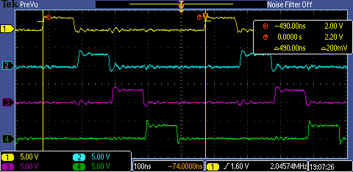
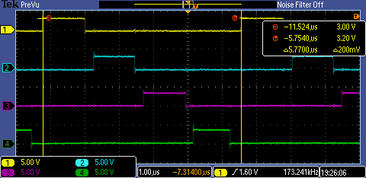
Key scan cycle compare @96MHz
Using EZH | Using CM0+ (SDK implement)
SCAN cycle
SCAN cycle
A key scan cycle is 490ns using EZH, while it is 5770ns using CM0+ @96MHz
IDE:MDK(optimize:-O0)
NOTE:
CH1: row 1; CH2: row 2, … CH4: row 4

Slide 4
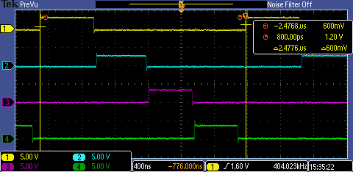
Key scan cycle compare @96MHz
Using EZH | Using CM0+ (SDK implement)
SCAN cycle
SCAN cycle
A key scan cycle is 490ns using EZH, while it is 2477.6ns using CM0+ @96MHz
IDE:MDK(optimize:-O3)
NOTE:
CH1: row 1; CH2: row 2, … CH4: row 4

Slide 5
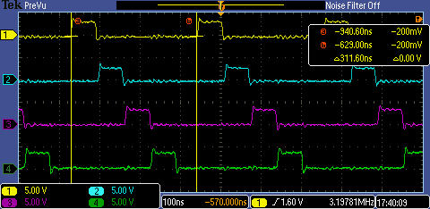
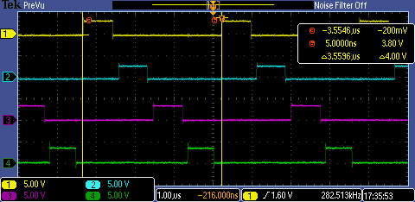
Key scan cycle compare @150MHz
Using EZH | Using CM0+ (SDK implement)
SCAN cycle
SCAN cycle
A key scan cycle is 311.6ns using EZH, while it is 3559.6ns using CM0+ @96MHz
IDE:MDK(optimize:-O0)
NOTE:
CH1: row 1; CH2: row 2, … CH4: row 4

Slide 6
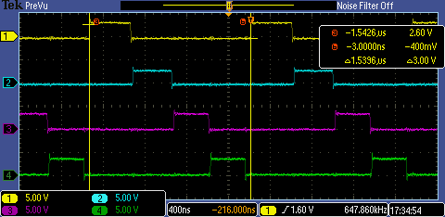
Key scan cycle compare @150MHz
Using EZH | Using CM0+ (SDK implement)
SCAN cycle
SCAN cycle
A key scan cycle is 311.6ns using EZH, while it is 1539.6ns using CM0+ @96MHz
IDE:MDK(optimize:-O3)
NOTE:
CH1: row 1; CH2: row 2, … CH4: row 4

Slide 7
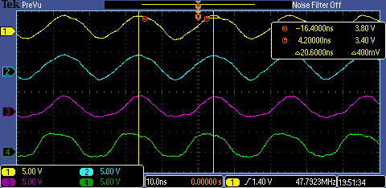
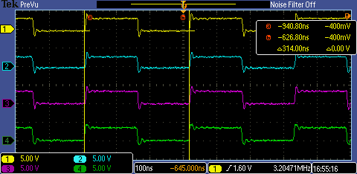
Four channels IO toggle cycle compare @96MHz
Using EZH | Using CM0+ (SDK implement)
toggle cycle
toggle cycle
Four channel IO toggle cycle is 20.6ns using EZH, while it is 314ns using CM0+ @96MHz
IDE:MDK(optimize:-O0)
while(1){
GPIO_PortToggle(GPIO, BOARD_KEY_PORT, (1u<<KEY_ROW_1)|(1u<<KEY_ROW_2)|(1u<<KEY_ROW_3)|(1u<<KEY_ROW_4));
}
NOTE:
CH1: row 1; CH2: row 2, … CH4: row 4

Slide 8
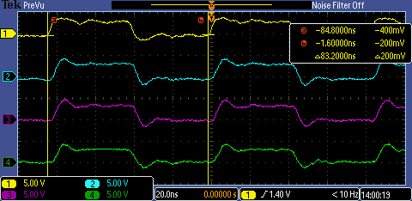
Four channels IO toggle cycle compare @96MHz
Using EZH | Using CM0+ (SDK implement)
toggle cycle
toggle cycle
Four channel IO toggle cycle is 20.6ns using EZH, while it is 83.2ns using CM0+ @96MHz
IDE:MDK(optimize:-O3)
while(1){
GPIO_PortToggle(GPIO, BOARD_KEY_PORT, (1u<<KEY_ROW_1)|(1u<<KEY_ROW_2)|(1u<<KEY_ROW_3)|(1u<<KEY_ROW_4));
}
NOTE:
CH1: row 1; CH2: row 2, … CH4: row 4

Slide 9

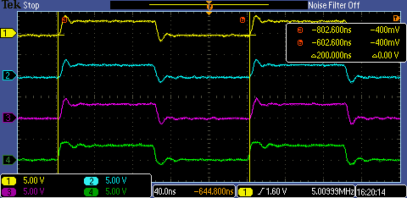
Four channels IO toggle cycle compare @150MHz
Using EZH | Using CM0+ (SDK implement)
toggle cycle
toggle cycle
Four channel IO toggle cycle is 13.2ns using EZH, while it is 200ns using CM0+ @150MHz
IDE:MDK(optimize:-O0)
while(1){
GPIO_PortToggle(GPIO, BOARD_KEY_PORT, (1u<<KEY_ROW_1)|(1u<<KEY_ROW_2)|(1u<<KEY_ROW_3)|(1u<<KEY_ROW_4));
}
NOTE:
CH1: row 1; CH2: row 2, … CH4: row 4

Slide 10
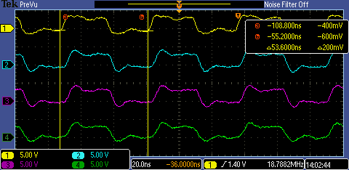
Four channels IO toggle cycle compare @150MHz
Using EZH | Using CM0+ (SDK implement)
toggle cycle
toggle cycle
Four channel IO toggle cycle is 13.2ns using EZH, while it is 53.6ns using CM0+ @150MHz
IDE:MDK(optimize:-O3)
while(1){
GPIO_PortToggle(GPIO, BOARD_KEY_PORT, (1u<<KEY_ROW_1)|(1u<<KEY_ROW_2)|(1u<<KEY_ROW_3)|(1u<<KEY_ROW_4));
}
NOTE:
CH1: row 1; CH2: row 2, … CH4: row 4

Slide 11

Four channels IO toggle cycle compare @96MHz
Using EZH | Using CM0+( feed GPIO register directly )
toggle cycle
toggle cycle
Four channel IO toggle cycle is 20.6ns using EZH, while it is 41.6ns using CM0+ @96MHz
IDE:MDK(optimize:-O0)
register uint32_t *p =(uint32_t *)0x4008E300; //GPIO toggle register address
register uint32_t myr0 = 0x002400a0; //GPIO toggle register value
while(1){ *p = myr0;*p = myr0;*p = myr0;*p = myr0;*p = myr0;*p = myr0;}
NOTE:
CH1: row 1; CH2: row 2, … CH4: row 4

Slide 12
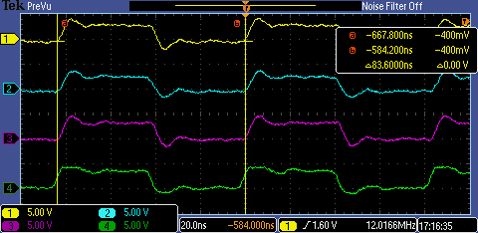
Four channels IO toggle cycle compare @96MHz
Using EZH | Using CM0+( feed GPIO register directly )
toggle cycle
toggle cycle
Four channel IO toggle cycle is 20.6ns using EZH, while it is 83.6 using CM0+ @96MHz
IDE:MDK(optimize:-O3)
register uint32_t *p =(uint32_t *)0x4008E300; //GPIO toggle register address
register uint32_t myr0 = 0x002400a0; //GPIO toggle register value
while(1){ *p = myr0;*p = myr0;*p = myr0;*p = myr0;*p = myr0;*p = myr0;}
NOTE:
CH1: row 1; CH2: row 2, … CH4: row 4

Slide 13
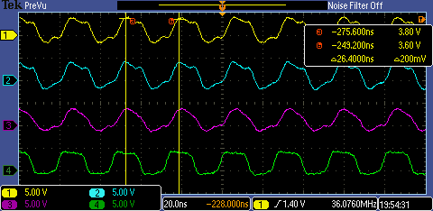
Four channels IO toggle cycle compare @150MHz
Using EZH | Using CM0+( feed GPIO register directly )
toggle cycle
toggle cycle
Four channel IO toggle cycle is 13.2ns using EZH, while it is 26.4ns using CM0+ @150MHz
IDE:MDK(optimize:-O0)
register uint32_t *p =(uint32_t *)0x4008E300; //GPIO toggle register address
register uint32_t myr0 = 0x002400a0; //GPIO toggle register value
while(1){ *p = myr0;*p = myr0;*p = myr0;*p = myr0;*p = myr0;*p = myr0;}
NOTE:
CH1: row 1; CH2: row 2, … CH4: row 4

Slide 14
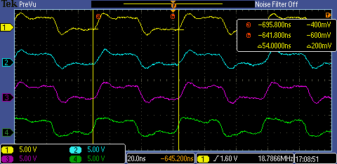
Four channels IO toggle cycle compare @150MHz
Using EZH | Using CM0+( feed GPIO register directly )
toggle cycle
toggle cycle
Four channel IO toggle cycle is 13.2ns using EZH, while it is 54ns using CM0+ @150MHz
IDE:MDK(optimize:-O3)
register uint32_t *p =(uint32_t *)0x4008E300; //GPIO toggle register address
register uint32_t myr0 = 0x002400a0; //GPIO toggle register value
while(1){ *p = myr0;*p = myr0;*p = myr0;*p = myr0;*p = myr0;*p = myr0;}
NOTE:
CH1: row 1; CH2: row 2, … CH4: row 4

