Slide 1
Key scan using EZH is much faster
 | EZH | Cortex-M0+
IO Registers | Register based IO access GPO register for PIN write GPI register for PIN read 12 EZH cycles for scanning 4x4 key array = 8 GPO Write + 4 GPI Read | Memory based I/O access LDR/STR Instruction – 1 clock latency for I/O port
Architecture | Modified Harvard Architecture Dual AHB Bus(instruction and Data) | Von Neuman Architecture Single System Bus
Interrupt latency | Bit slice (no cycle penalty) for IO event | 15 cycles with 0-waitstate memory
Composite Key | Yes | Yes
Hardware Loop | No penalty on branch | 1 cycle penalty

Slide 2
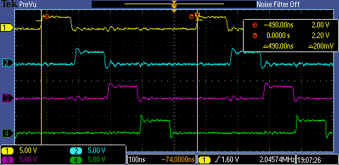
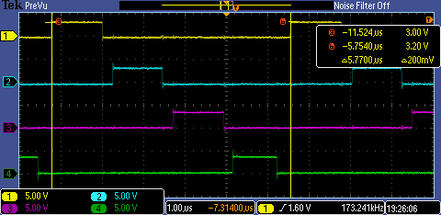
Key scan cycle compare @96MHz
Key scan cycle using EZH (490ns) | Key scan cycle using CM0+ (5770ns)
SCAN cycle
SCAN cycle
A key scan cycle is 490ns using EZH, while it is 5770ns using CM0+ @96MHz
NOTE:
CH1: row 1; CH2: row 2, … CH4: row 4

Slide 3

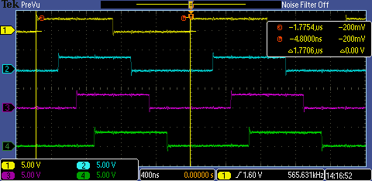
Four channel IO toggle cycle compare @96MHz
Using EZH | Using CM0+
toggle cycle
toggle cycle
Four channel IO toggle cycle is 82.6ns using EZH, while it is 1770.6ns using CM0+ @96MHz
NOTE:
CH1: row 1; CH2: row 2, … CH4: row 4

Slide 4
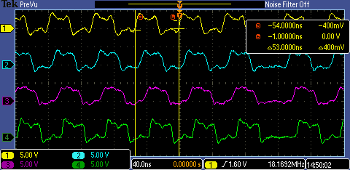
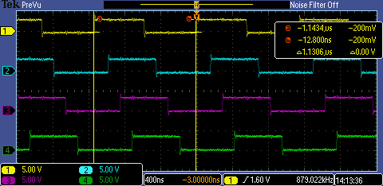
Four channel IO toggle cycle compare @150MHz
Using EZH | Using CM0+
toggle cycle
Toggle cycle
Four channel IO toggle cycle is 53ns using EZH, while it is 1130.6ns using CM0+ @150MHz
NOTE:
CH1: row 1; CH2: row 2, … CH4: row 4

