Slide 1
Toxicity Comments Classification
Jialiang Wu
Zhongyang Wu

Slide 2
Problem Set
Given a text, can we determine how toxicity it is? Is it rude, disrespectful or likely to make someone else to leave a discussion?
Nowadays, we see cyberbully everyday. If we can detect toxicity comments, we can take actions against those comments before they do much harm.
Thus, we are trying to build a model to determine whether the comment is toxicity or not.

Slide 3
Dataset
Our training set contains 1804874 entries and our test set contains 97320 entries.
Some example from training dataset
Comment | label
Thank you!! This would make my life a lot less anxiety-inducing. Keep it up, and don't let anyone get in your way! | 0.0
haha you guys are a bunch of losers. | 0.8936170212765957

Slide 4
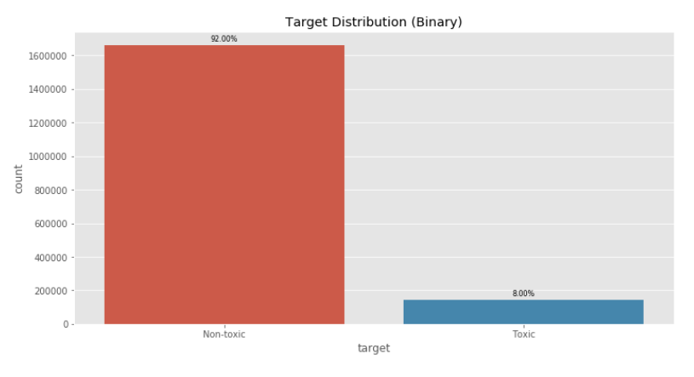
Dataset

Slide 5
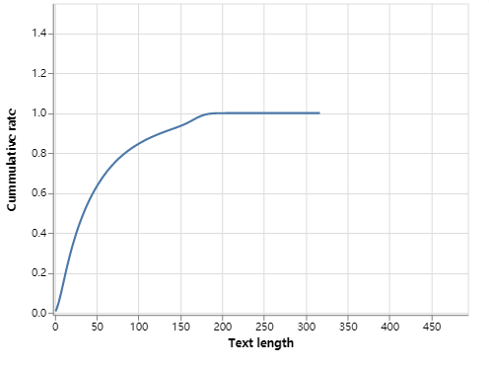
Dataset
Word count in comment.

Slide 6
How can we use string as input of Neural Network?
So far, our neural network can only take numbers as input. But our training set is consisted by string.
A clear and simple method is to treat word as categorical column, and convert it into one-hot vector.
But such vector does not capture any relationship between words.

Slide 7
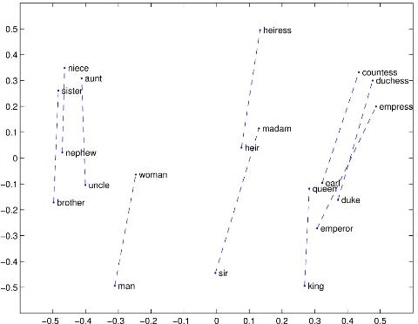
Word Embedding
Word embedding, is bunch of algorithms that could convert word to a vector while preserve their similarity not only on language aspect, but also in their meaning.

Slide 8
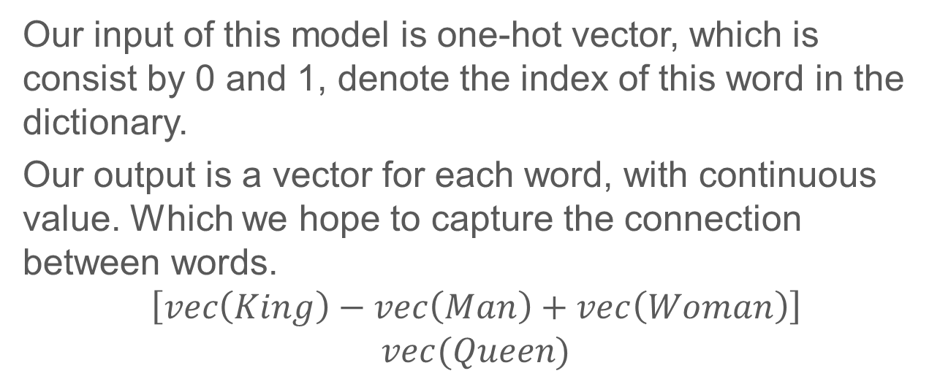
Word Embedding
Our input of this model is one-hot vector, which is consist by 0 and 1, denote the index of this word in the dictionary.
Our output is a vector for each word, with continuous value. Which we hope to capture the connection between words.
$$\left[vec\left(King\right)−vec\left(Man\right)+vec\left(Woman\right)\right]$$
$$vec(Queen)$$

Slide 9
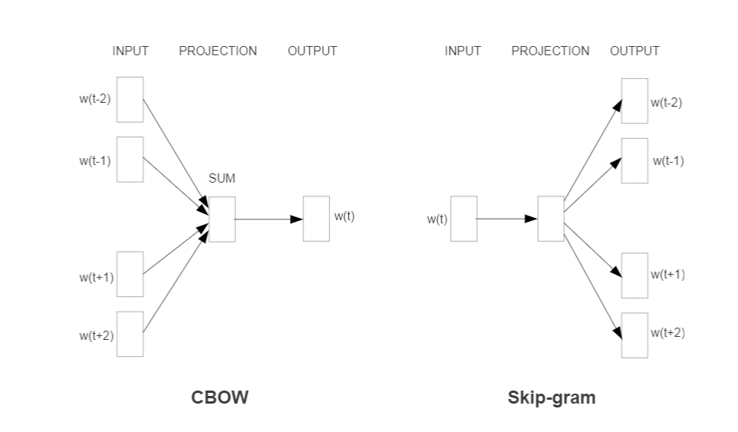
Word2Vec
CBOW, Continues Bag-of-Word
Skip-gram.

Slide 10
GloVe
Stands for “Global Vectors for Word Representation”.
Which is created from Stanford(Both the algorithm and the corresponding library)
Combines the matrix factorization Methods and Shallow Window-Based Methods.

Slide 11
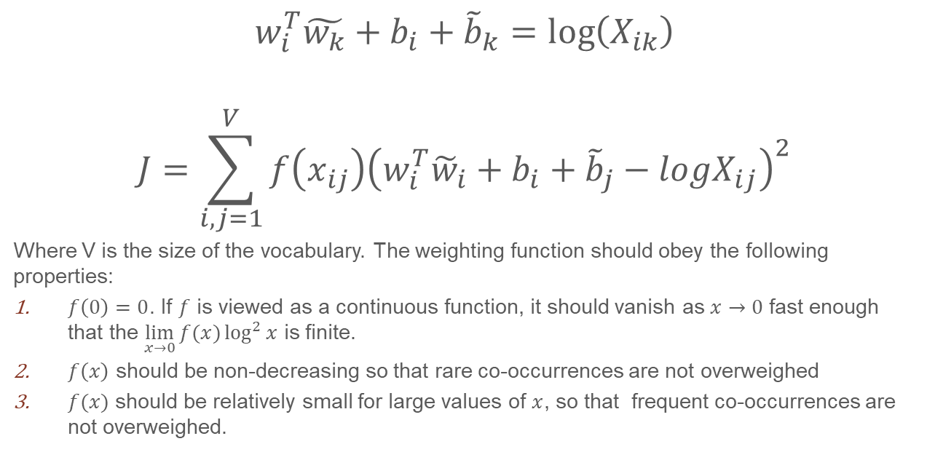
GloVe
$$w_{i}^{T}\tilde{w_{k}}+b_{i}+{\tilde{b}}_{k}=\log\left(X_{ik}\right)$$
$$J=\sum_{i,j=1}^{V}{f\left(x_{ij}\right){\left(w_{i}^{T}{\tilde{w}}_{i}+b_{i}+{\tilde{b}}_{j}−logX_{ij}\right)}^{2}}$$
Where V is the size of the vocabulary. The weighting function should obey the following properties:
$f\left(0\right)=0$. If $f$ is viewed as a continuous function, it should vanish as $x→0$ fast enough that the $\lim_{x→0}{f(x)}\log^{2}{x}$ is finite.
$f\left(x\right)$ should be non-decreasing so that rare co-occurrences are not overweighed
$f(x)$ should be relatively small for large values of $x$, so that frequent co-occurrences are not overweighed.

Slide 12
How text become a time-series problems?
Human need context to understand words. Thus, we need Neural Network to “remember” the context to understand word.
When we understand words, we are actually not only need what we already read, but also maybe what we will be reading.
He said “Teddy Roosevelt was a great President.”
He said “Teddy Bear is on sale.”

Slide 13
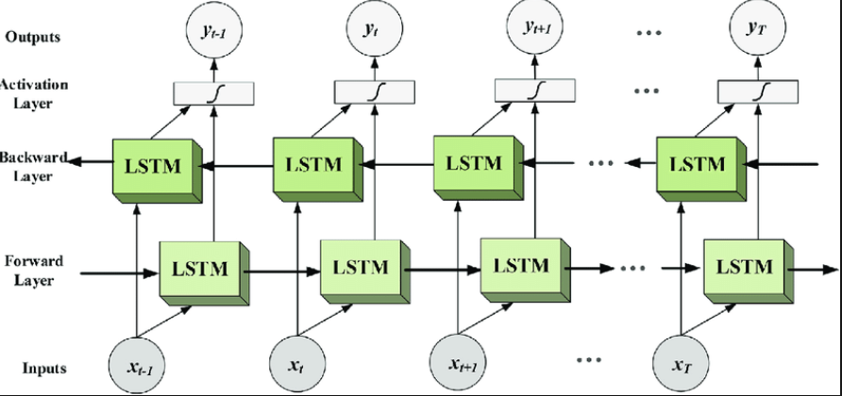
BLSTM – Bidirectional LSTM

Slide 14
Residual Network
$$H\left(x\right)=x+f(x)$$

Slide 15
Spatial dropout
For normal dropout, we randomly select elements in tensor and set them to be 0.
But for the spatial dropout, we will randomly select dimension and set all elements in that dimension to be zero.

Slide 16
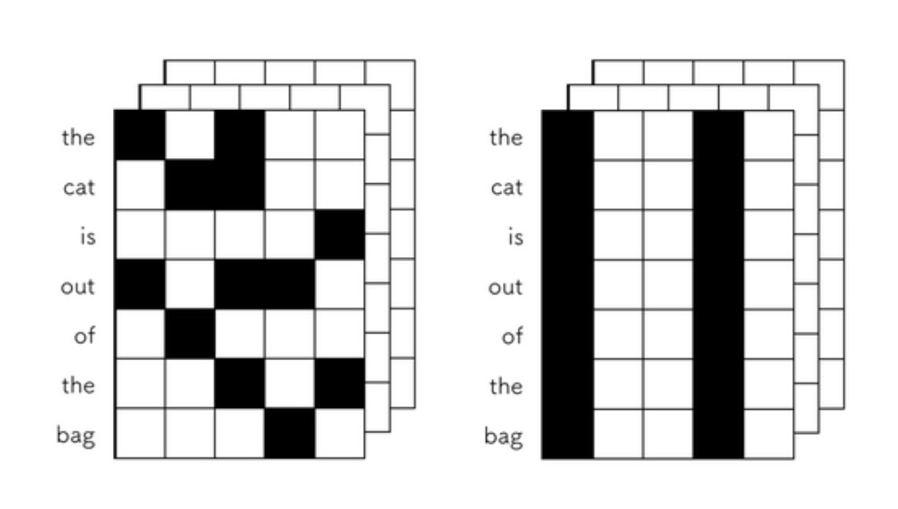
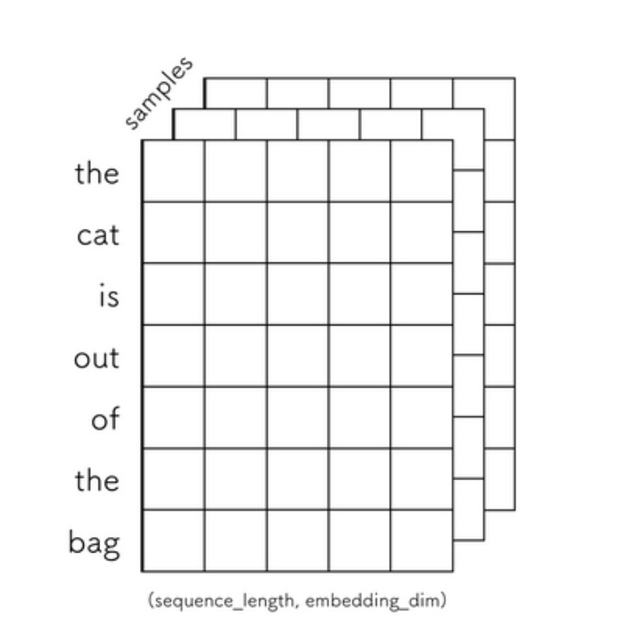
Spatial dropout

Slide 17
Data Preprocessing
Clean data
Delete special notation like ╣
Tokenized, convert sentence to one-hot vectors.
Word Embedding / Word2Vec
Get label, in the training set, the label is a continues float within [0,1]. We convert it into a 1/0 label by set the threshold of 0.5

Slide 18
Model
words = Input(shape=(MAX_LEN,))
x = Embedding(*embedding_matrix.shape, weights=[embedding_matrix], trainable=False)(words)
x = SpatialDropout1D(0.3)(x)
x = Bidirectional(CuDNNLSTM(LSTM_UNITS, return_sequences=True))(x)
x = Bidirectional(CuDNNLSTM(LSTM_UNITS, return_sequences=True))(x)
hidden = concatenate([
GlobalMaxPooling1D()(x), GlobalAveragePooling1D()(x)
])
hidden = add([hidden, Dense(DENSE_HIDDEN_UNITS, activation='relu')(hidden)])
hidden = add([hidden, Dense(DENSE_HIDDEN_UNITS, activation='relu')(hidden)])
result = Dense(1, activation='sigmoid')(hidden)
aux_result = Dense(num_aux_targets, activation='sigmoid')(hidden)
model = Model(inputs=words, outputs=[result, aux_result])
model.compile(loss='binary_crossentropy', optimizer='adam')

Slide 19
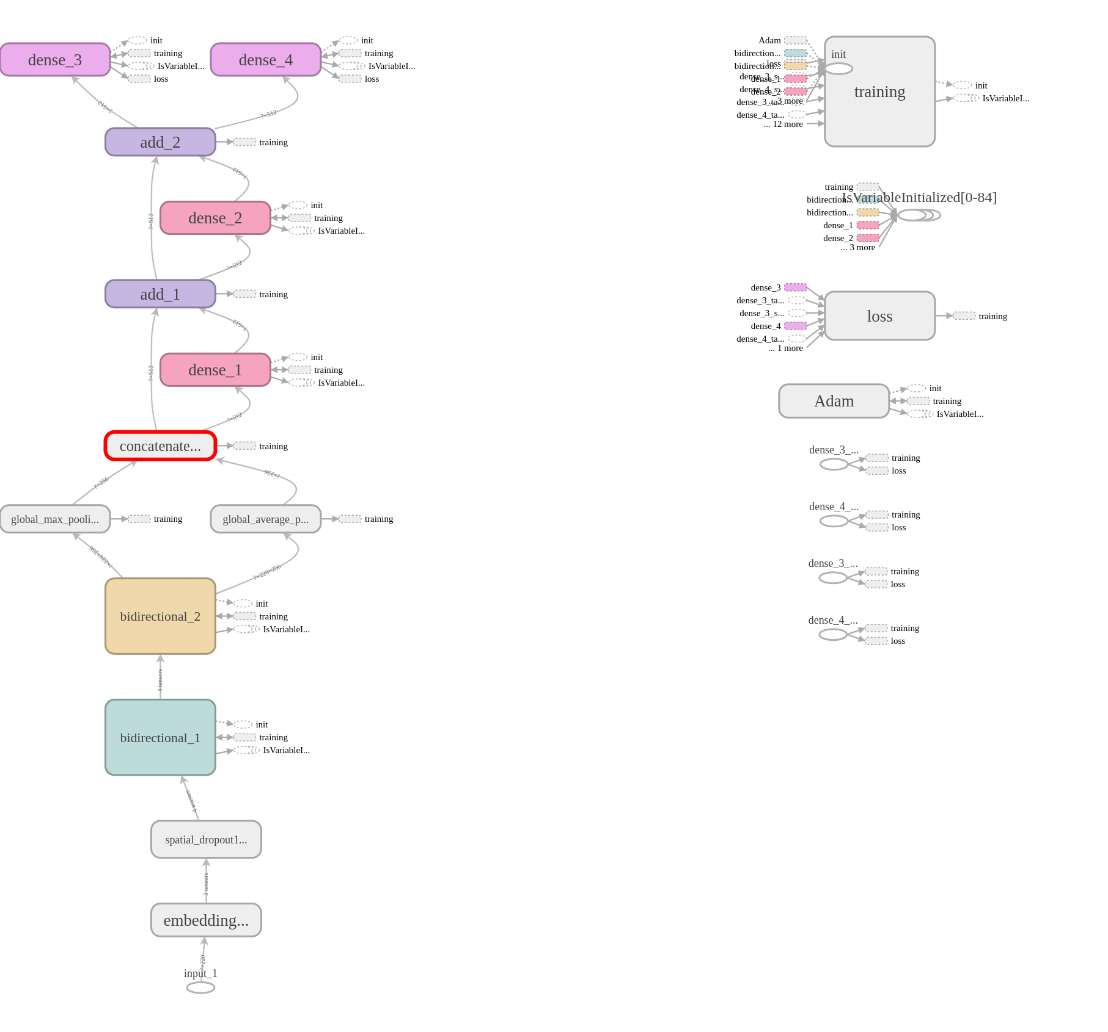

Slide 20
Experiments
Word embedding
Fasttext： 0.92870
Glove: 0.92783
Concatenate GloVe and Fasttext: 0.93010
BRNN cell choice
BGRU: 0.92943
BLSTM: 0.93010
BLSTM v.s. LSTM
BLSTM: 0.93010(Running for 7000s)
LSTM: 0.92821(Running for 3100s)

Slide 21
Experiments
merge_mode
Concatenate: 0.93010
Sum: 0.92836
Optimizer
Adam: 0.93010
Adadelta: 0.90783
Size of mini-batch
Mini-batch-1024 : 0.92825
Mini-batch-256: 0.93039
Mini-batch-512: 0.93010

Slide 22
Experiments
With spatial dropout or not
Without: 0.93095
With: 0.93010
Layer of BLSTM:
2 layers: 0.93010 (7000s)
3 layers: 0.92960 (9500s)
4 layers: 0.93043 (12000s)
Output of LSTM unit :
128: 0.93010
64: 0.92308

Slide 23
Thank You

