Slide 1
Threat Modeling Methodologies
STRIDE vs LINDDUN vs PASTA — applied to a multi-tenant SaaS web app
Case study: Worked Example 01 — Web Application (SaaS B2B)

Slide 2
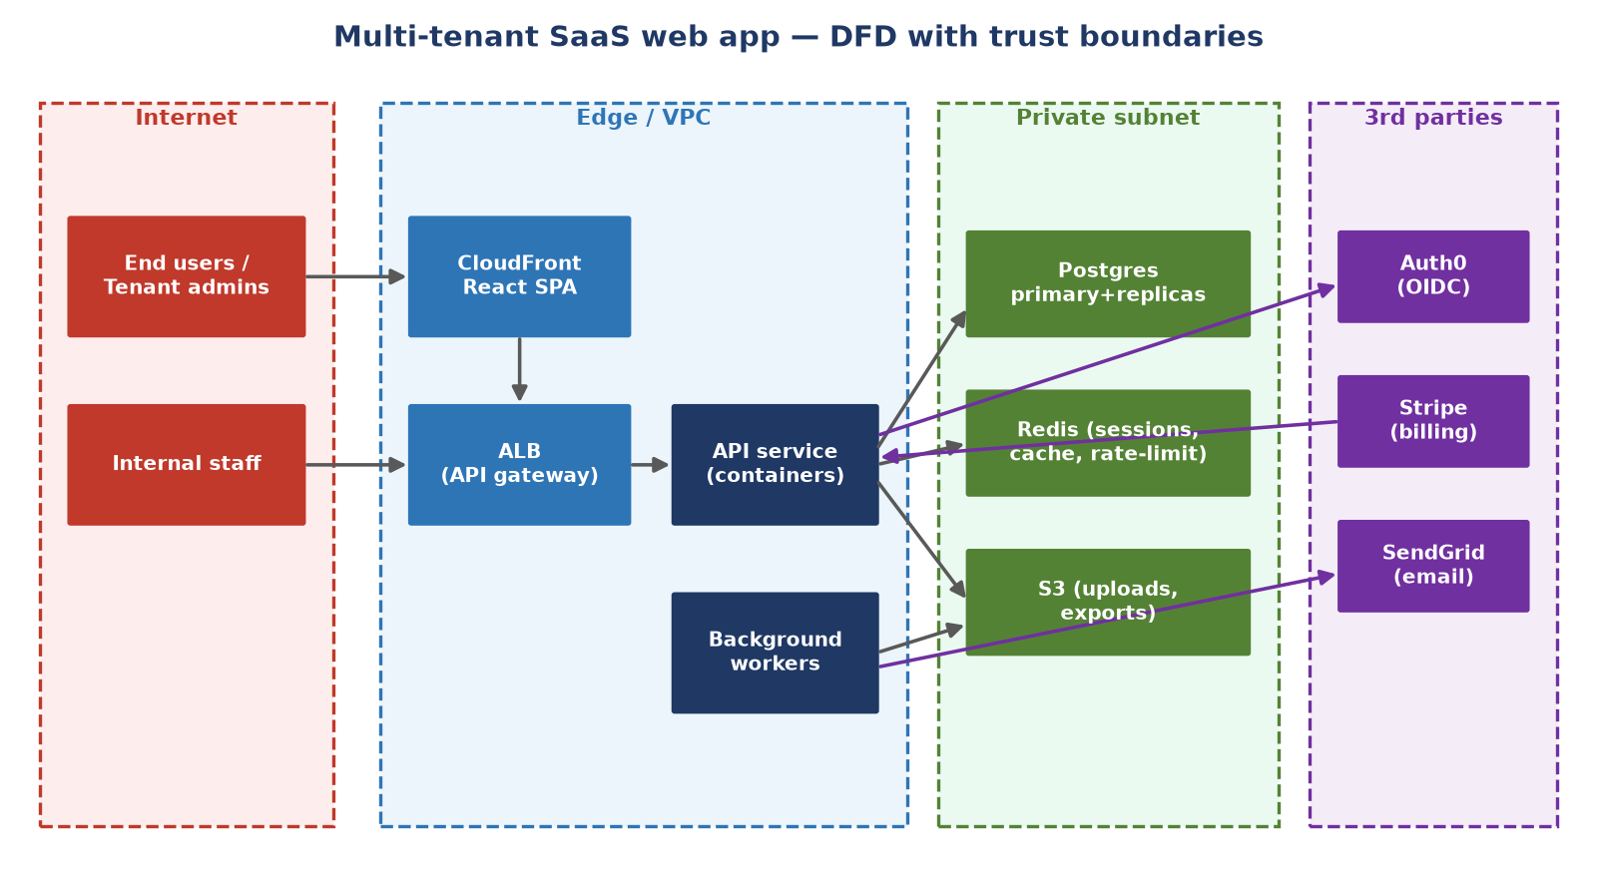
Our case study: a multi-tenant B2B SaaS web app
React SPA on CloudFront · REST API in containers behind ALB · PostgreSQL + Redis + S3 · Stripe, SendGrid, Auth0
Key trust boundaries: Internet↔Edge, VPC↔data stores, Tenant A↔Tenant B, user↔tenant admin↔internal staff

Slide 3
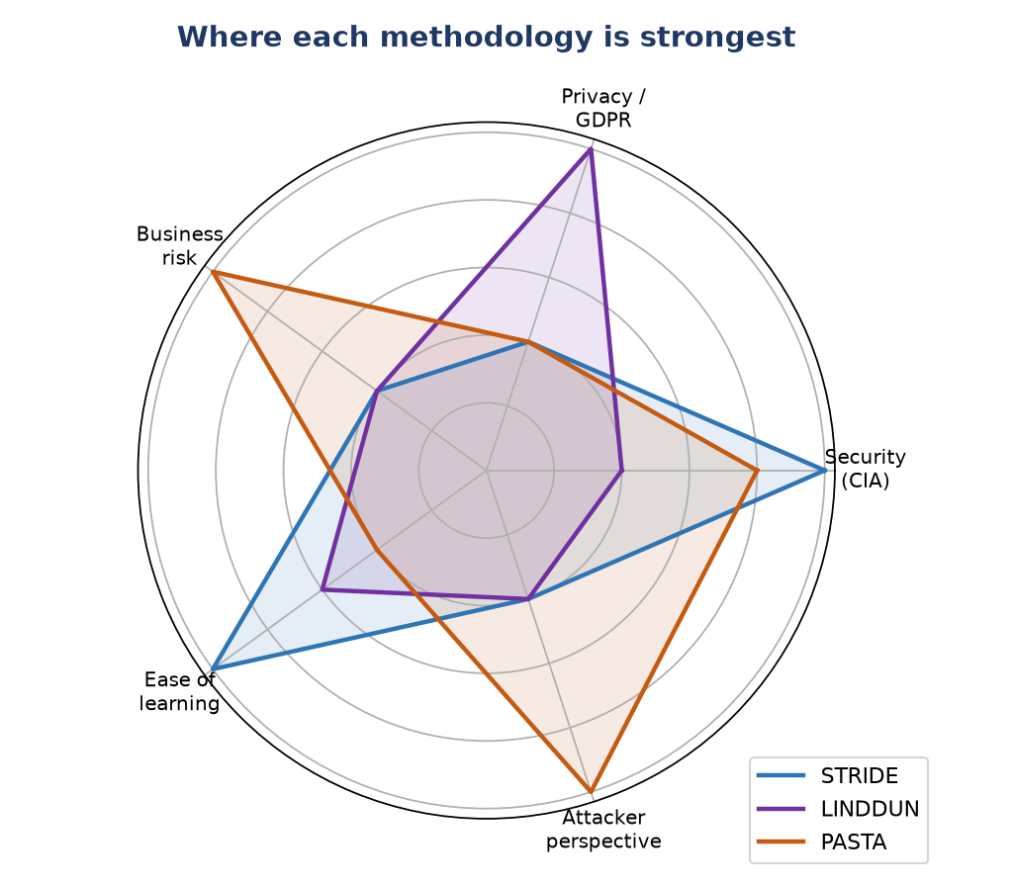
Three lenses on the same system
Threat modeling answers 4 questions:
  What are we building?
  What can go wrong?
  What are we doing about it?
  Did we do a good job?
Different methodologies answer “what can go wrong?” differently:
  STRIDE → security properties (attacker breaks CIA + AAA)
  LINDDUN → privacy of data subjects (GDPR-style harms)
  PASTA → business risk (what an attack costs us)

Slide 4
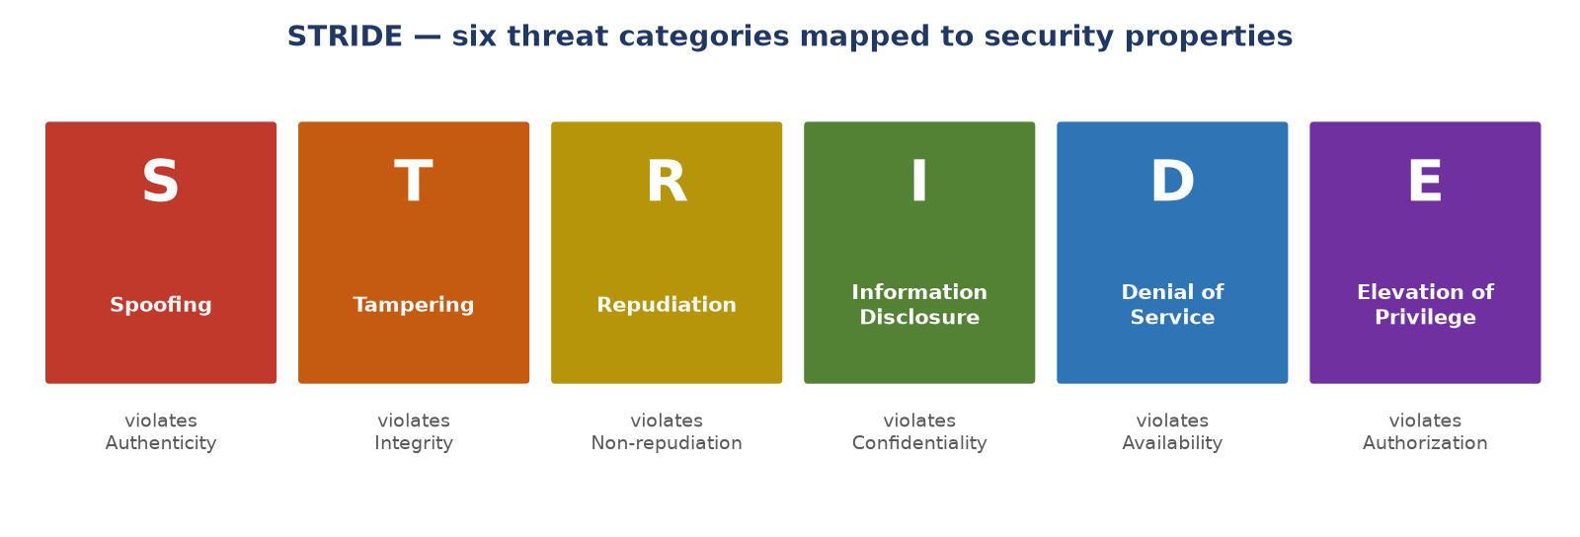
STRIDE — threat-centric, per-element security analysis
Origin: Microsoft. Walk every DFD element / trust boundary and ask which of the 6 categories applies
Best for: engineering teams doing design reviews; systematic coverage of technical threats
Output: a threat list per component, each mapped to a mitigation
Limitation: says little about privacy harms or business impact — a “low severity” leak may still be a GDPR fine

Slide 5
STRIDE applied to our SaaS app (selected threats)
Category | Threat found | Mitigation
S — Spoofing | Internal staff impersonating users for “support” | SCIM-managed admin roles + audit of impersonation events
T — Tampering | Stripe webhook tampering; mass assignment on billing endpoints | Signature verification on every webhook; DTO allowlists
R — Repudiation | Tenant admin disputes deletion of records | Immutable audit log + exports for tenant admins
I — Info disclosure | Cross-tenant data leakage via BOLA; leaked S3 export URLs | Postgres RLS + tenant_id checks + cross-tenant tests; signed URLs w/ 1h TTL
D — Denial of service | Expensive search endpoint; account-creation flooding | Per-tenant rate limits, query timeouts, complexity scoring, captcha
E — Elevation of privilege | User self-promoting to tenant admin / staff role | Strict RBAC; internal role only from internal IDP; approval flows

Slide 6
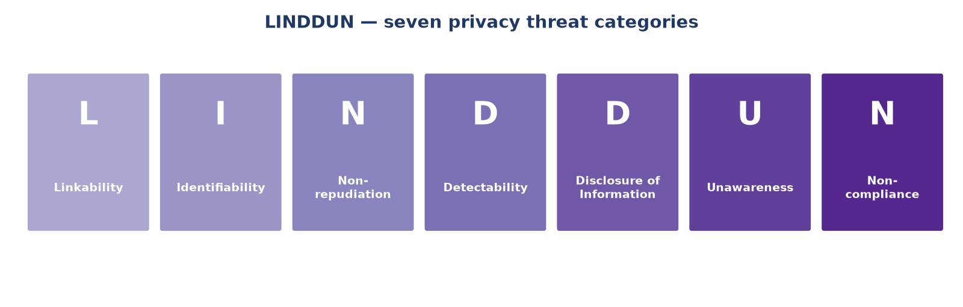
LINDDUN — privacy-centric threat modeling
Origin: KU Leuven. Focus on the data subject (the person), not the system owner
Best for: systems processing personal data; GDPR / privacy-by-design compliance work
Note the twist: Non-repudiation is a THREAT here (users may need deniability) — the opposite of STRIDE’s R!
Output: privacy threats per data flow, mapped to privacy-enhancing technologies (PETs)
Limitation: doesn’t cover classic security attacks or business risk prioritization

Slide 7
LINDDUN applied to our SaaS app (privacy highlights)
Linkability — same email in two tenants must NOT be linkable
  Kept as separate accounts; the tenant boundary is the privacy boundary
Identifiability — exports and logs can identify employees
  Tenant-scoped exports only; audit who exported what
Non-compliance — GDPR right to erasure
  Tenant-scoped delete with cascade across Postgres, Redis, S3 and backups
Disclosure of information — overlaps with STRIDE’s I, but viewed as harm to the person
  Cross-tenant leakage (BOLA) is both a security bug AND a privacy breach requiring notification
Unawareness — do employees know their employer’s admins can export their data?
  Data-subject access requests supported via tenant data export

Slide 8
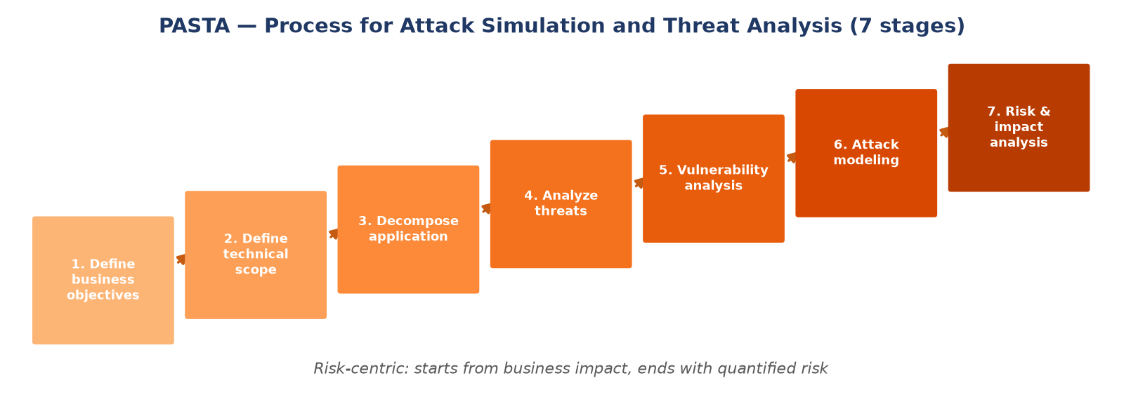
PASTA — risk-centric, attacker-driven, business-aligned
Origin: UcedaVélez & Morana. Seven stages from business objectives to quantified residual risk
Best for: mature organizations; aligning security spend with business impact; compliance evidence
Uses attack simulation: model realistic attacker paths (attack trees), not just categories
Limitation: heavyweight — needs threat intel, risk data and cross-team time; overkill for a single sprint review

Slide 9
PASTA applied to our SaaS app (stage walk-through)
1–2. Business objectives & scope: multi-tenant trust is the product — one cross-tenant leak can kill enterprise sales
3. Decompose: the DFD + trust boundaries we already drew
4. Threat analysis: who attacks a B2B SaaS? Competitors, malicious tenants, disgruntled staff, ransomware crews
5. Vulnerability analysis: BOLA on admin endpoints (missed by tests!), staging webhook secret in repo, DBA-writable audit log
6. Attack modeling: malicious tenant admin → enumerate object IDs → cross-tenant read → mass data exfiltration
7. Risk & impact: leak = breach-notification cost + churn + lost enterprise deals → justifies the top-5 mitigation budget:
  Automated cross-tenant BOLA regression tests
  Short-lived DB credentials via Vault
  Query complexity scoring · SCIM RBAC sync · signed-URL audit log

Slide 10
STRIDE vs LINDDUN vs PASTA — side by side
 | STRIDE | LINDDUN | PASTA
Focus | Security properties (CIA+AAA) | Privacy of data subjects | Business risk & attacker simulation
Question asked | How can each component be attacked? | How can personal data be misused? | What would a real attack cost us?
Categories / stages | 6 threat categories | 7 privacy threat categories | 7 process stages
Perspective | Defender / engineer | Data subject (the person) | Attacker + business
Effort | Low–medium; per design review | Medium; needs data-flow detail | High; cross-team, needs threat intel
Best output for our app | BOLA, webhook tampering, rate-limit gaps | Tenant linkability, erasure, export awareness | Prioritized budget: which 5 mitigations to fund first
Use when | Designing/reviewing features | Handling personal data / GDPR | Justifying security investment

Slide 11
Takeaways — they complement, not compete
Same system, three different threat lists — none is “wrong”
  STRIDE found BOLA & webhook tampering
  LINDDUN found tenant linkability & erasure gaps
  PASTA told us which fixes to fund first
Practical recipe for a SaaS team:
  STRIDE on every significant design change
  LINDDUN pass whenever personal data flows change
  PASTA-style risk review yearly / before big launches
Pitfalls from the case study:
  Cross-tenant tests only ran as standard user — admin endpoints missed
  Correct webhook verification, but secret checked into repo
  “Immutable” audit log was writable with DBA credentials

Slide 12
Appendix
Content link
Microsoft Threat Modeling Tool overview - Azure | Microsoft Learn
Threat Modeling Process (Historical) | OWASP Foundation
Tool link
Threat Modeling Tool
OWASP Threat Dragon | OWASP Foundation

