Slide 1
Threat Modeling Worksheets
Seven methodologies, one toolbox: STRIDE · LINDDUN · PASTA · Attack Trees · DFD
· Trust Boundaries · Abuse Cases
With pictures — what each one is, when to use it, and what to watch out for

Slide 2
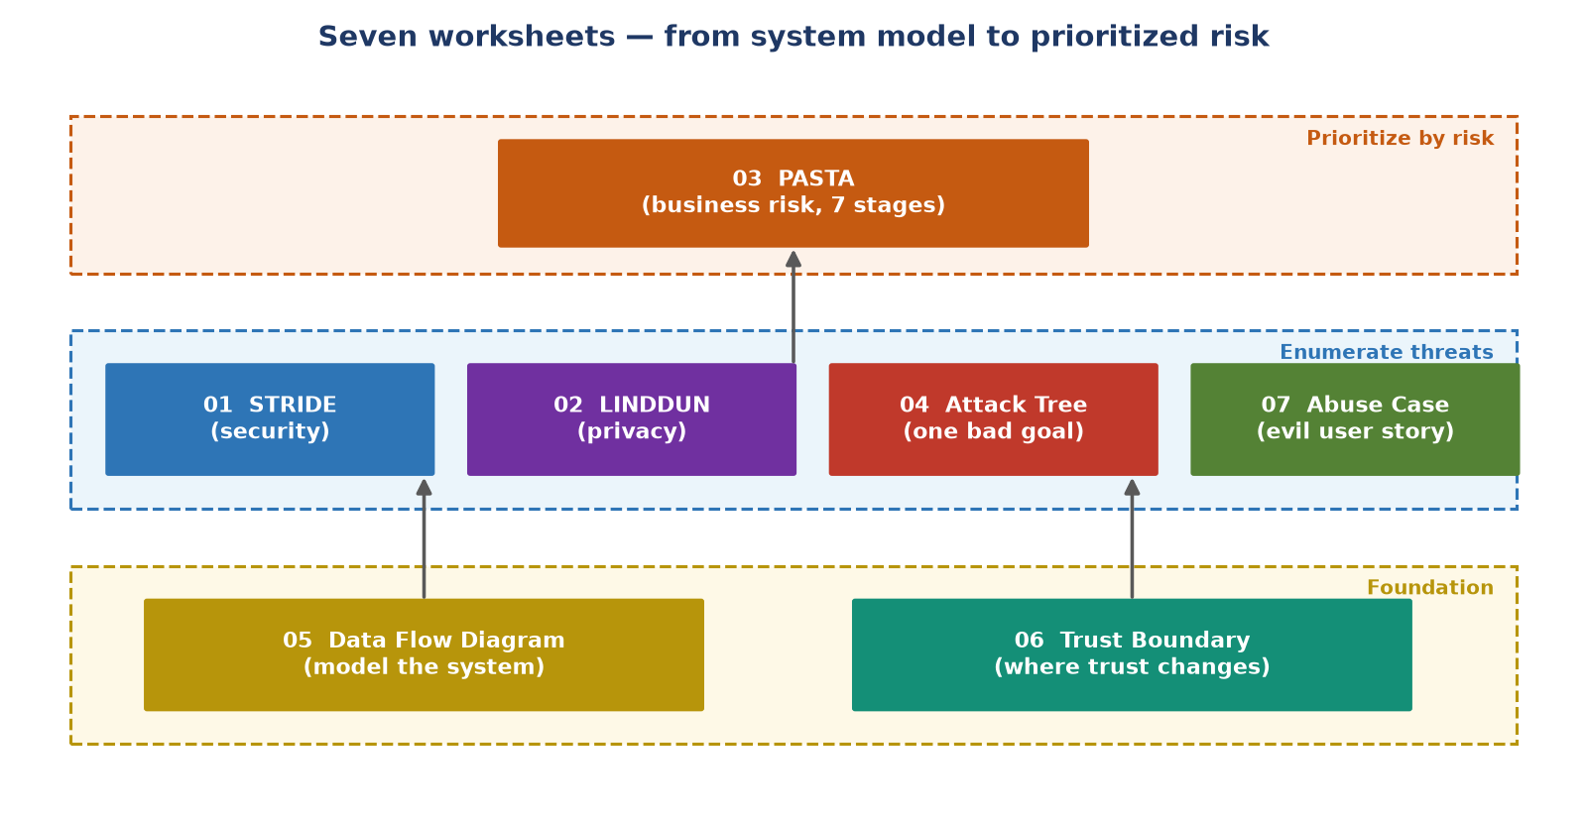
The big picture — how the seven worksheets fit together
Model first (DFD + trust boundaries) → enumerate threats (STRIDE / LINDDUN / attack trees / abuse cases) → prioritize by business risk (PASTA)

Slide 3
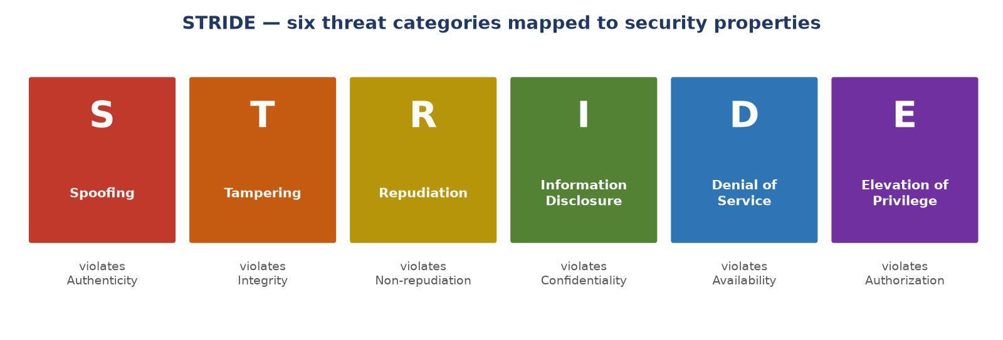
01 · STRIDE — per-component security threats
How: for every DFD element (process, store, flow, external entity), walk all six categories and record threats
Each threat gets an entry: ID, likelihood, impact, existing controls, gaps, mitigation plan, owner, status
Best for: engineering design reviews — systematic coverage of generic systems
Pitfall: mechanical checkbox filling — “no threat here” without actually thinking

Slide 4
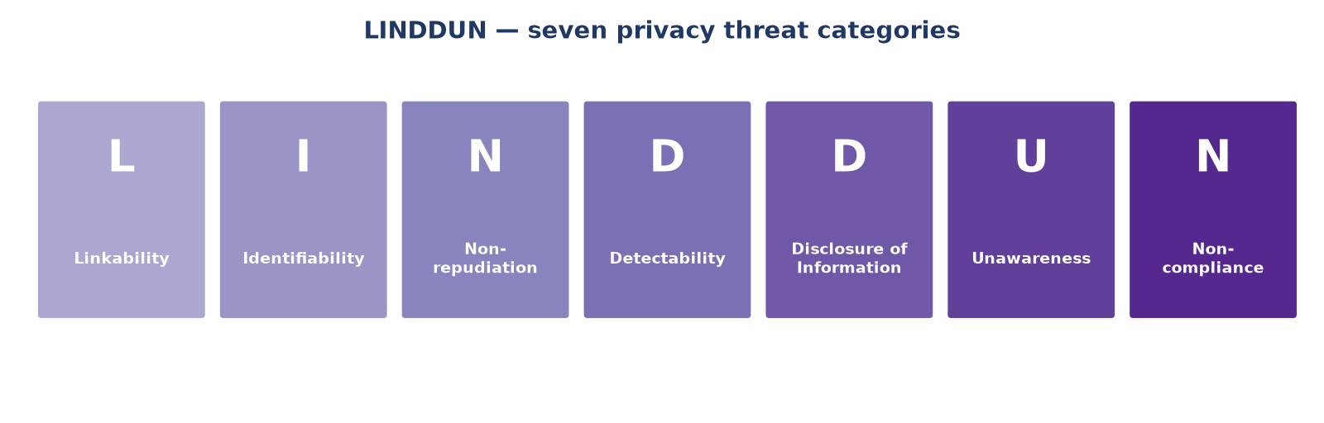
02 · LINDDUN — privacy threats to the data subject
Focus on the person whose data you hold, not the system owner — use when PII handling is core
Scope includes: personal data categories, lawful basis (GDPR), and who the data subjects are
The twist: Non-repudiation is a THREAT here — over-logging can destroy a user's ability to deny
Pitfall: quasi-identifiers (zip + birth date + gender) re-identify “anonymized” data

Slide 5
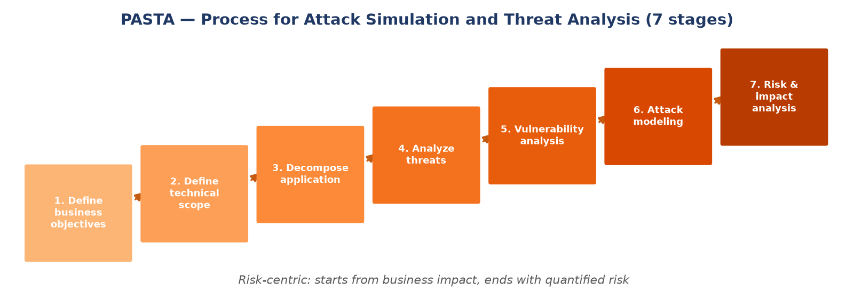
03 · PASTA — risk-centric, business-aligned, 7 stages
Starts from business objectives, ends with quantified residual risk and signed-off accepted risks
Uses threat actor profiles (MITRE ATT&CK), CVE/SAST findings, and attack modeling to find chokepoints
Best for: high-stakes systems where you need leadership to fund mitigations
Pitfall: heavyweight — needs threat intel and cross-team time; overkill for a sprint review

Slide 6
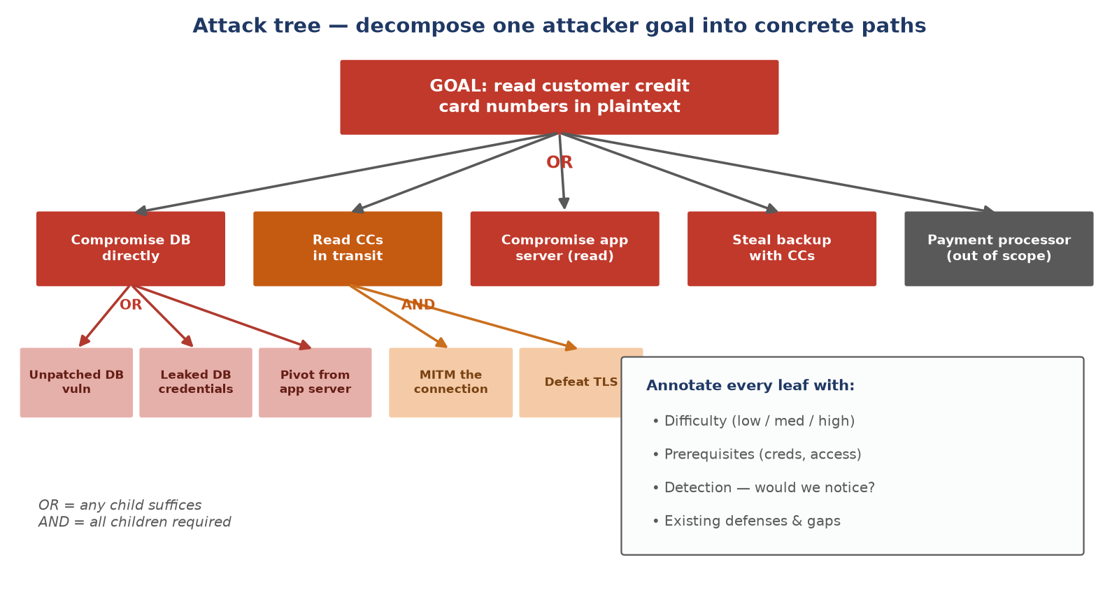
04 · Attack tree — decompose one attacker goal
Make the goal specific (“read credit card numbers”, not “compromise the system”) · chokepoints where paths converge are high-value to harden

Slide 7
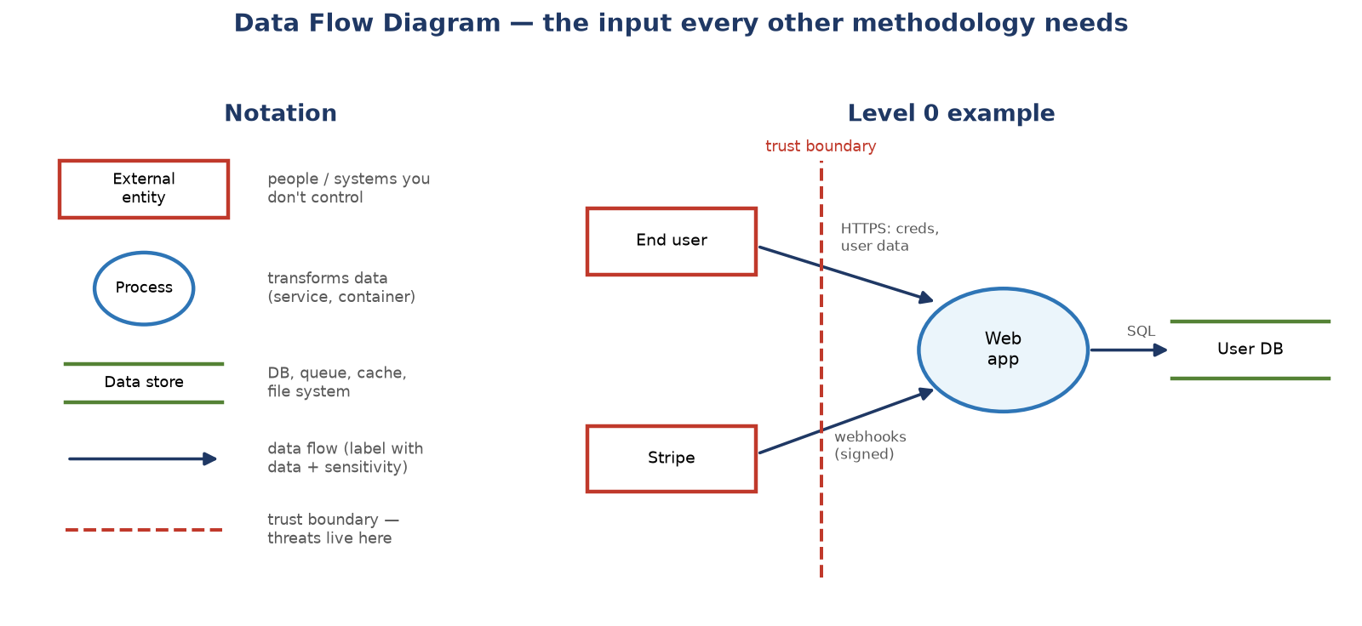
05 · Data flow diagram — the foundation document
Level 0 (context) → Level 1 (major processes) → Level 2+ until each leaf is well-understood
Label every flow: data type, sensitivity, authentication, transport security — get this right and STRIDE/LINDDUN become tractable

Slide 8
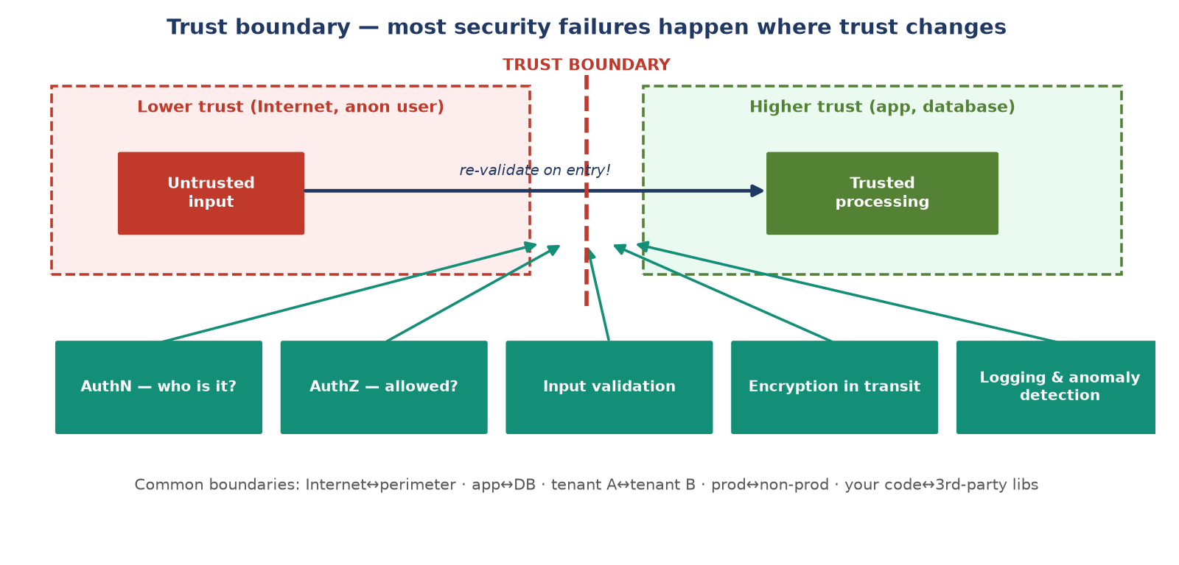
06 · Trust boundary — where the trust level changes
Per boundary, document: authN/authZ, input validation, encryption, logging — data trusted on one side must be re-validated on the other

Slide 9
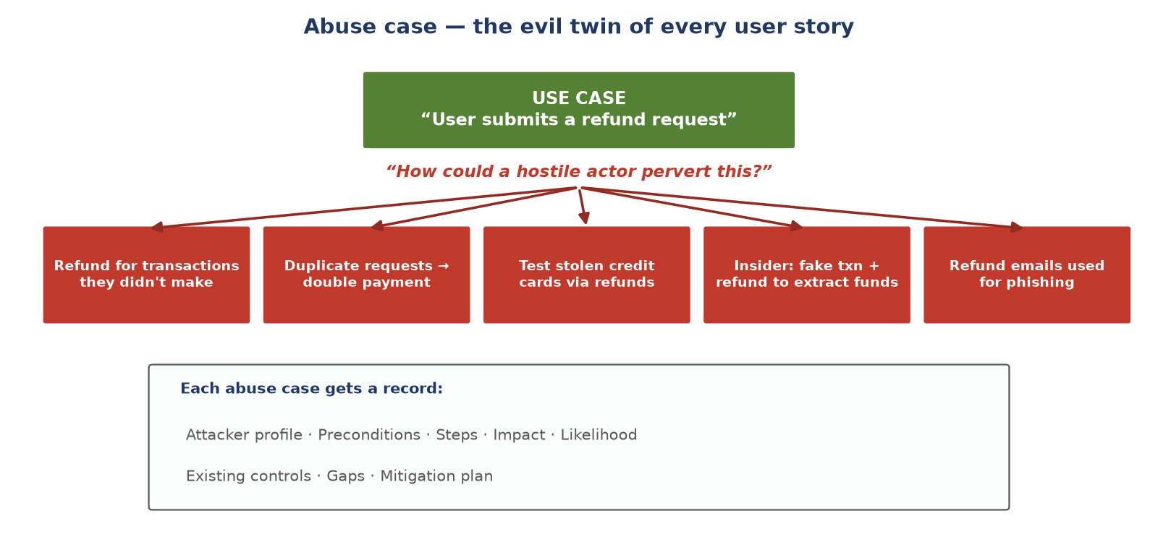
07 · Abuse case — the evil twin of user stories
Fits agile teams that already write user stories — write the abuse case next to the use case in the same design doc
Reusable patterns per feature type: registration (bot signup), login (credential stuffing, MFA fatigue), password reset (token reuse), search (resource exhaustion)

Slide 10
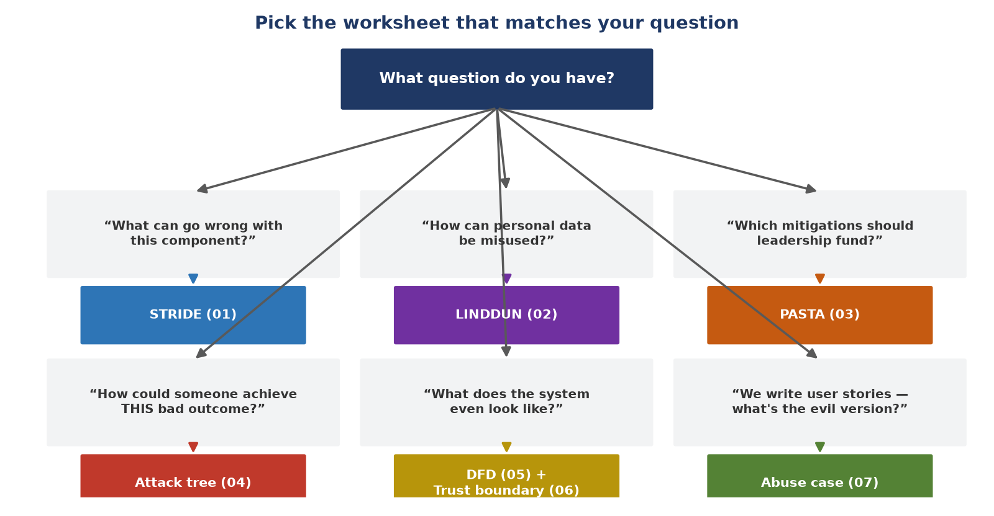
Which worksheet do I reach for?

Slide 11
All seven at a glance
Worksheet | Focus | Output | Effort
01 STRIDE | Security properties per component | Threat list + mitigations per element | Low–med
02 LINDDUN | Privacy of data subjects (GDPR) | Privacy threats mapped to PETs | Medium
03 PASTA | Business risk, attacker simulation | Quantified, prioritized risk register | High
04 Attack tree | One specific attacker goal | AND/OR paths + annotated leaves | Low–med
05 DFD | Modeling the system itself | Leveled diagrams + labeled flows | Low
06 Trust boundary | Where trust levels change | Per-boundary control checklist | Low
07 Abuse case | Hostile use of legitimate features | Abuse cases beside user stories | Low

Slide 12
Takeaways
1. Always start with a DFD and trust boundaries — every other worksheet consumes them
2. Pick the methodology that matches your question, not the most famous one
  STRIDE for components · LINDDUN for privacy · attack trees for one bad outcome · abuse cases for agile teams · PASTA for funding decisions
3. A threat without an owner, status, and mitigation plan is just a worry
4. Worksheets don't prevent pitfalls — mechanical checkbox filling defeats all of them
5. Revisit the model when the architecture changes — a threat model is a living document
Worked examples in this repo: web app · mobile app · ML pipeline · IaC pipeline · IoT device

