Slide 1
mWork: Med-Fi Prototyping
October 31st, 2014 | CS147 HCI + D
Lea Coligado | Design + Development
Andrea Sy | Managment + Design
Allen Yu | Documentation + User Testing
John Yang-Sammataro | Development + Management

Slide 2
Overview
Tasks & Changes
Revised UI Design and Rationale
Scenarios
What Worked
What Didn’t
Summary

Slide 3
Representative Tasks
Complex, Moderate, Simple

Slide 4


Slide 5
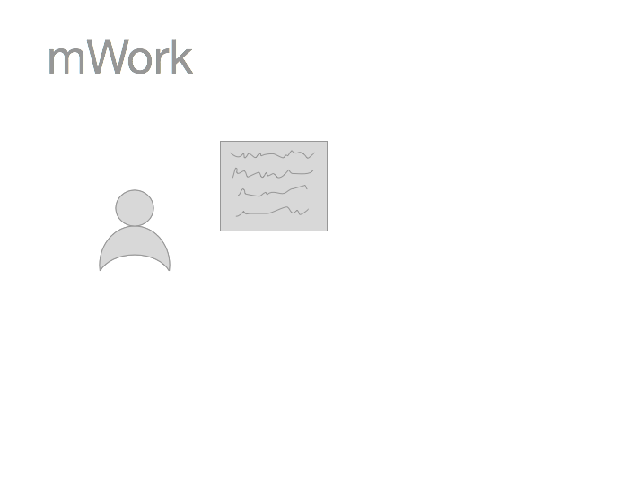

Slide 6
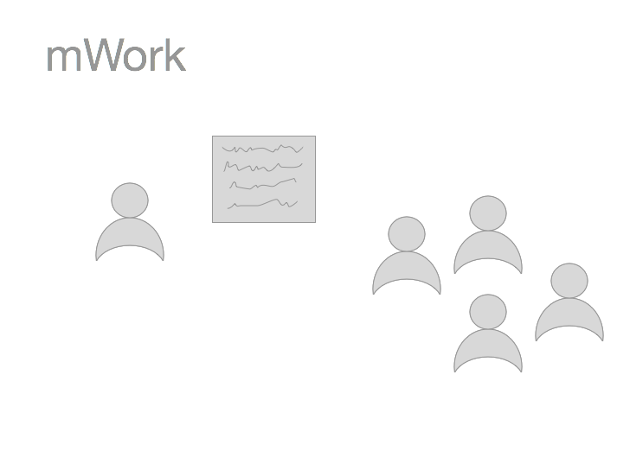

Slide 7


Slide 8
Matching client tasks to workers (moderate)
Notes:
Key Change: Decided to contextualize the way we match clients to tasks -- that is, give them the ability to “personalize” the task based on where they are

Slide 9
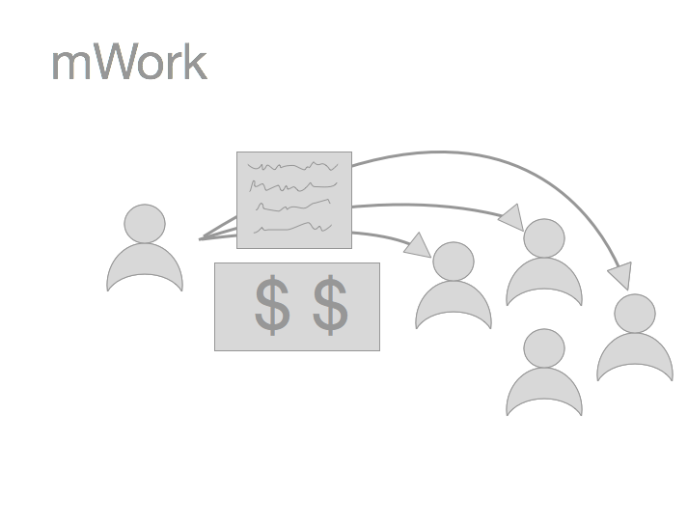

Slide 10
Paying users (client) cashing out (workers) (both complex)
Notes:
Key Change: Make the process of cashing out with multiple vendors more streamlined

Slide 11
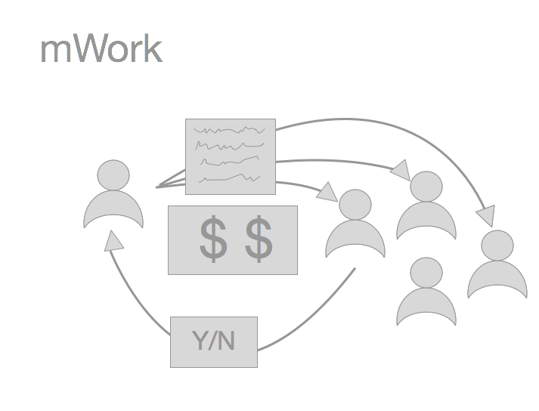
Categorizing content (simple)
Notes:
Key Changes: Not much changed -- swiping to categorize pictures is pretty straightforward. But there are other types of tasks -- text-entry, free-response, surveys, free-form, etc.

Slide 12
Tasks
Categorizing content (simple)
Matching clients to workers (moderate)
Payments (complex)

Slide 13
UI Changes
Footer Menu
Added text
Payment
Abstraction into its own tab
Task Menu
Divided by function → by time → by clarified function/context
Less options

Slide 14
Problem | Location | Severity Rating | Possible Fix | Task Number
Cannot login because user does not have an email account and doesn’t use computers often. | Signup / Login | 4 | Refocus and redefine our target audience to ones with access to email and online payment | 1
Thinks first intro screen is confusing | Signup / Login | 0 | Linear flow with only one option may be better | 1
User tries to go backward by clicking on the checkbox on the bottom right corner | Task Page | 1 | Have clearly labeled text-based buttons instead of symbols | 2
User has not heard of bitcoin | Payment | 2 | Make sure to educate the user through an initial tutorial. Even if they do not use bitcoin they can use the bank account option. | 3
User thought linking to bank account was confusing | Payment | 3 | Make flow easier to understand by having clear directions | 3
Notes:
2 min!
We have a variety of problems of varying severity, according to our test users

Slide 15
Problem | Location | Severity Rating | Possible Fix | Task Number
Cannot login because user does not have an email account and doesn’t use computers often. | Signup / Login | 4 | Refocus and redefine our target audience to ones with access to email and online payment | 1
User is confused about what certain task icons mean | Task Page | 2 | Simpler and less task icons | 2
User tries to go backward by clicking on the checkbox on the bottom right corner | Task Page | 1 | Have clearly labeled text-based buttons instead of symbols | 2
User has not heard of bitcoin | Payment | 2 | Make sure to educate the user through an initial tutorial. Even if they do not use bitcoin they can use the bank account option. | 3
User thought linking to bank account was confusing | Payment | 3 | Make flow easier to understand by having clear directions | 3
Notes:
Some of these were not fixable via UI changes -- they were situational issues that went back to the users’ socioeconomic background, their availability of technology, etc.

Slide 16
Problem | Location | Severity Rating | Possible Fix | Task Number
Cannot login because user does not have an email account and doesn’t use computers often. | Signup / Login | 4 | Refocus and redefine our target audience to ones with access to email and online payment | 1
User is confused about what certain task icons mean | Task Page | 2 | Simpler and less task icons | 2
User tries to go backward by clicking on the checkbox on the bottom right corner | Task Page | 1 | Have clearly labeled text-based buttons instead of symbols | 2
User has not heard of bitcoin | Payment | 2 | Make sure to educate the user through an initial tutorial. Even if they do not use bitcoin they can use the bank account option. | 3
User thought linking to bank account was confusing | Payment | 3 | Make flow easier to understand by having clear directions | 3
Notes:
The ones UI *can* fix I will pertain to the task menu, to the footer bar, and to the payment process

Slide 17
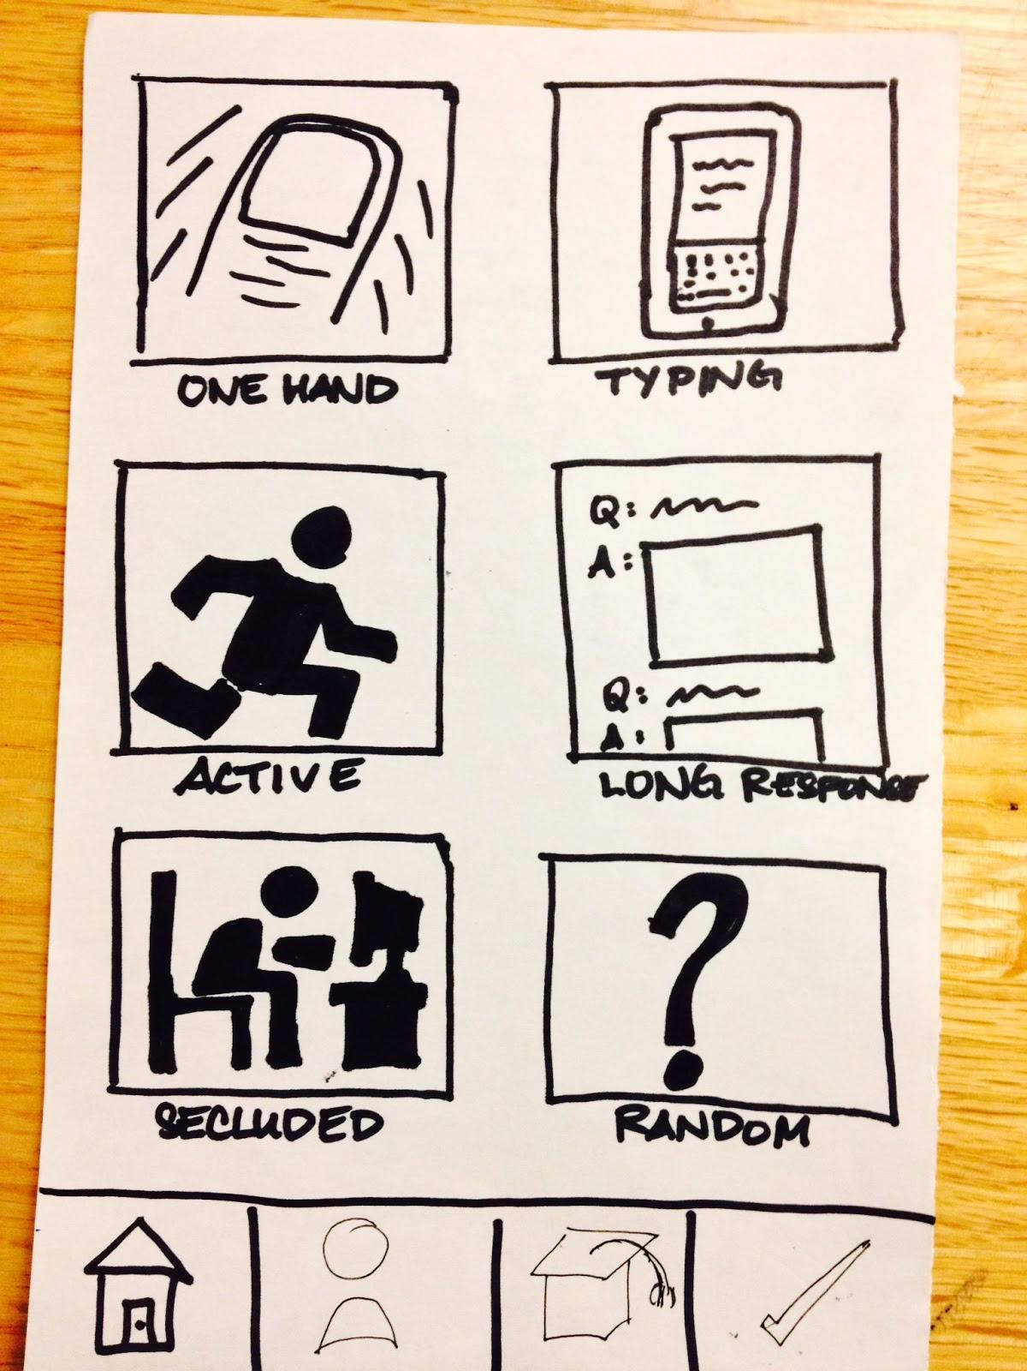
Footer Menu: Before
Notes:
What does the checkmark do?

Slide 18
Footer Menu: Before
Notes:
What does this hat do?

Slide 19
Footer Menu: Before
Notes:
Account information -- the user’s profile (analytics) and payment

Slide 20
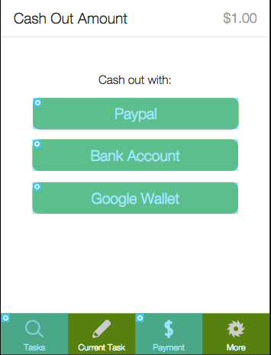
Footer Menu: After
Notes:
Modeled after Facebook’s footer menu. Reflects the primary tasks of our app.

Slide 21
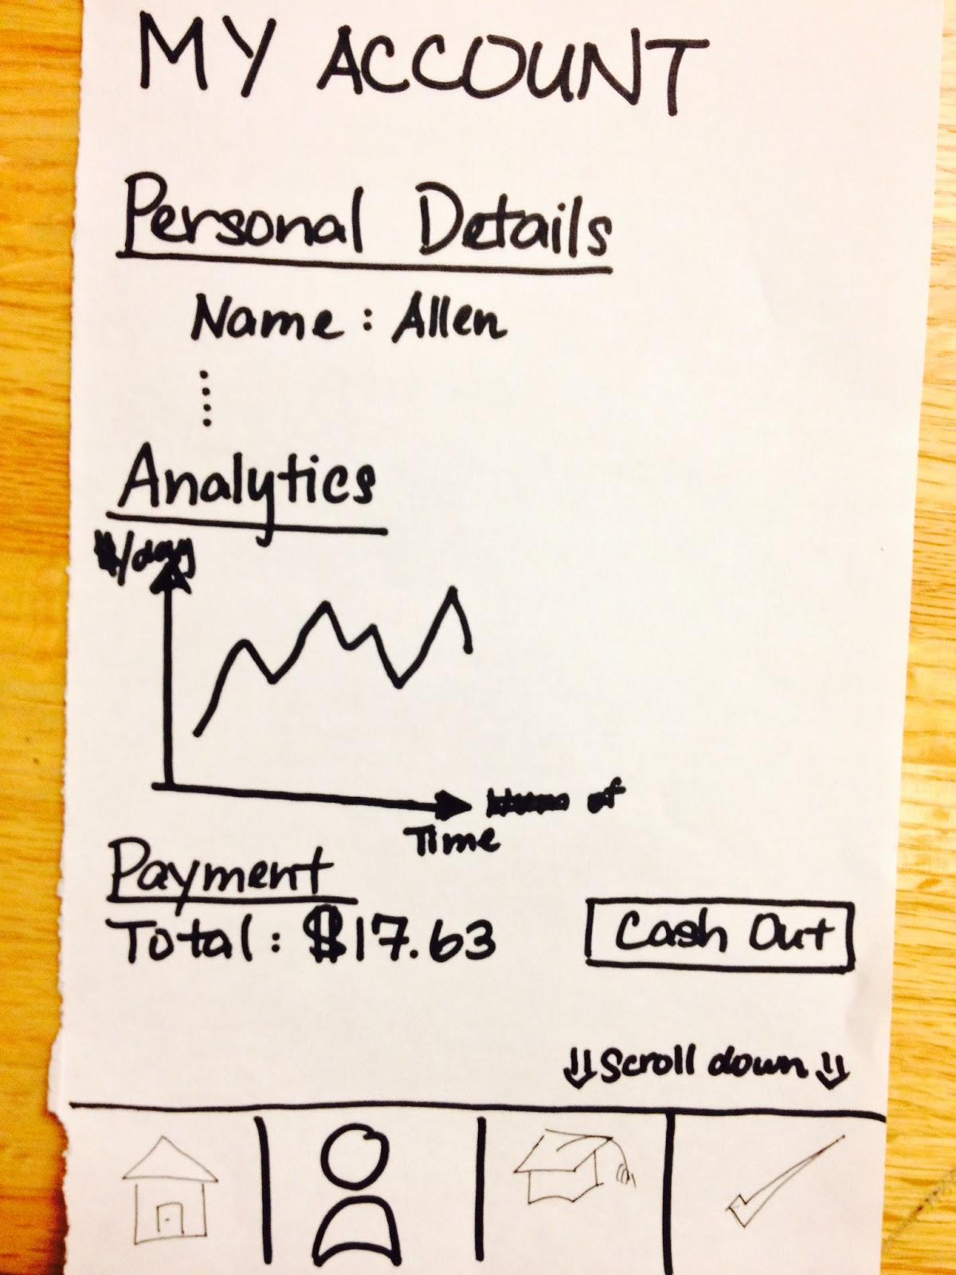
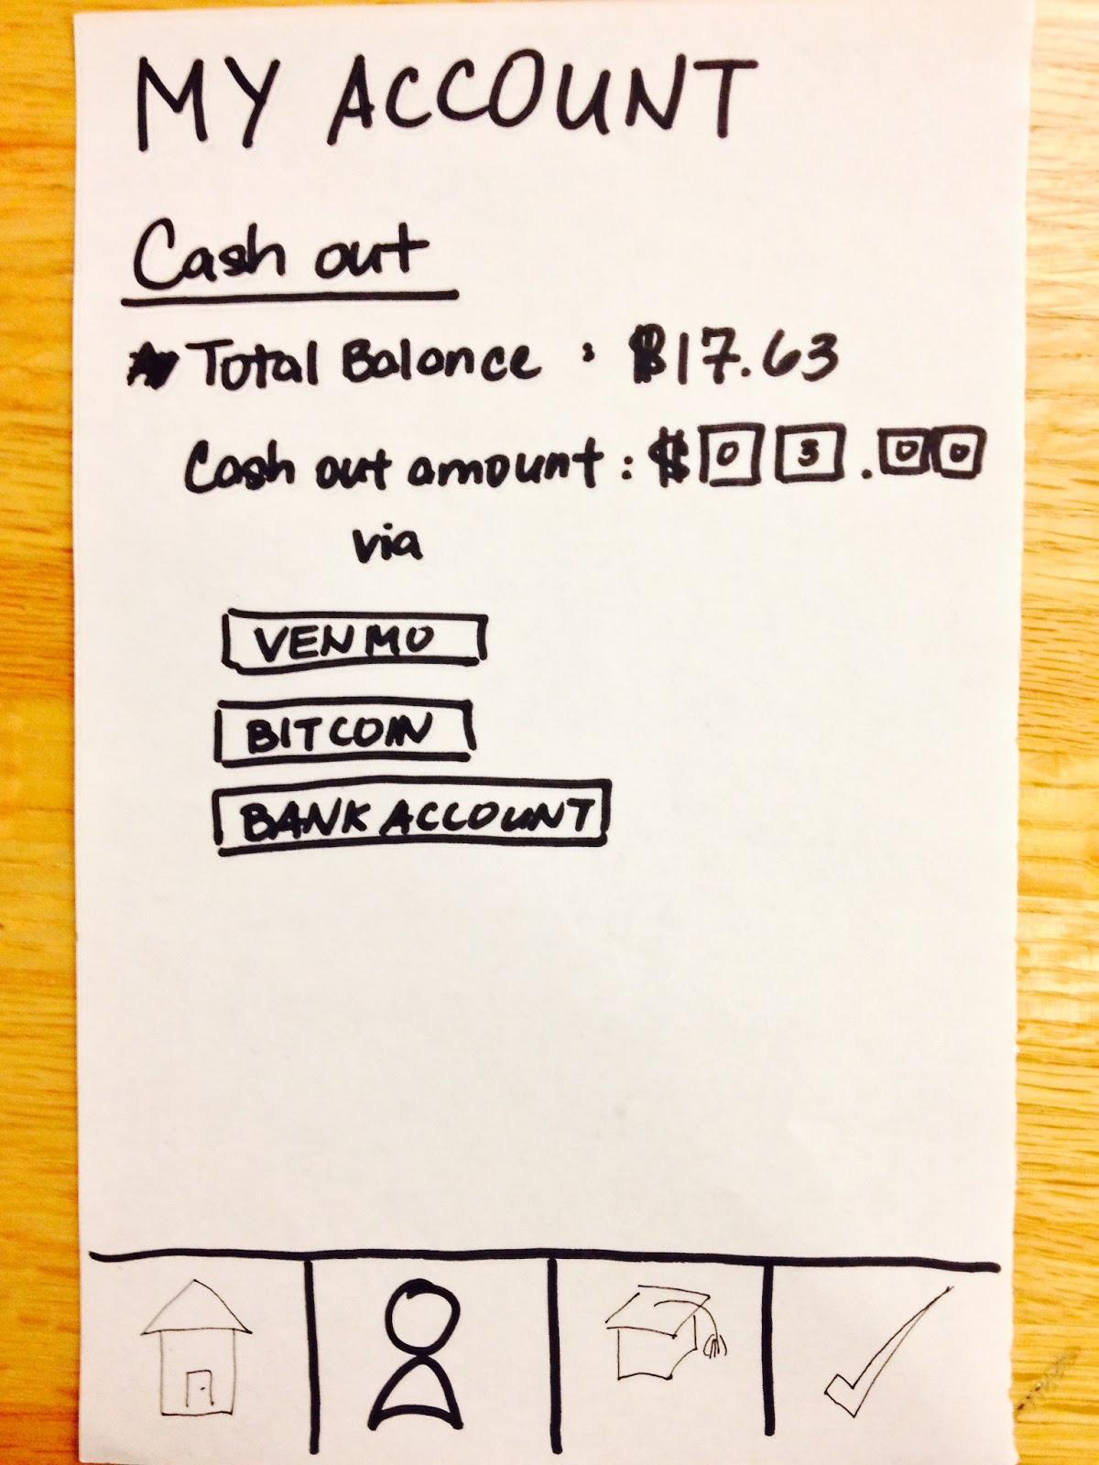
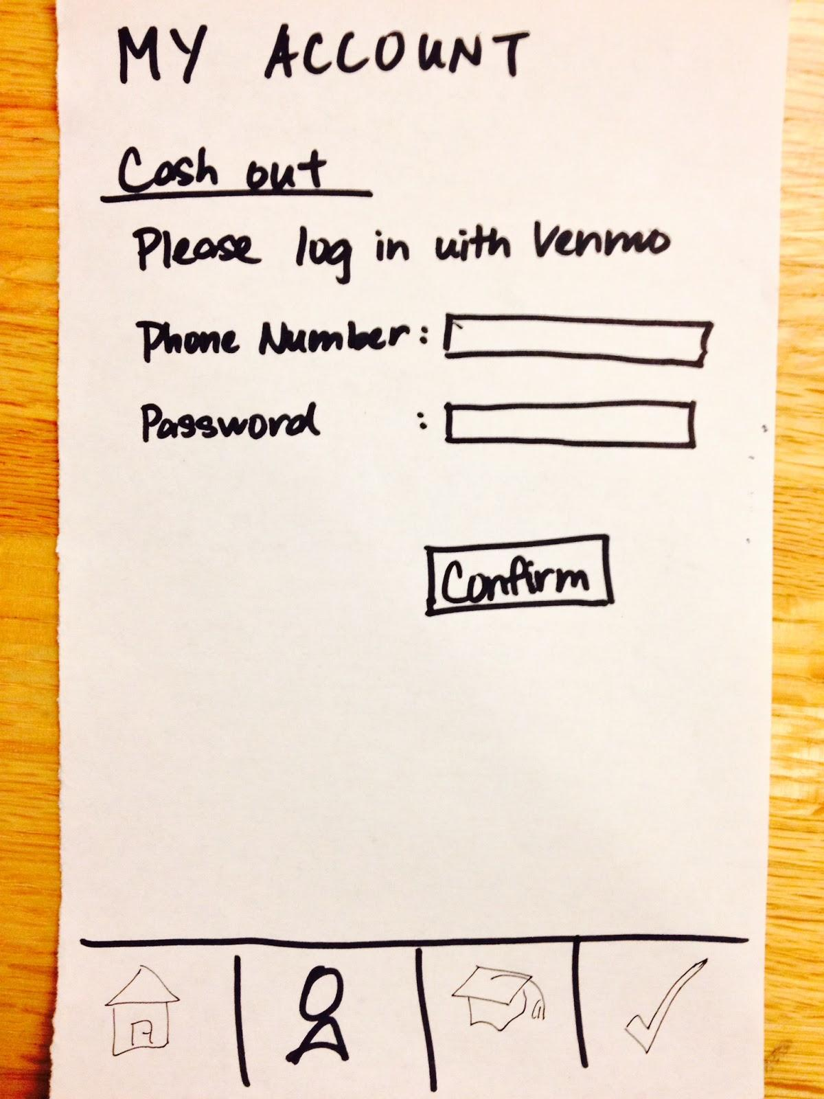
Payment Information: Before
Notes:
All clustered under the “My Account tab” -- not clear about how to cash out if all this functionality is nested under one tab

Slide 22
Payment Information: Before
Notes:
All clustered under the “My Account tab” -- not clear about how to cash out if all this functionality is nested under one tab

Slide 23
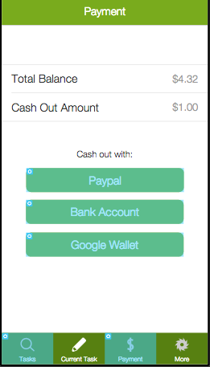
Payment Information: After
Notes:
We abstracted all of the Payment process into its own tab, because it’s so important. We give three options for them to cash out with. Total Balance/Cashout modeled after VenMo.

Slide 24
Task Menu: Before
Notes:
4 min
Icons unclear
What is one hand? (Supposed to be short tasks that require only one hand like swiping)

Slide 25
Task Menu: Before

Slide 26
Task Menu: Before
?
Notes:
What is the difference between typing and long response? Both involve typing? (Typing supposed to be shorter.)

Slide 27
Task Menu: Before
Notes:
Confusion among users what secluded means (it’s for longer tasks that require some quiet, focused space)

Slide 28
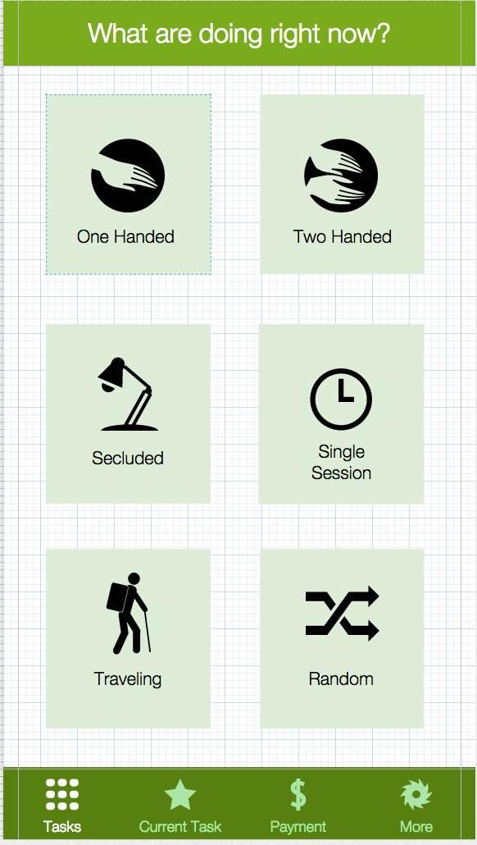
Task Menu: After
Notes:
Very contextualized -- we match users with tasks based very much on the context in which they are. We rule out icons that seem ambiguous or overlapping
No more active,
Single session -- can’t pause (psych surveys)

Slide 29
Med-Fi Prototype
Notes:
6 min

Slide 30
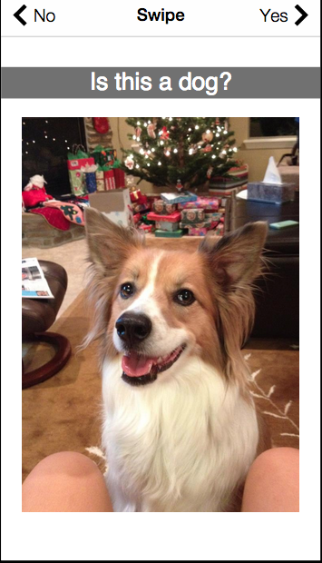
Categorization

Slide 31
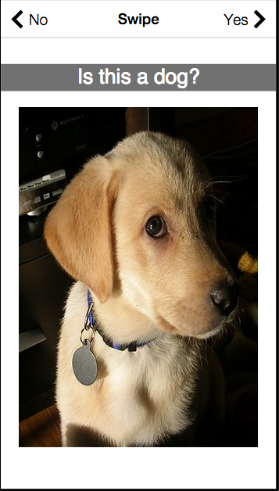
Categorization

Slide 32
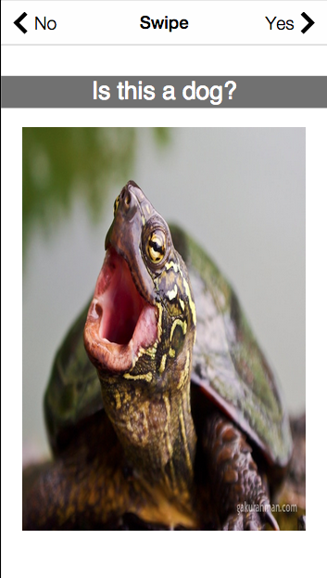
Categorization

Slide 33
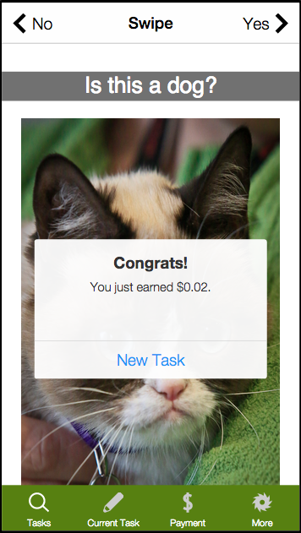
Categorization

Slide 34
Matching users with a task
Notes:
7 min

Slide 35
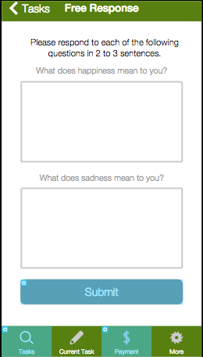
Matching users with a task
Notes:
7 min

Slide 36
Matching users with a task
Notes:
7 min

Slide 37
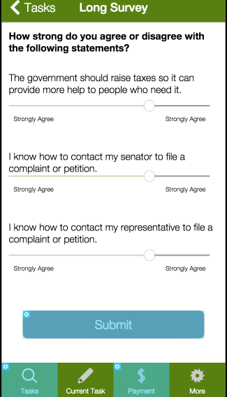
Matching users with a task
Notes:
7 min

Slide 38
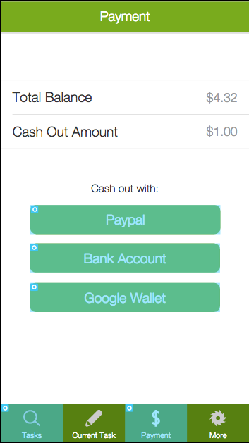
3. Payment

Slide 39
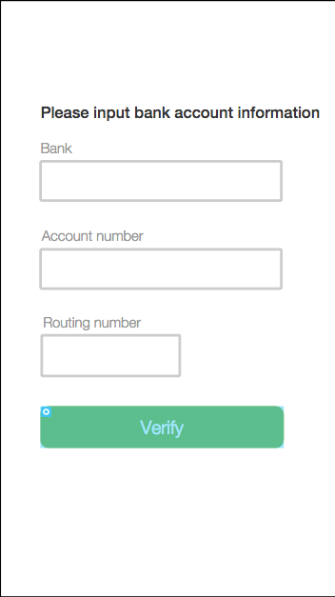
3. Payment

Slide 40
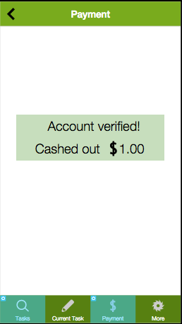
3. Payment

Slide 41
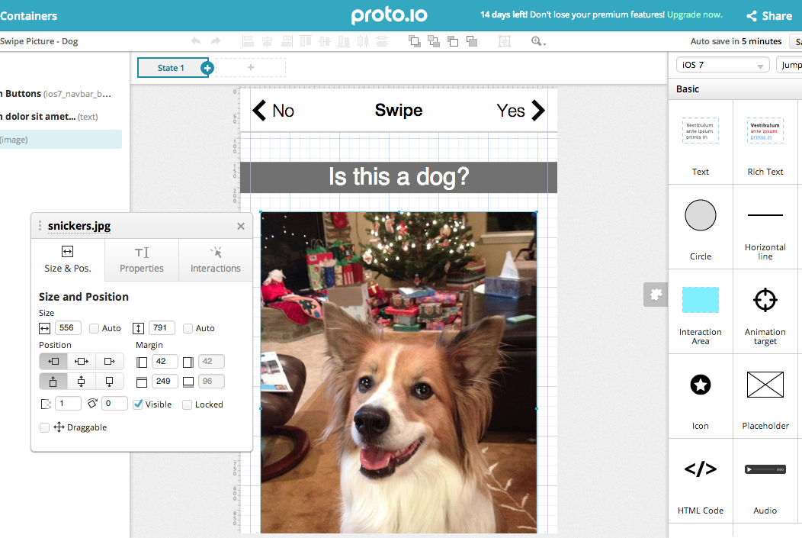
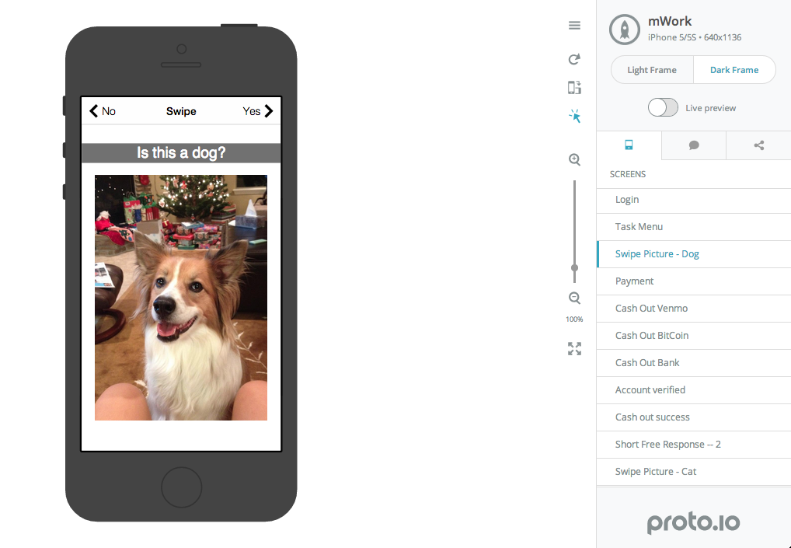

Tools

Slide 42
What Did Work?
Proto.io interface design visually pretty
More believable prototype
Forced us to get down to the details
Notes:
Proto.io is pretty!

Slide 43
What Didn’t Work?
Clunky web interface
Freezes
Collaboration doesn’t work!?!
Corrupted save files
Lower medium-fi prototype with HTML, CSS, JavaScript?
Tradeoffs between visual polish and interactive completeness
Notes:
The web interface is really clunky (zooming, Cmd+C doesn’t always work, shift to select multiple items is non-existent)
Collaboration corrupts files if you are both trying to edit anything
Lower medium-fi prototype using JS and HTML might have been faster and rougher
Still don’t have any backend functionality

Slide 44
WoZ Techniques (& Additional Tradeoffs)
Proto.io conditional form support
No validation for reasonable answers
Backend is non existent
Only a few example tasks - inefficient to make more
Notes:
Forms on sign up Proto.io are not checked
No validation for reasonable answers on Proto.io

Slide 45
In Summary
Tasks: categorization, task matching, payments
Valuable UI feedback from low-fi prototype
Abstracting each of these tasks into its own tab
Making icons clear and distinct
Streamlining the flow of each process

Slide 46
Thank you!

