Slide 1

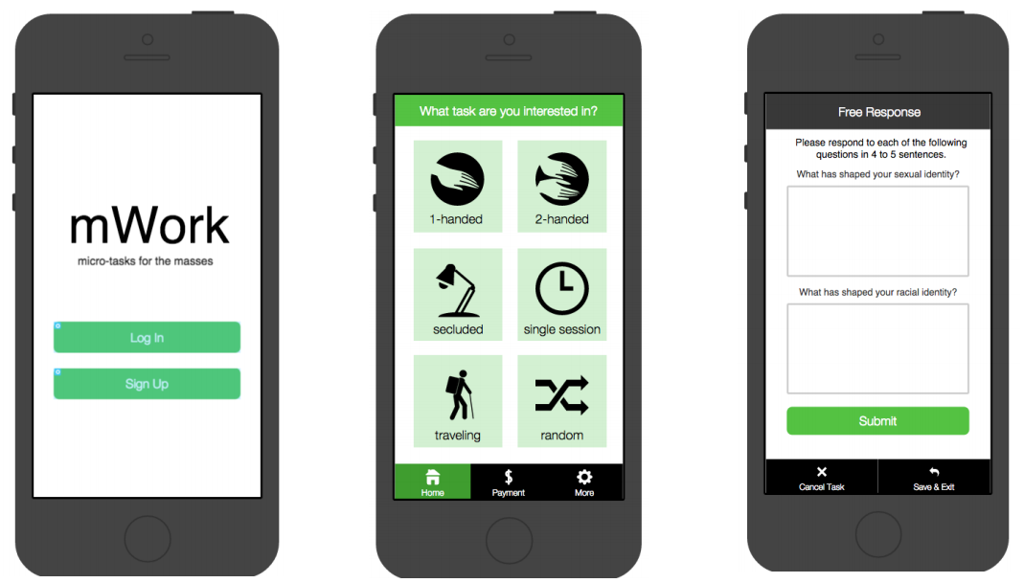
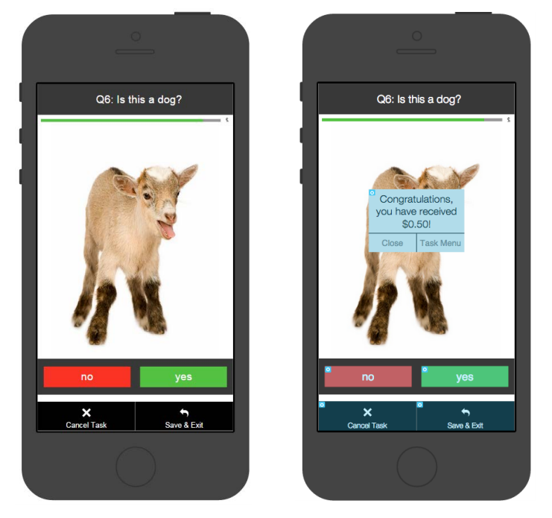
mWork
Re-imagining Mobile Work for the Masses
Be matched with a task on the go
Complete a task for a small reward
anyone can work from anywhere
by completing human-intelligent microtasks for small payments
and all you need is a smartphone

