Slide 1

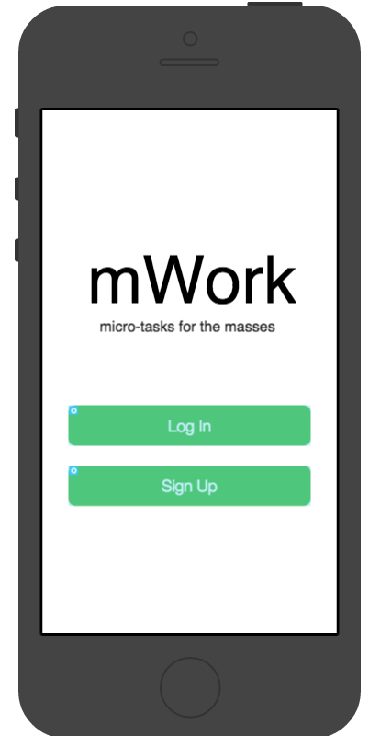
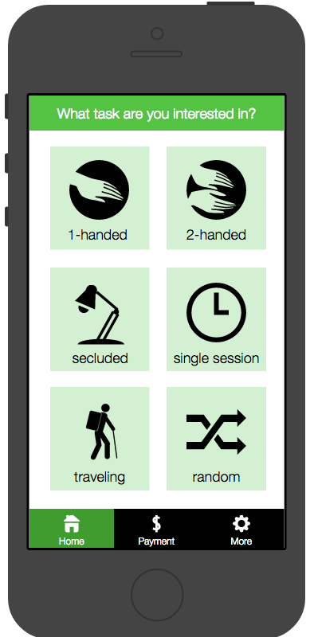
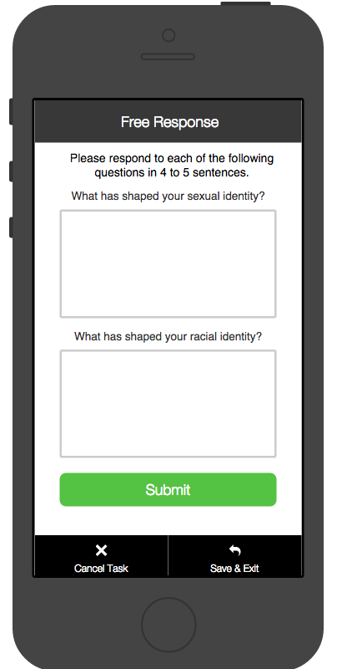
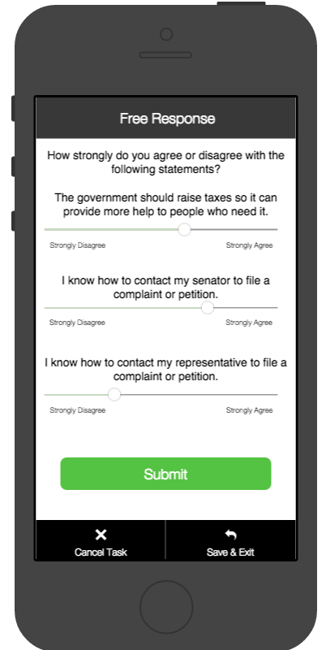
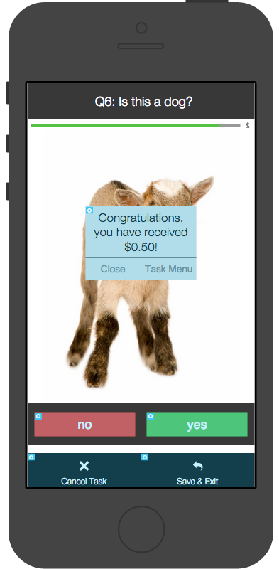
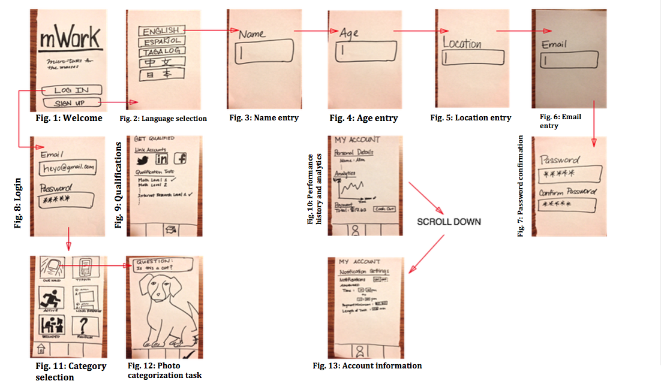
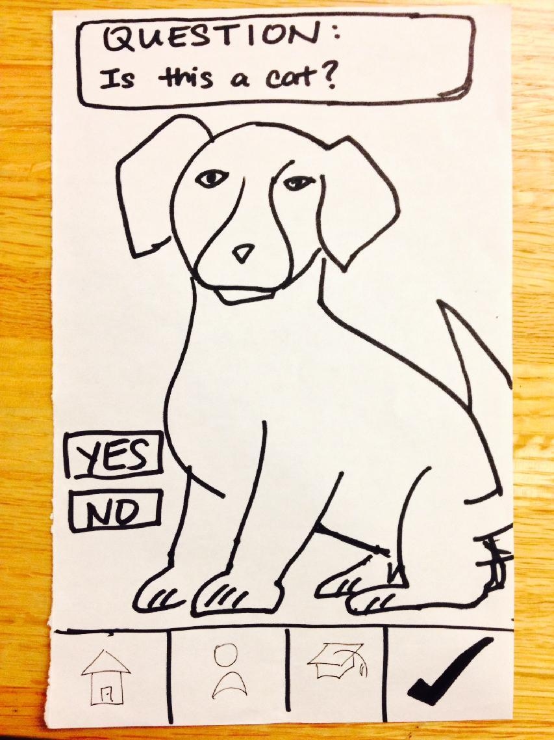
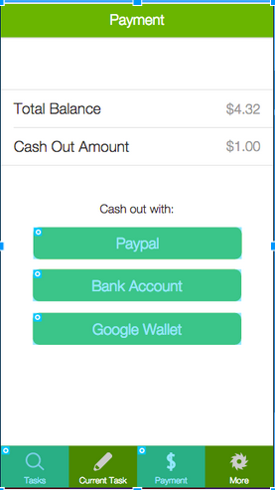

mWork
Re-imagining Mobile Work for the Masses
Overview
Companies are willing to pay individuals to complete millions of small human intelligence tasks. At the same time, the number of underemployed and unemployed workers only continues to rise. mWork connects micro tasks from clients to workers.
Screenshots of our Android App
Overall Goal
Help clients crowdsource important functions
Allow workers to earn extra disposable income
Our Solution
Provides a mobile interface to categorize content and complete tasks
Match client micro-tasks to workers with appropriate background
Enable a secure payment system to cash our earnings
Accept a task
Complete a task
Design Iteration
Technologies used: paper, Proto.io, InVision, Android SDK
Incorporated feedback from heuristic evaluation and user testing
Focus on simplistic UI
UI Flow and design iterations
Lea Coligado. John Yang-Sammataro. Andrea Sy. Allen Yu.
http://stanford.edu/class/cs147/projects/discovery/mwork/
CS 147
Autumn 2014

