Slide 1
Distribution of
Human Intelligence Tasks
Allen | Documentation
Andrea | Manager
Lea | Design
John | Development

Slide 2
Overview
Research
Process
Ideas
Notes:
There is a demand for Human Intelligence Tasks (mostly microtasks)
Short and quick, not intellectually challenging; but cannot be done by a computer
For example, writing down words that describe an image, filtering appropriate and inappropriate content, human sentiment information

Slide 3
Problem
Notes:
There is a need for human intelligence tasks that computers cannot do
These are perhaps tasks that don’t have right and wrong answers
Or tasks that require transforming abstract into concrete information, a task that requires human judgement
Multiple stakeholders, differing perspectives

Slide 4

Demand for solving problems beyond computer capabilities
Notes:
There is a need for human intelligence tasks that computers cannot do
These are perhaps tasks that don’t have right and wrong answers
Or tasks that require transforming abstract into concrete information, a task that requires human judgement
Multiple stakeholders, differing perspectives

Slide 5
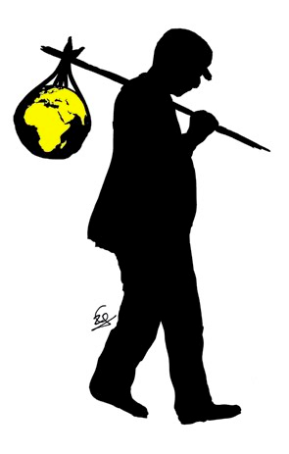
Poverty
Unemployment
Notes:
Problem: Over 3 billion people in developing countries live in poverty on less than $2.50 a day
Problem: There are a lot of micro-tasks that require human intelligence, and companies are willing to pay
Problem: People with downtime want to make additional money
Solution: Mobile microtask platform

Slide 6
Solution
Mobile Microtask platform
Notes:
Problem: Over 3 billion people in developing countries live in poverty on less than $2.50 a day
Problem: There are a lot of micro-tasks that require human intelligence, and companies are willing to pay
Problem: People with downtime want to make additional money
Solution: Mobile microtask platform

Slide 7
Process
Notes:
Problem: Over 3 billion people in developing countries live in poverty on less than $2.50 a day
Problem: There are a lot of micro-tasks that require human intelligence, and companies are willing to pay
Problem: People with downtime want to make additional money
Solution: Mobile microtask platform

Slide 8
Contextual Inquiry
Client
vs
User
Notes:
Problem: Over 3 billion people in developing countries live in poverty on less than $2.50 a day
Problem: There are a lot of micro-tasks that require human intelligence, and companies are willing to pay
Problem: People with downtime want to make additional money
Solution: Mobile microtask platform

Slide 9
Client 1
C.B. - Part-time Assistant in the Psychology Department

Slide 10
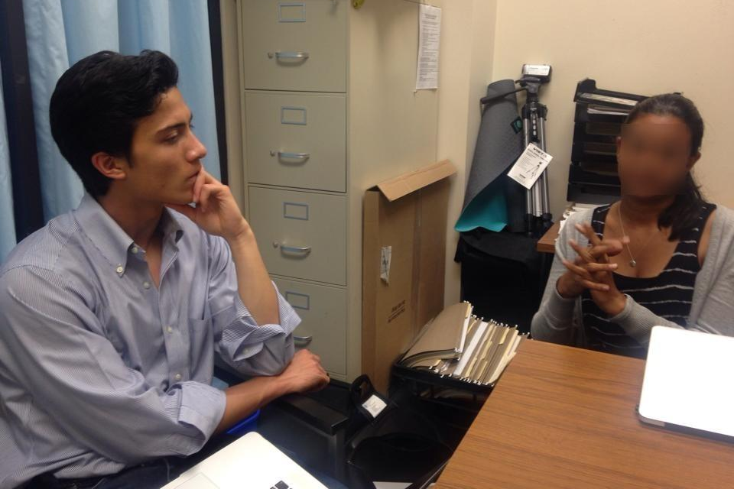
Notes:
Part-time worker, part-time mom who managed and oversaw the Psych SONA department
SONA is a paid database that contains information about users and studies
Found her through website
Major takeaway: cost for researchers so they have to pull from the credit pool, the SONA system can be clugy to utilize, severely understaffed and no one “manager” who oversees the entire system

Slide 11
Client 2
J. C. - Senior Product Specialist at LinkedIn, Trust & Safety Officer

Slide 12
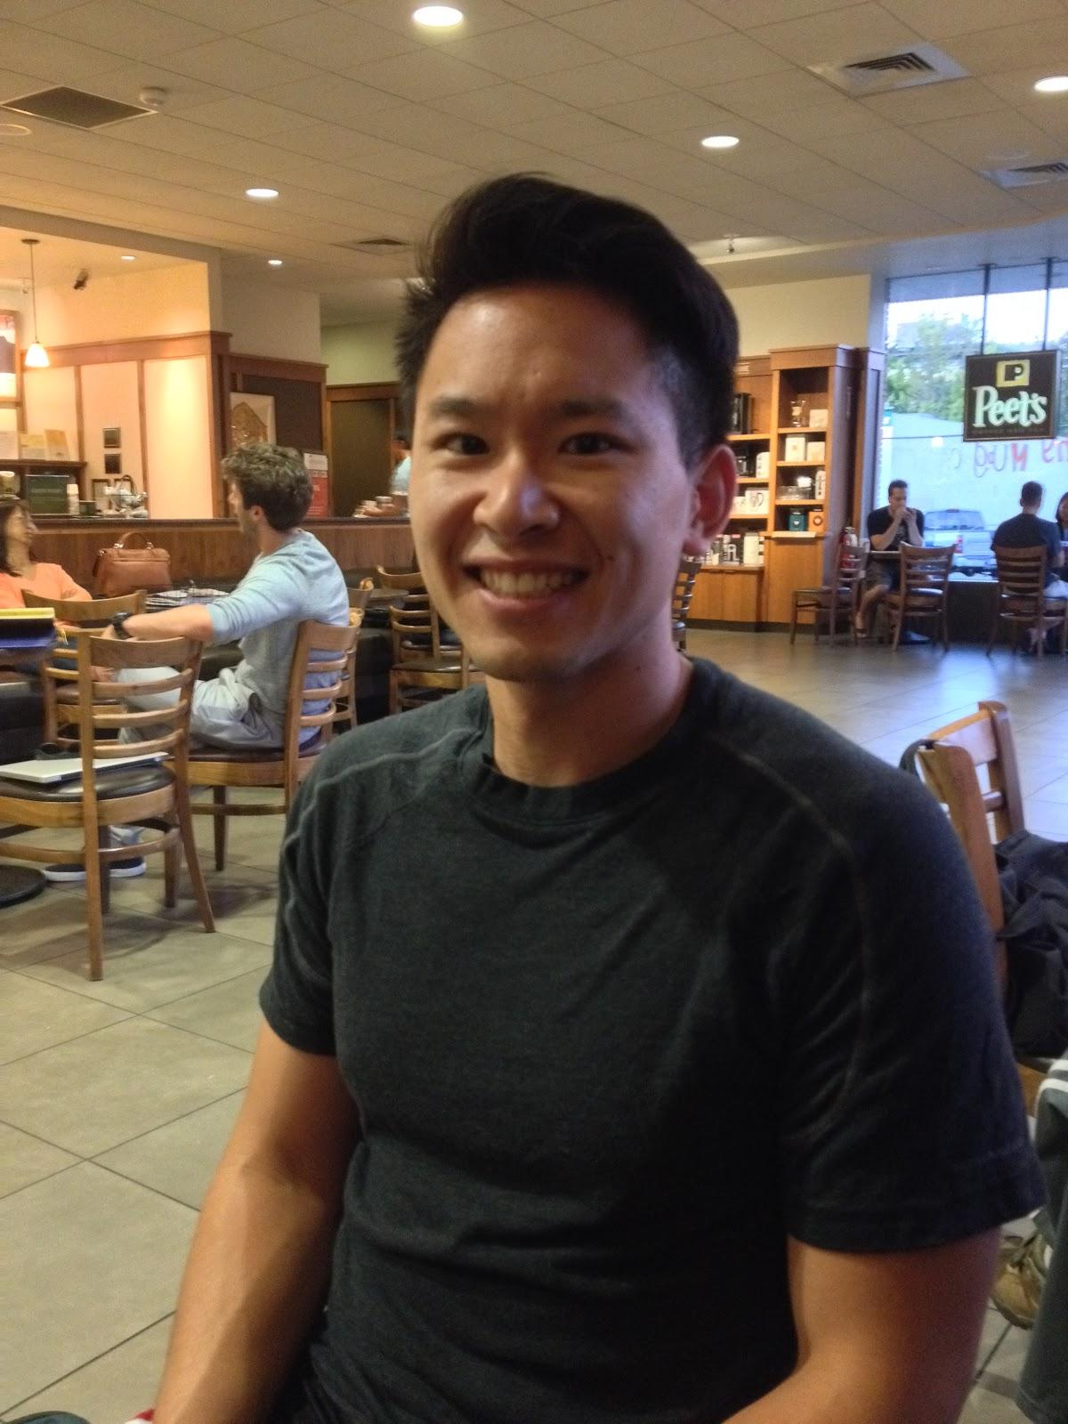
Notes:
The Trust & Safety Specialist is responsible for receiving, processing, investigating, and resolving customer disputes, fraud cases, and legal compliance issues

Slide 13
User 1
D. C. - Stanford Student working at BOSP

Slide 14
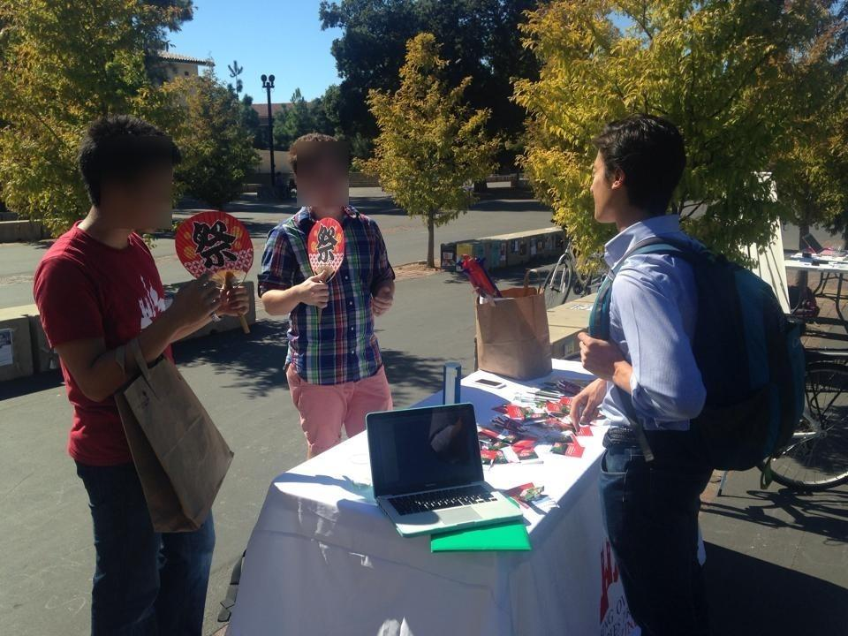
Notes:
Stanford student who doesn’t particularly need money but working for the sense of accomplishment
Found them at a White Plaza table
Maybe perform microtasks during downtime like in the bathroom

Slide 15
User 2
M. E. - Philippines Cook

Slide 16
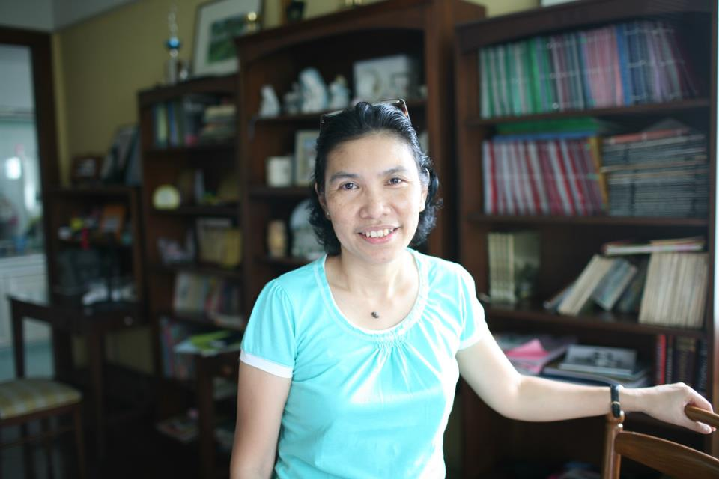
Notes:
40 year old female cook for a family
Family connections
Has a lot of downtime, always on her phone, would like to make more money to support her family

Slide 17
Task Analysis Results

Slide 18
Who is going to use the system?
Two sides of the equation:
“Clients” who leverage the application to find people to fulfill their micro-tasks
“Users” who use the application to find and complete micro-tasks for compensation
Notes:
Who?
Client: psych departments, large companies who work with people and need for data to understand their behavior , hedge funds / financial institutions who needs information
User: underemployed / low income individuals, people with inconsistent schedules, people who are bored

Slide 19
What tasks do they now perform?
Clients
Make sure surveys make sense and are understandable
Search for demographically random and representative survey takers
Figure out if an image or message contains anything regarding human trafficking, child porn, spam, or any other inappropriate content
Notes:
What?
Tasks:

Slide 20
What tasks do they now perform?
Users:
Occasionally fill out online, optional surveys from Stanford Psychology Department to make money
Performing daily tasks / Cooks for a family
Asking people for referrals to get jobs
Notes:
What?
Tasks:

Slide 21
What tasks are desired?
Clients
Find representative participants to take surveys and obtain those results
Automate parsing of photos to determine whether or not they are “inappropriate”
Identify when a user is taking advantage of invitation requests (essentially sending invitation spam) on LinkedIn
Teach people how to access their accounts
Users
Make money while performing short tasks
Escape boredom
Notes:
Clients: small micro tasks to gather information
Users: short work that could fill in downtime to make some extra disposable income

Slide 22
How are the tasks learned?
Clients
Through professional lab training and learned experience in the Psych lab
Through employee training sessions
Challenge: how to figure out how much / little training to give, how to figure out if humans are consistent in their decisions
Users
Through mailing lists from the Psych department advertising surveys
By reading the material and instructions
Hands on doing - experience
Notes:
repetition
qualification tests

Slide 23
Where are the tasks performed?
Clients
On a computer in Stanford Psychology laboratories
On a computer at LinkedIn offices
On premises
Users
Online, usually in the comfort of their home
Downtime at work
Wherever they are bored
Notes:
at the office, bathroom, whereever when they have downtime

Slide 24
What’s the relationship between customer & data?
Clients
Use the survey results to draw conclusions about psychological behavior
Customer makes judgements on different LinkedIn user accounts and different LinkedIn products based on the data
Users
Provides data based on personal experience
Money maker

Slide 25
What other tools does the customer have?
Clients
Emails or paper postings
Credit (Stanford students paid for participation)
Paid (general public paid for participation)
Reporting from other LinkedIn members/employees
Users
Other opportunities for making money available to students, including paid surveys from other departments, student jobs, etc.
Job referrals
Notes:
smartphones, computers

Slide 26
How do users communicate with each other?
Clients
Communicate with participants through Qualtrics surveys to obtain data and advertise to participants through email, paper postings, or mTurk
LinkedIn individuals communicate and set common practices / ground rules in team meetings
Relationships
Users
Communicate results to the surveyors via survey responses
Notes:
Facebook, social media, texts

Slide 27
How often are the tasks performed?
Clients
Distribute roughly 5 to 10 surveys a week
Multiple times a day
Users
Roughly once a month (and receive emails about survey once a week)
Notes:
daily, very frequent

Slide 28
What are the time constraints on the tasks?
Clients
Prefer to receive all comprehensive survey results within a month
Depends on what the priority of the “ticket” is
Users
Prefer not to complete survey in less than 10 minutes
No real time constraint because participation in survey is completely optional
Notes:
very short, in between downtime
nature of micro is short

Slide 29
What happens when things go wrong?
Clients
Manually weed out survey results that seem scammy
LinkedIn representatives have to go and figure what went wrong. Go look into individual LinkedIn user profiles
Users
Small negative repercussions
Loss of income
Notes:
Troubleshooting
Try doing another task

Slide 30
Common Themes:
Clients
Abstract → discrete (0 to 1)
Input → output (quantifiable)
Unique challenge that requires human to do (machines can’t do this)
Worried about reliability (skills and authenticity of users)
Users
Motivations: income, boredom
Inconsistent schedules
Downtime
Notes:
Troubleshooting
Try doing another task

Slide 31
Representative Tasks

Slide 32
Simple
Determining appropriate/valid content (images, messages)
Notes:
Changing abstract input into discrete verifiable output

Slide 33
Medium
Sharing information about human behavior and personal preference
(hard to access information)
Notes:
Receiving information about personal preference
Unstructured data

Slide 34
Complex
Discovering micro-tasks to earn an extra disposable income
Notes:
Fill up free time
Job searching is a complex task, lots of processes involved
Some micro tasks may need qualifications / screening
Finding suitable ones that they can do and would be worth their time is more complex than you might think

Slide 35
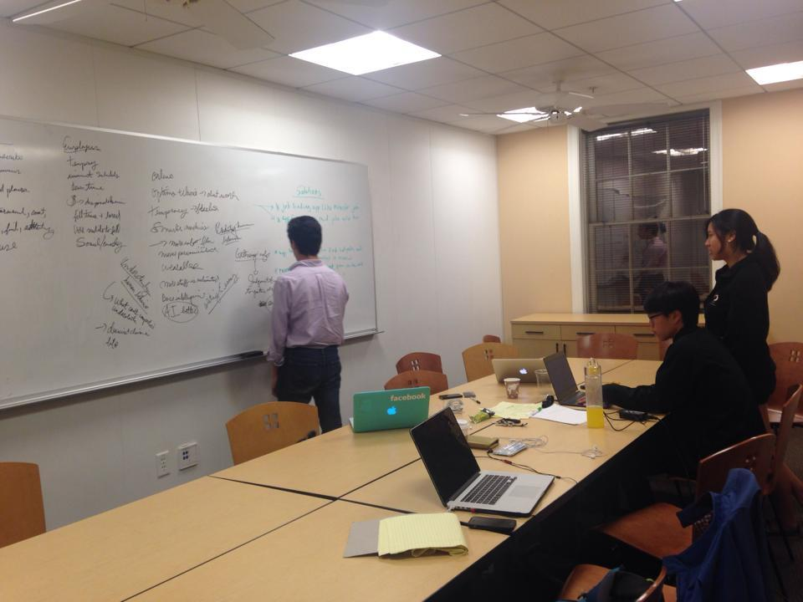
Application Ideas

Slide 36
World Mapping Application
Lack of satellite coverage, topographical information
Explorers, people with free time, adventure-seekers
Better graph out the world

Slide 37
Crowdsourced Predictions
predicts events around the world
Google Glass app, clients asks a question and provides parameters
i.e. “What is the sentiment surrounding Ukraine conflict?”
Notes:
predicts events around the world
Google Glass app, clients asks a question and provides parameters
i.e. Ukraine event, deciding whether or not to transport oil

Slide 38
Mobile MTurk
similar to Amazon MTurk
Use social media channels in developing nations
location based requests

Slide 39
Sketches

Slide 40
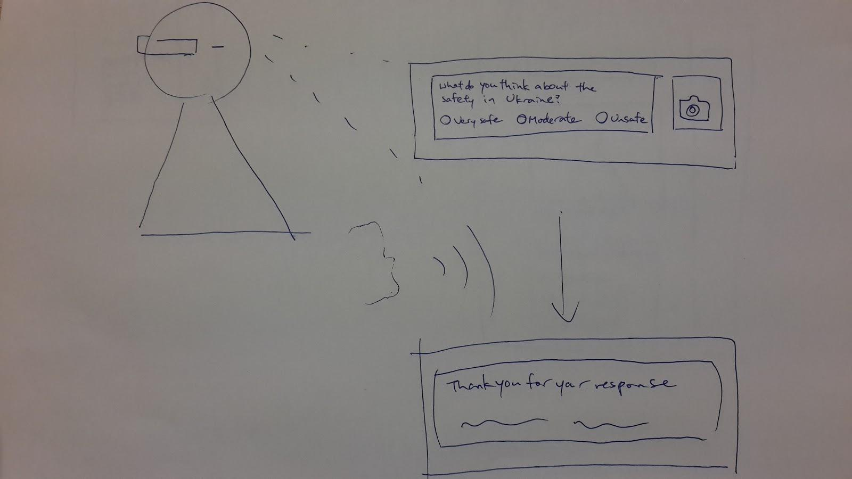

Slide 41
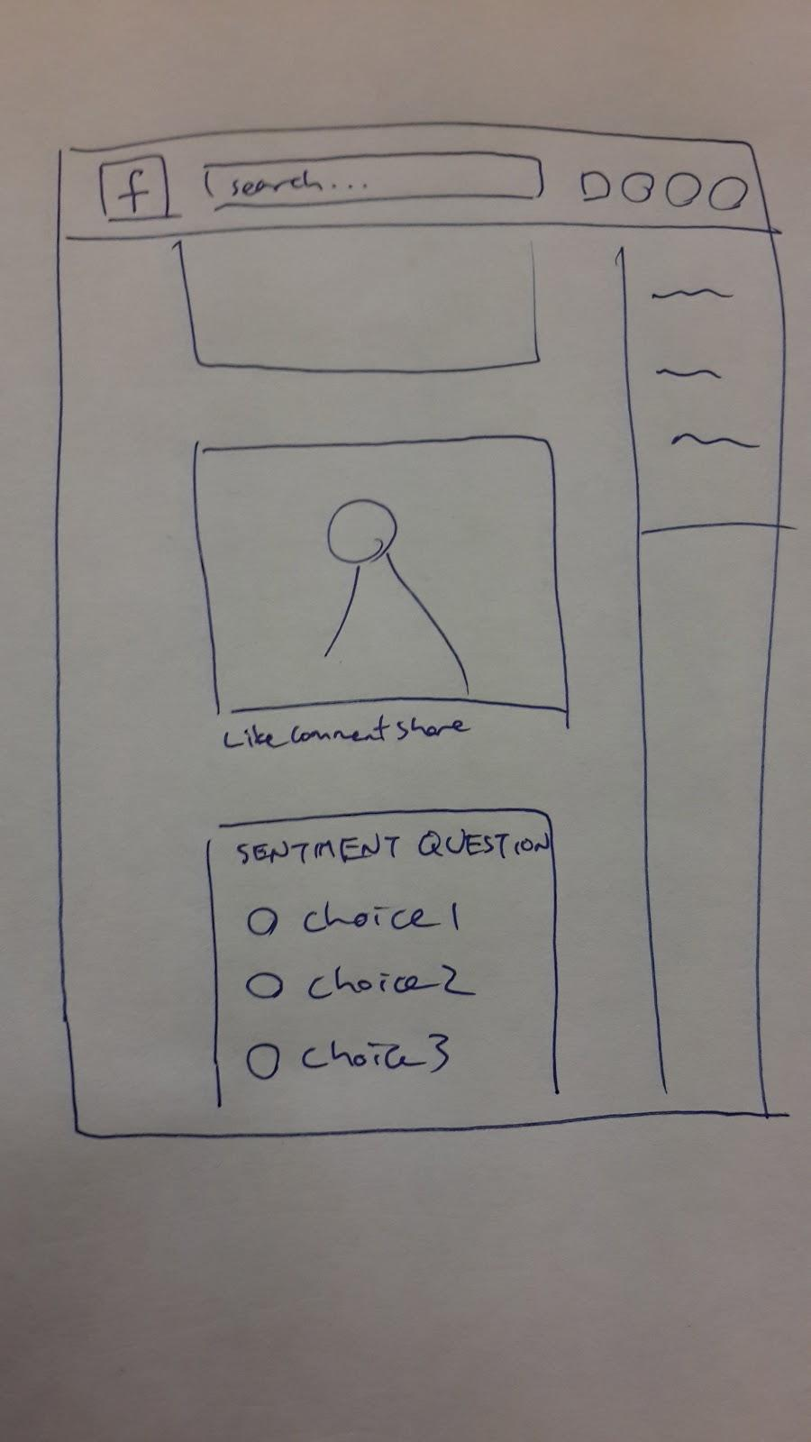

Slide 42
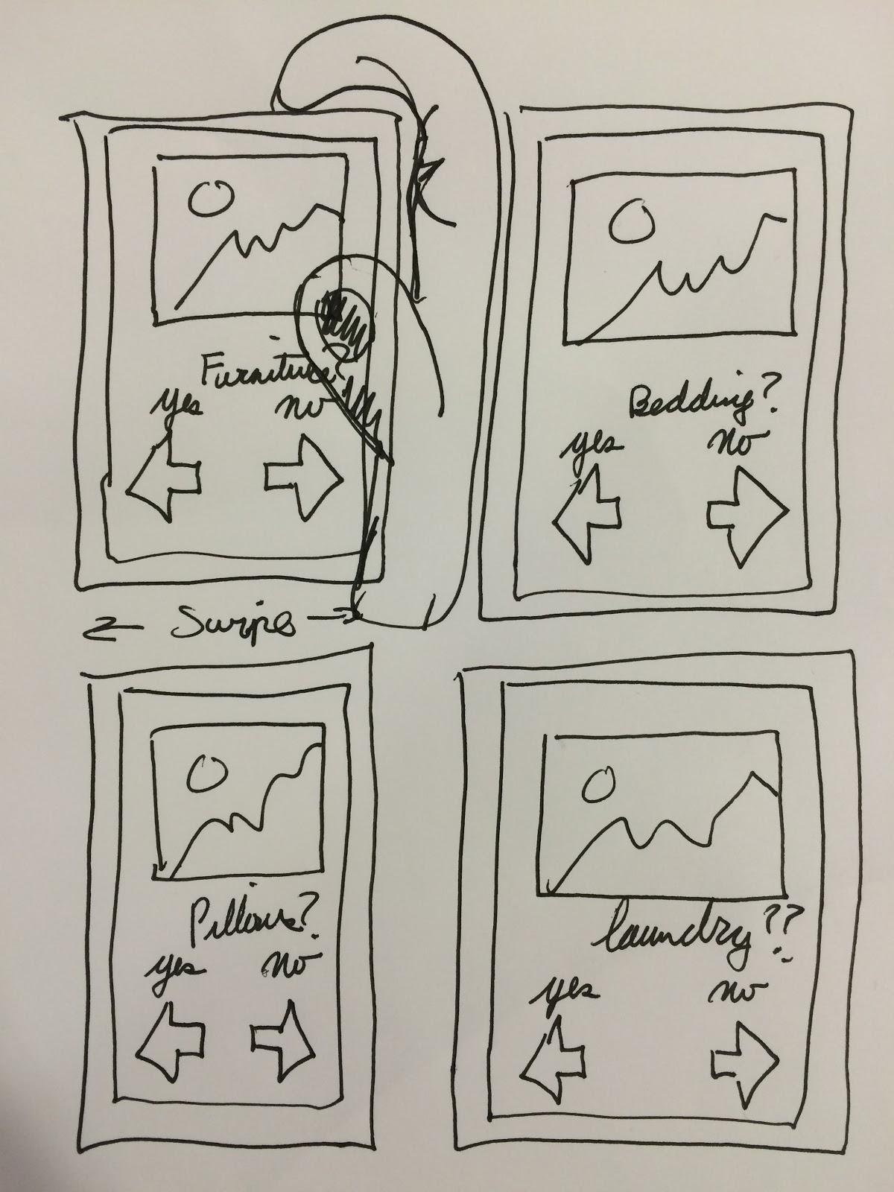

Slide 43
Summary
How to enable the larger workforce?
What will “work” look like in 50 years?

