Slide 1

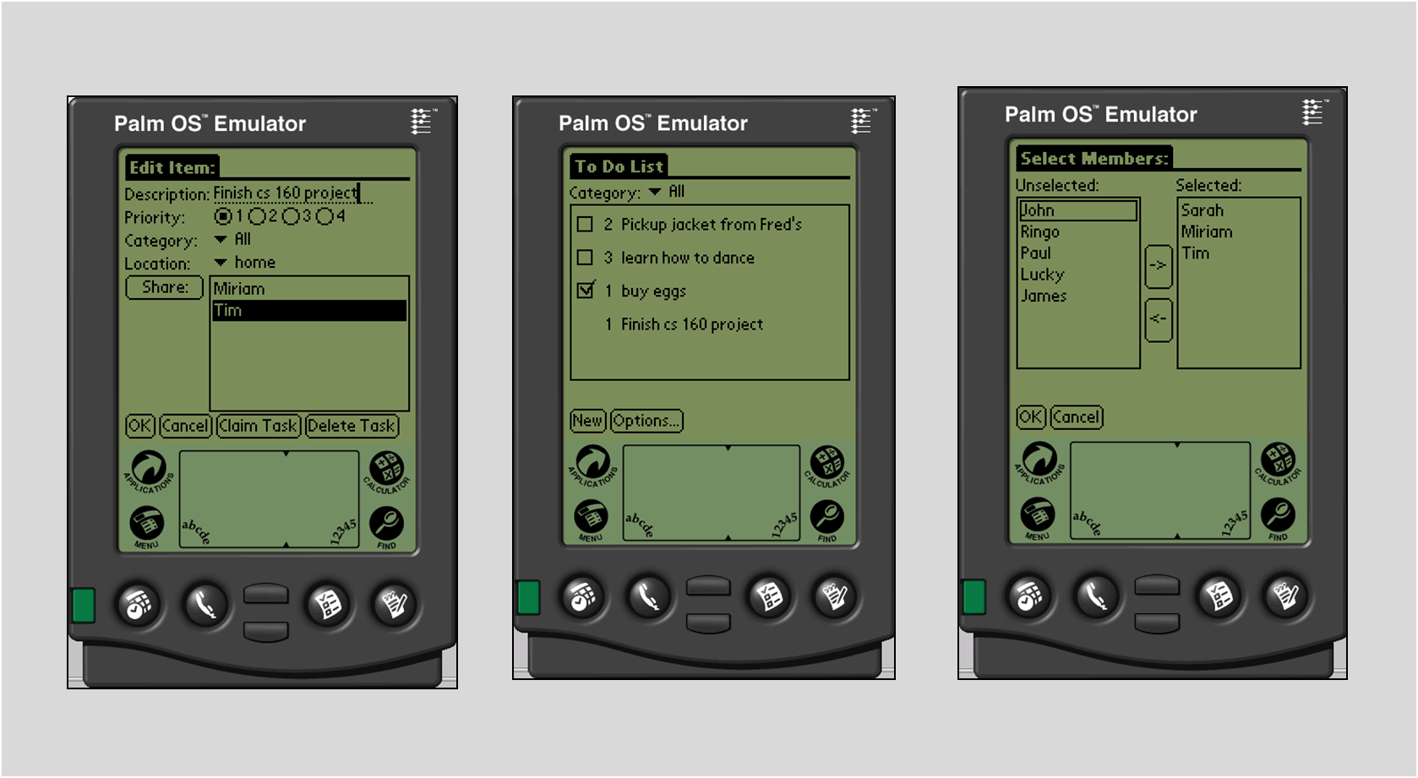
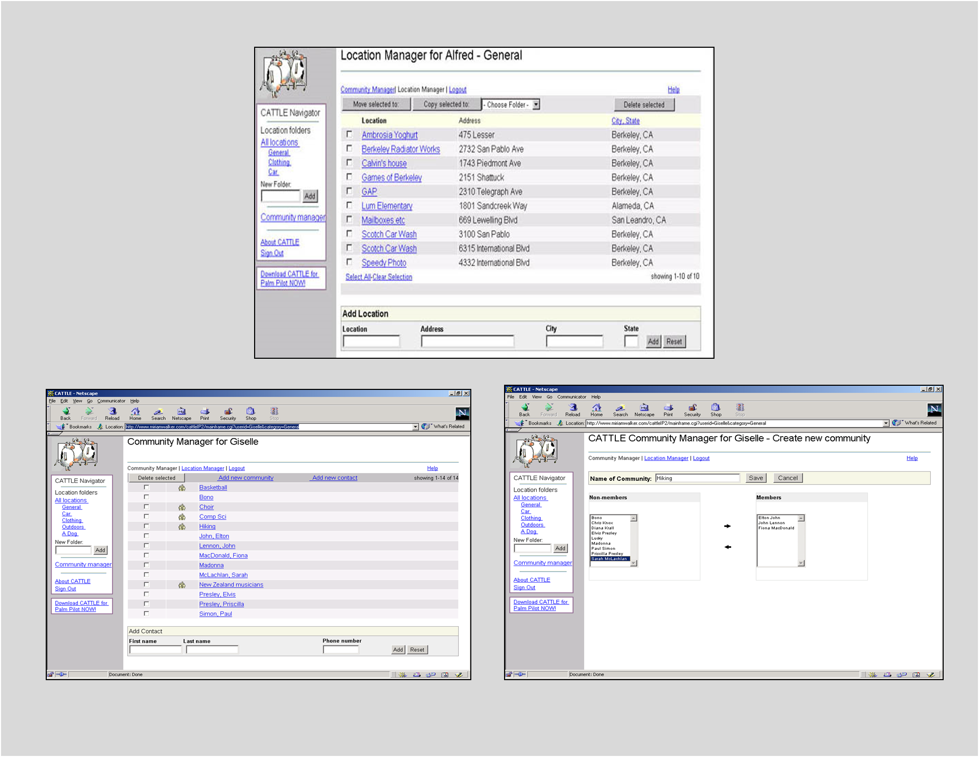
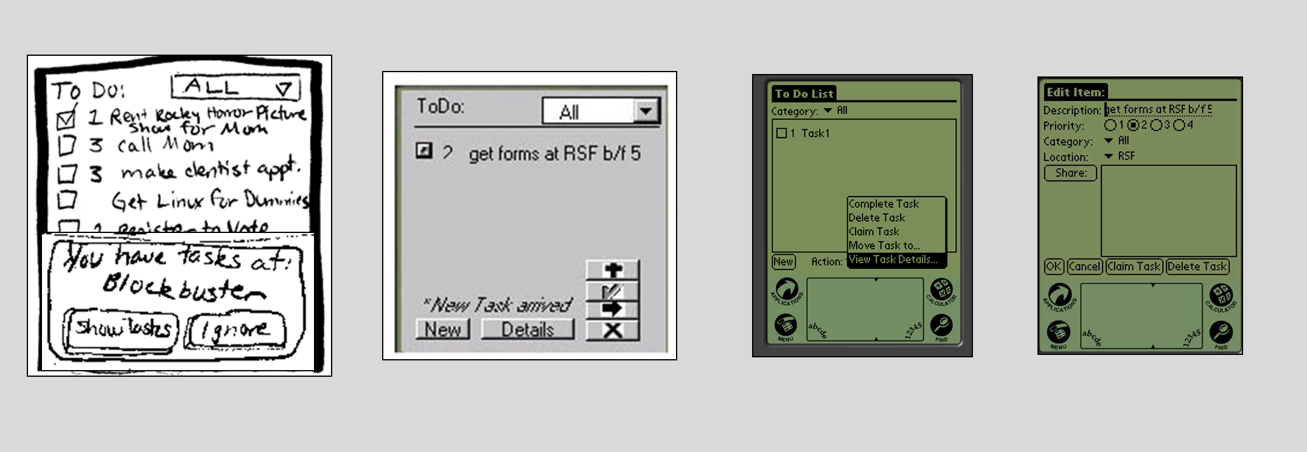

Project Title
Subtitle or Value Proposition
Overview
The basic problem you are attacking
Gain a cursory understanding of approach within first 15 seconds
Caption text goes here
Our Solution
Put key features here
Use appropriately sized fonts especially for titles
Use navigational cues to tell audience where to look next
Pick color scheme & stick to it
Don’t wrap lines & if you do make sure 2nd starts aligned
Lots of images & limited text
Line stuff up in PPT using
Arrange -> Align menu item
View at 100% to see how BIG it will be when done
Have ½ as much text as this box!
Caption text goes here describing hi-fi prototype
Design Iteration
Show paper proto/sketh
Medium-fidelity
Hi-fidelity prototype (or images from user tests)
Caption text goes here: label each iteration
Wa Chu . Corey Chandler . James Landay . Kate Everitt
http://hci.stanford.edu/courses/cs147/2015/au/projects/theme/project-title
CS 147
Autumn 2015

