Slide 1
A Closer Look at Tree Boosting Methods
Felipe Santos and John Yap

Slide 2
Project Questions
What is boosting?
Is boosting used exclusively for trees?
What are AdaBoost, Gradient Boosting, and XGBoost?
How are they similar or different?
Are they used for different purposes?
Is one better than others?
How do we use them?
Research-oriented
Focus on binary classification
More details in upcoming blog!

Slide 3
Outline
Part I: Boosting (John)
What is boosting? (AdaBoost)
Simulated data example
AdaBoost, Gradient Boosting, XGBoost
Model Parameters (Python)
Part II: Toxic Comments Classification (Felipe)
Kaggle Dataset
Multi-label Classification
Analyses and Results
Notes:
This is an outline of our talk. There are two parts. In part I, I will talk about boosting and in part II, Felipe will talk about boosting in a Kaggle dataset on toxic comments classification.

Slide 4
Part I: Boosting

Slide 5
What is boosting?
AdaBoost (for binary classification)
Weak classifier
slightly better than random guessing
e.g. stump
Basic idea:
produce a sequence of weak classifiers
data is modified at each iteration where misclassified observations are upweighted while correctly classified observations are down-weighted
combine (weighted) predictions from the weak classifiers to obtain a more accurate classifier
Notes:
We will illustrate the boosting concept using the original idea when it was first developed for binary classification over twenty years ago for AdaBoost. Also, in our project, we focused on binary classification.
We start with a weak classifier which is defined as a classifier that is slightly better than random guessing. An example is a decision tree stump which is simply a tree with one split and two nodes or partitions. The basic idea in boosting is to combine weak classifiers to produce a weighted classifier with a much better classification performance. The weak classifier is sequentially applied to modified versions of the data where misclassified observations are upweighted while correctly classified observations are downweighted. Then combine...

Slide 6
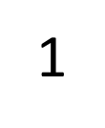
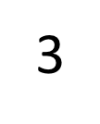
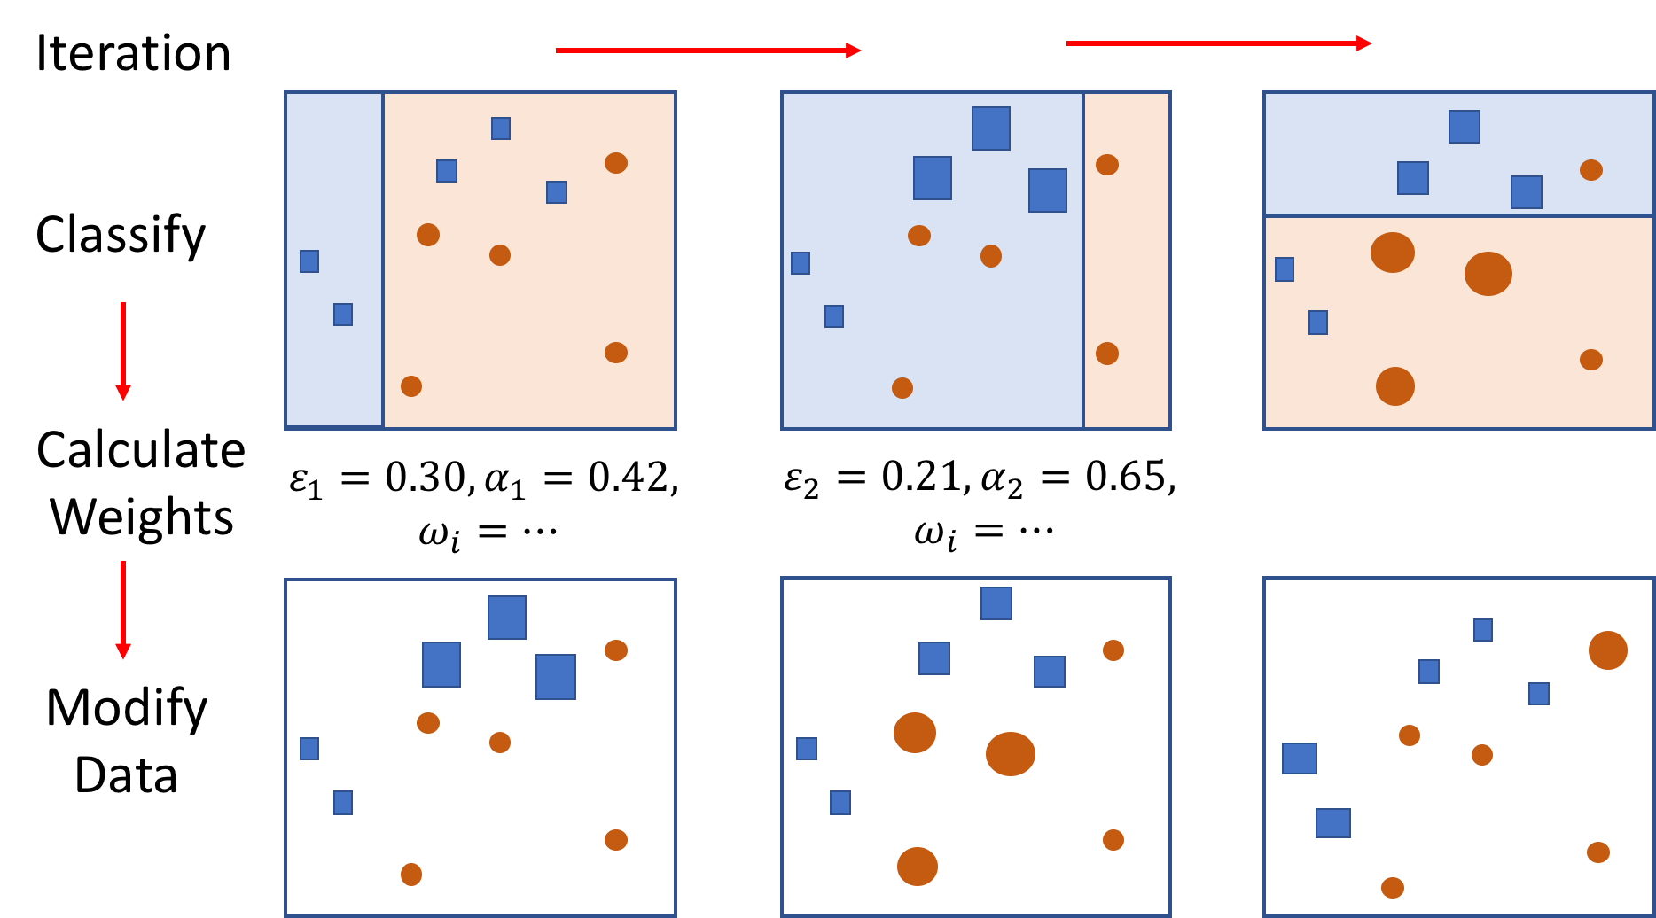
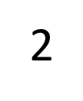
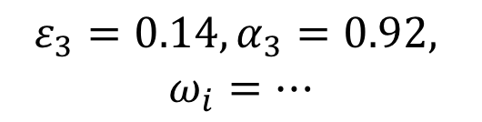
Notes:
In this slide and the next we present an illustration of the AdaBoost algorithm. This is a toy example taken from the original authors of AdaBoost. The task is to classify two types of data points, orange and blue (Go Gators!). So we can think of this as having classes 1 for blue and -1 for orange data points. Here we have three classifiers in three sequential columns. The rows are the processes that happen at each iteration. For the first set of data we apply our weak classifier. Then we calculate the classification error and the weight for the classifier using formulas. We can then calculate the weights for each observation.
Misclassified observations are upweighted while correctly classified observations are downweighted. We see that the three blue misclassified observations are now upweighted (enlarged here). Please note that technically, the correctly classified observations should be shrunk but we do not do that in the illustration. Then you apply the weak classifier again to this modified data and you continue doing this for several iterations.

Slide 7
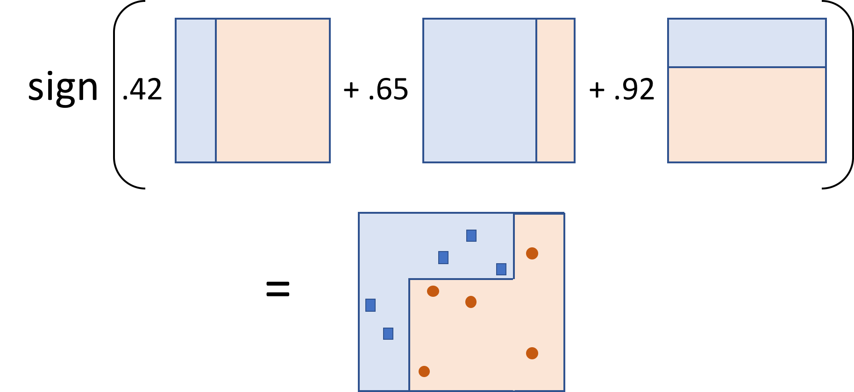
Notes:
After we determine the classifiers, we create a weighted sum of them and determine the sign of the result. You can view this as taking a weighted majority vote where more higher weights are given to more accurate classifiers. The resulting classifier is now more complex than the weak classifiers and is much better at classifying the dataset.
If this illustration is not clear at this point, we encourage you to spend some time to think about it later and figure it out. Remember that each of the three classifier take on values 1 for blue and -1 for orange.

Slide 8
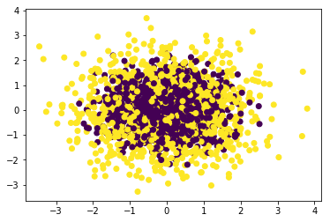
Simulated Data
10 features, each standard independent Gaussian
1 if sum of squares of features > median of chi-square(df=10), -1 ow
Classifiers:
- stump
- decision tree (9 nodes)
- boosted stump (400 iter)
Plot classification error vs iter
References: The Elements of Statistical Learning and Scikit-Learn
Notes:
We illustrate the power of boosting using a simulated dataset example from the book, ESL. The data was generated with ten features from ten standard independent Gaussian random variables. The labels took on values -1 or 1 and were determined based on whether the sum of the squares of the features were greater than or less than the median of a chi-square distribution with ten degrees of freedom. The data is trained using a stump, a decision tree with nine nodes, and boosted stumps using AdaBoost for 400 iterations.
The plot presents the error rate versus the number of iterations. The test error rates are 0.46 and 0.31 for the decision stump (green) and decision tree (orange), respectively. For the “AdaBoosted” stump, the training error decreases very quickly and becomes zero at 250 iterations. The test error also decreases and improves as the number of iterations increase.
Note that at around 250, the training error for the boosted stump is essentially zero. The model at this point has become overly complex and should have high variability. We would expect to observe overfitting but alas, the test error continues to decrease! This is in fact one of the hallmarks of boosting - that it can (but not always) be robust to overfitting.
Note that although we illustrate boosting using decision tree stumps, boosting can accommodate other types of classifiers like neural networks. Also, in general, the weak classifiers do not need to be the same at each iteration.

Slide 9
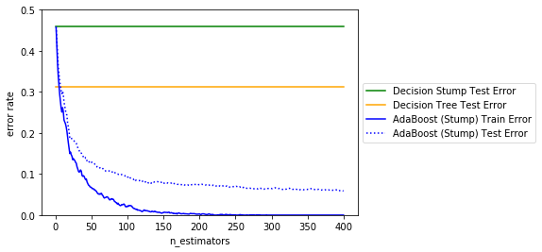
Simulated Data...continued
References: The Elements of Statistical Learning and Scikit-Learn
Notes:
We illustrate the power of boosting using a simulated dataset example from the book, ESL. The data was generated with ten features from ten standard independent Gaussian random variables. The labels took on values -1 or 1 and were determined based on whether the sum of the squares of the features were greater than or less than the median of a chi-square distribution with ten degrees of freedom. The data is trained using a stump, a decision tree with nine nodes, and boosted stumps using AdaBoost for 400 iterations.
The plot presents the error rate versus the number of iterations. The test error rates are 0.46 and 0.31 for the decision stump (green) and decision tree (orange), respectively. For the “AdaBoosted” stump, the training error decreases very quickly and becomes zero at 250 iterations. The test error also decreases and improves as the number of iterations increase.
Note that at around 250, the training error for the boosted stump is essentially zero. The model at this point has become overly complex and should have high variability. We would expect to observe overfitting but alas, the test error continues to decrease! This is in fact one of the hallmarks of boosting - that it can (but not always) be robust to overfitting.
Note that although we illustrate boosting using decision tree stumps, boosting can accommodate other types of classifiers like neural networks. Also, in general, the weak classifiers do not need to be the same at each iteration.

Slide 10
Boosting Methods
AdaBoost
Gradient Boosting
- create a sum of trees
- estimate gradient with tree
- for squared-error loss in regression, gradient is residual!
- for classification, use deviance or exponential loss
XGBoost
- same idea behind gradient boosting but uses second order approximations
- includes more capabilities
Notes:
So far we have seen the idea of boosting using AdaBoost. There are two other main algorithms available to our knowledge, namely, Gradient Boosting and XGBoost. It will take some time to explain how to get from AdaBoost to Gradient Boosting so we will reserve the details to our blog. But the general idea behind gradient boosting is to create a sum of trees sequentially where each added tree attempts to improve the model. To create the boosted tree model, each added tree estimates the gradient of the loss function that is used for fitting the model. In the case of regression using squared error loss, the gradient turns out to be simply the residual. Therefore, gradient boosting in the case of regression is simply fitting a tree in each iteration to the residuals. This is what we learned in class!
For classification, gradient boosting uses deviance as the loss function by default. If an exponential loss is used, then gradient boosting will become AdaBoost. Note that the deviance and exponential loss functions behave very similarly, therefore, we should expect the performance of AdaBoost and Gradient Boosting to be very similar.
Whereas gradient boosting performs a first order numerical approximation when optimizing, XGBoost performs a second order approximation. In gradient boosting, the tree structure and values assigned to each partition are estimated separately, whereas in XGBoost, this is done simultaneously. Thus, XGBoost potentially can yield better estimates.

Slide 11
Model Parameters
Parameters | AdaBoost | Gradient Boosting | XGBoost
max_depth
learning_rate
n_estimators
subsample
max_features/colsample_bylevel
colsample_bytree
reg_alpha
reg_lambda
Notes:
This slide presents selected parameters that are shared and not shared by the three algorithms that we discussed. Please read our blog for more details. Based on our analyses runs on three datasets, we did not find any big advantage in terms of accuracy among the three algorithms. We have, however, observed that XGBoost runs much faster than the other two. We are unsure why this is the case. It could be because of the optimization algorithm or the additional tuning parameters such as colsample_bytree. Colsample_bytree allows you to select a subset of the features when constructing each tree per iteration. Note that this is not the same as in random forest, although XGBoost has that additional feature as well, with the parameter colsample_bylevel.
XGBoost also has additional regularization parameters reg_alpha and reg_lambda that gradient boosting does not have. We think of these parameters as like pruning the tree in each iteration. In this case, XGBoost not only tries to find a more accurate prediction but also tries to reduce the variability of the prediction.
Our suggested strategy is construct training and test set errors versus n_estimators for selected values of max_depth and learning_rate. ESL recommends max_depth between 4 and 8 and a low learning rate (<0.1). This will allow you to determine suitable values for max_depth and learning_rate and study the behaviour of the train and test set errors. You will want the n_estimator to be the one for which the test error is lowest and before the test error diverges. Later you may then study how the other parameters affect the error plots. We are not sure if this strategy is optimal but at least it will allow you to derive a sense of how the parameters interplay with each other.

Slide 12
Part II:
Toxic Comments Classification

Slide 13
Model Accuracies
Dataset | n_train; #feat | AdaBoost | Gradient Boosting | XGBoost
Simulation | 2000; 10 | 0.948 | 0.947 | 0.940
Spam Email* | 2300; 57 | 0.950 | 0.948 | 0.951
Evergreen | 2389; 22 | 0.684 | 0.703 | 0.720
Notes:
*For decision tree: 0.907; random forest: 0.945

Slide 14
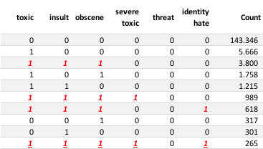
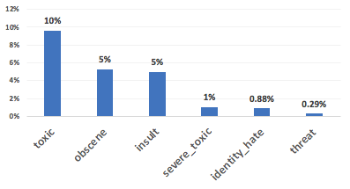
Toxic Comment Classification
- Identify and classify toxic online comments: from Wikipedia’s talk page
Unbalanced Distribution:
159,571 comments
Multi-label problem: each comment can be categorized into more than one label.
Notes:
Unbalanced Situation
Multi-label problem diferente de multiclass
The task is to classify comments as either toxic, obscene, insult, severe_toxic, identity_hate, or threat or a combination of these. Because we allow combinations, this problem is a multi-label problem and not a multi-class problem. [Then explain using table on right...]

Slide 15

Toxic Comment Classification - Steps
Multilabel (some options):
"One vs. All" (our method of choice)
Chain Classifier
Power Set
NLP:
Stemmer: Closed, Closing, Closing = Close
TF-IDF: term frequency–inverse document frequency
Bigram = 1, 2, 3
Boosting Methods (test_size= 33%):
AdaBoost
Gradient Boosting
XGBoost
Results:
Accuracy
Confusion Matrix
Time required for calculation
Comments
Notes:
OnevsAll : simplest method
For multilabel problems there are different approaches, such as…. , our choice was OneVsAll.
OneVsAll means that we model toxic vs non-toxic, then separately model obscen vs non-obscene, etc…
To process our comments for OneVsAll modeling, we perform the NLP methods, Stemmer and TF-IDF….[explain each...]
We perform OneVsAll classification using the three boosted tree methods, AdaBoost, Gradient Boosting, and XGBoost.
We present in our results tge accuracy, confusion matrix, and time required for calculation

Slide 16
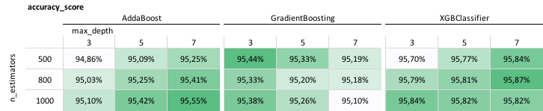
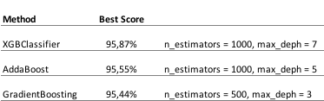
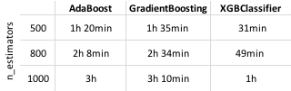
Toxic Comment Classification - Results
Exploring Label = Toxic Comments
time required for calculation (average)
Notes:
We present the results for toxic comments only.
Each row of the table on top are the accuracies for three different iterations (n_estimators): 500, 800, and 1000.
For each of the three boosting methods, we have as columns different tree sizes of depth 3, 5, and 7. The results do not appear to be very different from one another.
The table on the bottom left summarizes the best results per method. We see that XGBoost gives the best prediction. We note that these estimates are very similar to other results that we’ve seen online using Support Vector Classifier or Logistic Regression.
Also, we recorded the computation time and we found that XGBoost performs calculations much faster than the other two methods. See table on bottom right. As you can see, the computational times for the models are very long. This is the main reason we present only results for toxic comments.
We do have the results in our jupyter notebook for all models with max_depth=3 and n_estimators = 500, 800, and 1000. Please see our GitHub page.

Slide 17
Further Work
Scikit-learn pipeline issue:
TfidfVectorizer does not work outside pipeline
TfidfVectorizer in pipeline seems inefficient
Find datasets where XGBoost will perform much better than Gradient Boosting
Explore NLP techniques that might help improve predictions (e.g. lemmatization)
Explore techniques other than OneVsAll for multi-label classification (e.g. chain classifier and power set)

Slide 18
Obrigado!

