Slide 1
Team Members Team 4:
Johnathan Gressick
Garrett Olsen
Presentation Link: https://youtu.be/m958fumJWFA

Slide 2
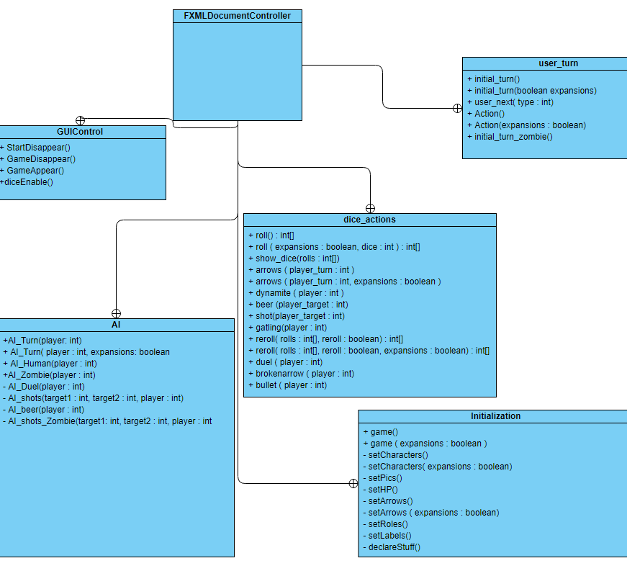
UML Diagrams

Slide 3
Classes Developed
GUIControl:
Garrett Olsen
Johnathan Gressick
AI:
Garrett Olsen
Johnathan Gressick
Dice_Actions:
Garrett Olsen
Johnathan Gressick
User_Turn:
Garrett Olsen
Johnathan Gressick
Initialization:
Garrett Olsen
Johnathan Gressick

Slide 4
Model
The logic for the game is functional with a few minor bugs.
The logic was tested by multiple play tests.
Problems:
The game could soft lock due to dying by dynamite – Resolved
Remainders in java could be negative which impacted moving between characters – Resolved
If a player dies to Indian attack during their turn, their turn still progresses.
DLC character abilities.

Slide 5
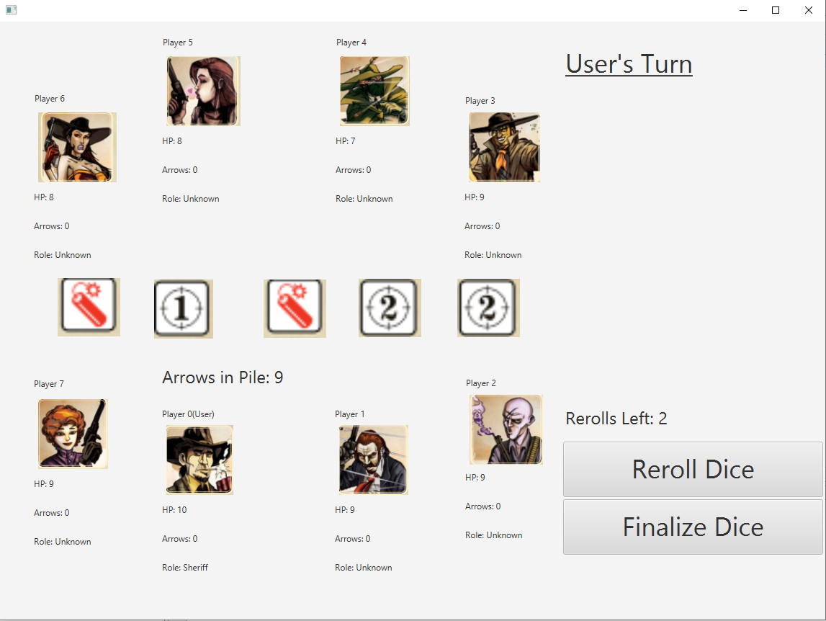
View
The GUI is in working condition such that the game can be played from it.

Slide 6
Controller
The controller was merged with the view.
The game does have full GUI integration support as shown by the project demo.

Slide 7
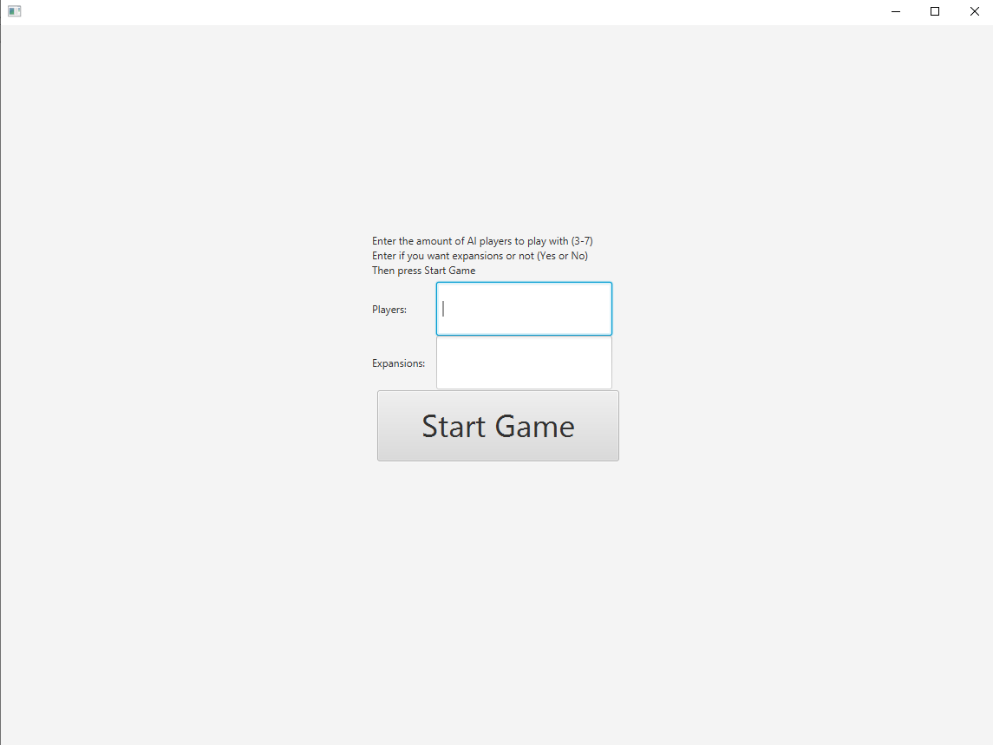
GUI screenshots
The first screen a user is shown, they are to input the game parameters.

Slide 8
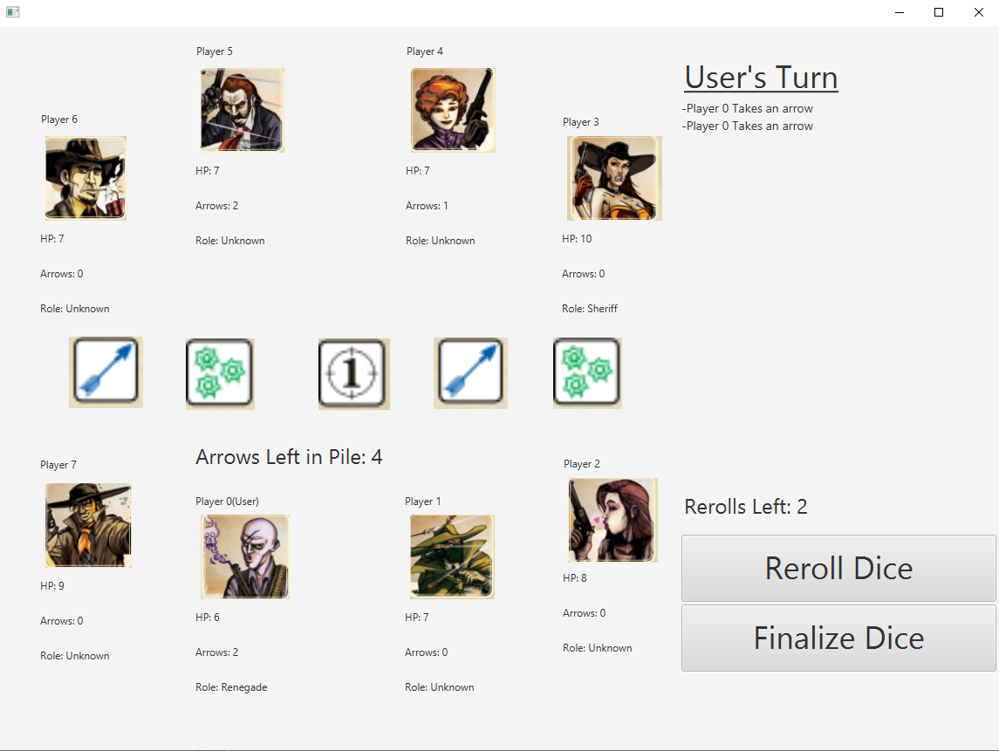
GUI screenshots
Shows a users turn when they receive the dice

Slide 9
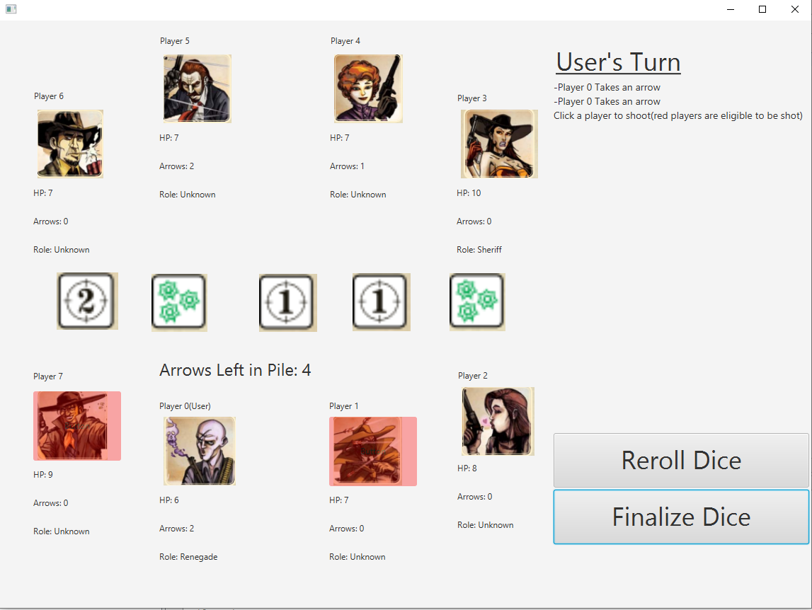
GUI screenshots
Shows how a user attacks a target

Slide 10
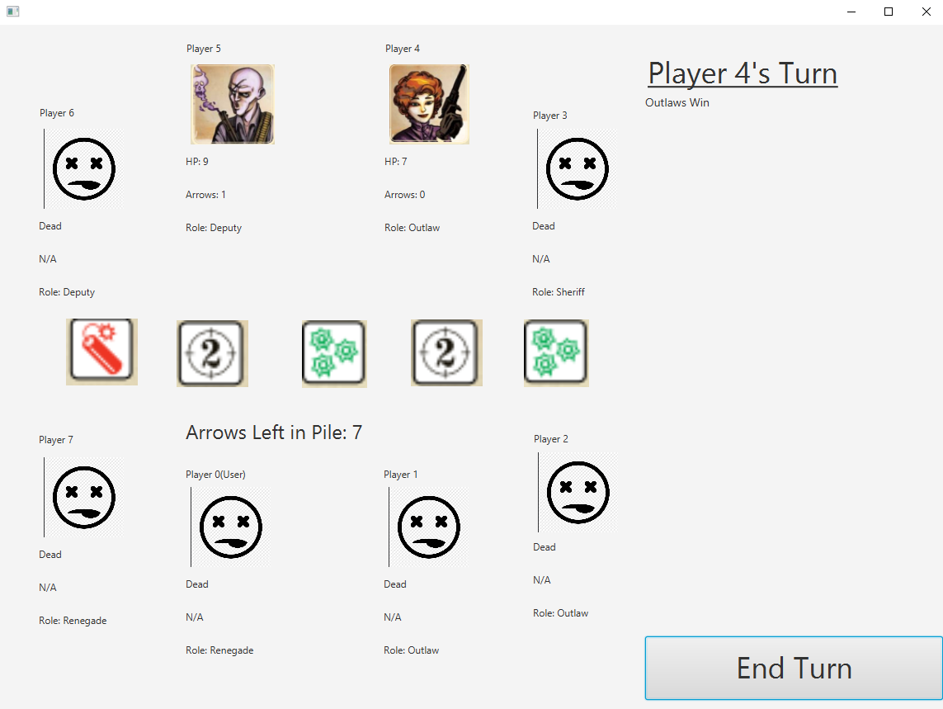
GUI screenshots
Shows the end game screen

Slide 11
Code Highlights
This is an example of a time method overloading was used in the project.
Which method gets picked depends on if the DLCs are being used

Slide 12
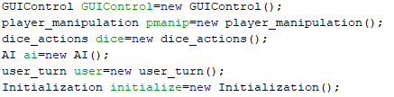
Code Highlights
This is an example of composition within the program
All the instantiated objects need to be able to use the functionality of the others to make the game work.

Slide 13
Project Demo
Link: https://youtu.be/hpzWPI5CtvY

