Slide 1

Predicting Arrivals
With Henry Friesen
And Jonathan Jack

Slide 2
Overview
First Look
Cleaning and EDA
Insights
Show feature selection and interesting points
Results
Model results and interpretation

Slide 3

Add a Slide Title - 1
EDA

Slide 4
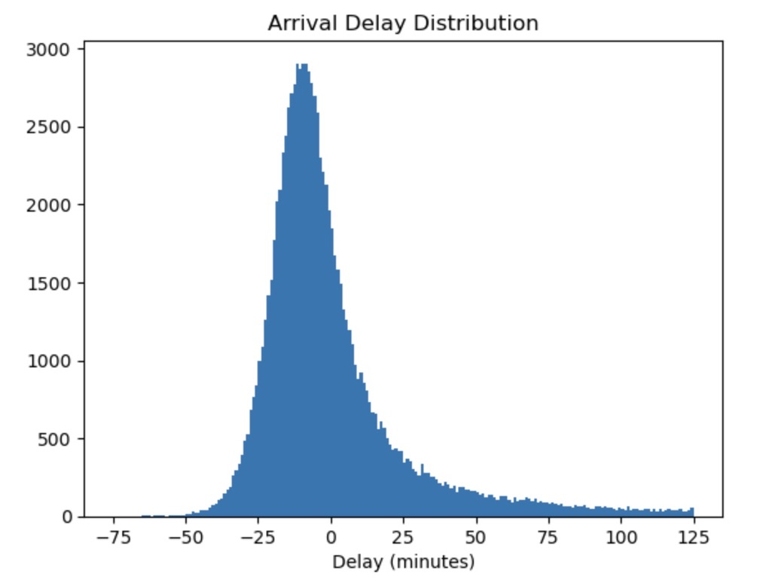
Delay Distribution
Delay from random selection of data
Slight right skew
Mean is close, but not zero

Slide 5
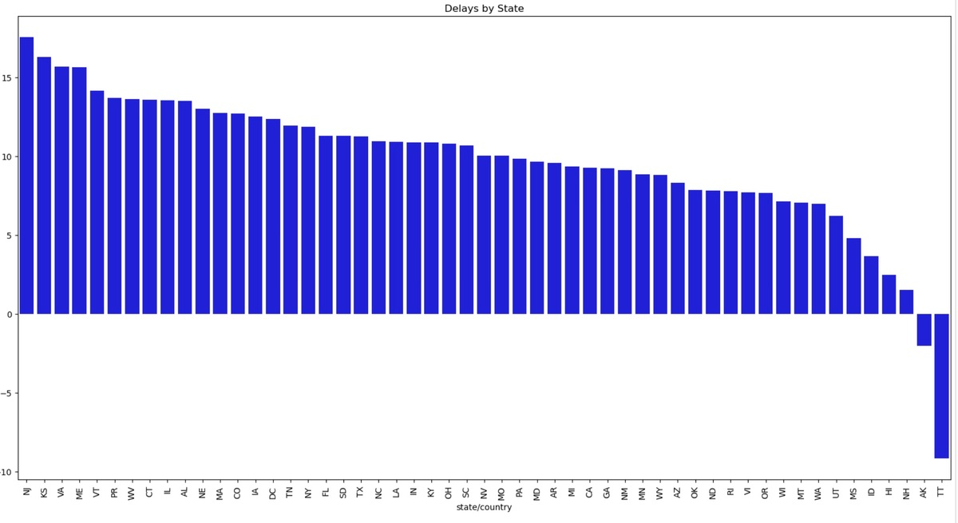
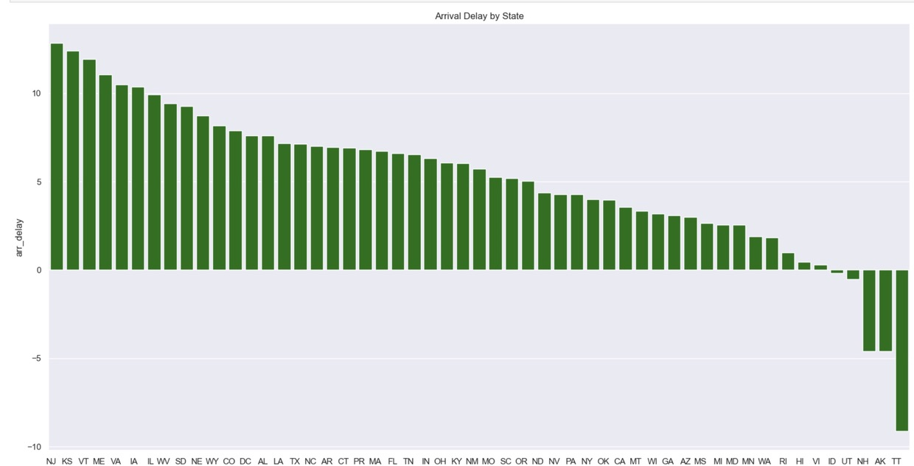
Departures Delays Vs. Arrival Delays
Does one cause the other?

Slide 6

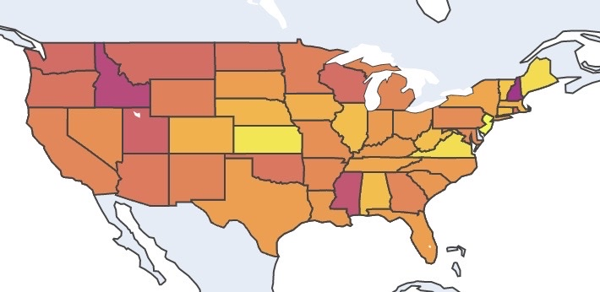
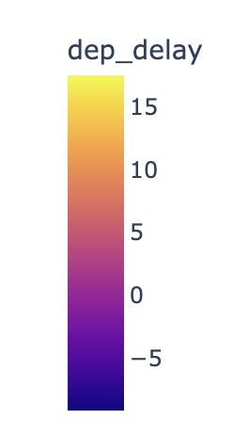

Traffic by State
Global picture of delayed flights in the USA.

Slide 7
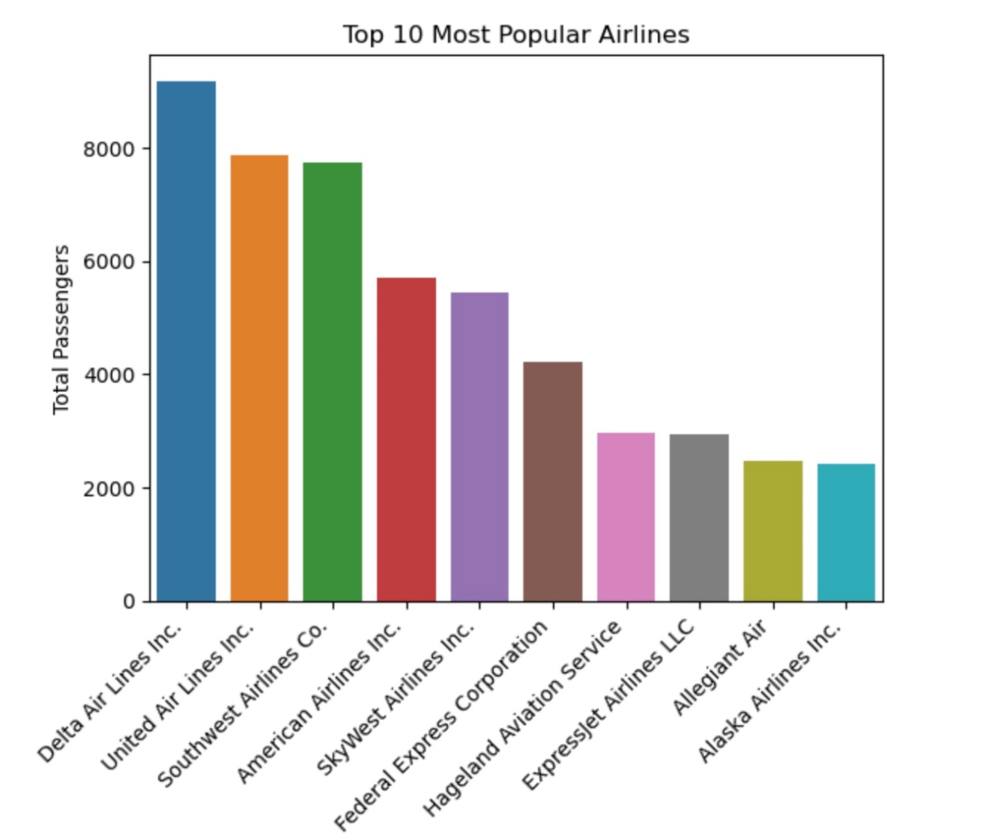
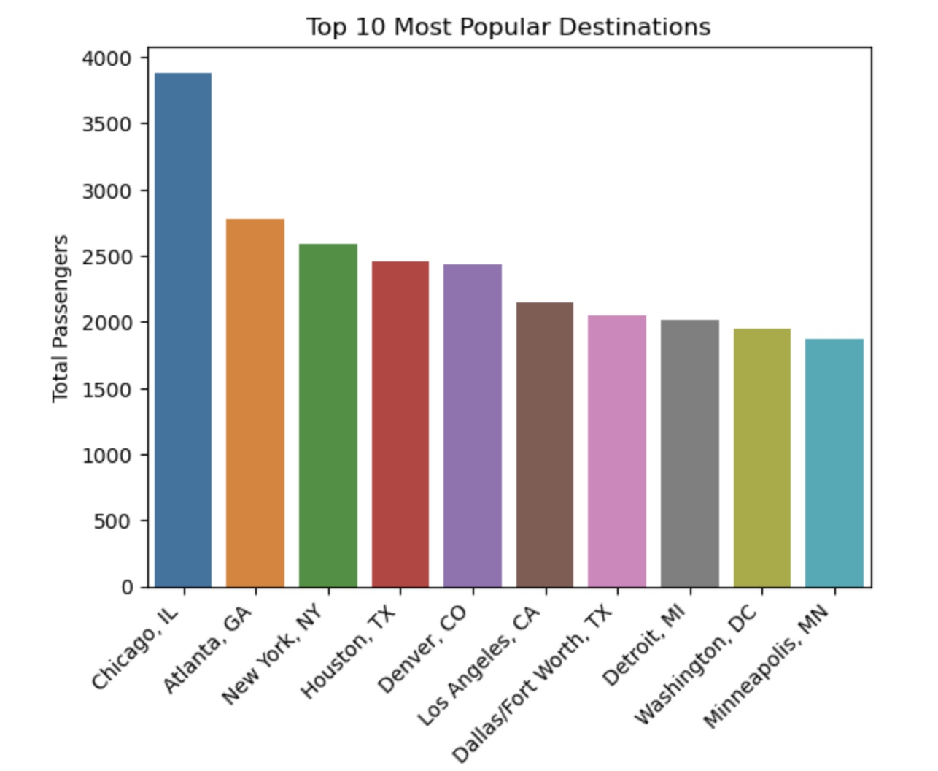
Checking Out The Top Ten

Slide 8
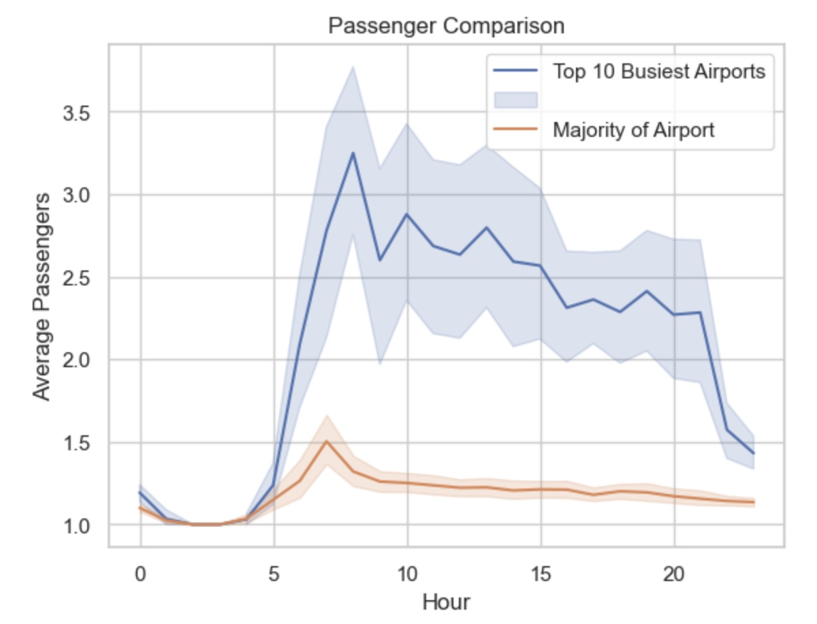
Highest Traffic Hours

Slide 9
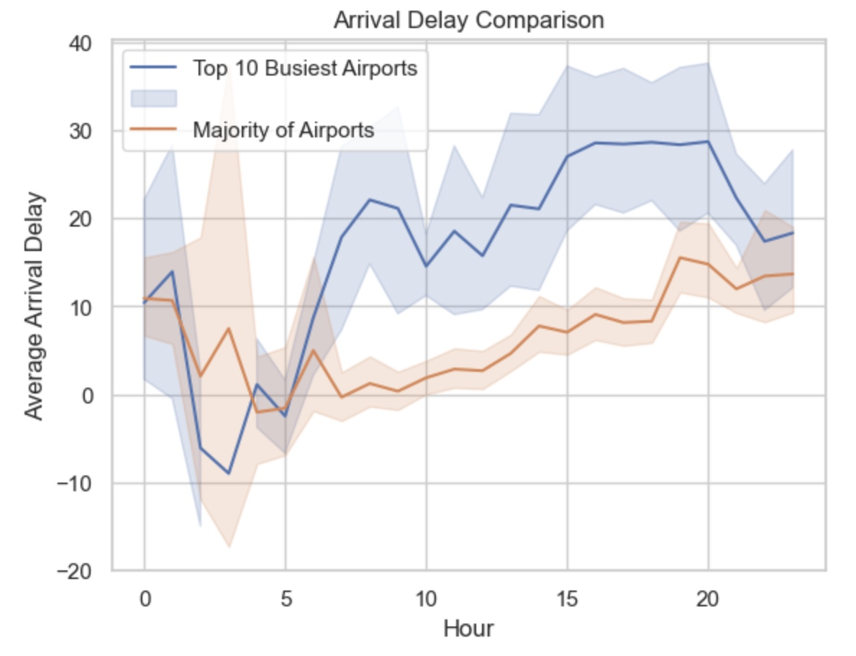
Comparing Delays per Hour

Slide 10

Model Results

Slide 11
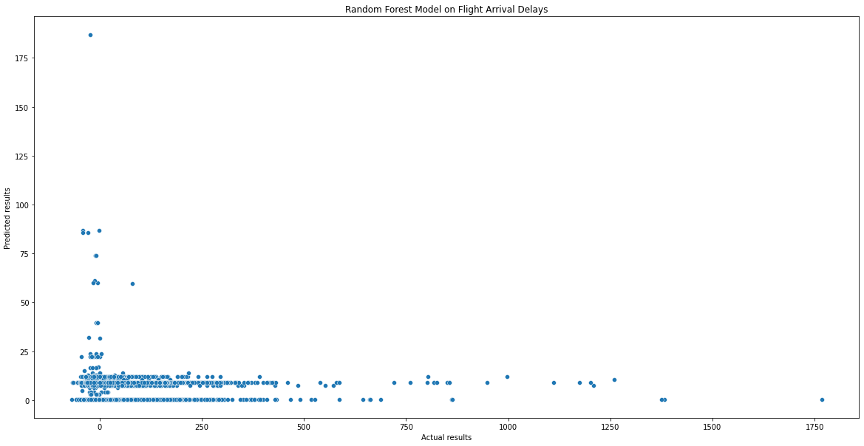
Random Forest Model
Parameters: crs_elapsed_time, distance, month, departing hour, arrival hour, origin, destination and op_unique_carrier
R2 Score: 0.005
Mean Squared Error: 2478.71
Root Mean Squared Error: 49.79

Slide 12
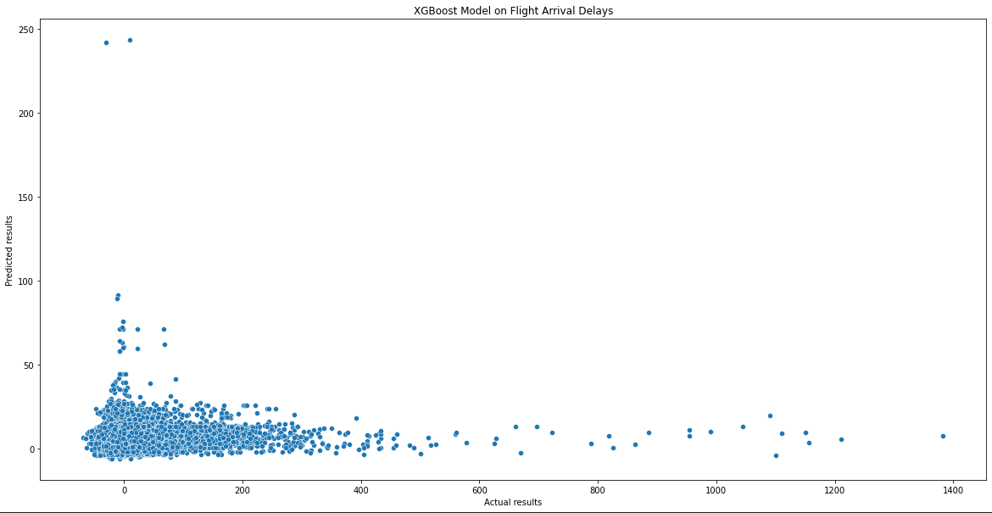
XGBoost Model
Parameters: crs_elapsed_time, distance, month, departing hour, arrival hour, origin, destination and op_unique_carrier
R2 Score: 0.013
Mean Squared Error: 2272.64
Root Mean Squared Error: 47.67

Slide 13
Challenges/Future Goals
Understanding the hyperparameters of different machine learning models and optimizing them
Forging new features that are important and increases model accuracy
Weather and location API limited our use of weather information
Only had a table of 500 weather forecasts
Attempt to complete the classification problem involving cancelled flights
Brainstorm more ideas for better features in return for a better model
Try out more regression models
mainly focused on XGBoost and Random Forest

Slide 14
Thank You
Henry Friesen
Jonathan Jack

