Slide 1

Predicting Arrivals
With Henry Friesen
And Jonathan Jack

Slide 2
Predicting Arrivals
With Henry Friesen
And Jonathan Jack

Slide 3
Overview
First Look
Cleaning and EDA
Insights
Show feature selection and interesting points
Results
Model results and interpretation

Slide 4

Add a Slide Title - 1
EDA

Slide 5
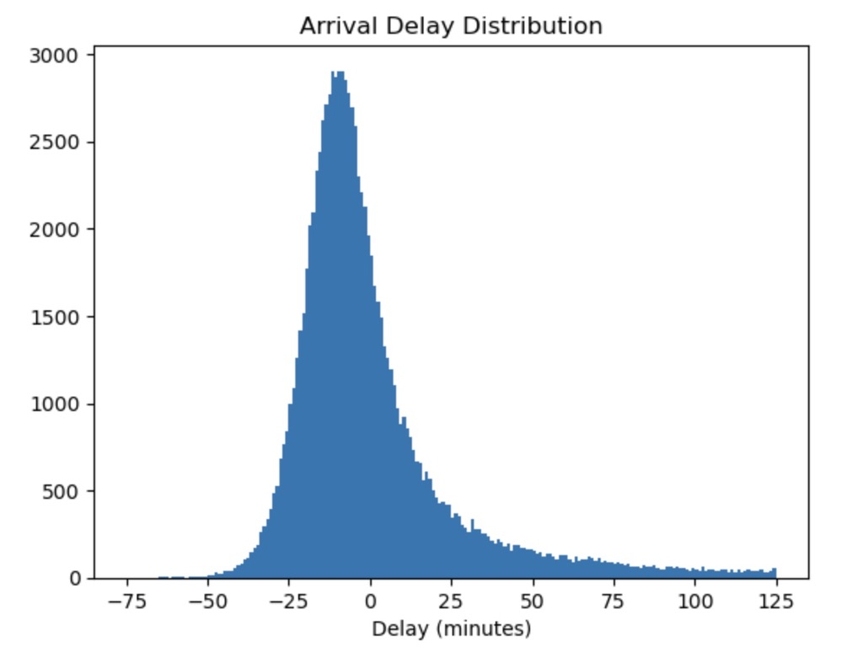
Delay Distribution
Delay from random selection of data
Slight right skew
Mean is close, but not zero

Slide 6
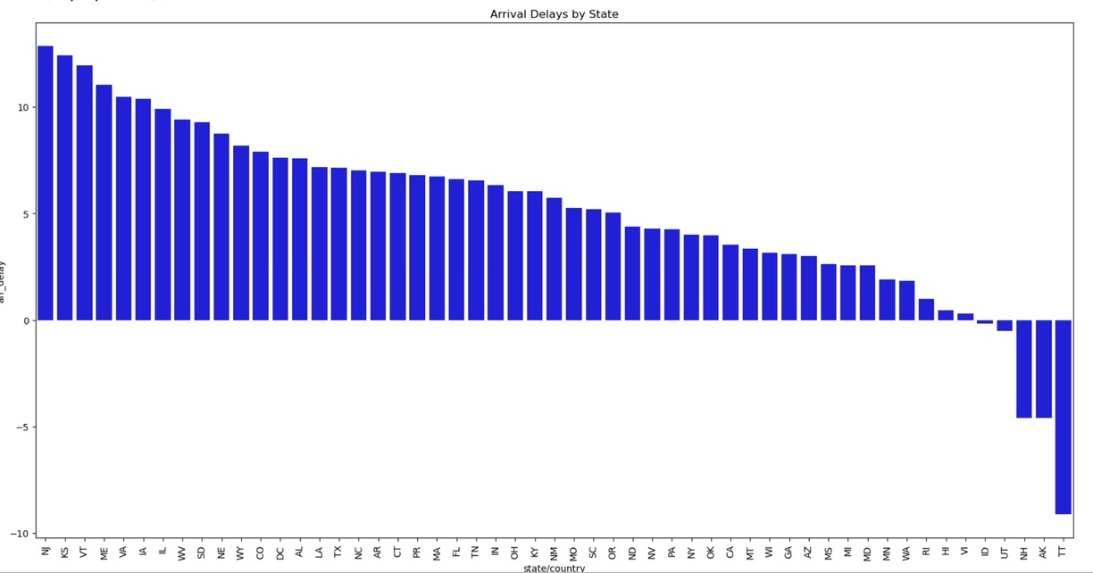
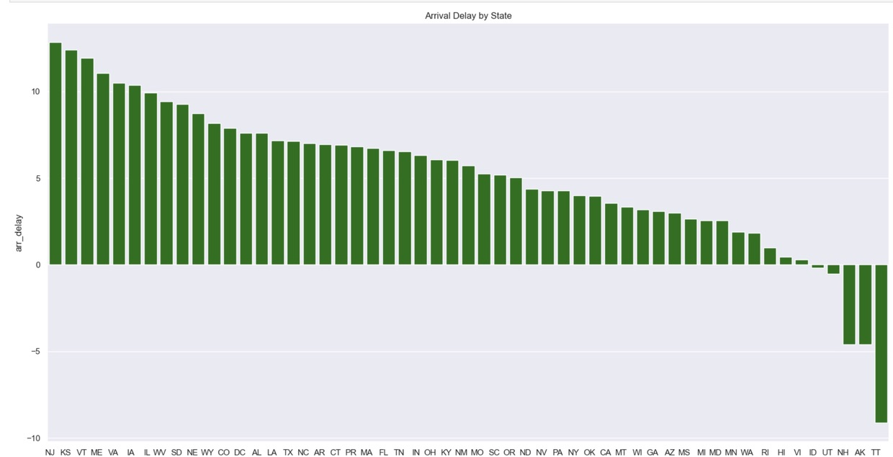
Departures Delays Vs. Arrival Delays
Does one cause the other?

Slide 7

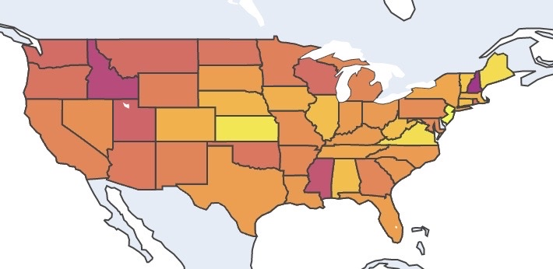
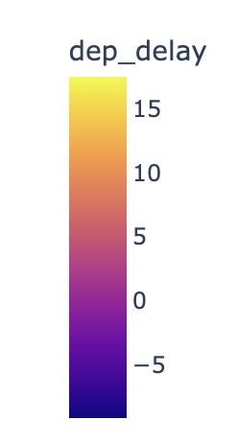

Traffic by State
Global picture of delayed flights in the USA.

Slide 8
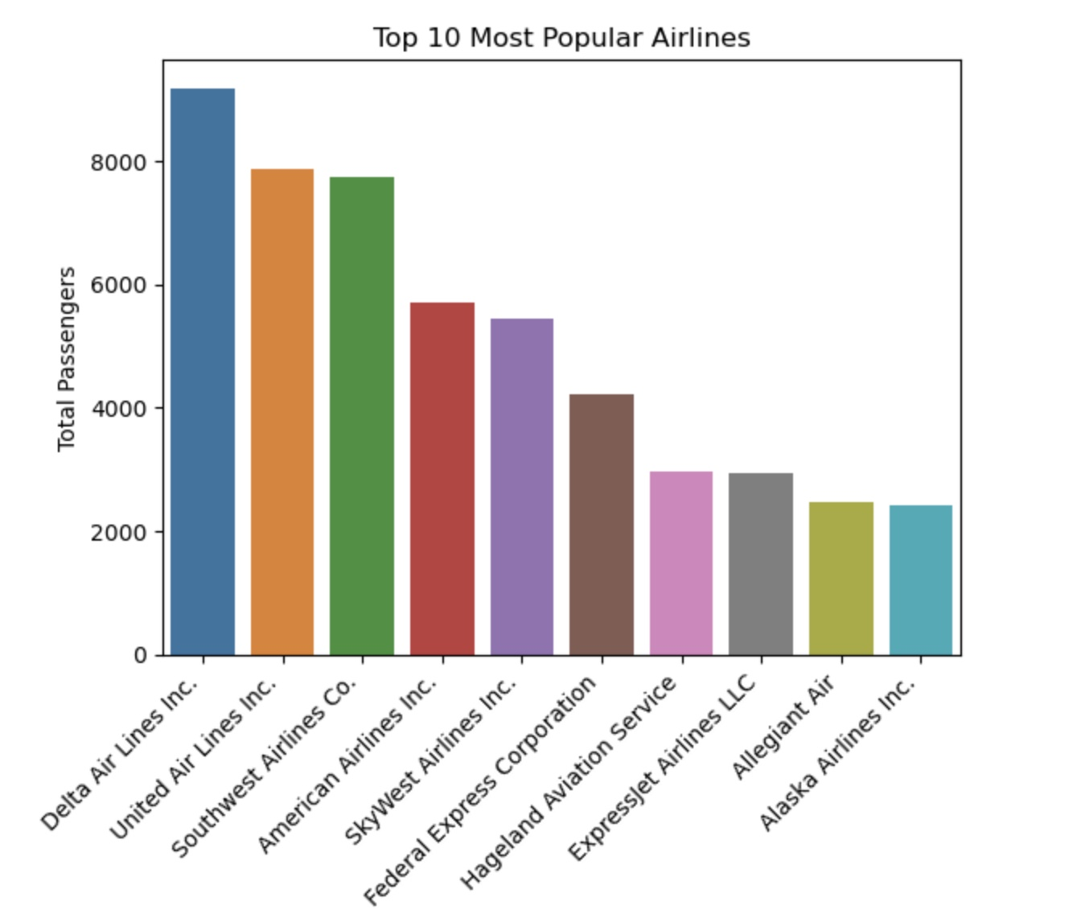
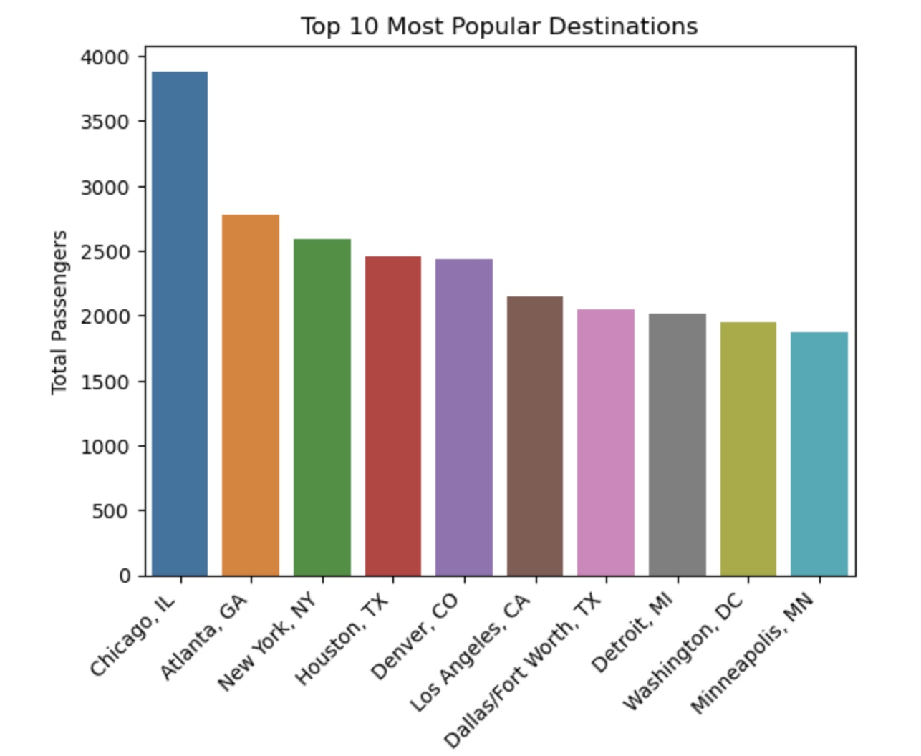
Checking Out The Top Ten

Slide 9
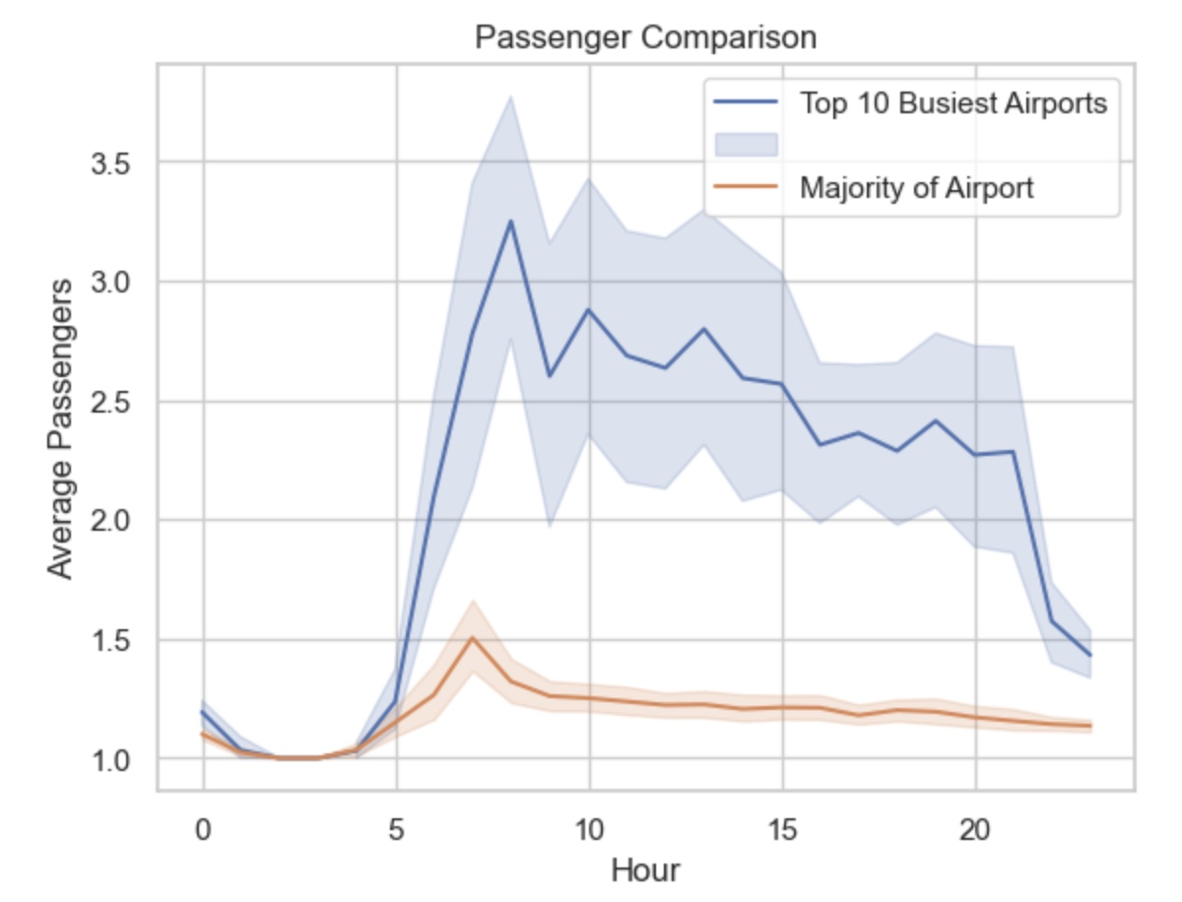
Highest Traffic Hours

Slide 10
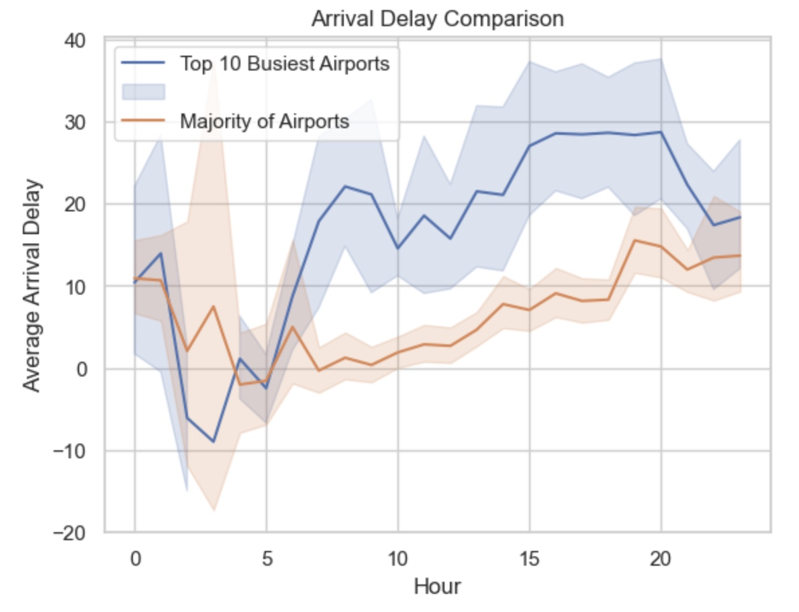
Comparing Delays per Hour

Slide 11

Model Results

Slide 12
Add a Slide Title - 7

