Slide 1
Stats Modelling Project

Slide 2
Process
CityBikes API used for Toronto, ON to gather latitudes and longitudes of all bike stations
Use those latitudes and longitudes for getting restaurant information from Yelp and FourSquare APIs
Checked for differences between the two different API sources
Did an initial scatterplot with the data
Combined the dataframes and create a regression model

Slide 3
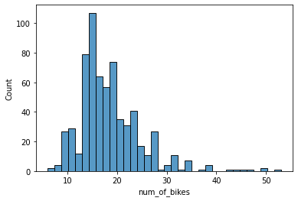
Exploratory Data Analysis
Looks left skewed as there are very few locations with a high number of bikes

Slide 4
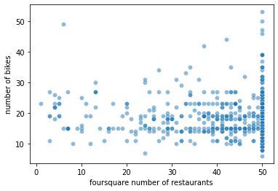
Exploratory Data Analysis
Looks like there is no correlation
A high number of restaurants capped at 50
Due to the nature of the APIs limiting 50 queries

Slide 5
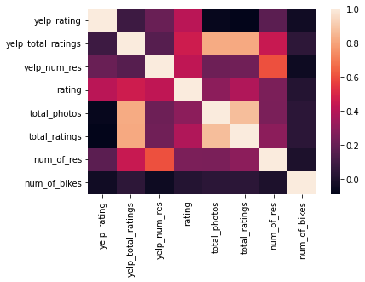
Exploratory Data Analysis
No correlation between the number of bikes and any of the variables measured
There are some correlation for some of the other variables

Slide 6
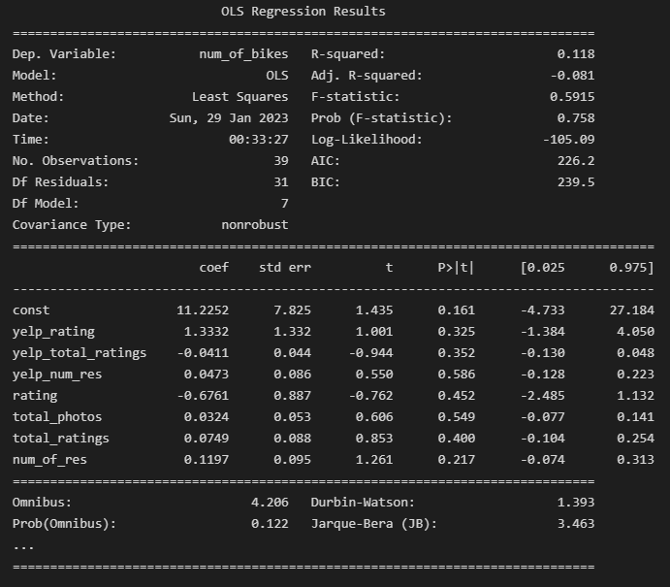
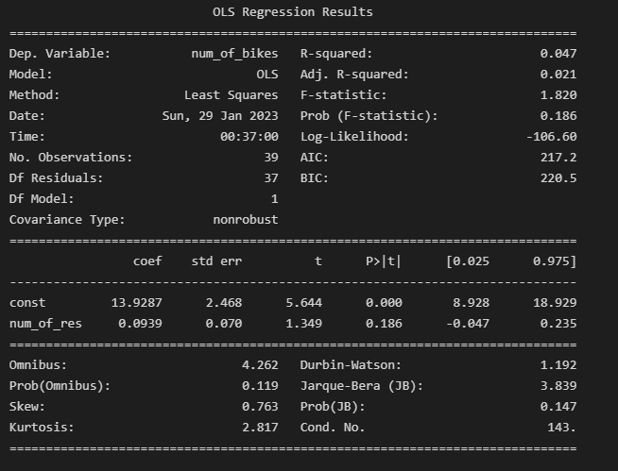
Initial Regression Model
Final Regression Model

Slide 7
Biggest Challenges
The API limit of 50 results, Yelp gave me 26900 that were 50+, and FourSquare gave 16248.
Merging the APIs and getting a data frame that only has 655 from both APIs compared to an outer join that has 56415
Unable to find a correlation with the number of bikes and number of restaurants (maybe if data was not limited, might have given a better correlation than the one currently shown)
Try to figure out other point of interests that may increase the number of bikes
Tried doing subway stations but that gave no correlation either
Educational institutions, tourist spots, shopping areas should be looked into for this

