Slide 1
Boardgame recommender
By: Johnathan Jack

Slide 2
Overview
Motivation
Why boardgames?
Exploratory Data analysis
What kind of information and insight can be discovered?
Results
Which model provided the best “recommendations”?
Future goals
Next steps to elevate the project

Slide 3
Motivation
Boardgames:
Fun for all ages
Increase social community
Feel a sense of comradery
Enable friendly competition
Notes:
Boardgames are a vessel to involve people of all ages to get together and create wonderful memories. They increase our social communities, enable friendly competition and through teamwork, we can feel a sense of comradery to strangers who we just met. But after the game is done, their replayability is often an issue as they can become stale and repetitive over time. A solution is to discover new games that have similar attributes but in a different setting/environment that satisfies/exceeds our expectations!

Slide 4
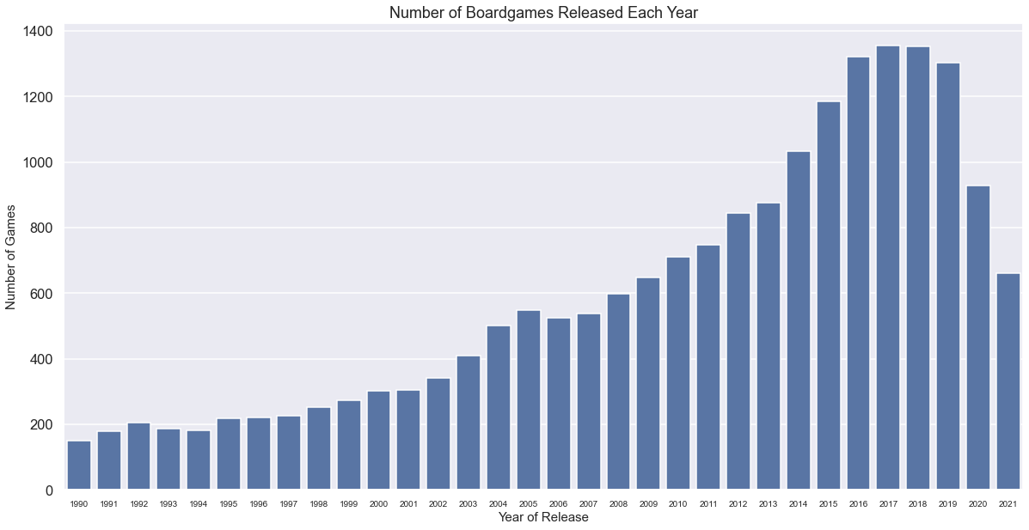
Exploratory Data Analysis
Number of boardgames released each year from 1990
Overall trend has been increasing
Large dropoff after 2019
Notes:
Graph shows the overall trend of the number of boardgames released each year. Overall, it is increasing but there is a significant drop after 2019. This could be related to covid19 as the world was on lockdown.

Slide 5
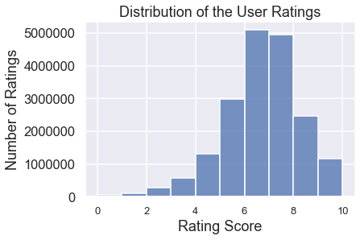
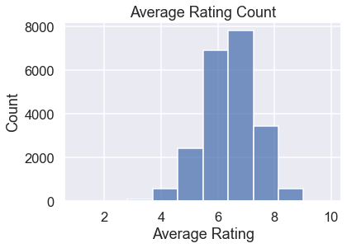
Exploratory Data Analysis
User ratings for games
Similar distribution between each other
Average Rating Count is dependent on the User Ratings
Notes:
The graphs show a similar distribution between each other. They are both dependent on one another as the user rates increase or decrease, the average rating for the game will fluctuate. It is seen that users will rate games higher and lower but it averages out around 6.5-7. This could be due to users being harsh critics or lenient ones!

Slide 6
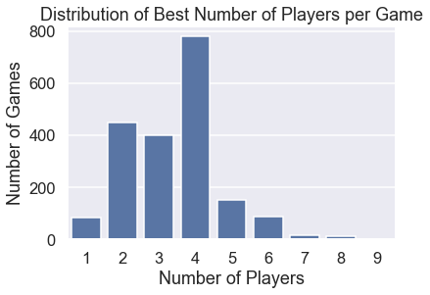
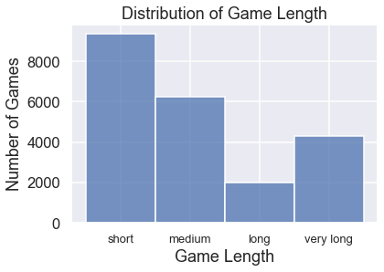
Exploratory Data Analysis
Game features
Best Number of players is 4
Game length
Short (<30mins)
Medium (<60mins)
Long (<90mins)
Very long (>90mins)
Notes:
Most games have an optimum number of players at 4 with a game length that is shorter than 30minutes. Following the optimum number of 4, the next highest is 2, which can indicate competitive games between two players. From the game length graph, it shows that there is not a market for games that are between 60-90minutes long. This could be a gray area where players rather play a longer intense game or a shorter fast paced game.

Slide 7
Results
content based recommender
Utilized game description with TfidfVectorizer to determine cosine similarities
Collaborative filtering based recommender
Utilized Matrix Factorization with Tensorflow to create recommendations between users
Hybrid based recommender
Combined both content based features and neural collaborative filtering

Slide 8
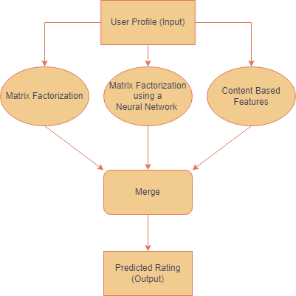
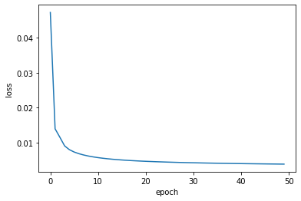
Hybrid recommender system
Results
Training Loss per Epoch
Able to predict top n boardgames given the user and n number of boardgames
RMSE = 0.082
Notes:
The model is successful in predicting a user’s top n number of boardgames that they have not played. This is done by utilizing the content-based features and the collaborative filtering method combined into a neural network. This model has the lowest RMSE value compared to the rest.

Slide 9
Future goals
Deployment
Would like to return the top n recommendations with a picture of the boardgame instead of just the text
Increase speed of result
Current turn around time is around 10seconds, would like to make it less than a second!
Continue experimentation on hidden layers
Add more custom features and hidden layers for better user recommendations

Slide 10
THANK YOU
Johnathan Jack
https://github.com/JohnathanJack/

