Slide 1
Duplicate Detection through Machine Learning
Presented by Johnathan Jack

Slide 2
Overview
Importance of Duplicate Detection
Exploratory Data Analysis
Results
Challenges
Future Goals

Slide 3
Importance of Duplicate Detection
Clean and concise database that can be easily searched and navigated
Faster response and answer to the questioner if the answer has already been given
Reduce the number of resources and time spent for answering duplicates

Slide 4
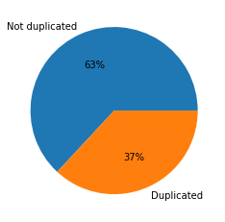

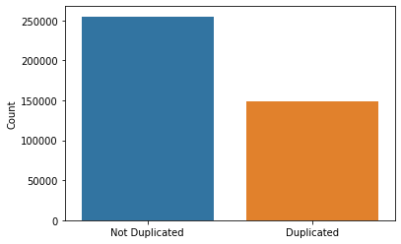
Exploratory Data Analysis
Some bias in the data as there are more non-duplicated data points

Slide 5
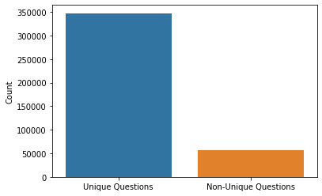
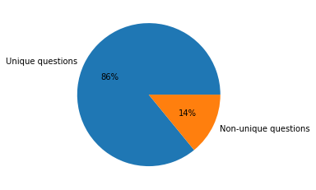
Exploratory Data Analysis
Top Question Asked from qid2:
How can you look at someone’s private Instagram account without following them?
Top Question Asked from qid1:
How do I improve my English speaking?

Slide 6
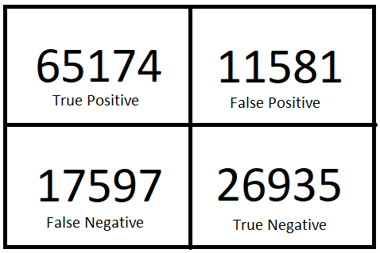
Naïve Bayes Results
Accuracy: 76%
Precision: 70%
Recall: 60%
F1 Score: 65%

Slide 7
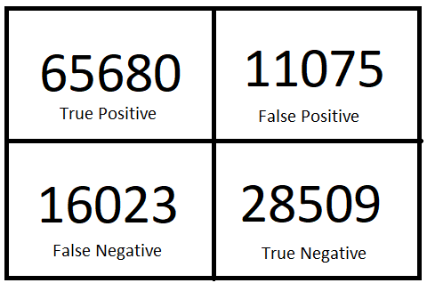
XGBoost Results
Accuracy: 78%
Precision: 72%
Recall: 64%
F1 Score: 68%
Performed GridSearch, had worse results than default configuration

Slide 8
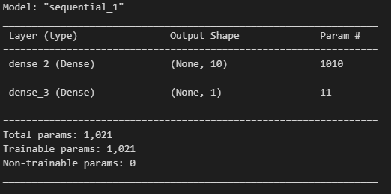
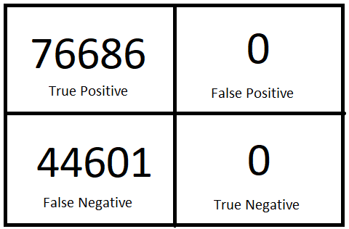
Basic Neural Network
1 Hidden layer
10 nodes
25 epochs
Training accuracy: 63%
Testing accuracy: 63%

Slide 9
Challenges / Future Goals
Vectorizing and combining question 1 and question 2 columns in the data frame
Learned to use sparse matrices to accomplish this
Creating new features was difficult
Use word2vec/glove and try to see if that increases the overall performance of the model
Improve on the deep neural network

