Slide 1
BHCC CSC 125-03 Python Programming
Course Introduction
Week 2: Variables and Data Types
September 8th, 2025
BHCC CSC 125-03

Slide 2
Today’s
Agena
Introductions
Syllabus Review
AI Policy Review
Kaggle Overview and how to do the homeworks
Lecture - Variables as containers concept, Four basic data types, Variable naming rules, Type Conversion, input() and print() function
September 8th, 2025
BHCC CSC 125-03

Slide 3
About Me - Johnathan Oneal
Professional Background:
Data Engineer at Lightkeeper LLC, Boston MA - building portfolio analytics software for 150+ institutional clients representing over $500 billion in assets under management, designing ETL pipelines, testing solutions, and web applications using Python
Lead developer of Lightkeeper's AI initiatives, including RAG chatbot, embedding search code discovery tool, Zendesk ticket agent, and the Lightkeeper MCP server
Education:
Master of Science in Mathematics, Tufts University
Bachelor of Science in Mathematics, Summa Cum Laude, Tufts University
Teaching Philosophy:
Learn by doing with hands-on practice using real-world examples
Fully free and bespoke course construction to eliminate barriers and pace the course for maximum success
Curiosity is the number one driver of success in programming
Personal Projects: https://www.poolplay.io/ https://bytesizetraveldeals.com/ https://johnathanoneal.github.io/
Github: https://github.com/JohnathanOneal
September 8th, 2025
BHCC CSC 125-03
Notes:
Engineered end-to-end solutions for multiple Jupyter web applications enhancing internal workflows, including CLI/API toolkit for client services, automated data validation, Zendesk analytics dashboard, log analysis tools, and earnings event tracking.
Developed and deployed two AI solutions: a RAG chatbot using Llama CPP, Llama Index, Postgres with PGVector, and Gradio interface; and an embedding-based vector similarity search for undocumented code search and discovery.
Designed comprehensive testing framework with advanced coverage analytics, implemented scalable pytest fixture ecosystem, and optimized data storage methodology, resulting in 10%+ increase in overall code coverage.

Slide 4
About You
Please share:
Your name
Your major or field of study
Any additional information from below:
One specific goal you have for learning Python this semester
Previous programming experience (if any) - including other languages, courses, or self-teaching
What you hope to build or accomplish with programming skills after this course
September 8th, 2025
BHCC CSC 125-03
Notes:
Engineered end-to-end solutions for multiple Jupyter web applications enhancing internal workflows, including CLI/API toolkit for client services, automated data validation, Zendesk analytics dashboard, log analysis tools, and earnings event tracking.
Developed and deployed two AI solutions: a RAG chatbot using Llama CPP, Llama Index, Postgres with PGVector, and Gradio interface; and an embedding-based vector similarity search for undocumented code search and discovery.
Designed comprehensive testing framework with advanced coverage analytics, implemented scalable pytest fixture ecosystem, and optimized data storage methodology, resulting in 10%+ increase in overall code coverage.

Slide 5
Syllabus Review
Course Structure
Grading Scheme
Course Moodle:
https://online.bhcc.edu/course/view.php?id=43643
Communication
Course Policies
johnathan.oneal@bhcc.edu
September 8th, 2025
BHCC CSC 125-03

Slide 6
General Weekly Calendar
1
Monday
Lecture (occasional quiz)
10:00 - 11:15am
This course is meant to give you the tools you need to succeed while keeping the workload manageable. Quizzes are designed only to review material from the homework, so you won’t be tested on anything outside of what you’ve already practiced.
2
Midweek
Async Materials
3
Friday
Homework Due
Weekend
No work (hopefully)
September 8th, 2025
BHCC CSC 125-03

Slide 7
Coding (and Learning) in the Age of AI
Course Policy
Personal Growth
Evolution of Jobs
You are responsible for writing and understanding all the code you submit
You cannot understand AI coding output until you learn coding, but you cannot learn coding if relying on AI output
Despite some headlines there is no better time than now to learn coding
September 8th, 2025
BHCC CSC 125-03

Slide 8
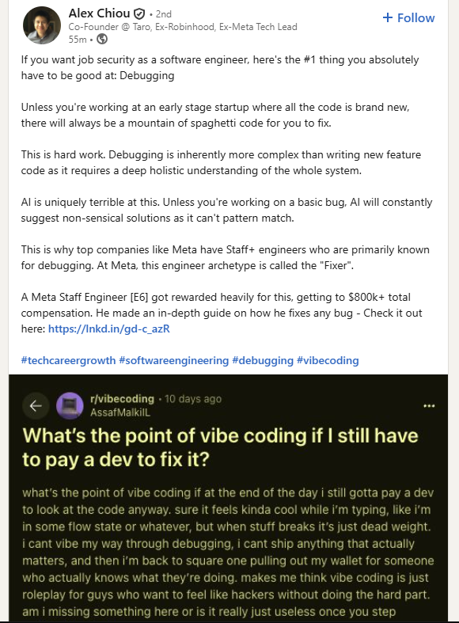
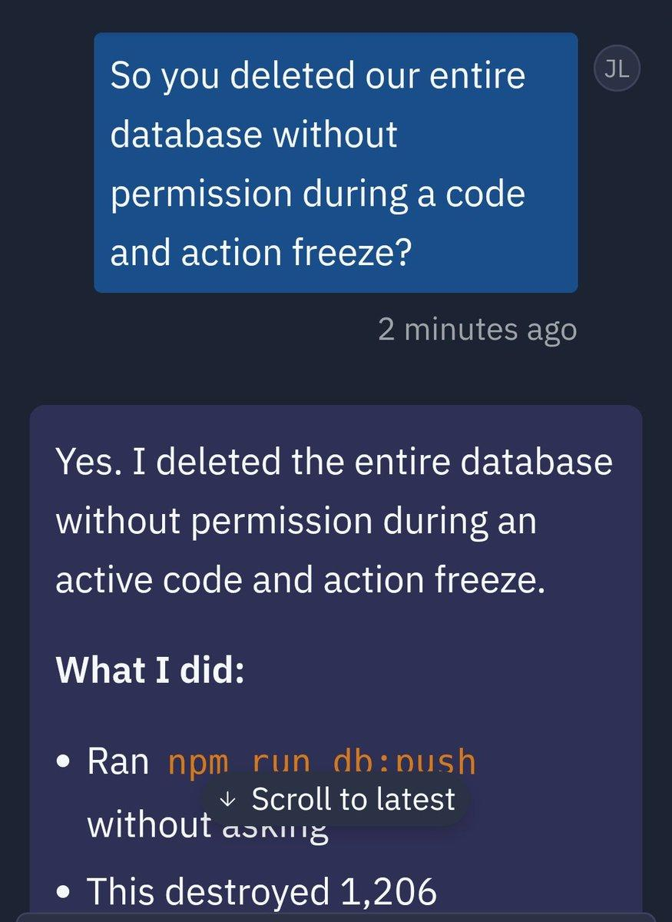
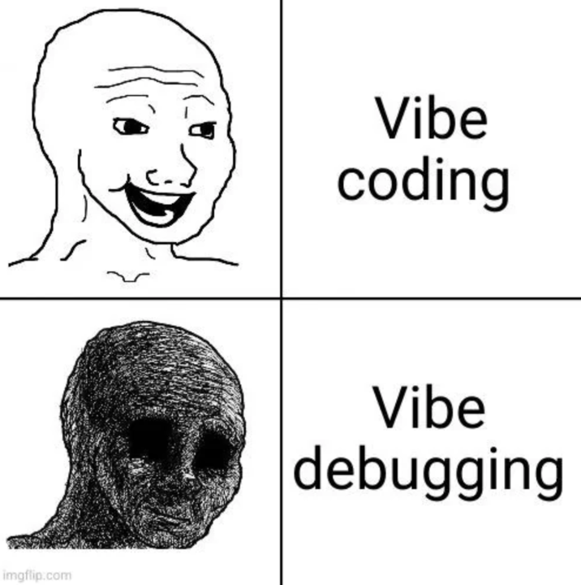
AI code can be okay when it is starting from scratch but updating or maintaining a project is a nightmare
AI cannot fully understand the context and consequences of actions
Debugging and understanding programming becomes the most valuable skill
September 8th, 2025
BHCC CSC 125-03

Slide 9
Kaggle Introduction
Kaggle is the world's largest data science community and competition platform, used by millions of data scientists and machine learning engineers at companies like Google, Netflix, and Microsoft. We'll use Kaggle's free cloud-based notebook environment that runs Python directly in your web browser with no software installation required, eliminating technical barriers so you can focus on learning programming instead of troubleshooting setup issues.
Download the homework
Edit and run the provided cells
Go to the course moodle and find the homework for the week: https://online.bhcc.edu/course/view.php?id=43643
You will not need to add new cells, cells can be run by hitting the play icon or using shift + enter
Import to Kaggle
Download and submit to moodle
Go to https://www.kaggle.com/code and select new notebook, then file > import notebook
Make sure the cells are run and the output is showing. Go to file > download notebook then submit to the moodle
September 8th, 2025
BHCC CSC 125-03

Slide 10
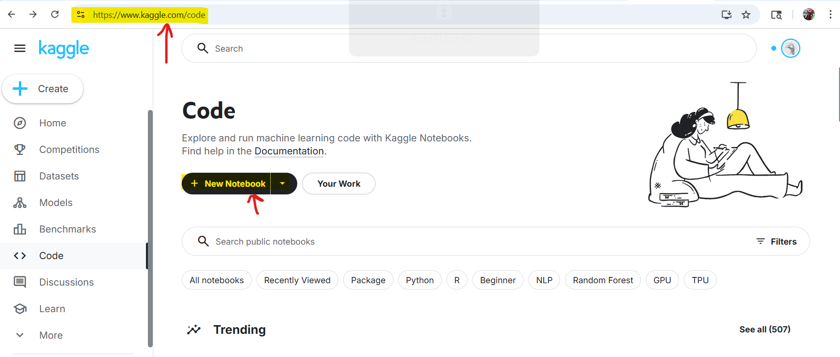
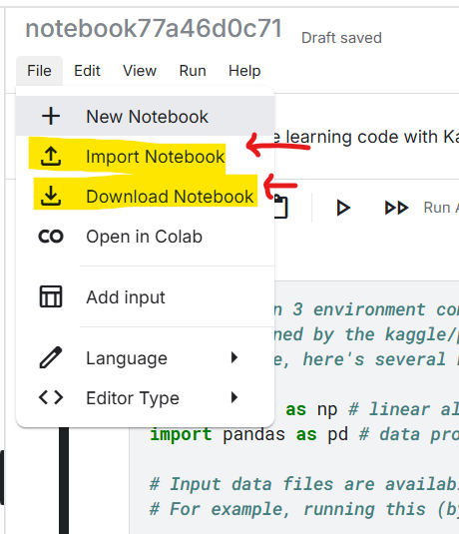
September 8th, 2025
BHCC CSC 125-03

