Slide 1
BHCC CSC 125-03 Python Programming
Course Introduction
Week 3: Working With Strings + Debugging
September 15th, 2025
BHCC CSC 125-03

Slide 2
Today’s
Agena
Homework 2 Review - Variables and data types concepts
Week 3 Introduction: String operations, indexing and slicing, f-string formatting, and debugging fundamentals
September 15th, 2025
BHCC CSC 125-03

Slide 3
Every homework assignment builds directly on the concepts we've covered in class and the asynchronous materials, so you already have all the tools you need to succeed. When you encounter challenges, take a step back and review the relevant examples and materials carefully because they contain the patterns and solutions you'll need. Remember that debugging and problem solving are core programming skills, so use print statements to check your variables and read error messages closely since they often point directly to the issue. Most importantly, don't hesitate to reach out via email when you're stuck because asking questions is an essential part of learning, and I'm here to help you understand the concepts, not just complete the assignments.
General Weekly Calendar
1
Monday
Lecture (occasional quiz)
10:00 - 11:15am
2
Midweek
Async Materials
3
Friday
Homework Due
Weekend
No work (hopefully)
September 15th, 2025
BHCC CSC 125-03

Slide 4
Homework Review
Variables as Containers
Mental model: variables are labeled storage boxes for data
Assignment syntax and the importance of descriptive naming
Data Types Fundamentals
String, integer, float, and boolean - when to use each type
Using type() function to check variable types
Variable Naming Conventions
snake_case naming rules and restrictions
Common naming errors and how to avoid them
Type Conversion
Converting between strings, integers, and floats using int(), float(), str()
Why input() always returns strings and requires conversion for math operations
Common Debugging Patterns
Reading error messages: TypeError, NameError, SyntaxError
Variable spelling mistakes and missing quotes
Type mismatch errors when mixing strings and numbers
September 15th, 2025
BHCC CSC 125-03
Notes:
Engineered end-to-end solutions for multiple Jupyter web applications enhancing internal workflows, including CLI/API toolkit for client services, automated data validation, Zendesk analytics dashboard, log analysis tools, and earnings event tracking.
Developed and deployed two AI solutions: a RAG chatbot using Llama CPP, Llama Index, Postgres with PGVector, and Gradio interface; and an embedding-based vector similarity search for undocumented code search and discovery.
Designed comprehensive testing framework with advanced coverage analytics, implemented scalable pytest fixture ecosystem, and optimized data storage methodology, resulting in 10%+ increase in overall code coverage.

Slide 5
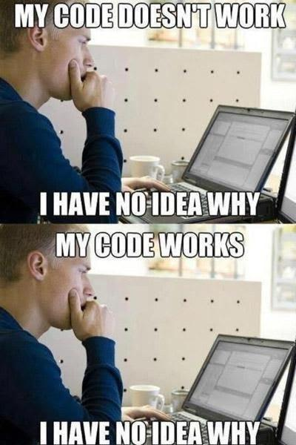
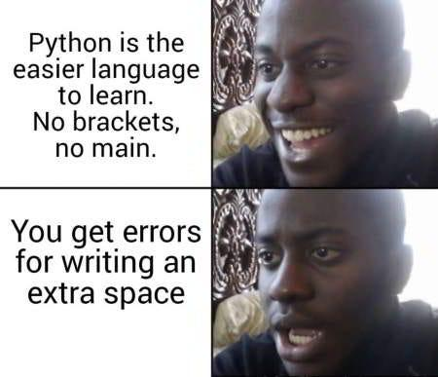
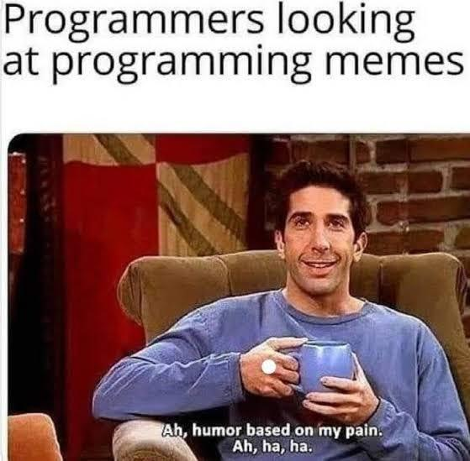
The Universal Programming Experience: When your code mysteriously breaks and mysteriously fixes itself
Python's is 'Beginner-friendly' until you discover IndentationError
When you see a meme about debugging at and it hits too close to home
September 15th, 2025
BHCC CSC 125-03

Slide 6
Week 3 - Working With Strings + Debugging
String Methods and Manipulation
Essential string methods: upper(), lower(), strip(), replace()
Method chaining and when to use each transformation
String Indexing and Slicing
Accessing individual characters with bracket notation [0]
Extracting substrings using slice syntax [start:end]
Understanding positive and negative indexing
F-String Formatting
Modern string formatting with f-strings for dynamic output
Embedding variables and expressions within strings
Creating professional, readable output messages
Error Messages and Debugging
Reading and interpreting common error types: IndexError, TypeError, AttributeError
Systematic debugging approaches using print statements
Building confidence in troubleshooting your own code
September 15th, 2025
BHCC CSC 125-03
Notes:
Engineered end-to-end solutions for multiple Jupyter web applications enhancing internal workflows, including CLI/API toolkit for client services, automated data validation, Zendesk analytics dashboard, log analysis tools, and earnings event tracking.
Developed and deployed two AI solutions: a RAG chatbot using Llama CPP, Llama Index, Postgres with PGVector, and Gradio interface; and an embedding-based vector similarity search for undocumented code search and discovery.
Designed comprehensive testing framework with advanced coverage analytics, implemented scalable pytest fixture ecosystem, and optimized data storage methodology, resulting in 10%+ increase in overall code coverage.

Slide 7
Kaggle Introduction
Kaggle is the world's largest data science community and competition platform, used by millions of data scientists and machine learning engineers at companies like Google, Netflix, and Microsoft. We'll use Kaggle's free cloud-based notebook environment that runs Python directly in your web browser with no software installation required, eliminating technical barriers so you can focus on learning programming instead of troubleshooting setup issues.
Download the homework
Edit and run the provided cells
Go to the course moodle and find the homework for the week: https://online.bhcc.edu/course/view.php?id=43643
You will not need to add new cells, cells can be run by hitting the play icon or using shift + enter
Import to Kaggle
Download and submit to moodle
Go to https://www.kaggle.com/code and select new notebook, then file > import notebook
Make sure the cells are run and the output is showing. Go to file > download notebook then submit to the moodle
September 15th, 2025
BHCC CSC 125-03

Slide 8
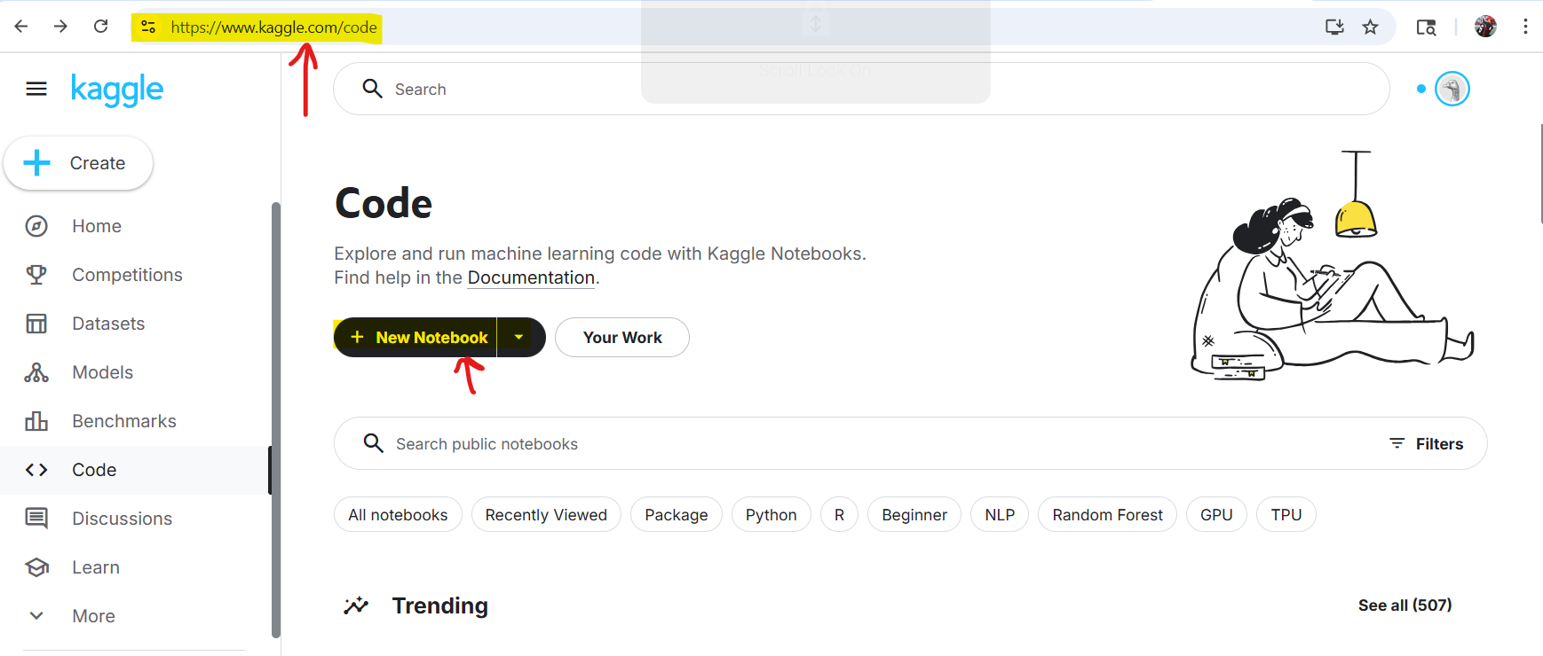
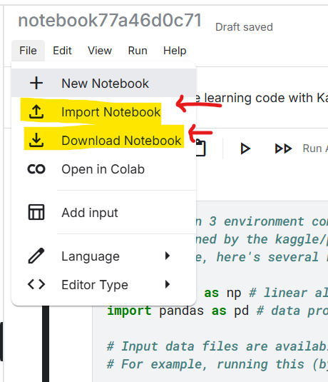
September 15th, 2025
BHCC CSC 125-03

