Slide 1
BHCC CSC 125-03 Python Programming
Week 8: For Loops
October 19th, 2025
BHCC CSC 125-03

Slide 2
Today’s
Agena
Week 7 Review
Midterm Practice Preview
Week 8 Intro
Week 8 Code Lecture
Week 3-4 Quiz
October 19th, 2025
BHCC CSC 125-03

Slide 3
Week 7 - Advance List Operations
Creating and Accessing Lists
Create with brackets [1, 2, 3], access with index starting at 0: my_list[0]
Negative indices count from end: my_list[-1] is last item
Use len(my_list) to count items, lists are mutable
List Slicing
[start:end] extracts portion, end excluded: my_list[1:4] gets indices 1, 2, 3
[:3] first three, [3:] from index 3 on, [::-1] reverses
my_list[:] creates copy
Modifying Lists
.append(item) adds to end, .insert(i, item) adds at position
.remove(value) deletes first, .pop() removes last
.sort() and .reverse() modify in place, return None
Methods: Modify vs Return
Modify in place (return None): .append(), .sort(), .reverse(), .remove()
Return new value: sorted(), len(), max(), min(), sum()
Don't assign .sort() result - use sorted() instead
References vs Copies
list2 = list1 creates reference, both point to same list
Changes to either affect both
Copy with [:], .copy(), or list() for independence
Tuples
Immutable: (1, 2, 3) cannot change after creation
Use for fixed data: coordinates, colors, records
Unpack: x, y = point or swap: a, b = b, a
October 19th, 2025
BHCC CSC 125-03

Slide 4
Midterm Overview
Topics Tested
Variables, data types, type conversion, input/output
Strings: methods, slicing, f-strings
Operators: arithmetic, comparison, assignment, boolean, precedence
Conditionals: if/elif/else, logical operators, nested conditions
Lists/Tuples: creation, indexing, slicing, basic methods, mutability
For loops: syntax, range(), nested loops, iteration patterns
While loops: syntax, break/continue, input validation
Practice Problems on Moodle, and an additional practice covering the code writing problems will be posted next week. https://online.bhcc.edu/pluginfile.php/3819291/mod_resource/content/1/midterm_practice_01.pdf
Coverage
Weeks 2-9: Variables through While Loops
Excludes: Week 1 intro, Week 7 advanced lists, Week 10 planning
Format
Mix of code writing, code reading, and debugging
Trace code execution and predict output
Fix errors in provided code
Write short programs combining multiple concepts
The structure while be very similar to the quizzes with the addition of writing small programs
October 19th, 2025
BHCC CSC 125-03

Slide 5
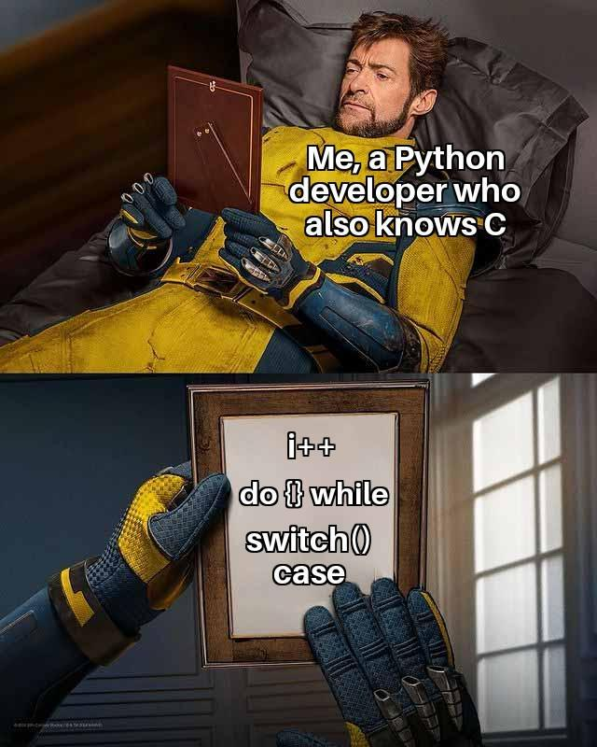
For Loops: Real World Examples
Scenario: Fitbit Step Counter
Fitness tracker records your steps every minute (1,440 data points per day)
How does it add up all readings to get daily total?
How does it find your most active hour?
Scenario: Video Game Collision
Game has 50 enemies on screen
How does it check if player's bullet hit any enemy?
How does it update health for each enemy that got hit?
Scenario: Barcode Scanner at Checkout
Cashier scans 20 items in your cart
How does the register look up each item's price in the database?
How does it calculate your total and apply discounts?
October 19th, 2025
BHCC CSC 125-03

Slide 6
But What Does it Look Like in Python?
Barcode Scanner
for item in cart:
price = database.lookup(item.barcode)
total += price
for item in cart:
if item.has_coupon:
total -= item.discount
Video Game Collision
for enemy in enemies:
if bullet.hits(enemy):
enemy.health -= 10
for enemy in enemies:
if enemy.health <= 0:
enemies.remove(enemy)
Fitbit Step Counter
for reading in step_data:
total_steps += reading
for hour in range(24):
if steps[hour] > max_steps:
max_hour = hour
October 19th, 2025
BHCC CSC 125-03

