Slide 1
BHCC CSC 125-03 Python Programming
Week 9: While Loops, Debugging, Try/Except
October 27th, 2025
BHCC CSC 125-03

Slide 2
Today’s
Agena
Week 8 Review
Midterm Practice
Week 9 Intro
Week 9 Code Lecture
The homework and materials this week are much shorter to give you more time to study.
October 27th, 2025
BHCC CSC 125-03

Slide 3
Week 8 - For Loops
For Loop Basics
Use for to iterate through sequences: for item in list:
Works with lists, strings, and ranges
Loop body must be indented under for
Using range()
range(stop), range(start, stop), range(start, stop, step)
range(5) gives 0–4, end excluded
Use list(range(5)) to see full list
Common Patterns
Accumulate: total += num adds up items
Count: if cond: count += 1 increments on match
Build list: new.append(item * 2) creates new list
Looping with Indices
for i in range(len(list)): gives positions
Modify by index: list[i] += 1
Only use indices when needed
References vs Copies
for char in text: iterates characters
Count vowels or filter letters
Build new string by adding chars
Nested Loops and Conditionals
Inner loop runs fully for each outer loop
Combine with if for filtering or comparisons
Avoid deep nesting when possible
October 27th, 2025
BHCC CSC 125-03

Slide 4
Midterm Overview
Topics Tested
Variables, data types, type conversion, input/output
Strings: methods, slicing, f-strings
Operators: arithmetic, comparison, assignment, boolean, precedence
Conditionals: if/elif/else, logical operators, nested conditions
Lists/Tuples: creation, indexing, slicing, basic methods, mutability
For loops: syntax, range(), nested loops, iteration patterns
While loops: syntax, break/continue, input validation
Practice Problems on Moodle, and an additional practice covering the code writing problems are posted. https://online.bhcc.edu/pluginfile.php/3819291/mod_resource/content/1/midterm_practice_01.pdf
Coverage
Weeks 2-9: Variables through While Loops
While loops will not be heavily tested as you will not have much time with them before the Midterm
Format
Mix of code writing, code reading, and debugging
Trace code execution and predict output
Fix errors in provided code
Write short programs combining multiple concepts
The structure while be very similar to the quizzes with the addition of writing small programs. Practice Here: https://online.bhcc.edu/pluginfile.php/3824470/mod_resource/content/1/midterm_practice_02.pdf
October 27th, 2025
BHCC CSC 125-03

Slide 5
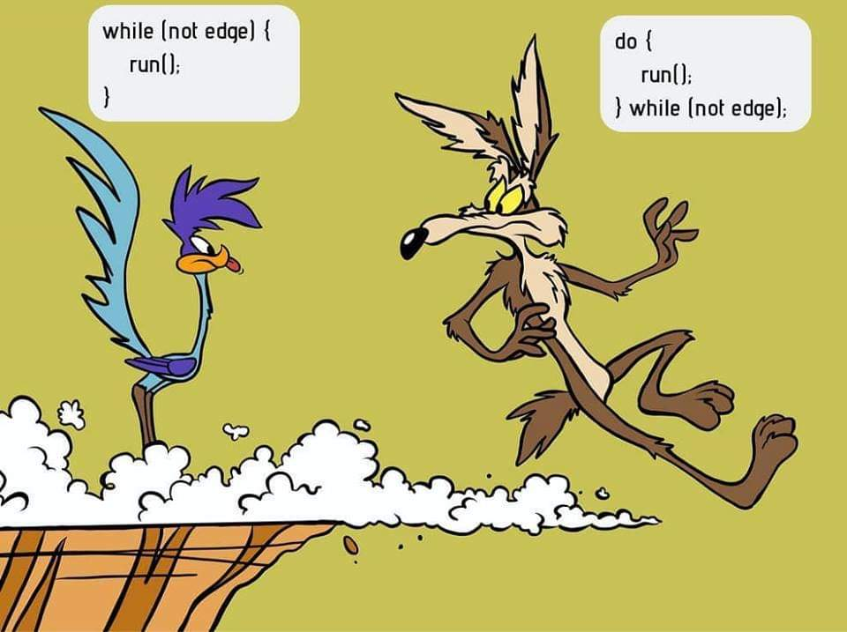
While Loops: Real World Examples
Scenario: Phone Battery Monitor
Your phone checks battery level every minute
How does it warn you when power drops below 20%?
How does it keep showing the updated percentage as time passes?
Scenario: ATM Withdrawal
An ATM waits for you to enter the correct PIN
How does it keep asking until you enter it right or cancel?
How does it stop after three failed attempts?
Scenario: Coffee Machine
Machine keeps brewing until water runs out
How does it monitor the water tank level?
How does it stop heating when the tank is empty?
October 27th, 2025
BHCC CSC 125-03

Slide 6
But What Does it Look Like in Python?
ATM Withdrawal
attempts = 0
pin = ""
while pin != "1234" and attempts < 3:
pin = input("Enter PIN: ")
attempts += 1
if pin == "1234":
print("Access granted")
else:
print("Card locked")
Coffee Machine
water = 5
while water > 0:
print("Brewing coffee...")
water -= 1
print("Out of water, stopping machine")
Phone Battery Monitor
battery = 100
while battery > 20:
print(f"Battery at {battery}%")
battery -= 5
print("Low battery warning!")
October 27th, 2025
BHCC CSC 125-03

