Slide 1
BHCC CSC 125-03 Python Programming
Week 11: Dictionaries
November 9th, 2025
BHCC CSC 125-03

Slide 2
Today’s
Agena
Midterm Review
Whiteboard Problem
Week 11 Intro
Week 11 Code Lecture
November 9th, 2025
BHCC CSC 125-03

Slide 3
Week 11 - Dictionaries
Dictionary Basics
Store key-value pairs: {"key": "value"}
Access with brackets: my_dict["key"]
Keys must be unique, values can be any type
Creating Dictionaries
All at once: car = {"make": "Toyota", "year": 2020}
Start empty: car = {} then car["make"] = "Toyota"
Add or update: my_dict["key"] = "value"
Dictionary Methods
Check key: if "key" in my_dict:
Safe access: my_dict.get("key", "default")
Get keys/values: .keys(), .values(), .items()
Looping Through Dictionaries
Keys only: for key in my_dict:
Values only: for value in my_dict.values():
Key-value pairs: for key, value in my_dict.items():
Common Patterns
Counting: if item in count: count[item] += 1 else: count[item] = 1
Find max: loop through .items(), track highest
Build from lists: use range(len(list)) to pair up data
Nested Dictionaries
Dictionary of dictionaries: students = {"Alice": {"age": 20, "major": "CS"}}
Access nested: students["Alice"]["major"]
Loop nested: for name, info in students.items():
November 9th, 2025
BHCC CSC 125-03

Slide 4
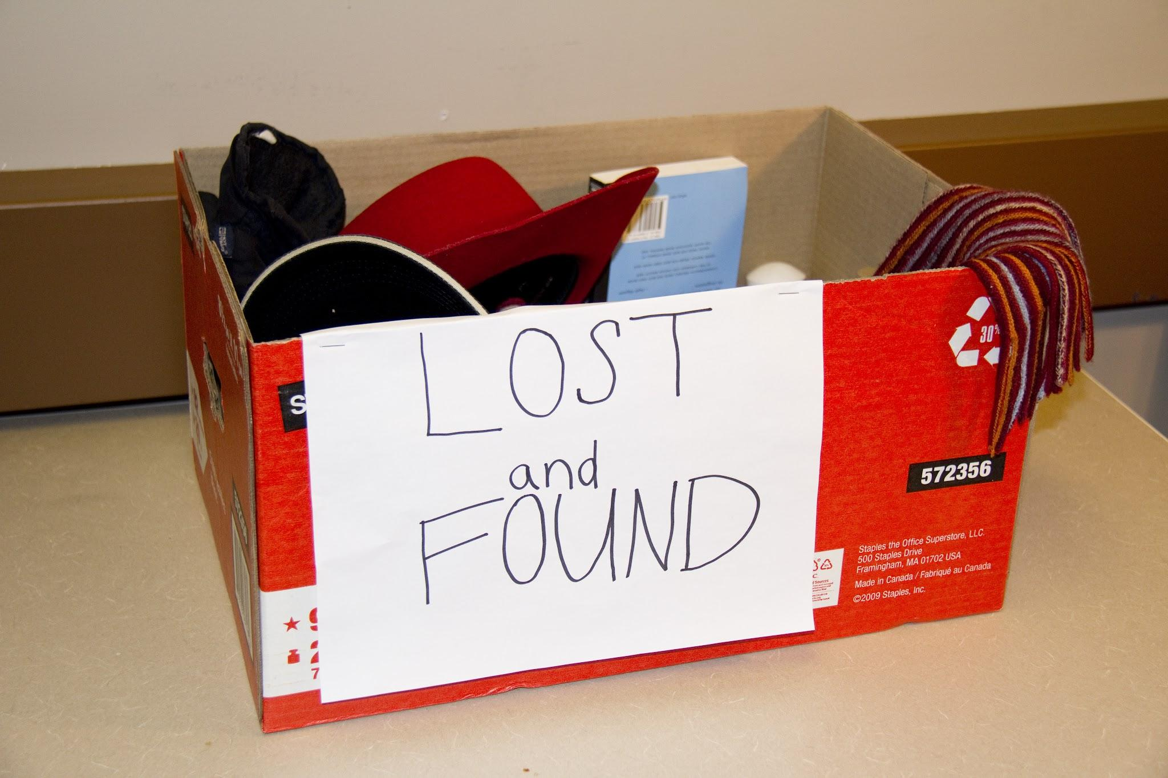
Dictionary: Lost and Found
Add Items to the Lost and Found Below: Add Owners of the items to the lost and found Below:
November 9th, 2025
BHCC CSC 125-03

Slide 5
The Problem with Lists
Lost and Found Box
items = ["keys", "wallet", "phone", "laptop", "backpack"]
owners = ["Alice", "Bob", "Charlie", "Diana", "Eve"]
What Can Go Wrong?
Hard to Look Up: "Who lost their phone?" → Find phone at position 2 → Check owners[2] → "Charlie"
Easy to Break:
items.remove("wallet") # Bob claimed his wallet
# Forgot to update owners list!
print(items[2]) # "laptop"
print(owners[2]) # "Charlie" ← Wrong! Says Charlie lost laptop
Confusing: What is owners[3]? Have to count positions… What if you wanted to add a field for how long they have been there?
November 9th, 2025
BHCC CSC 125-03

Slide 6
Dictionaries Solve these Problems
Lost and Found - The Right Way
lost_and_found = {
"keys": "Alice",
"wallet": "Bob",
"phone": "Charlie",
}
BONUS: Easy to Add More Info!
lost_and_found = {
"phone": {"owner": "Charlie", "days": 3},
"keys": {"owner": "Alice", "days": 1}
}
Easy Lookup:
"Who lost their phone?"
owner = lost_and_found["phone"] # "Charlie" - Done!
Can't get Out of Sync:
Remove entire entry at once
lost_and_found.pop("wallet") # Removes "wallet": "Bob" completely, everything else still works perfectly!
Note: pop("wallet") removes the whole "wallet": "Bob" pair and returns "Bob". The key "wallet" is gone from the dictionary.
November 9th, 2025
BHCC CSC 125-03

