Slide 1
BHCC CSC 125-03 Python Programming
Week 13: Libraries and Modules
November 24th, 2025
BHCC CSC 125-03

Slide 2
Today’s
Agena
Course Schedule Reminder
Week 12 Refresher
Week 13 Intro
Week 13 Code Lecture
November 24th, 2025
BHCC CSC 125-03

Slide 3
Course Schedule - Final Weeks
WEEK 13 (this week) – Monday, November 24th
Quiz, Dictionaries
Homework from last week: Final Project Pseudocode Extended to be due Tuesday, November 25th at 11:59PM
Enjoy Thanksgiving Break, BHCC is off Thursday through Sunday
WEEK 14 – Monday, December 1st
Start working on Final Project Code, Nothing due
WEEK 15 (LAST CLASS) – Monday, December 8th
Special Final Quiz (if you have a laptop bring it, if not we can use the classroom computers, anyone who attends will get full credit) Coffee and Donuts will also be provided
FINAL PROJECT DUE
Sunday, December 14th at 11:59 PM
November 24th, 2025
BHCC CSC 125-03

Slide 4
Week 12 Refresher - Functions
Function Basics
Define with def function_name(parameter):
Call with function_name(argument)
Body must be indented
Parameters and Arguments
Parameters are variables in the definition: def greet(name):
Arguments are values when calling: greet("Alice")
Multiple parameters: def area(length, width):
Return Values
Use return to send data back from function
Returned value can be used in expressions: total = add(5, 3) * 2
Without return, function returns None
November 24th, 2025
BHCC CSC 125-03

Slide 5
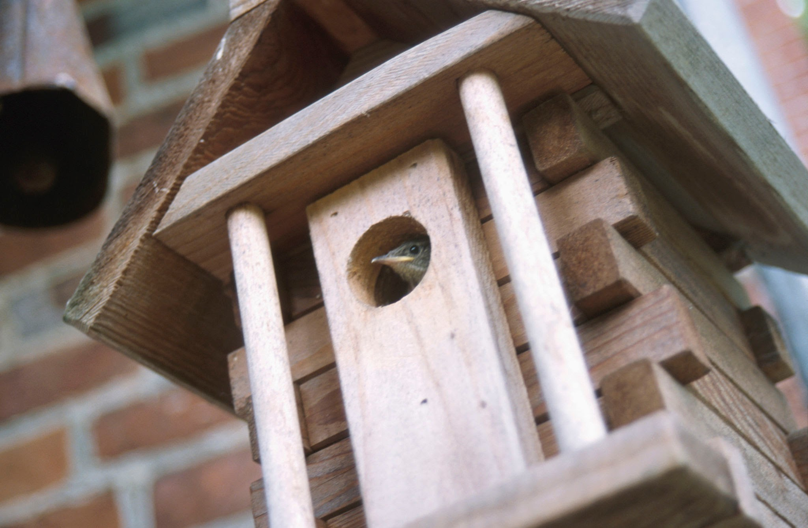
Libraries: Build a Birdhouse
What do you need?
Hammer
Saw
Screwdriver
Nails
Wood
Do you BUILD the hammer first?
November 24th, 2025
BHCC CSC 125-03

Slide 6
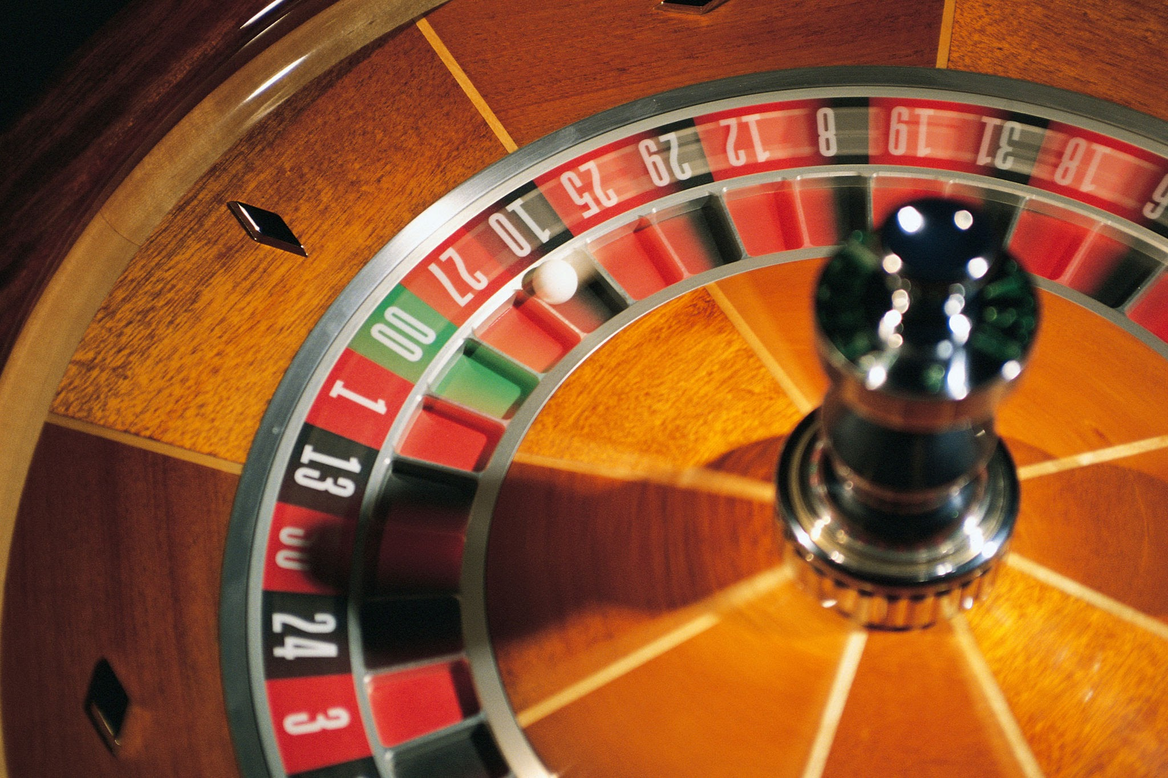
Programming is the same
You're building a program that needs:
Random numbers
Date calculations
Math operations
Do you BUILD the random number generator first?
November 24th, 2025
BHCC CSC 125-03

Slide 7
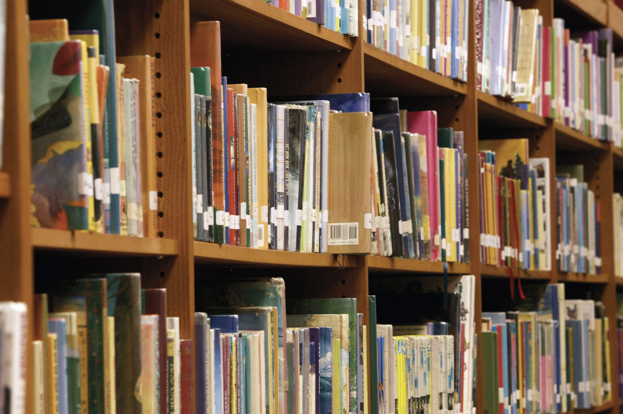

What Are Libraries
Library = Toolbox of pre-built functions
Someone already:
Wrote the code
Tested it thoroughly
Made it work perfectly
You just grab it and use it
Why Use Libraries? Without libraries: Spend weeks building a random number generator
With libraries: Write one line: import random
Focus on YOUR project, not rebuilding basic tools
November 24th, 2025
BHCC CSC 125-03

