Slide 1


ML4NR
Machine learning for noise reduction in old audio records
Bachelor thesis

Slide 2
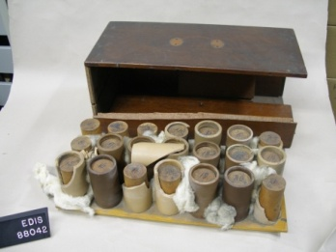
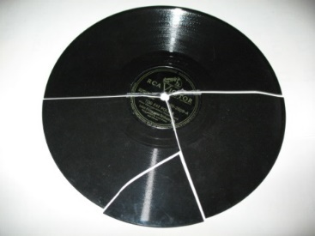
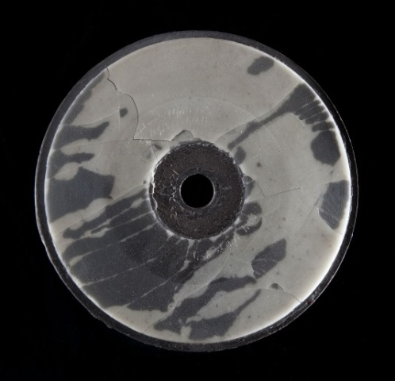
Audio records
Thomas Edison, 1877
Impractical cylinders
Brittle material
For us : 78 RPM Shellac
Preservation of valuable data

Slide 3
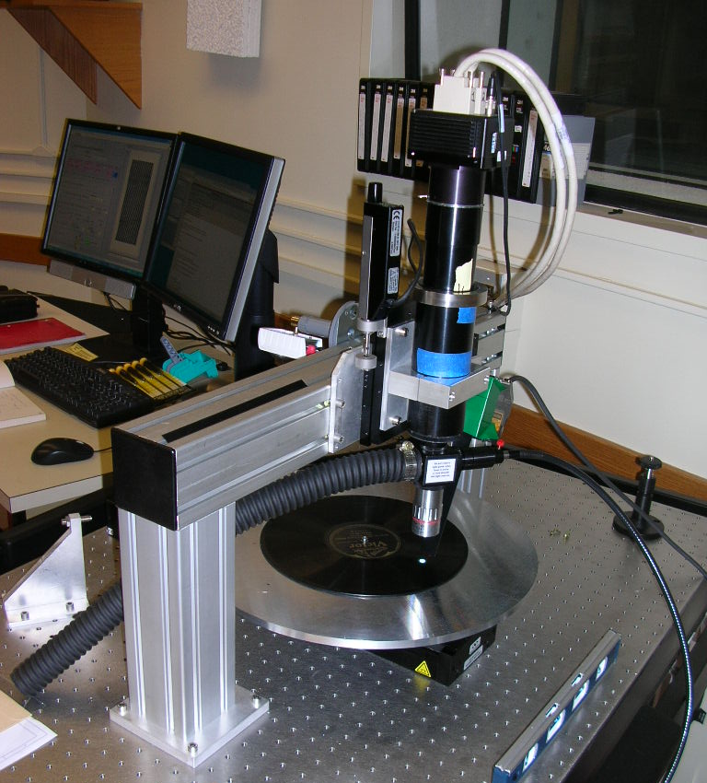
IRENE and Weaver
Imaging machine
Processing software
Able to simulate play back
Preservation of records as pictures

Slide 4
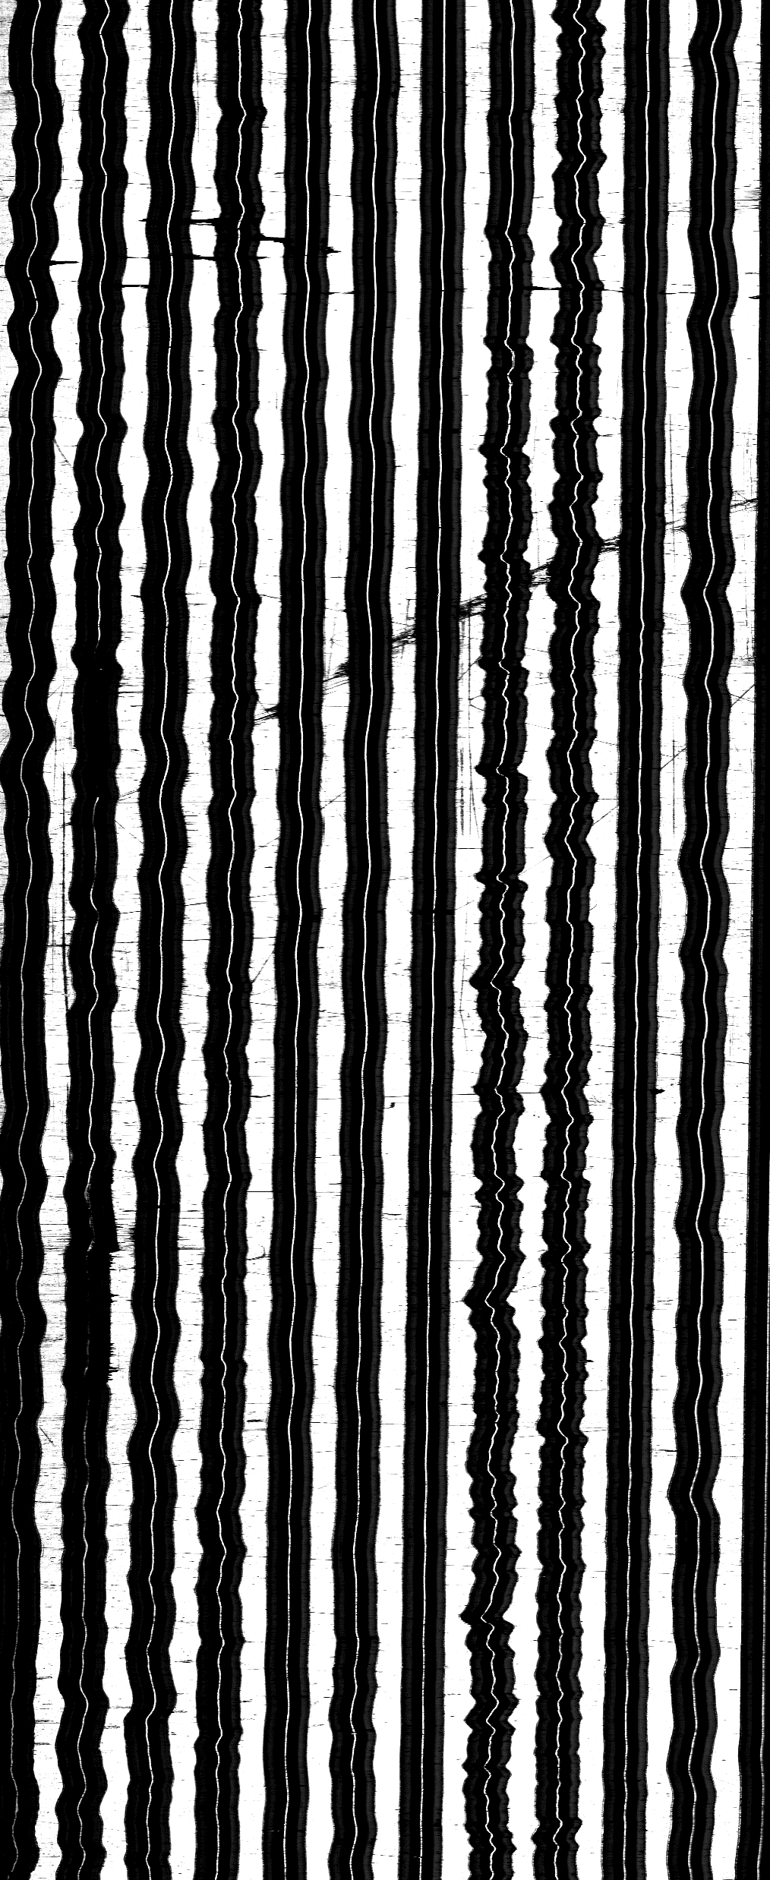
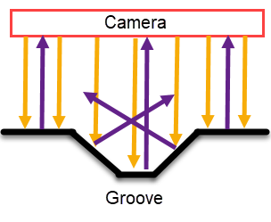
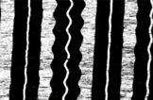
Taking pictures

Slide 5
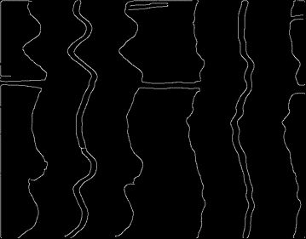
Audio reconstruction
Edge detection, middle of groove
Perpendicular velocity, not position
Affected by noise

Slide 6
Machine learning
Classification : FNN, CNN, RNN, ResNet, …
Regression : logistic, linear, LSTM, CNN …
Generation : GAN, …
Denoising : Auto-encoder, …

Slide 7
Objectives
Improve the audio generated from images. Divided in prototypes for validation :
Prototype 0 : Keras familiarization
Prototype 1 : clean sound from clean sine grooves
Prototype 2 : clean sound from noisy sine grooves
Prototype 3 : noisy sound from disc images
Prototype 4 : clean sound from disc images

Slide 8
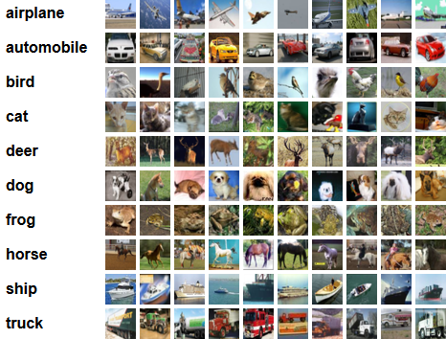
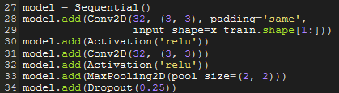

Prototype 0
Keras :
Makes implementation on of model simpler
Lots of tools for data processing
CIFAR-10 :
- 60’000 images in 10 classes

Slide 9
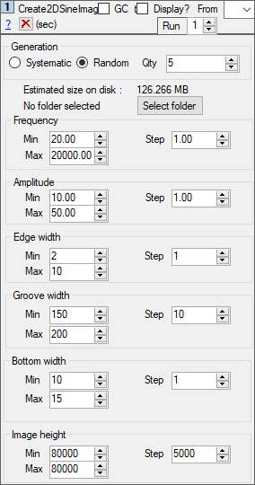
Prototype 1
Generation of simple groove dataset : Weaver
CNN usage, results uncertain
Problem can be tweaked to fit different categories

Slide 10
Prototype 1
Input : block of rows
Target : amplitude of sound
-> 0.8
-> 1.0
-> 0.6
-> 0.1
-> -0.3
-> -0.9
-> -1.0
-> -0.4
-> 0.0
-> 0.4

