Slide 1

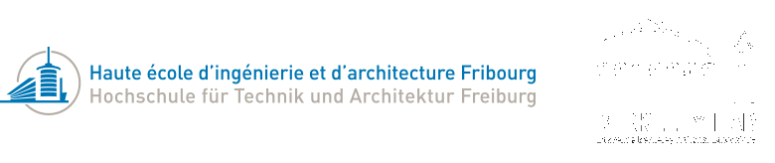
ML4NR
Machine learning for noise reduction in old audio records
Bachelor thesis

Slide 2
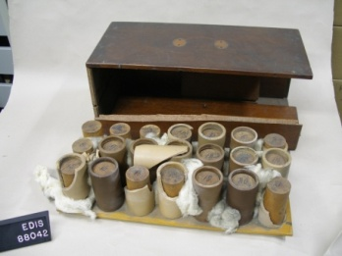
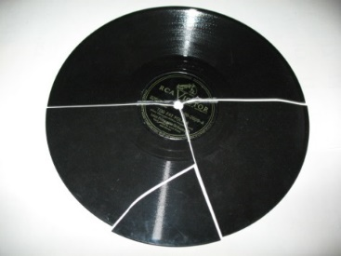
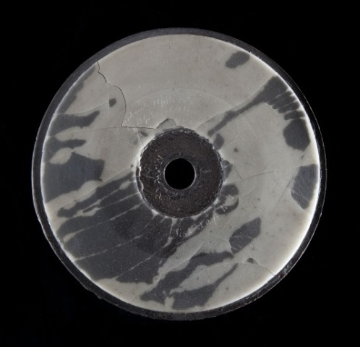
Audio records
Thomas Edison, 1877
Impractical cylinders
Brittle material, deterioration
Here : 78 RPM Shellac discs
Preservation of valuable data

Slide 3
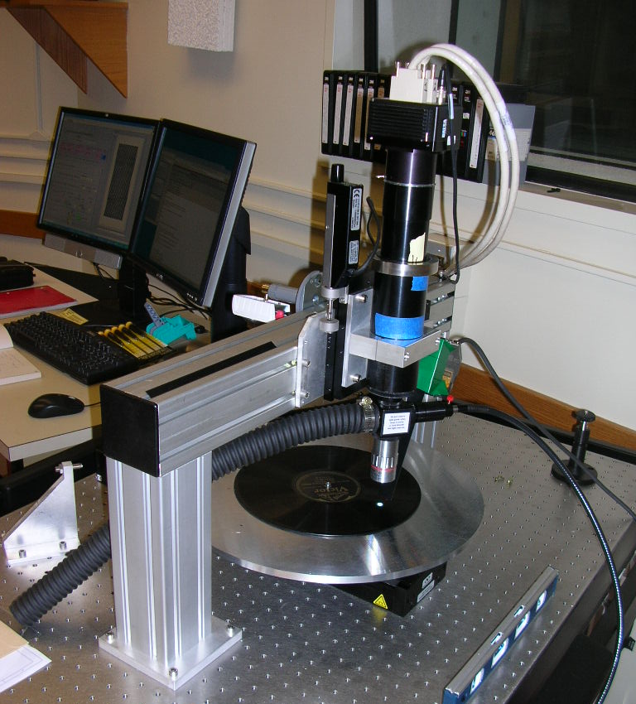
IRENE and Weaver
Imaging machine
Processing software
Able to simulate play-back
Preservation of records as pictures

Slide 4
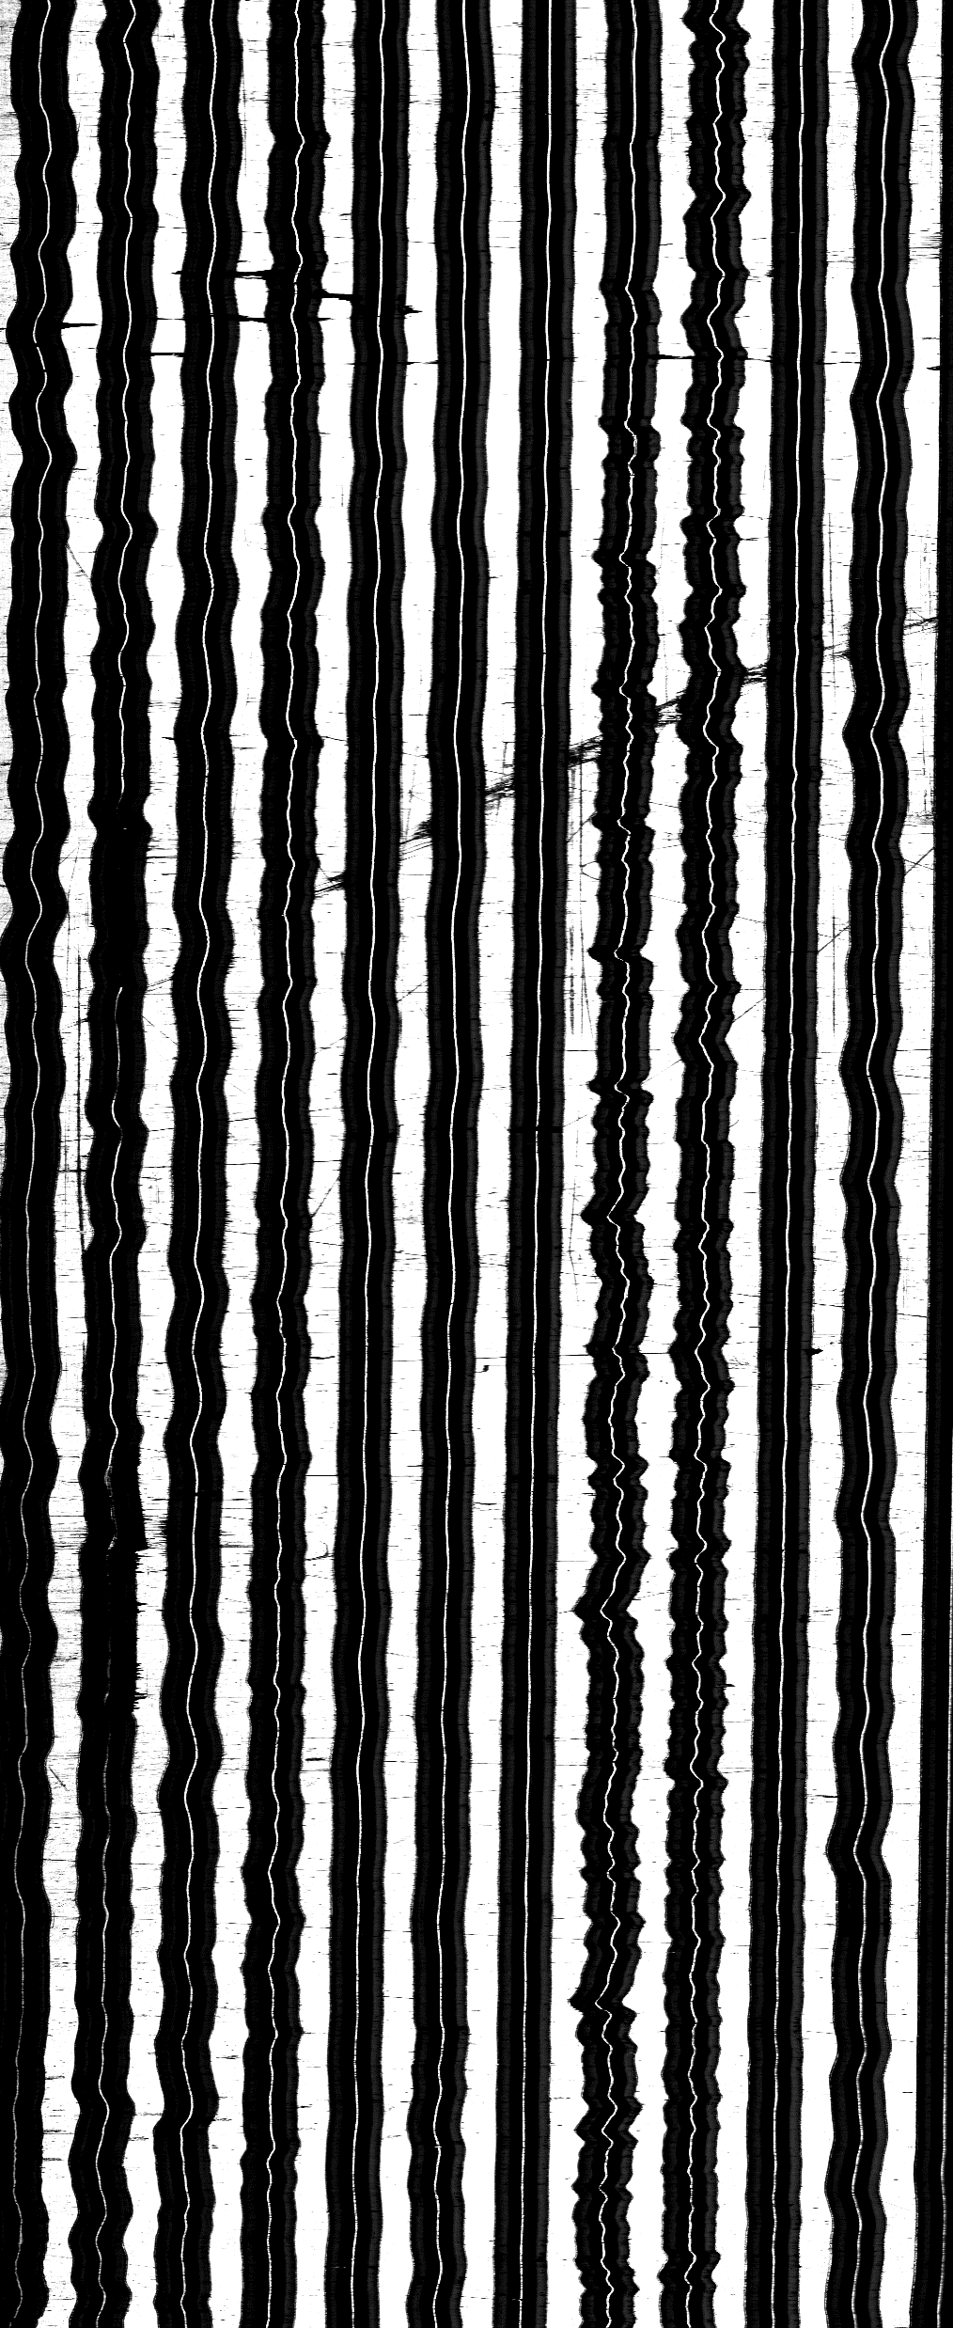
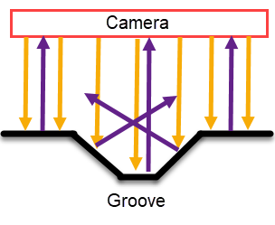
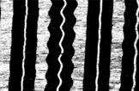
Taking pictures

Slide 5
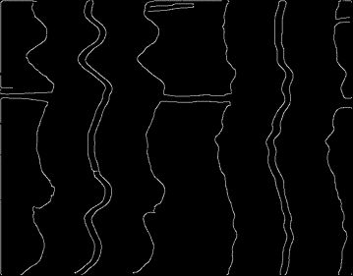

Audio reconstruction
Edge detection, middle of groove
Perpendicular velocity, not position
Affected by noise

Slide 6
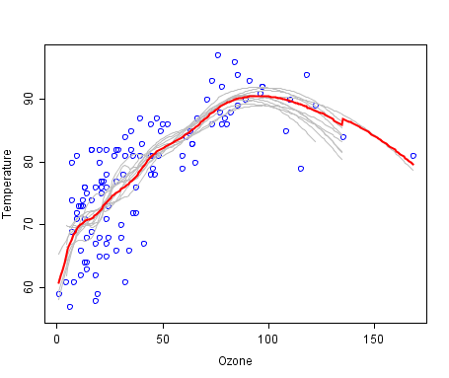
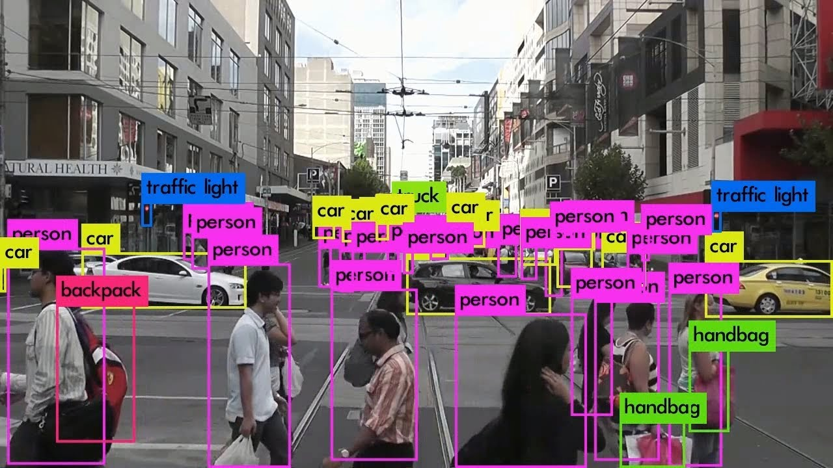
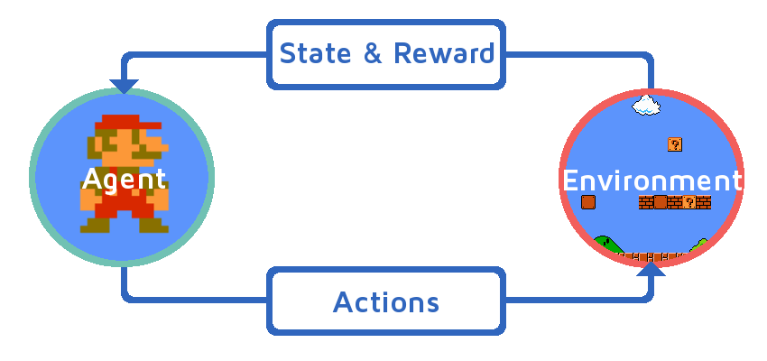
Machine learning
Classification : FNN, CNN, RNN, ResNet, …
Regression : logistic, linear, LSTM, CNN …
Reinforcement : Decision making
Generation : GAN, …
Denoising : Auto-encoder, …

Slide 7
Objectives
Improve the audio generated from images. Divided in prototypes for validation :
Prototype 0 : Keras familiarization
Prototype 1 : clean sound from clean sine grooves
Prototype 2 : clean sound from noisy sine grooves
Prototype 3 : noisy sound from disc images
Prototype 4 : clean sound from disc images

Slide 8
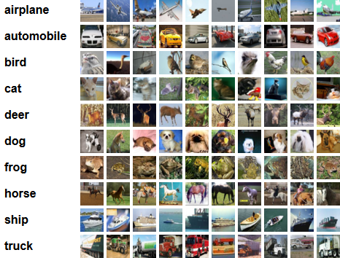
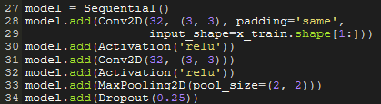

Prototype 0
Keras :
Makes implementation of machine learning modes simpler
Lots of tools for data processing
CIFAR-10 :
- 60’000 images in 10 classes

Slide 9
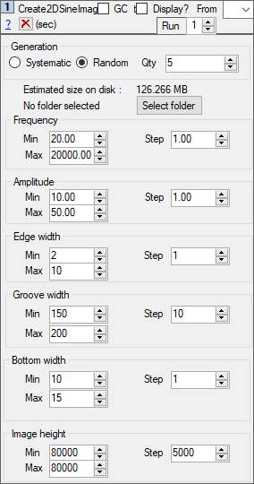
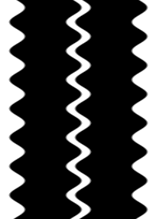
Prototype 1 - dataset
Generation of pure sine groove images with Weaver (80’000 x 220)
Randomized values for robustness of training
Weaver’s audio reconstruction as target

Slide 10
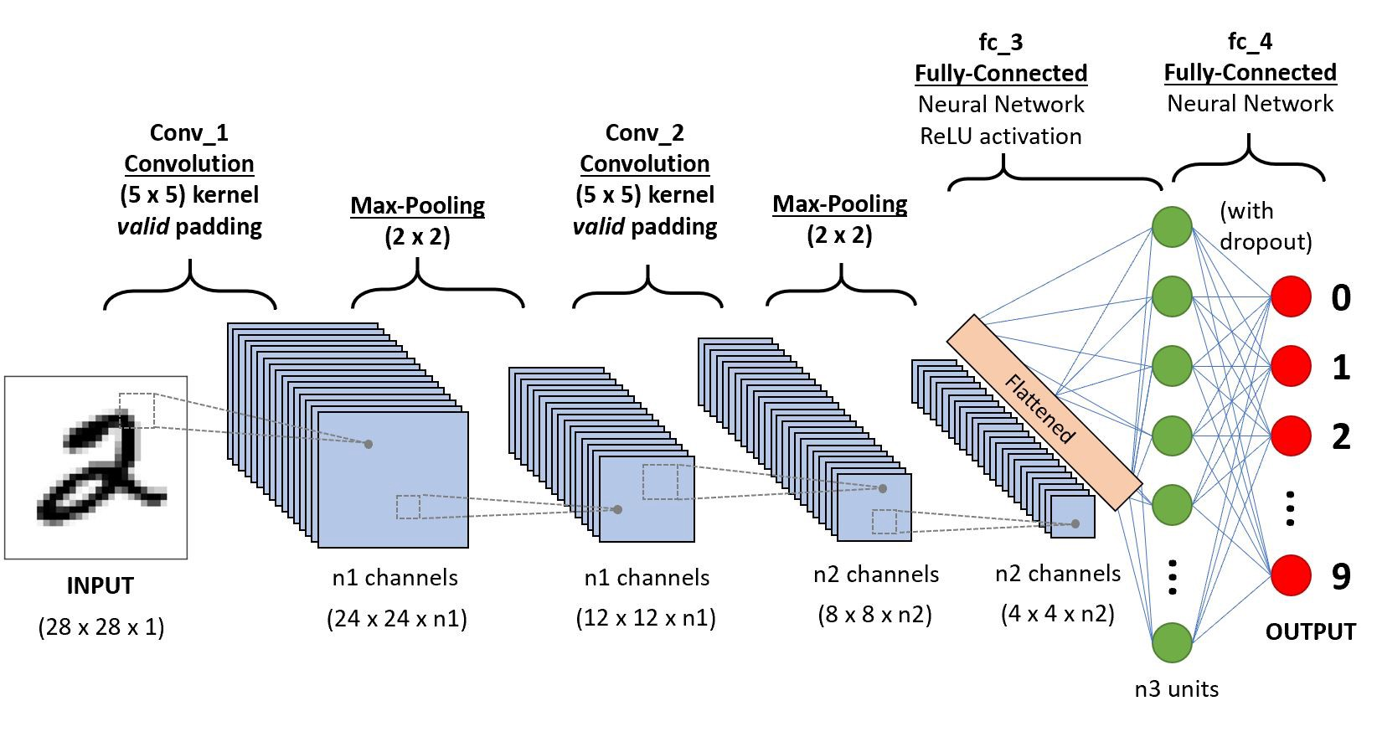
Prototype 1 – first version
Convolutional neural network (same as prototype 0)
Input : entire groove image
Problems : Trillions of weights
Target : entire sound wave

Slide 11

Prototype 1 – second version
Long Short-Term Memory network
Input : block of rows
Problem : no convergence
Target : amplitude of sound (~= lateral velocity of stylus)
-> 0.8
-> 1.0
-> 0.6
-> 0.1
-> -0.3
-> -0.9
-> -1.0
-> -0.4
-> 0.0
-> 0.4

Slide 12
Prototype 1 – third version
- CNN again
Input : block of rows
Data preprocessing : Normalization of pixel values (0 to 1), generation of pure sine wave as target
Promising results !
Target : amplitude of sound (lateral velocity od stylus)

Slide 13
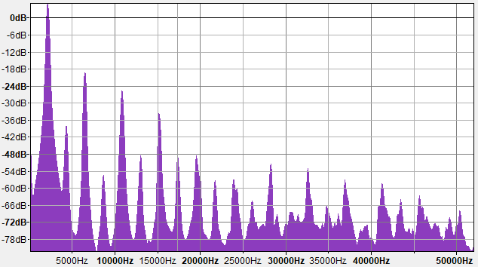
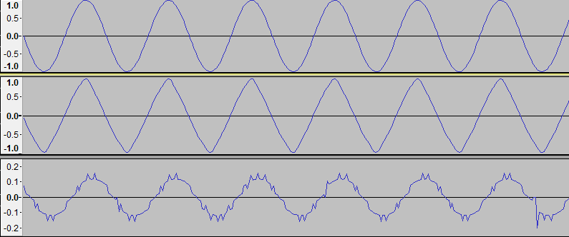
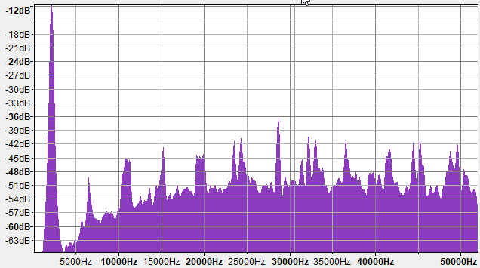
Prototype 1 – third version

Slide 14
Prototype 1 – Fine tuning
Finding best values for all hyper-parameters :
Number of rows in a block
Number of predictions in a block
Size of convolution filters
Max pooling or not, what size
Dropout or not, what rate
Optimizer and its learning and decay rate
Activation functions

Slide 15
Prototype 1 – Final Results
Best values = small values !
Only 5 rows each time, with 1 prediction
Convolutions of 3x3
Max pooling of 2x2
Dropout of 0.25 for first layers, 0.5 for last
Close to default values for RMSprop optimizer
ReLu for first layers, tanh for last

Slide 16
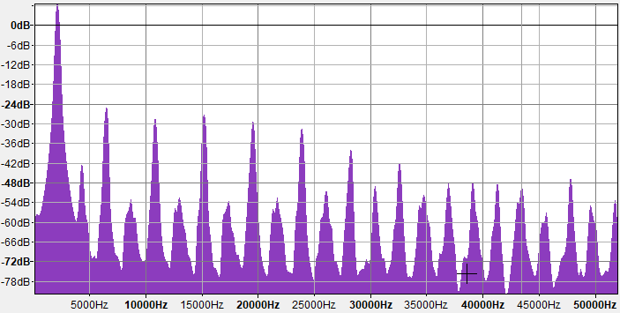
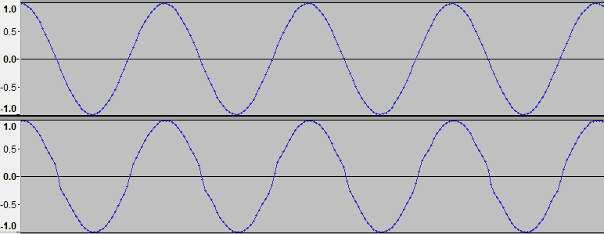
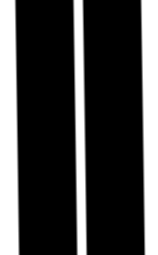
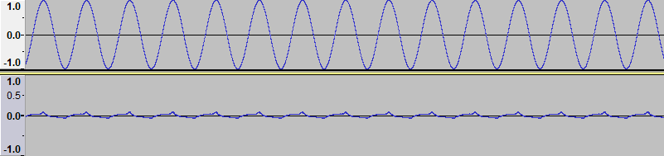
Prototype 1 – Final Results

Slide 17
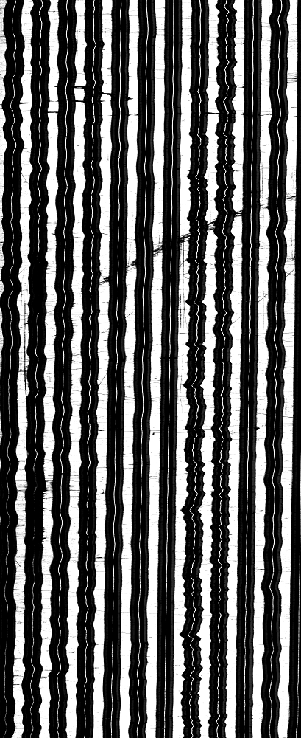
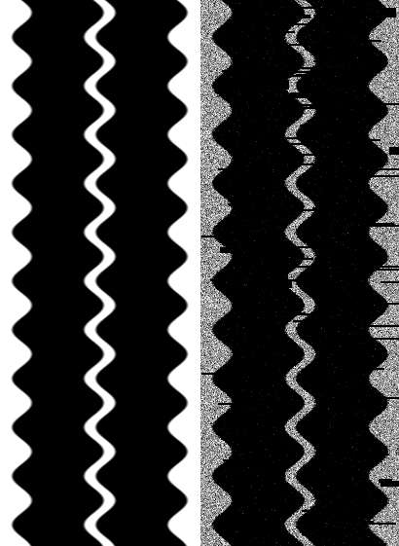
Prototype 2 – Noisy images

Slide 18
Prototype 2 – Fine tuning again
Properties are different
Maybe seeing more rows can help correct defaults
The optimizer is bad : results are fast but not improving over time.
General architecture stays the same

Slide 19
Prototype 2 – Results
Best results with 15 rows of pixels
RMSProp and Adam optimizers have good but different results, slightly improving over time

Slide 20
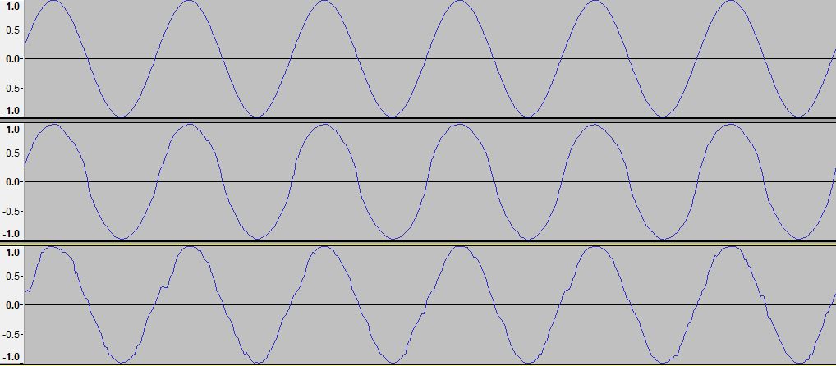
Prototype 2 – Results

Slide 21
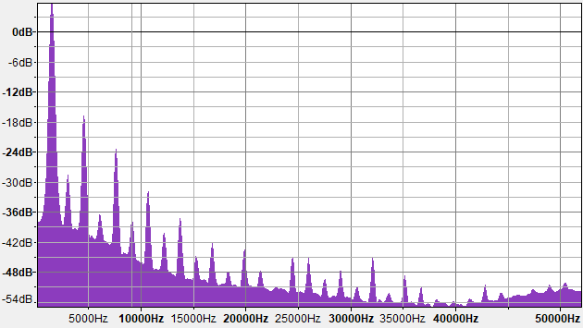
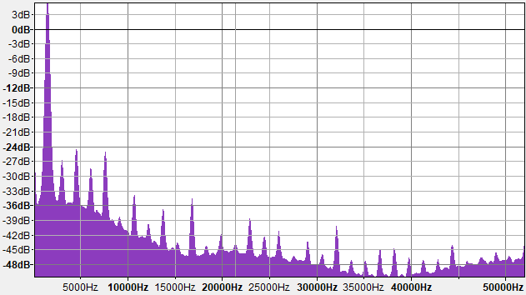
Prototype 2 – Results

Slide 22
Next steps
Using actual disc images
Transfer learning or training from the start
Finish report and evaluate project

