Slide 1
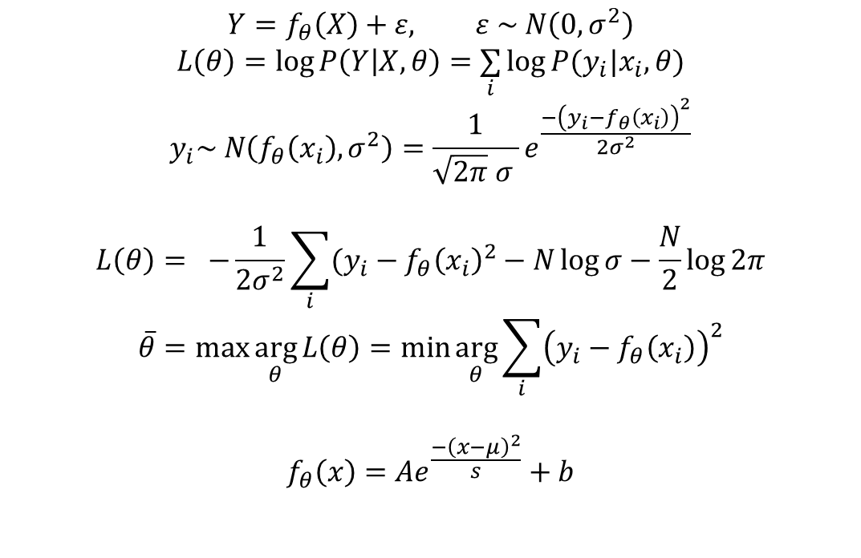
One Gaussian fitting
$$Y=f_{θ}\left(X\right)+ε, ε \sim N\left(0,σ^{2}\right)$$
$$L\left(θ\right)=\log{P\left(Y | X,θ\right)=\underset{i}{∑}\log{P(y_{i}|x_{i},θ)}}$$
$$y_{i}\sim N\left(f_{θ}\left(x_{i}\right),σ^{2}\right)=\frac{1}{\sqrt{2π} σ }e^{\frac{{−\left(y_{i}−f_{θ}\left(x_{i}\right)\right)}^{2}}{2σ^{2}}}$$
$$L\left(θ\right)= −\frac{1}{2σ^{2}}\sum_{i}{(y_{i}−f_{θ}{\left(x_{i}\right)}^{2}}−N\log{σ}−\frac{N}{2}\log{2π}$$
$$\overline{θ}=\max{\arg_{θ}{L\left(θ\right)}=\min{\arg_{θ}{\sum_{i}{{\left(y_{i}−f_{θ}\left(x_{i}\right)\right)}^{2}}}}}$$
$$f_{θ}\left(x\right)=Ae^{\frac{−{\left(x−μ\right)}^{2}}{s}}+b$$

Slide 2
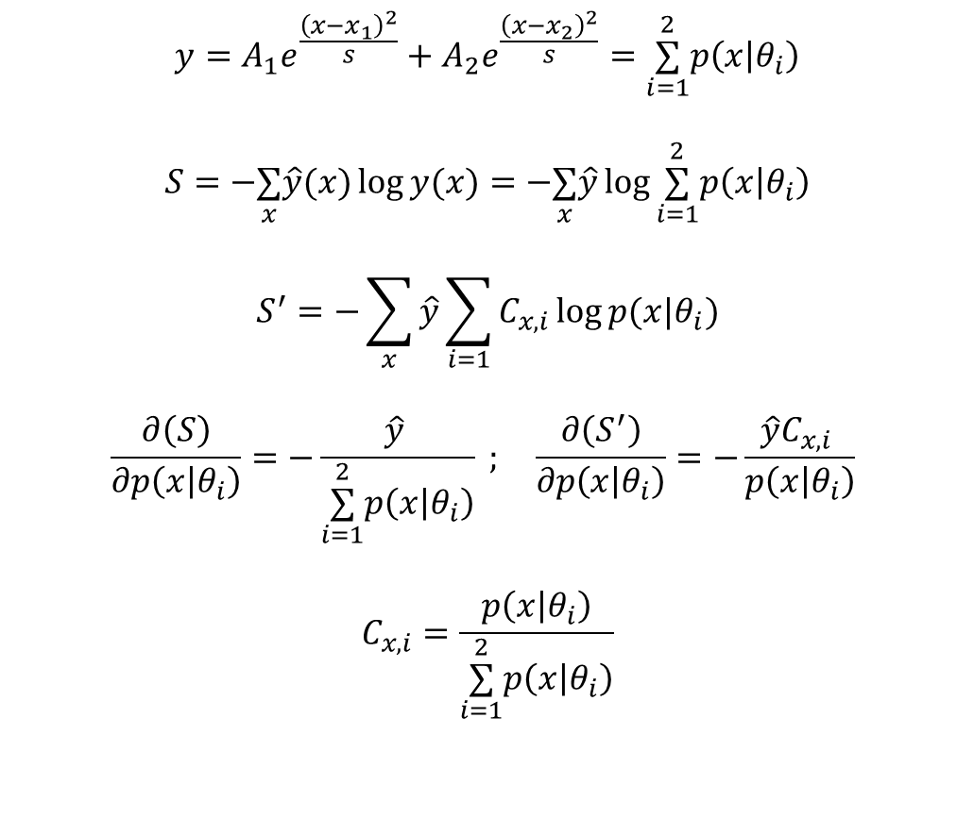
Two Gaussian fitting
$$y=A_{1}e^{\frac{{\left(x−x_{1}\right)}^{2}}{s}}+A_{2}e^{\frac{{\left(x−x_{2}\right)}^{2}}{s}}=\underset{i=1}{\overset{2}{\text{∑}}}p\left(x | θ_{i}\right)$$
$$S=−\underset{x}{\text{∑}}\hat{y}(x)\log{y(x)}=−\underset{x}{\text{∑}}\hat{y}\log{\underset{i=1}{\overset{2}{\text{∑}}}p\left(x | θ_{i}\right)}$$
$$S^{′}=−\sum_{x}{\hat{y}}\sum_{i=1}{C_{x,i}\log{p(x|θ_{i})}}$$
$$\frac{∂\left(S\right)}{∂p\left(x | θ_{i}\right)}=−\frac{\hat{y} }{\underset{i=1}{\overset{2}{\text{∑}}}p\left(x | θ_{i}\right)} ; \frac{∂\left(S^{′}\right)}{∂p\left(x | θ_{i}\right)}=−\frac{\hat{y}C_{x,i} }{p\left(x | θ_{i}\right)}$$
$$C_{x,i}=\frac{p\left(x | θ_{i}\right)}{\underset{i=1}{\overset{2}{\text{∑}}}p\left(x | θ_{i}\right)}$$

Slide 3
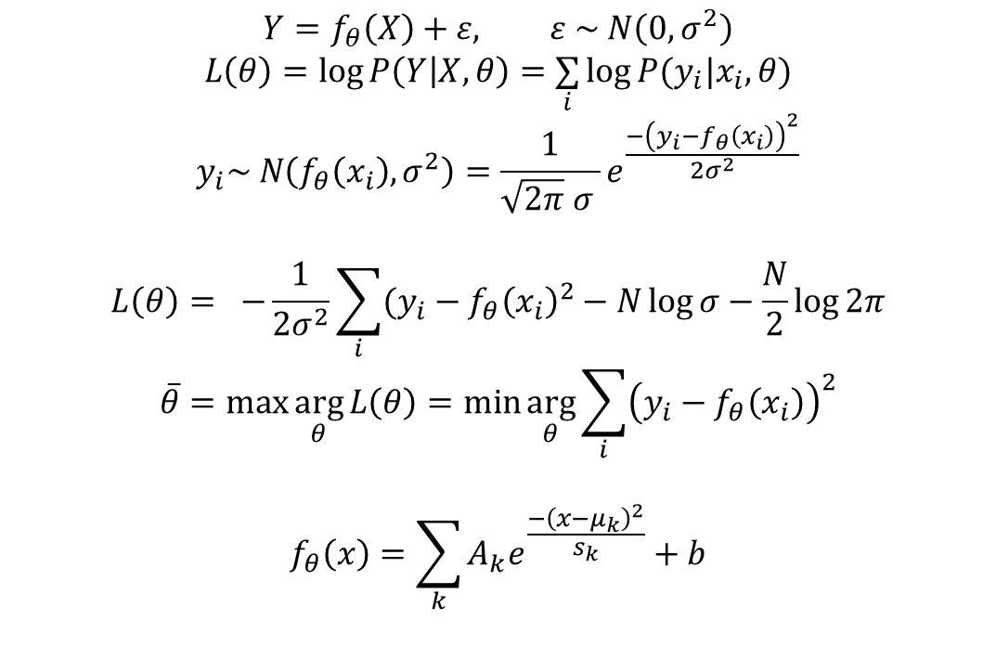
Two Gaussian fitting
$$Y=f_{θ}\left(X\right)+ε, ε \sim N\left(0,σ^{2}\right)$$
$$L\left(θ\right)=\log{P\left(Y | X,θ\right)=\underset{i}{∑}\log{P(y_{i}|x_{i},θ)}}$$
$$y_{i}\sim N\left(f_{θ}\left(x_{i}\right),σ^{2}\right)=\frac{1}{\sqrt{2π} σ }e^{\frac{{−\left(y_{i}−f_{θ}\left(x_{i}\right)\right)}^{2}}{2σ^{2}}}$$
$$L\left(θ\right)= −\frac{1}{2σ^{2}}\sum_{i}{(y_{i}−f_{θ}{\left(x_{i}\right)}^{2}}−N\log{σ}−\frac{N}{2}\log{2π}$$
$$\overline{θ}=\max{\arg_{θ}{L\left(θ\right)}=\min{\arg_{θ}{\sum_{i}{{\left(y_{i}−f_{θ}\left(x_{i}\right)\right)}^{2}}}}}$$
$$f_{θ}\left(x\right)=\sum_{k}{A_{k}e^{\frac{−{\left(x−μ_{k}\right)}^{2}}{s_{k}}}}+b$$

