Slide 1

PLUMB
Floor pricing,
with a human in charge
A floor-pricing partner for ad ops. Statistics propose, an agent can refuse, a human decides.
J John Britto | Head of Product | 100xEngineers Cohort 7 capstone | Solo
Notes:
One-liner: PLUMB is a floor-pricing partner for ad ops. A statistics layer proposes a move, an agent can refuse when the data cannot be trusted, and a human makes the call. All numbers in this deck are from a synthetic sample dataset because my real data is confidential.

Slide 2

PROBLEM
PLUMB
Price floors are set by hand, on a belief, with no way to see the curve
Too low
Too high
No signal
Money left on the table in every auction
Auctions go unfilled and revenue drops
A bidder outage, demand surge or reporting glitch looks like a trend
In sample data, modelled manual pricing captures 78.7% of the available revenue and makes a harmful move on 16.3% of decisions.
Notes:
Floors are nudged placement by placement on a belief about fill rate. Good moves are never made because evidence is unclear; bad moves are made because a one-day swing was read as a trend. The 78.7% and 16.3% come from the modelled manual arm in the sample world, so it shows direction, not a measured gap.

Slide 3
SOLUTION
PLUMB
Three parts, each doing only what it is good at
1
Statistics layer
Fits revenue per 1k requests against log floor over 21 days. Step is capped and shrinks when confidence is low.
2
Agent that can refuse
Reads ops notes and data-quality signals. Returns a trust plan, never a price. Refuses on thin traffic, flat floors, outlier days.
3
Human decides
Every recommendation sits in a queue with its evidence. Ops accepts, edits or rejects, and the reason is logged.
Notes:
The agent never returns a price. It returns a plan for how much to trust the data: hold, exclude the last day, change the window, adjust direction. The price always comes from the statistics layer, and the decision always belongs to a person.

Slide 4
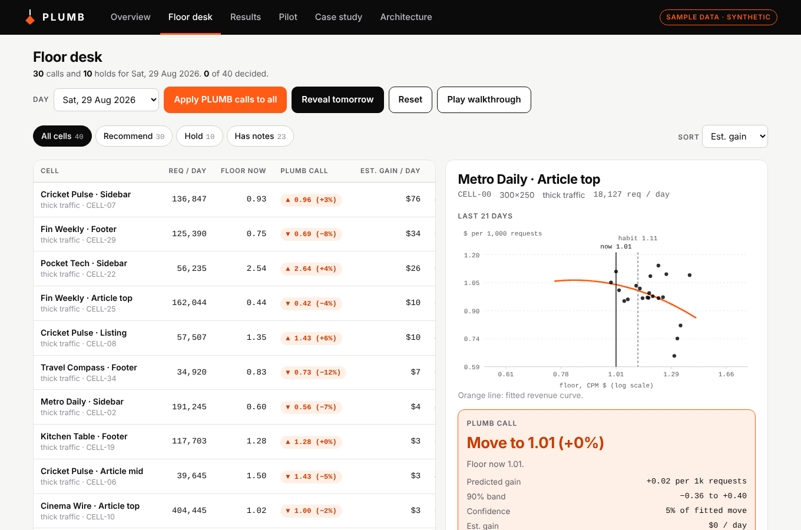
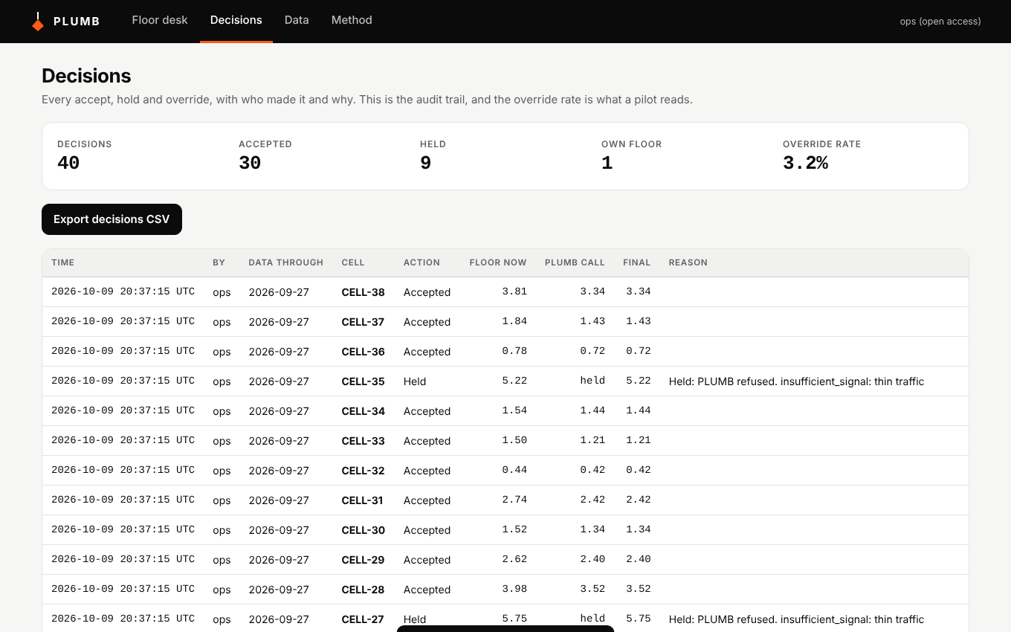
PRODUCT DEMO
PLUMB
A working web app and a clickable demo
Web app: decision log with reasons, CSV in and out
Floor desk: evidence beside every recommendation
plumb-floor-pricing-demo.vercel.app | github.com/Johnbritt/Plumb-Floor-Pricing
Notes:
Walk through the floor desk: pick a cell, see the recommendation, the evidence and any refusal reason, then accept or edit. The web app is FastAPI plus SQLite and runs with Docker or Render. The walkthrough video is in the repo.

Slide 5
TRACTION
PLUMB
What exists today, all verifiable in the repo
40 x 180
6
sample cells and days, with events and ops notes
arms evaluated, scored on a held-out world
100
11
test runs per pilot design, plus A/A placebo
automated tests, CI passing on GitHub
Next: a matched-cell pilot with real ops colleagues. Success criteria are already written and checked on sample data.
Notes:
Everything on this slide can be checked in the repo: the sample data, the evaluation, the pilot design tests and the CI run. The next step is a matched-cell pilot with real ops colleagues.

Slide 6
RESULTS ON SAMPLE DATA
PLUMB
The statistics layer does the work. Refusal buys safety.
Harmful moves
Ops alone 16.3%. Unguarded stats 6.2%. Guarded 2.6% to 3.0%.
What did not hold
The agent stand-in did not beat a plain rule. The pair did not beat the model alone. Both stay open until the Claude backend is run.
Notes:
Tuned on one sample world, frozen, scored on a fresh one. Intervals are cluster bootstraps over cells. The manual arm is my model of manual pricing, so the direction is reliable and the size of the gap is not.

Slide 7
BUILD JOURNEY
PLUMB
The findings changed the design four times
Scope
Started as a VAST/GAM discrepancy adjudicator, narrowed to floor pricing where the decision and the outcome are both measurable
v1
Hard significance gate refused 82% of days and cost 1.7 points. Replaced by a confidence-scaled step
Metric
Exploration jitter made held floors look harmful. Harm redefined: move over 10% and revenue down over 1%
Findings
Refusing thin cells freezes learning. Holding during an outage can hurt
Pilot
Tested the pilot design itself: 20 cells for one week passes 26% of the time. Redesigned to 40 cells, 4 live weeks
Notes:
Each step was driven by a result, not a plan. The refusal gate and the harm metric were both wrong in v1 and the evaluation showed it.

Slide 8
TEAM
PLUMB
One builder, product and engineering in one head
J John Britto
Head of Product, Bengaluru
8+ years in AdTech, from UI/UX designer to Head of Product
Built ad servers, header bidding, OpenRTB exchange and reporting pipelines
Leads backend, frontend and data engineers, and the roadmap
PLUMB built solo: problem, statistics, agent design, evaluation, app
Notes:
The point of the team slide: the person who understands the auction mechanics also built the statistics, the agent and the app, so nothing was lost in handoff.

Slide 9
PLUMB
Statistics propose. The agent can refuse. A human decides.
Demo: plumb-floor-pricing-demo.vercel.app
Code: github.com/Johnbritt/Plumb-Floor-Pricing

