Slide 1
MS Graph API workshop
系統整合中心-企業科技服務事業
簡報者：周祖昊
Email:john_th_chou@wistron.com

Slide 2
Outline
09:30 ~ 10:30 Microsoft Graph API intro
10:45 ~ 12:00 使用API Explorer 測試 API
12:00 ~ 13:00 午餐
13:20 ~ 14:30 Hands-On Lab 1
14:30 ~ 15:30 Hands-On Lab 2
15:30 ~ 16:00 Break
16:00 ~ 17:30 Hands-On Lab 3
17:30 ~ 18:00 Q & A

Slide 3
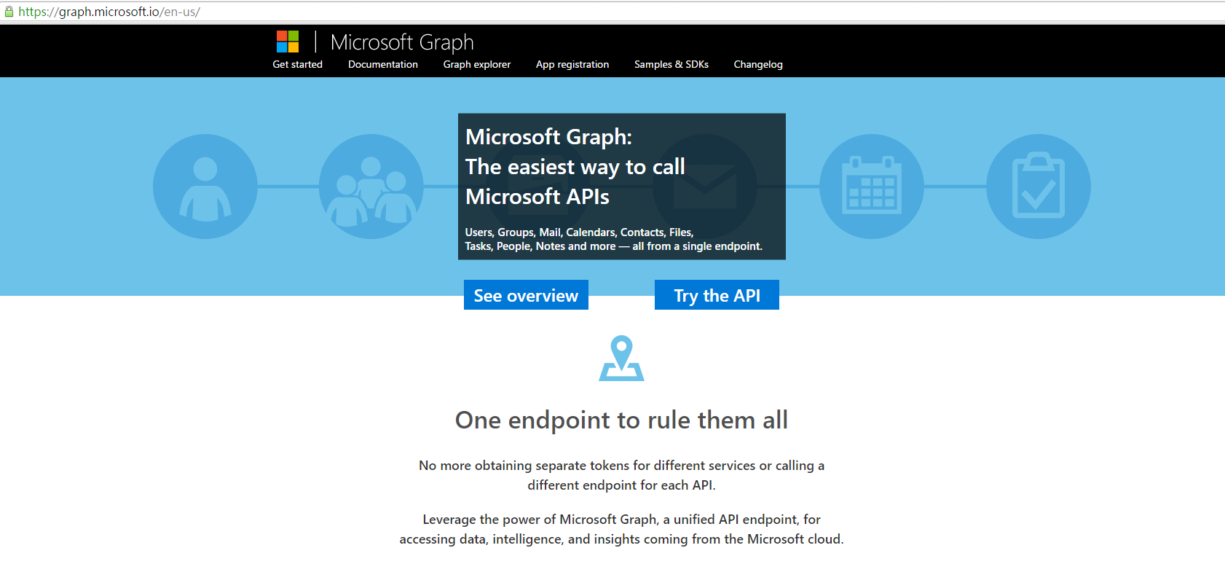
Microsoft Graph API intro
Microsoft Graph (previously called Office 365 unified API) exposes multiple APIs from Microsoft cloud services through a single REST API endpoint (https://graph.microsoft.com). Using the Microsoft Graph, you can turn formerly difficult or complex queries into simple navigations.

Slide 4
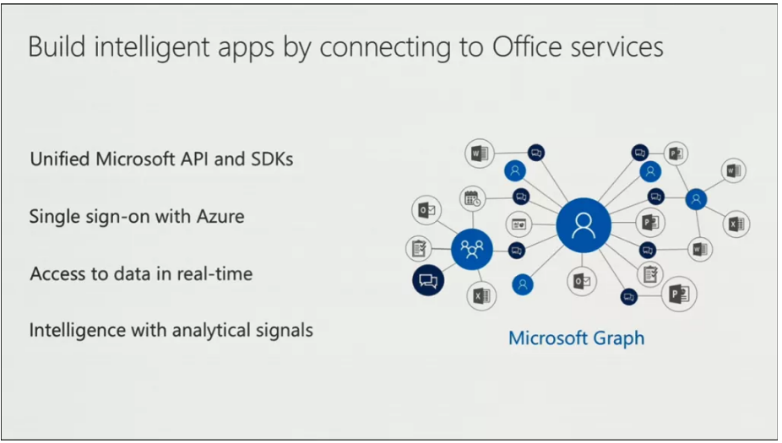
Microsoft Graph API feature
Unified Microsoft API and SDKs
Single sign-on with Azure
Access to data in real-time
Intelligence with analytical signals

Slide 5
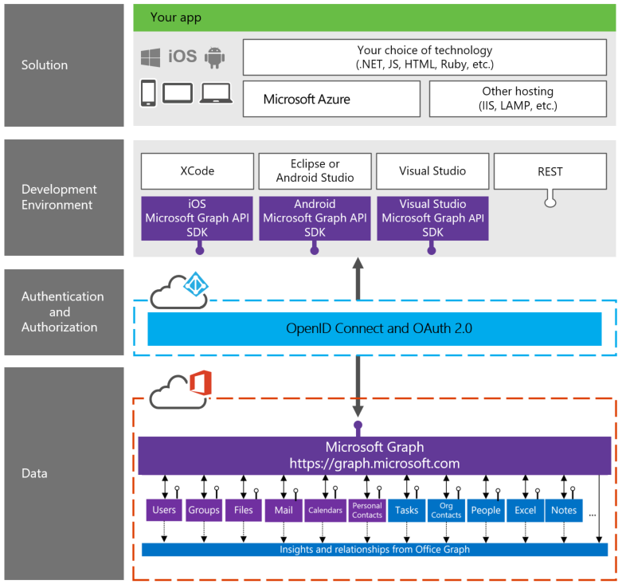
How to use it
By Graph API explore
By Microsoft Graph API SDKs

Slide 6
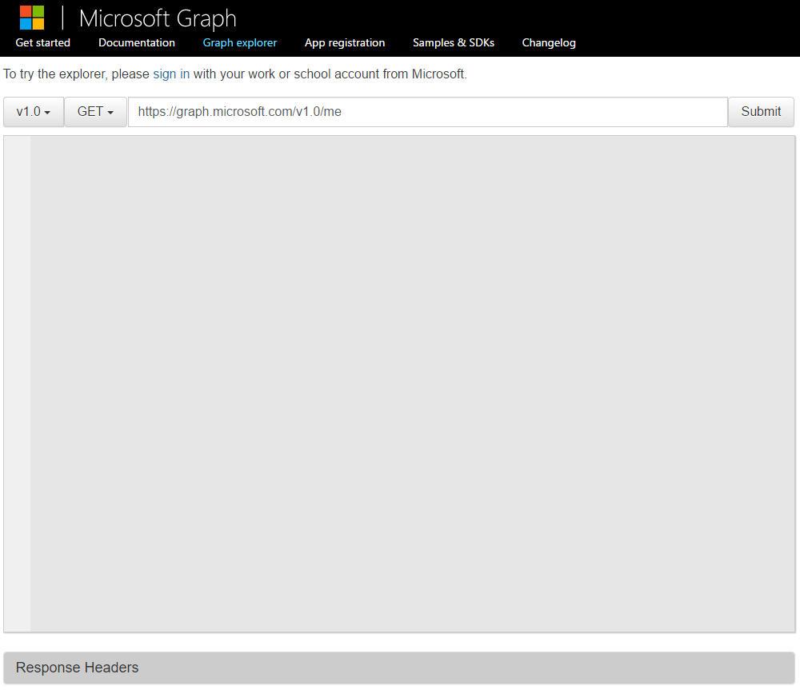
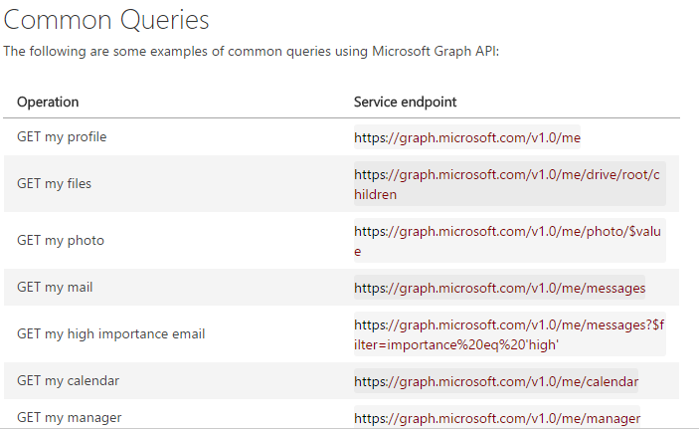
Some Common Queries
Get my profile
Get my files
…

Slide 7
Break time

Slide 8
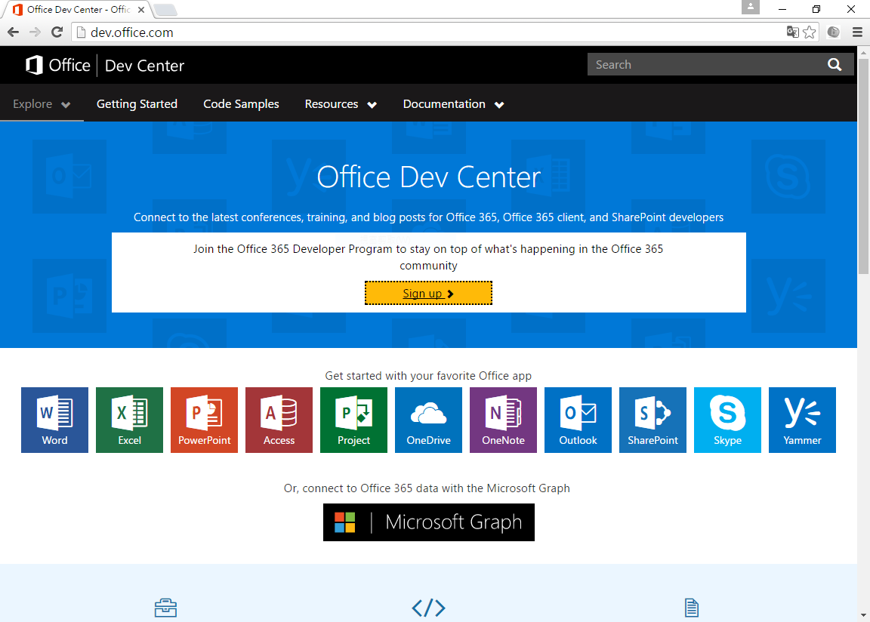
Setting
Sign up a developer account (gotoLink)
Login Office365:prepare email and onedrive(gotoLink)

Slide 9
Graph API Explorer
Login with dev account & get start( https://graph.microsoft.io/ )
Query parameters( gotoLink )

Slide 10
Example
Get my contacts data
https://graph.microsoft.com/v1.0/me/contacts
Get calendar events list
https://graph.microsoft.com/v1.0/me/events

Slide 11
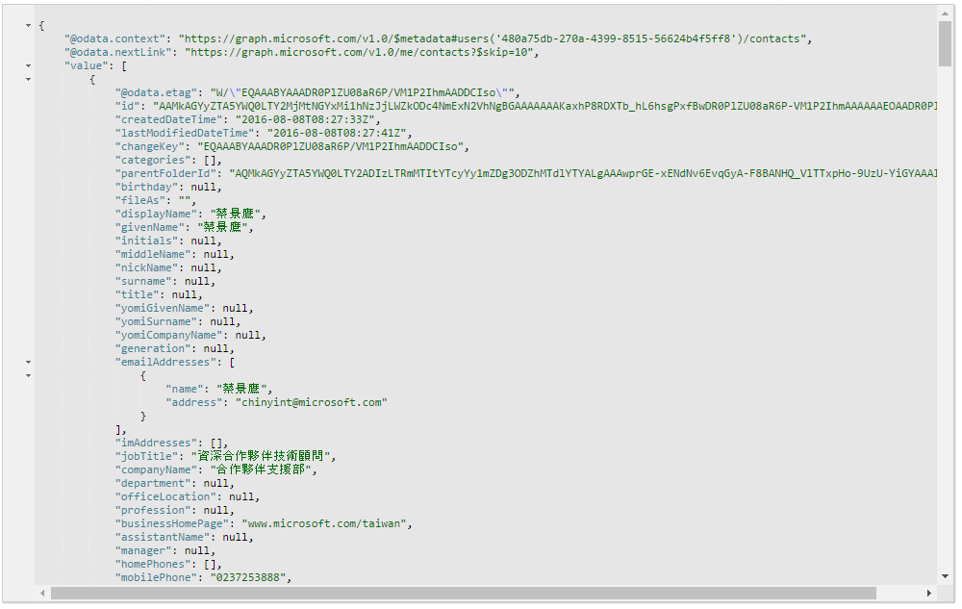
Get my contacts result

Slide 12
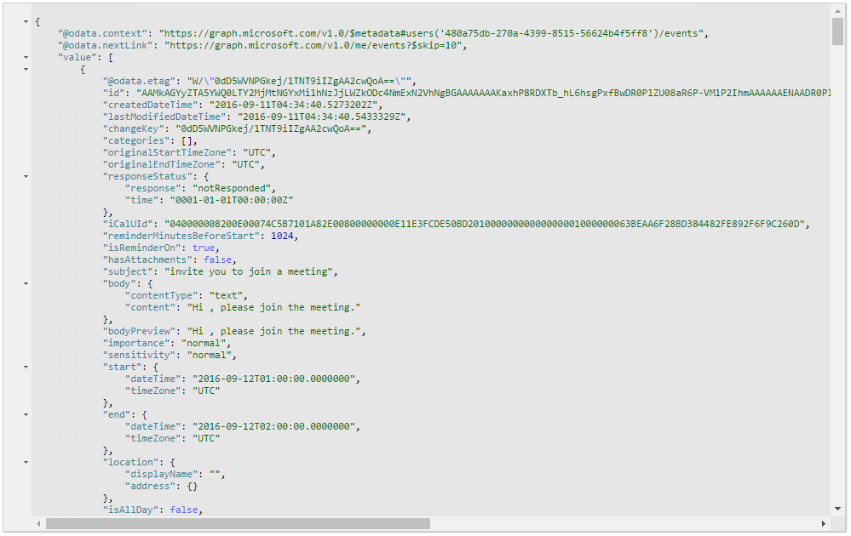
Get my events result

Slide 13
Lunch time

Slide 14
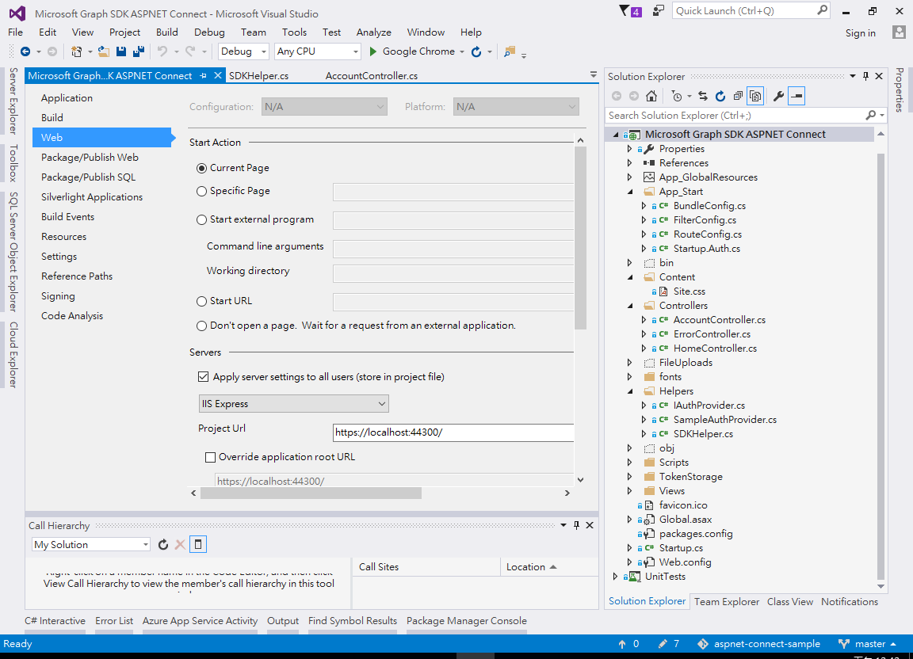
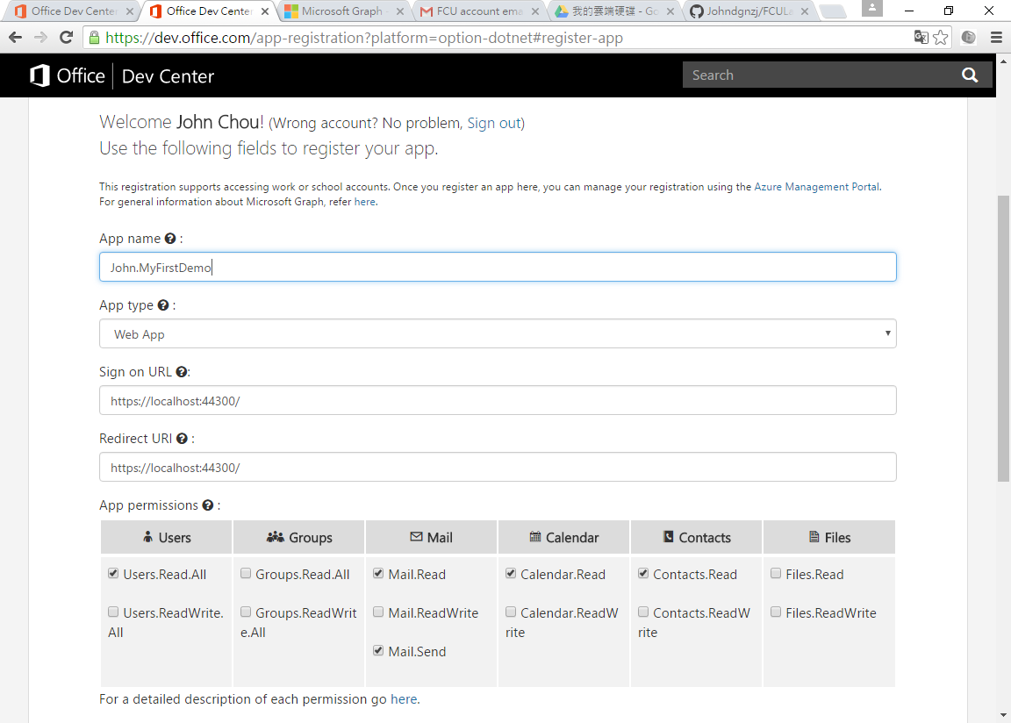
Hands-On Lab1
Download sample code from github(UnifiedApiConnect)
Registry a new application.

Slide 15
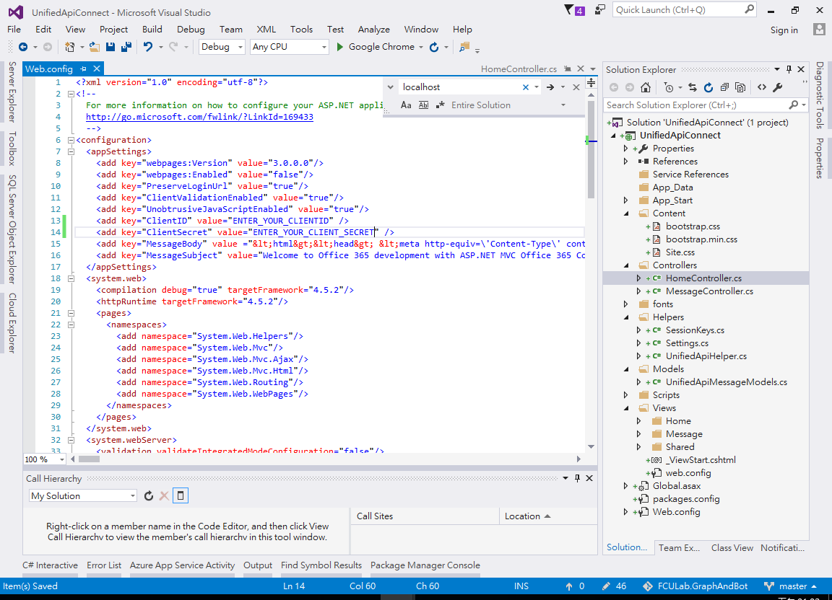
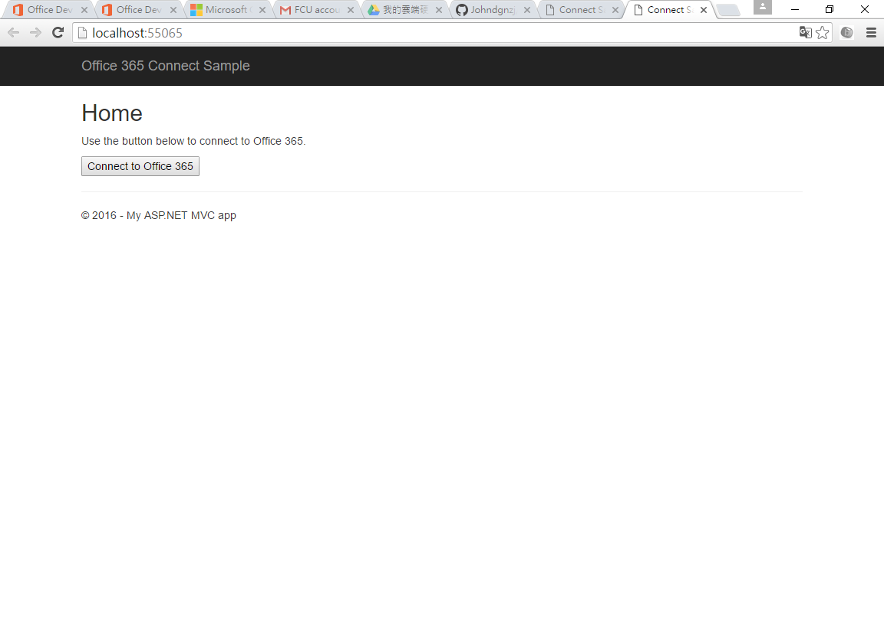
Hands-On Lab1
Copy Client ID and Client Secret to your app
Run the APP!

Slide 16
Hands-On Lab2
查Calendar
動手作：建立Event

Slide 17
Hands-On Lab3
讀 OneDrive 列表
動手做：下載附件

Slide 18
Q&A

Slide 19
See you next section!

