Slide 1
Bot Framework

Slide 2
Outline
09:30 ~ 10:30 Microsoft Bot Framework相關概念介紹
10:45 ~ 12:00 Bot Builder, Emulator 介紹
12:00 ~ 13:00 午餐
13:20 ~ 14:30 Hands-On Lab 1 :介紹 EchoBot
14:30 ~ 15:30 Hands-On Lab 2：介紹SandwichBot
15:30 ~ 16:00 Break
16:00 ~ 17:30 Hands-On Lab 3：做出請假Bot(1 請假；2 查詢請假時數)
17:30 ~ 18:00 Q & A

Slide 3
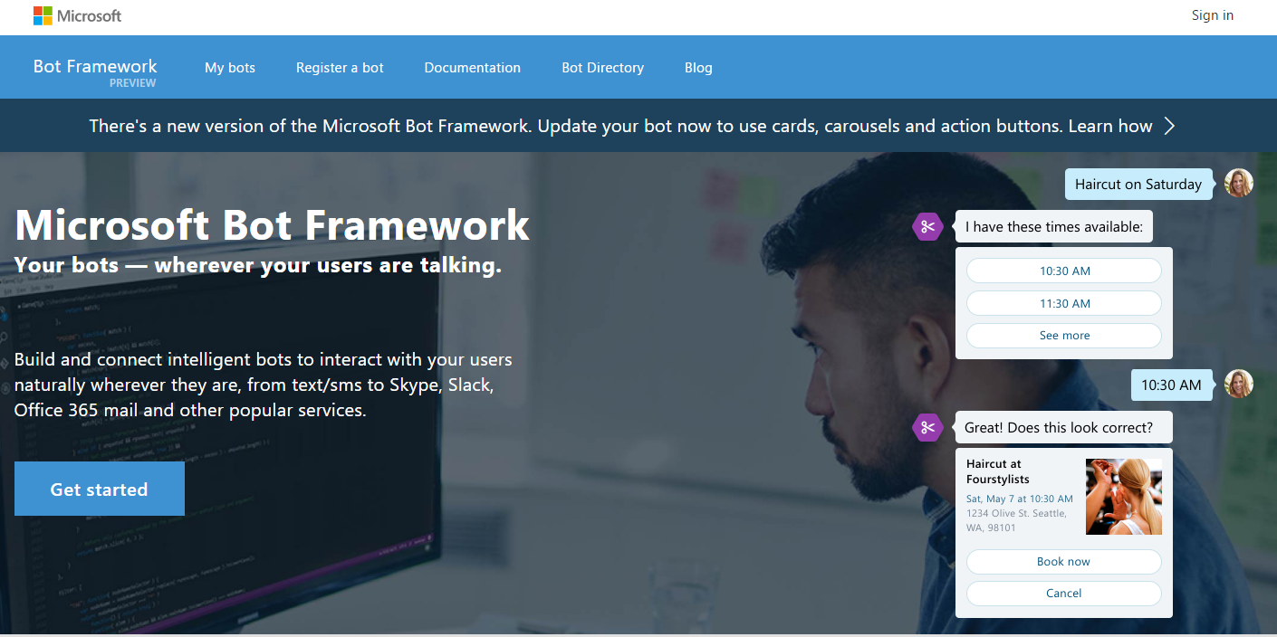
Microsoft Bot Framework相關概念介紹
Bot Builder
Bot Connector
Bot Framework Emulator

Slide 4
Bot Builder
Microsoft Bot Builder is a powerful framework for constructing bots that can handle both freeform interactions and more guided ones where the possibilities are explicitly shown to the user. It is easy to use and leverages C# to provide a natural way to write bots.
C#.NET (gotoLink)
Dialog
Form Flow
Language Understanding Intelligent Service (LUIS)
Node.js (gotoLink)

Slide 5
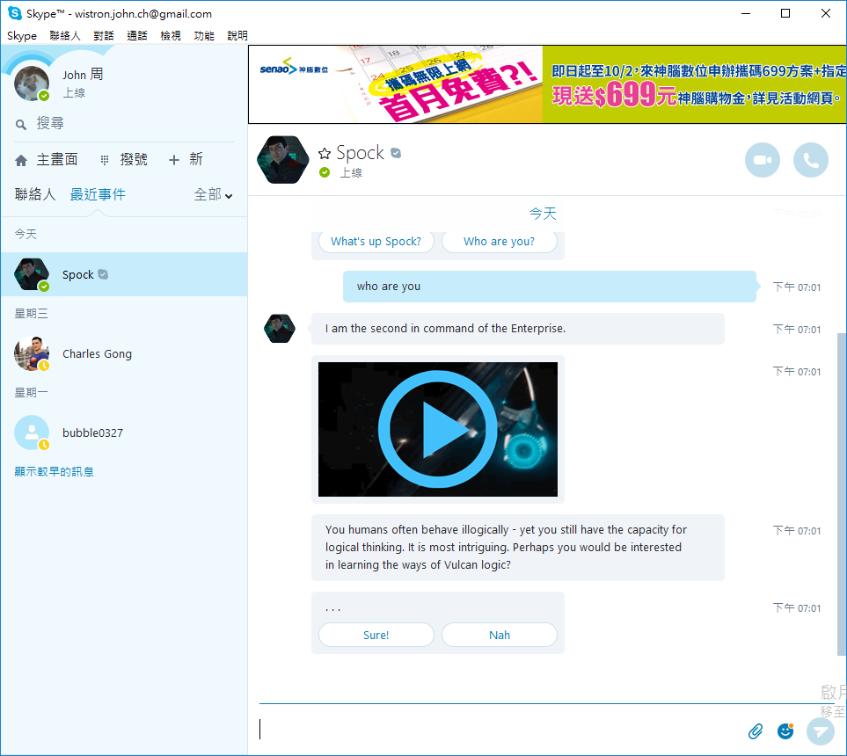
Bot Builder .NET Dialog

Slide 6
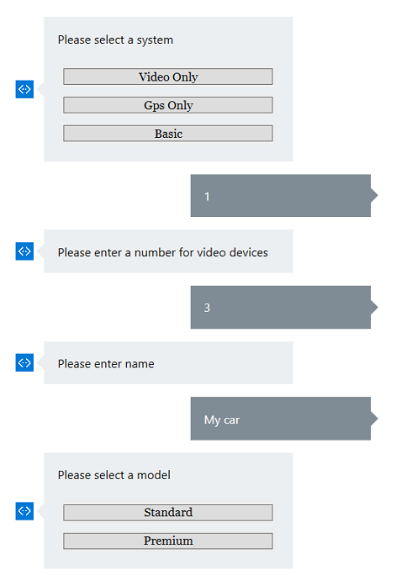
Bot Builder .NET Form flow

Slide 7
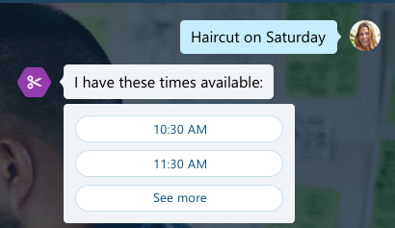

Bot Builder .NET LUIS
Create language understanding models.
Send Message to LUIS
Design your program to process intents and action.
Haircut on Saturday
intents and action
LUIS Model

Slide 8
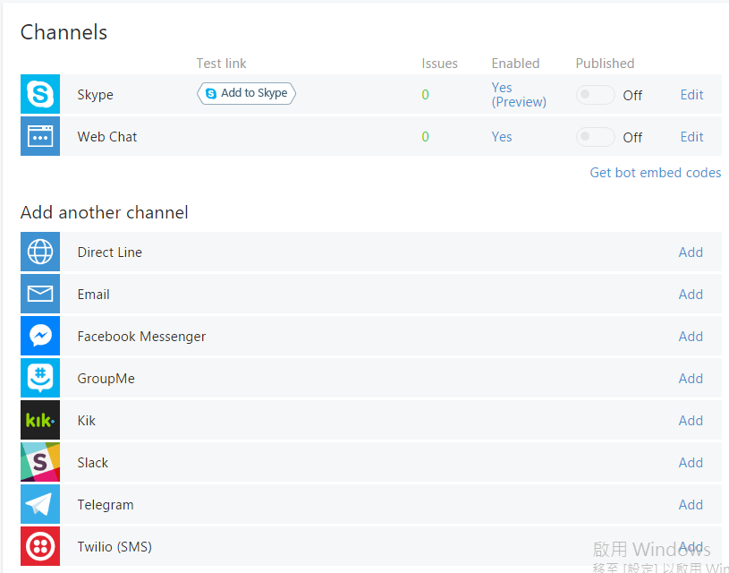
Bot Connector
Skype
Web Chat
Direct Line
Email
Facebook Messenger
GroupMe
Kik
Slack
Telegram
Twilio

Slide 9
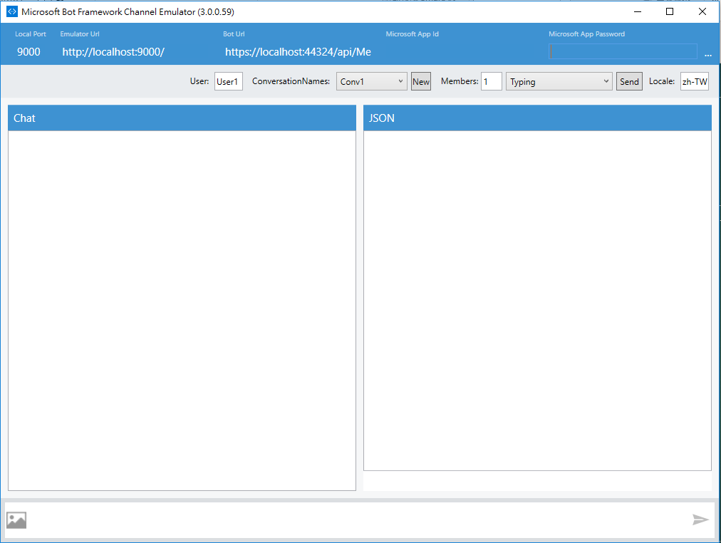
Bot Framework Emulator
An easy way to debug your bot(gotoLink).

Slide 10
Bot Sample
Spock (https://join.skype.com/bot/7fa82ae6-547c-41b1-ba00-9de3b4190dac)
ImageBot (https://join.skype.com/bot/79eaad73-f046-4720-9bba-3a2c8e1b0e0b)

Slide 11
Lunch time

Slide 12
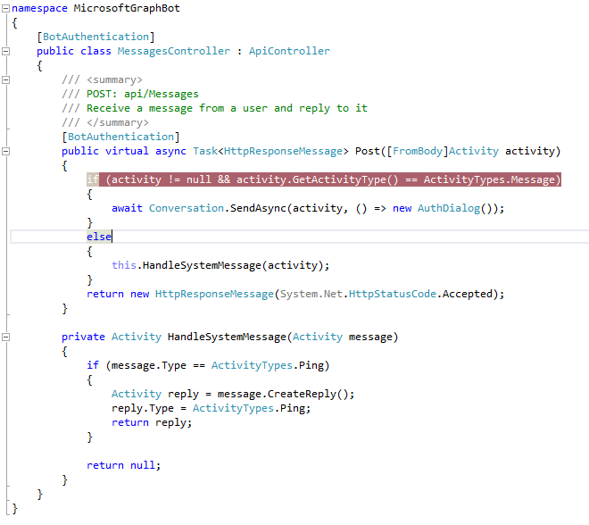
Hands-On Lab1
Download sample code (gotoLink)
EchoBot

Slide 13
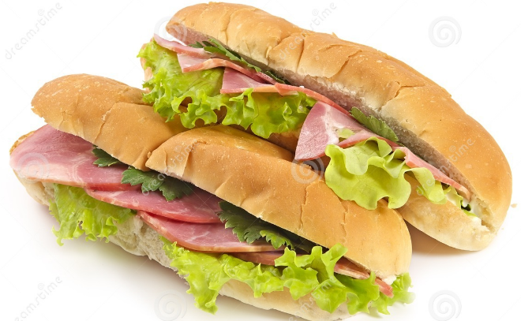
Hands-On Lab2
Sandwich Bot
Design a form flow.
Design return message.

Slide 14
Breaks

Slide 15
Hands-On Lab3
做出請假Bot
請假
查詢請假時數

Slide 16
References
https://dev.botframework.com/
https://www.luis.ai/
https://ankitbko.github.io/2016/08/ChatBot-using-Microsoft-Bot-Framework-Part-1/
http://www.codeproject.com/Articles/1106457/An-Introduction-to-the-Microsoft-Bot-Framework

Slide 17
Q&A

Slide 18
See you next section!

