Slide 1
MS Graph API workshop
系統整合中心-企業科技服務事業
簡報者：周祖昊
Email:john_th_chou@wistron.com

Slide 2
Outline
09:30 ~ 10:30 Microsoft Graph API intro
10:45 ~ 12:00 使用API Explorer 測試 API
12:00 ~ 13:00 午餐
13:20 ~ 14:30 Hands-On Lab 1
14:30 ~ 15:30 Hands-On Lab 2
15:30 ~ 16:00 Break
16:00 ~ 17:30 Hands-On Lab 3
17:30 ~ 18:00 Q & A

Slide 3
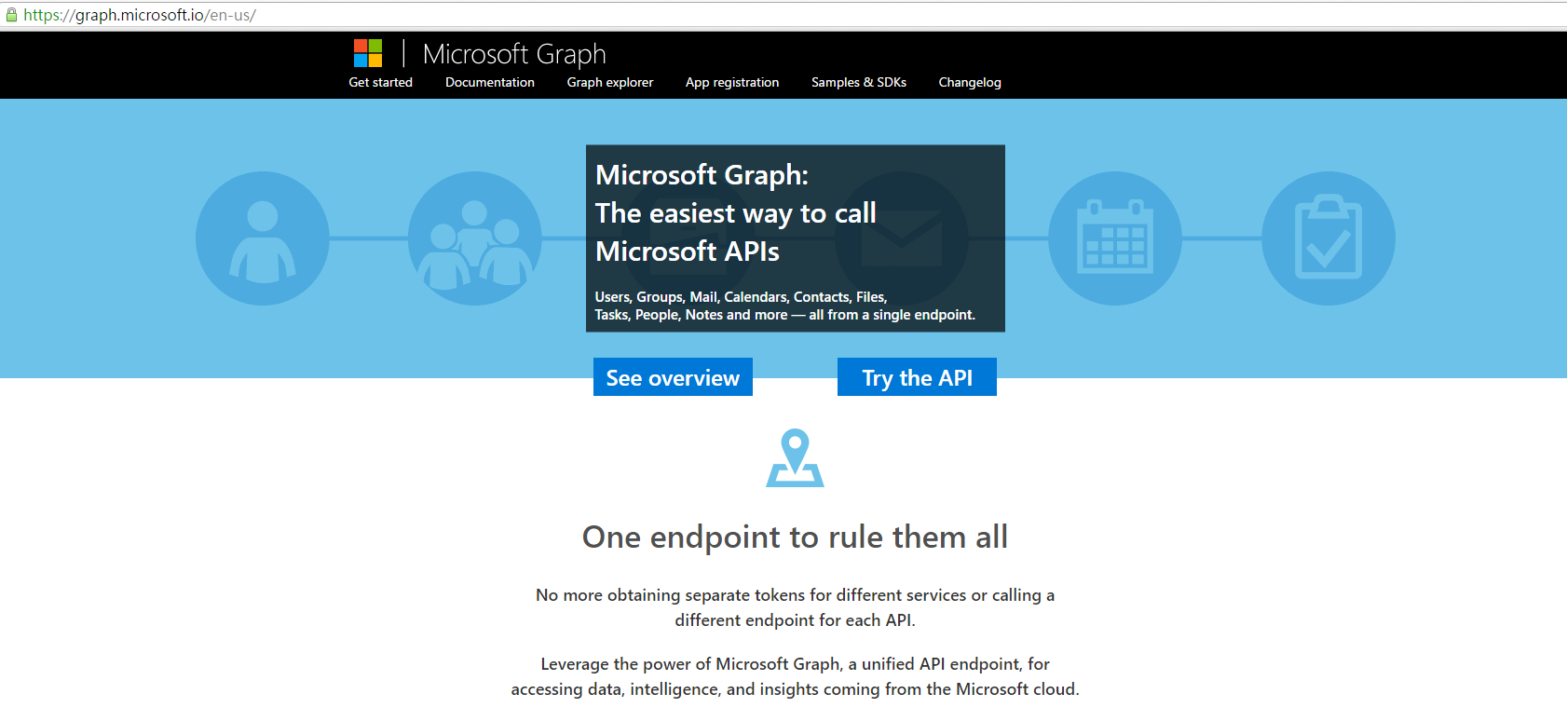
Microsoft Graph API intro
Microsoft Graph (previously called Office 365 unified API) exposes multiple APIs from Microsoft cloud services through a single REST API endpoint (https://graph.microsoft.com). Using the Microsoft Graph, you can turn formerly difficult or complex queries into simple navigations.

Slide 4
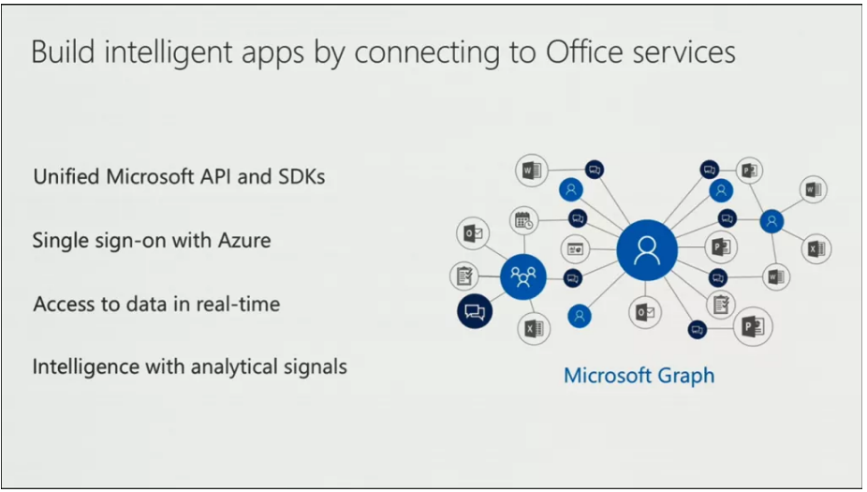
Microsoft Graph API feature
Unified Microsoft API and SDKs
Single sign-on with Azure
Access to data in real-time

Slide 5
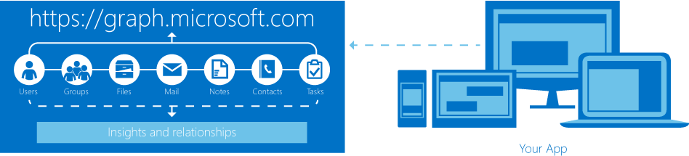
How many Graph APIs
User
OneDrive
Excel
Outlook Mail
Outlook Calendar
Personal Contact
Groups
Data Extentions
Directary
Webhook

Slide 6
Graph API - OneDrive
The drive resource is the top level object within a user's OneDrive. A user will always have at least one Drive available--the default Drive.

Slide 7
Graph API – Outlook Mail
A message in a mail Folder.

Slide 8
Graph API – Outlook Calendar
A calendar which is a container for events.

Slide 9
Graph API – Group
Represents an Azure Active Directory group, which can be an Office 365 group, dynamic group, or security group. Inherits from directoryObject.

Slide 10
Graph API - User
Represents an Azure AD user account. Inherits from directoryObject.

Slide 11
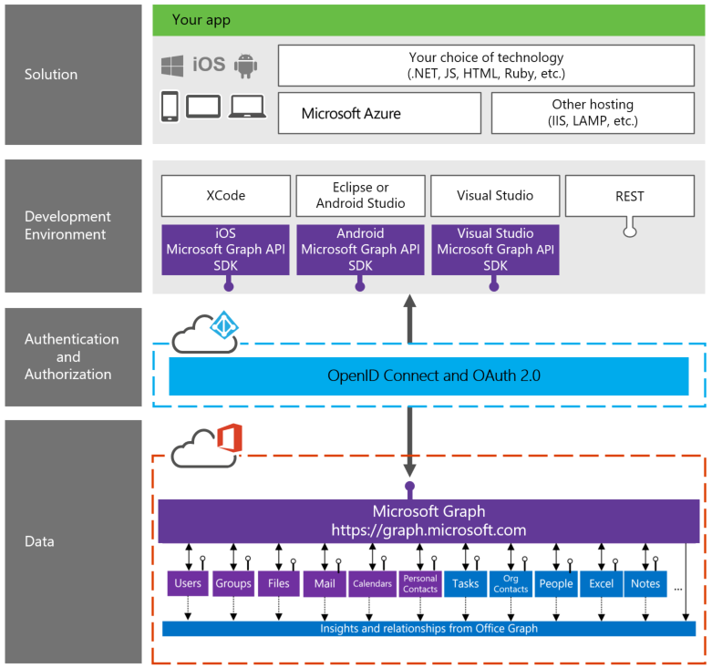
How to use it
By Graph RESTful API
By Microsoft Graph API SDKs

Slide 12
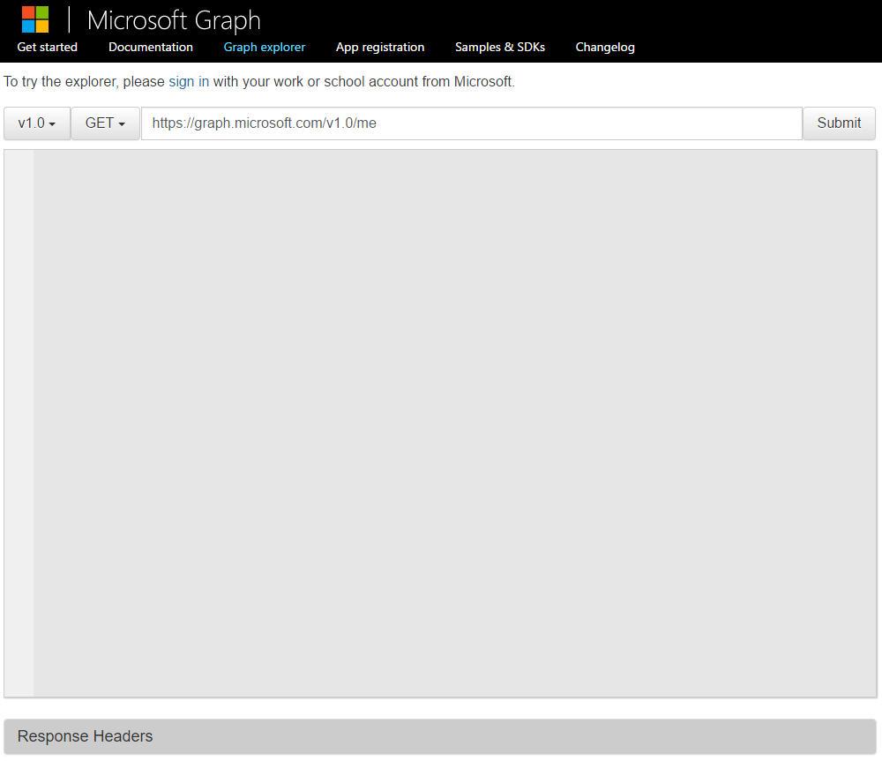
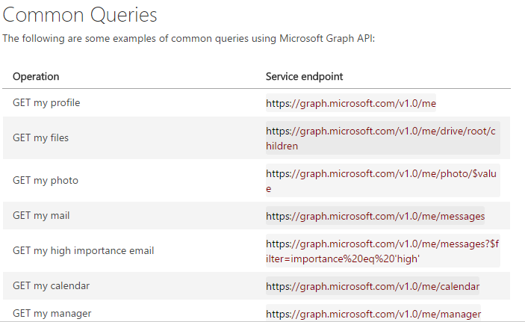
Some Common Queries
Get my profile
Get my files
…

Slide 13
What is REST, RESTful API ？
具象狀態傳輸（英文：Representational State Transfer，簡稱REST）是Roy Thomas Fielding博士於2000年在他的博士論文 "Architectural Styles and the Design of Network-based Software Architectures" 中提出來的一種全球資訊網軟體架構風格。

Slide 14
REST是設計風格而不是標準
資源是由URI來指定。
對資源的操作包括獲取、創建、修改和刪除資源，這些操作正好對應HTTP協議提供的GET、POST、PUT和DELETE方法。
通過操作資源的表現形式來操作資源。
資源的表現形式則是XML或者HTML，取決於讀者是機器還是人，是消費web服務的客戶軟體還是web瀏覽器。當然也可以是任何其他的格式。

Slide 15
符合REST設計風格的Web API稱為RESTful API
它從以下三個方面資源進行定義：
直觀簡短的資源地址：URI，比如：http://example.com/resources/。
傳輸的資源：Web服務接受與返回的網際網路媒體類型，比如：JSON，XML，YAML等。
對資源的操作：Web服務在該資源上所支持的一系列請求方法（比如：POST，GET，PUT或DELETE）。

Slide 16
REST的優點
可更高效利用快取來提高響應速度
通訊本身的無狀態性可以讓不同的伺服器的處理一系列請求中的不同請求，提高伺服器的擴展性
瀏覽器即可作為客戶端，簡化軟體需求
相對於其他疊加在HTTP協議之上的機制，REST的軟體相依性更小
不需要額外的資源發現機制
在軟體技術演進中的長期的相容性更好

Slide 17
Break time

Slide 18
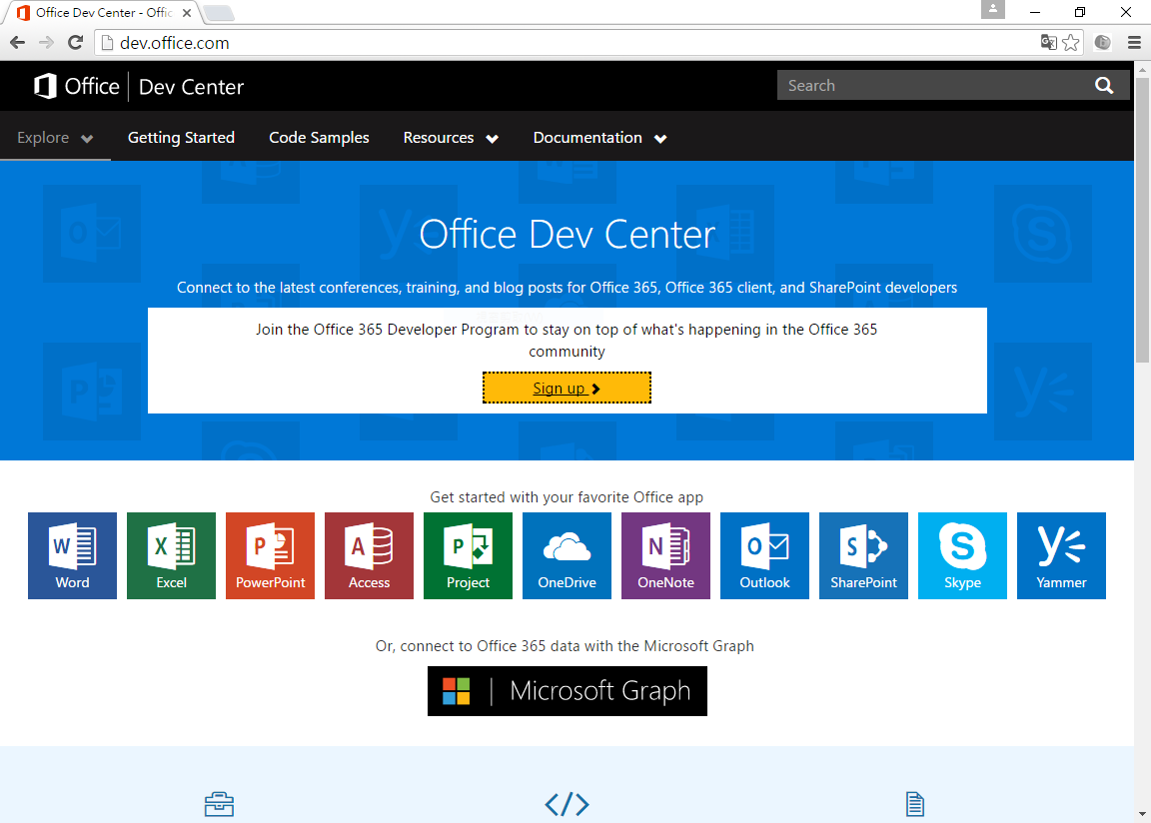
Setting
Sign up a developer account (gotoLink)
Login Office365:prepare email , Calendar and onedrive (gotoLink)

Slide 19
Graph API Explorer
Login with dev account & get start( https://graph.microsoft.io/ )
Query parameters( gotoLink )

Slide 20
Example
Get my contacts data
https://graph.microsoft.com/v1.0/me/contacts
Get calendar events list
https://graph.microsoft.com/v1.0/me/events

Slide 21
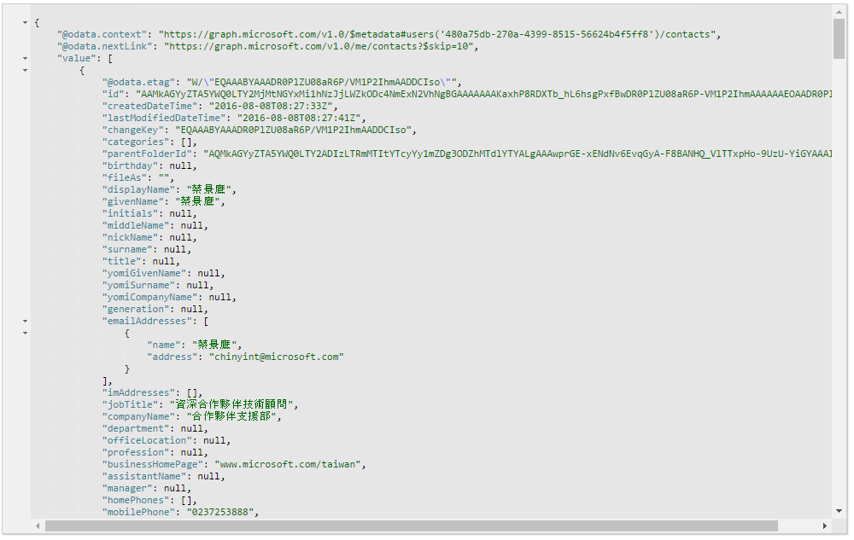
Get my contacts result

Slide 22
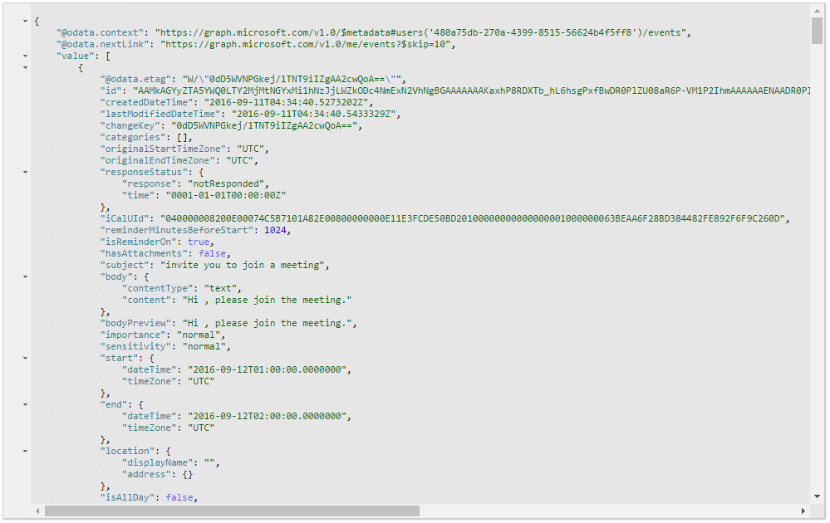
Get my events result

Slide 23
Lunch time

Slide 24
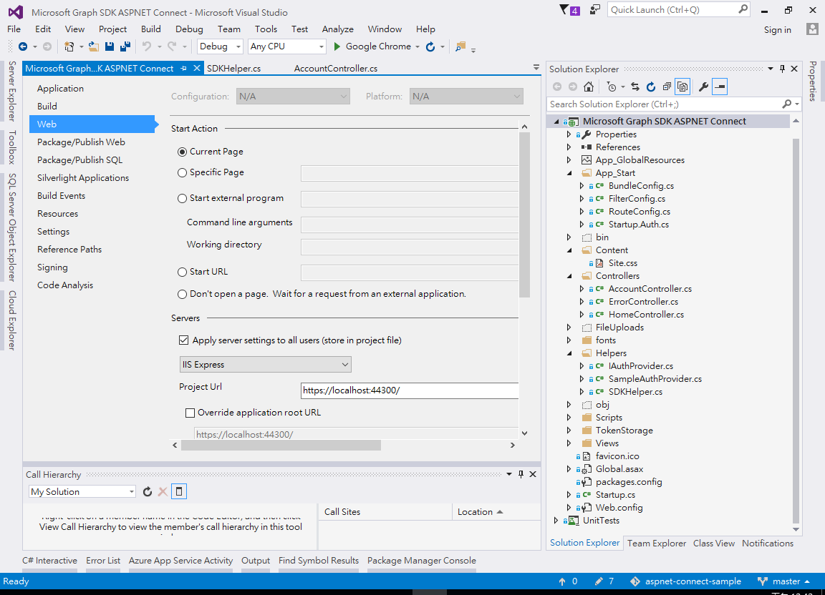
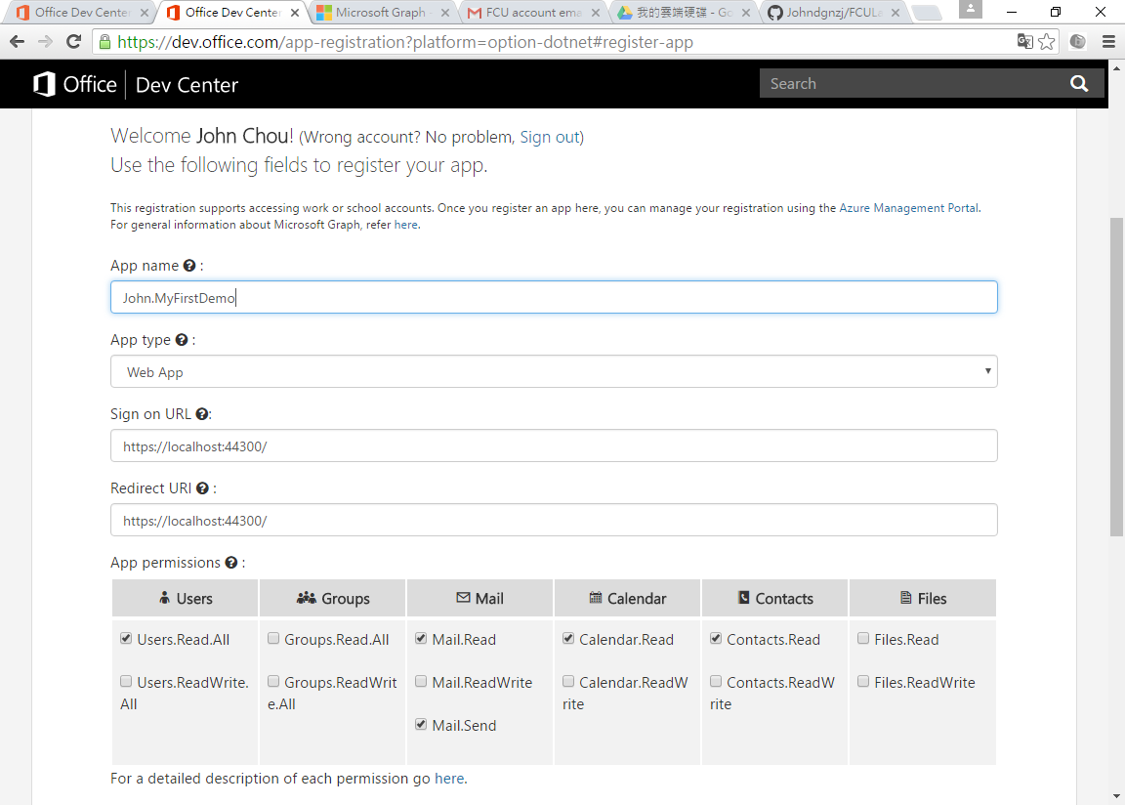
Hands-On Lab1
Download sample code from github(UnifiedApiConnect)
Registry a new application(gotoLink).

Slide 25
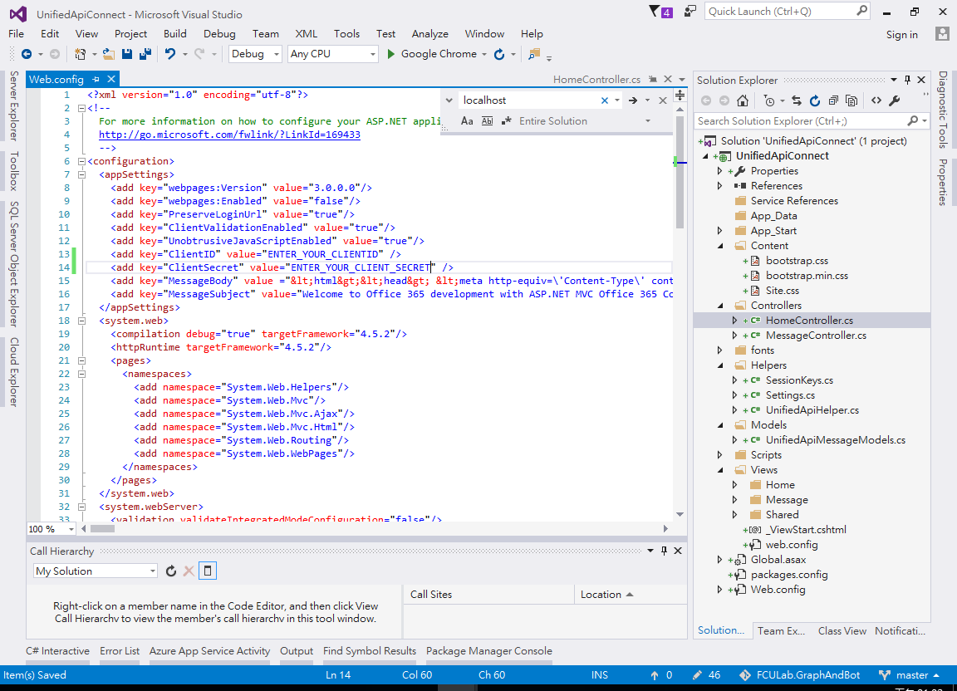
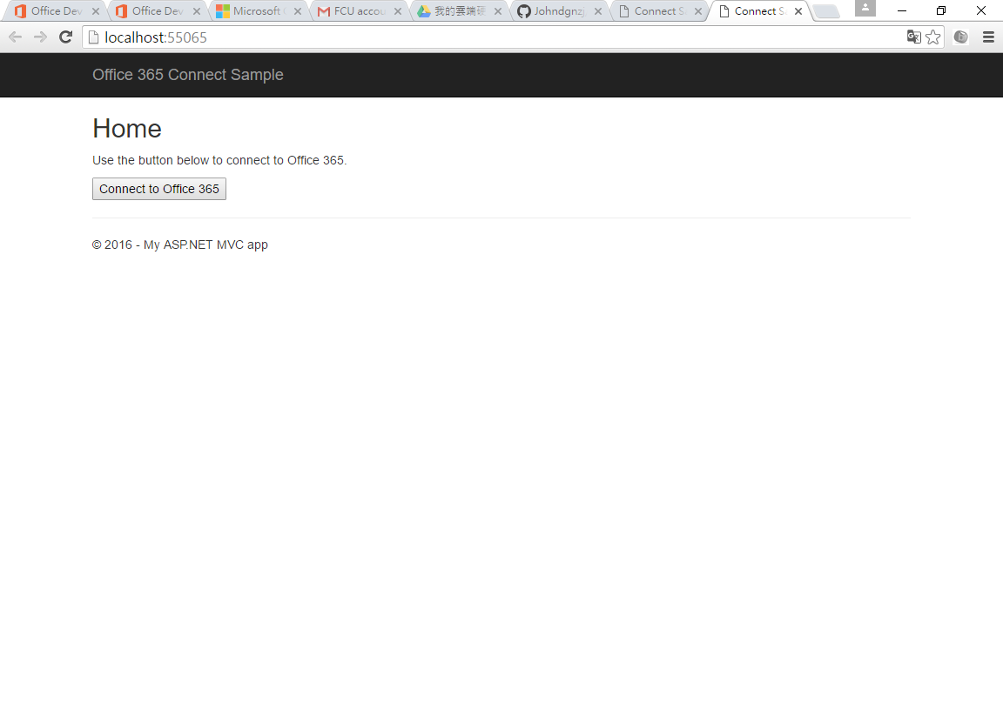
Hands-On Lab1
Copy Client ID and Client Secret to your app
Run the APP!

Slide 26
Hands-On Lab2
查詢Calendar內的Events
動手作：為自己在Office365 Calendar上建立一個Event。

Slide 27
Hands-On Lab3
讀取 OneDrive 列表
動手做：上傳檔案、下載清單中的附件。

Slide 28
Q&A

Slide 29
See you next time!

