Slide 1
MULTI-VENDOR E-COMMERCE DATABASE SYSTEM
COMP7640_Group11

Slide 2
CONTENT
INTRODUCTION
Overview of the database system
ER Diagram Design
Display ER diagram and explain the meaning of entities, attributes, and relationships
Relational Table Design
Showcase the relational table design
Functionality Demonstration
Demonstrate the functionalities and demo playing

Slide 3
INTRODUCTION
This project aims to create and execute a multi-vendor e-commerce platform with a focus on personalizing the user experience.
In such an environment, a powerful database system is essential. Database systems will play a key role in storing and managing the complex relationships between suppliers, products, customers, and transactions.
Through the effective design and implementation of the database system, the smooth operation of the platform can be ensured to provide users with a personalized and efficient shopping experience.
Put a website picture

Slide 4
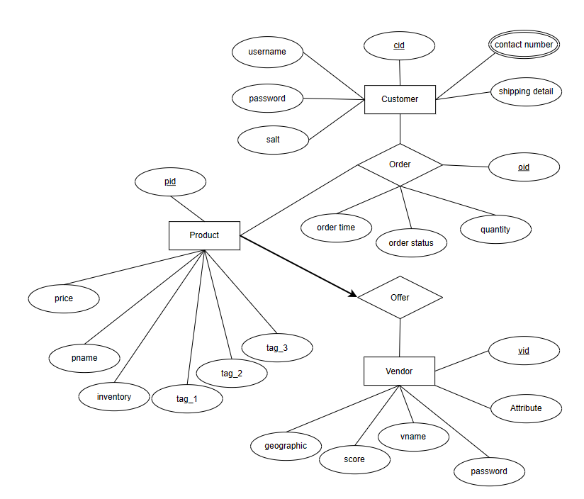
ER DIAGRAM DESIGN
This ER diagram show the relationship
between vendor, product and customer.
Vendor and product: one to many
Product and customer: many to many
To clarify a point: Although inventory is
set by the vendor, it is more convenient to
use it as an attribute of the product in the
database system.

Slide 5
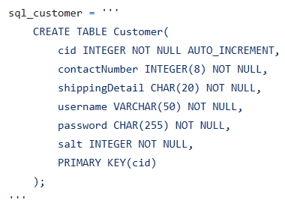
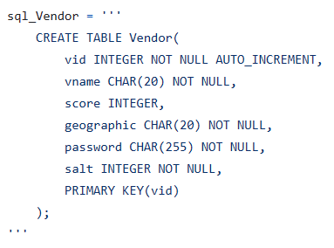
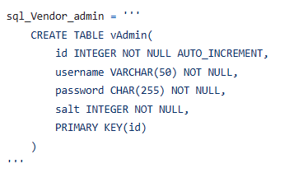
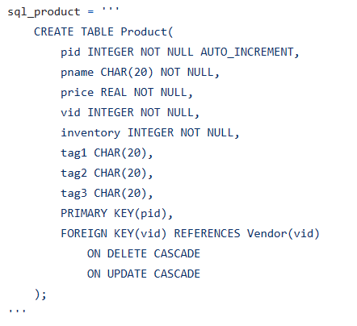
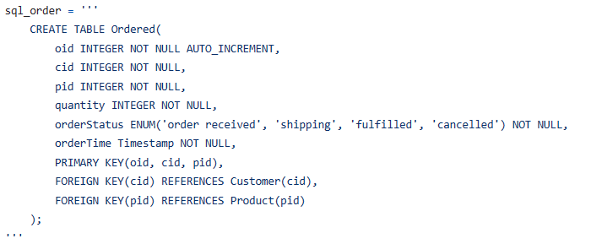
RELATIONAL TABLE DESIGN
In the database system, we have designed 5 relational tables. The offer table is implemented by vid foreign key in product table. We need a vendor admin table
to store vendor administrator.
SQL command to create relational table.

Slide 6
FUNCTIONALITY DEMONSTRATION
Vendor Administration:
Display all vendor;
Add a new vendor
Product Catalog Management:
Display all products of a vendor;
Add a new product
Customer module:
Product search;
Product purchase;
Order modification
Demo video

Slide 7
THANK YOU

