Slide 1
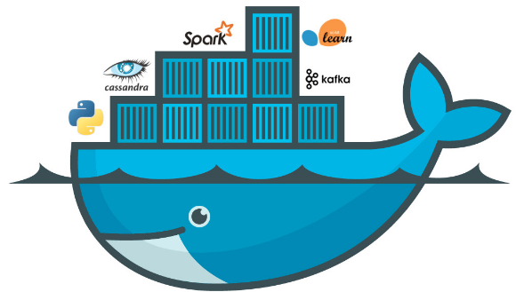

Dockers

Slide 2
Installing Docker
https://docs.docker.com/install/linux/docker-ce/ubuntu/
workable
tesable
repeatable

Slide 3

Container ID Image Name Command used created Alive Exposed Container name
Docker inspect <container name> | less

Slide 4
-docker container run --it --name=john busybox:1.26 - Now when you run this. if will first see if it has a local copy of the image or it will download and then run.
run - run
-it - interatctive session
name - to give the name
busybox - is the image
-exit -> to exit from the container and kill it
-ctrl+p+q -> to exit from the container with out killing it
-docker attach <container name> to login to the container which is running
-docker container ls -> to see running containers
-docker container ls -a -> To see the Background/Stopped/running containers.
-docker container rm <name> -> To remove the comtainer and data present it is completely lost.

Slide 5
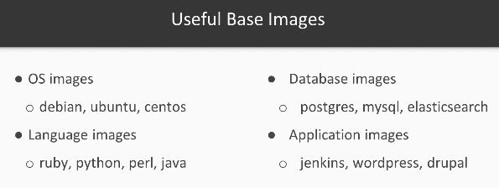

Slide 6
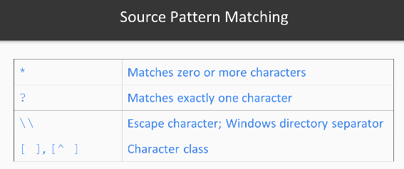
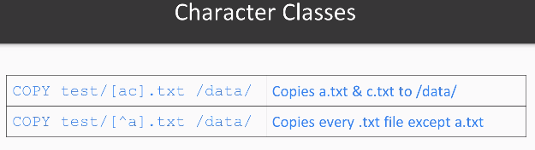
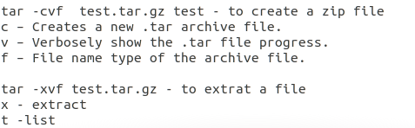
Copy & ADD
Example 1: - copying a file
FROM ubuntu:latest
cp text.txt /data/text
- docker build -t john .
- docker run --rm -it john -> you will see that the data directory is created and text.txt exits
Example 2: - copying a Directory
FROM ubuntu:latest
cp text /data/
- docker build -t john .
- docker run --rm -it john ls -R /data-> you will see that the data directory is copied and file exits.
Example 3: - copying with special instructions
FROM ubuntu:latest
ADD test.tar.gz /data/
- docker run --rm -ti john ls -R /data
Example 4: Runnign custom commands
FROM ubuntu:latest
RUN apt-get update && \ apt-get unstall -y \ git \ golang\ rsync \ wget \
Example 5: CMD -> It just lists the cmd and not allow to login
FROM ubuntu:latest
CMD ["ls", "/"]

Slide 7

Network Connections
Docker run -p -> for exposing ports
Example 5:
docker run -d -P --name nginx nginx
Example 6: Exposing ports
FROM rub.2.4.1
RUN apt-get update && apt-get install -y nodejs
RUN gem install rails
Run mkdir /app
WORKDIR /app
RUN rails new blog
EXPOSE 3000
WORKDIR /app/blog
CMD ["bin/rails", "server"]
- docker run -d -p 3000 --name john john
docker run -it --rm -p 8888:8080 tomcat:8.5.15-alpine

Slide 8
ENV & ARG Variables
Example 7: Environment Variables
FROM debian:latest
ENV About=My-name-is-john
ENV Location=from-Hyderabad
ADD script.sh /usr/local/bin/script.sh
RUN chmod 777 /usr/local/bin/script.sh
CMD ["/usr/local/bin/script.sh"]
- docker build -t john2
- docker run --rm <Image-Name>
- docker container run --rm -e Location="Banglore" john2
- docker container run --rm -e Location="Banglore" -e About="My name is john" john2
- docker container run --rm --env-file script in the PWD john2 -> We should create a file before
Example 8: Argument Variables -> You should create those files before
FROM debian
ARG environment=development
COPY ${environment}.conf /myapp.conf
- docker run --rm -ti john3
- docker build -t john3 --build-arg environment=production .
- docker run --rm john3 cat /myapp.conf

Slide 9
Volume, Tags, Commit
docker container run --rm -ti -v /tmp/data:/data debian:latest
docker tag john3 john:stable-1.0
docker commit d8f5f06a9eb1 john:stable-1.1

Slide 10
Build Image with Packers
docker container run --rm -ti -v /tmp/data:/data debian:latest
docker tag john3 john:stable-1.0
{
"builders" : [
{
"type" : "docker",
"image" : "debian:latest",
"commit" : true,
"chages" : [
"CMD [\"nginx\", \"-g\", \"daemon off;\"]",
"EXPOSE 80"
]
}
],
"provisioners" : [
{
"type" : "shell",
"inline" : ["apt-get update && apt-get install -y nginx"]
}
],
"post-processors" : [
[
{
"type" : "docker-tag",
"repository" : "packer-nginx",
"tag" : "1.0"
}
]
]
}
Packer build test.json

Slide 11
docker pull ubuntu
docker run --name test-lamp-server -it ubuntu:latest bash
apt-get update
apt-get install lamp-server
Docker ps
docker commit -m "Added LAMP Server" -a "NAME" test-lamp-server USER/test-lamp-server:latest
docker login
docker push USER/test-lamp-server

