Slide 1

Git
Source code management Tool

Slide 2

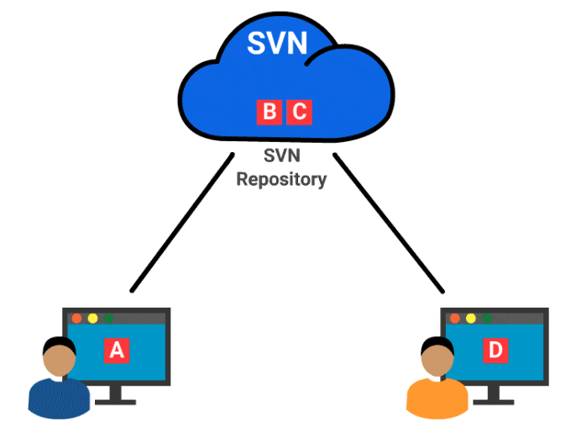
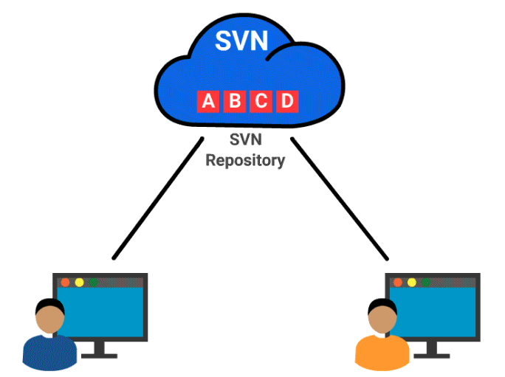
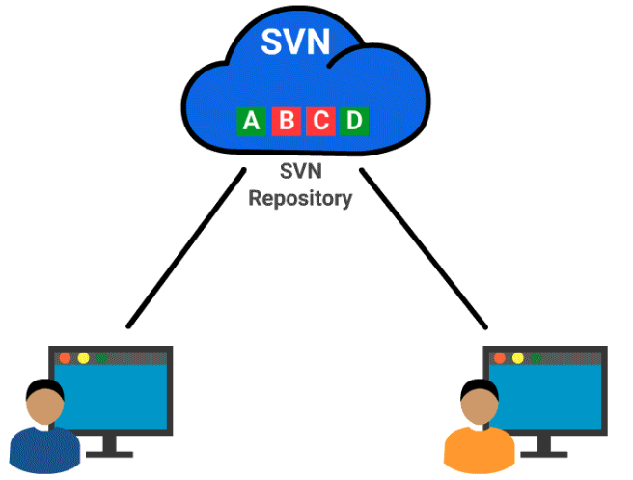
Centralized VS Distributed
2
sdf
1
2
3

Slide 3

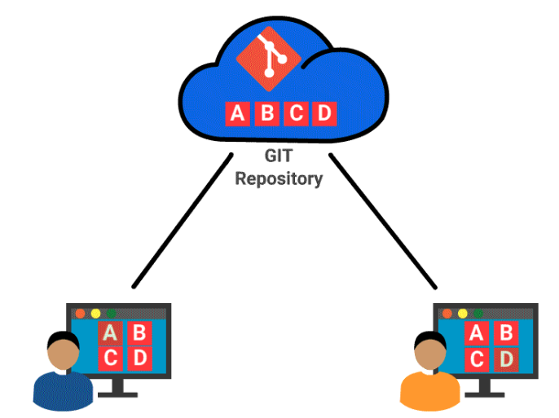
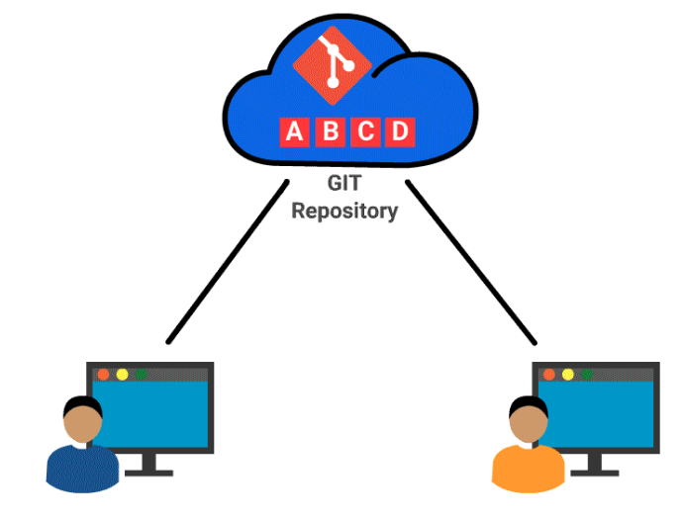
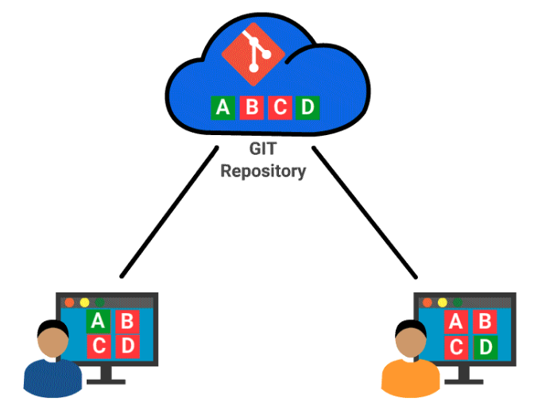
Centralized VS Distributed
2
sdf
1
2
3

Slide 4
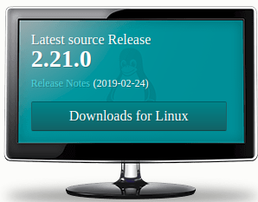

For Windows you will install GIT Bash - https://git-scm.com/downloads
Linux type the following commands from the shell
- apt-get update
- apt-get install git
After Installing you can configure your user name and e-mail id.
- git config --global user.name "First Last"
- git config --global user.email "myemail@domain.com"

Slide 5
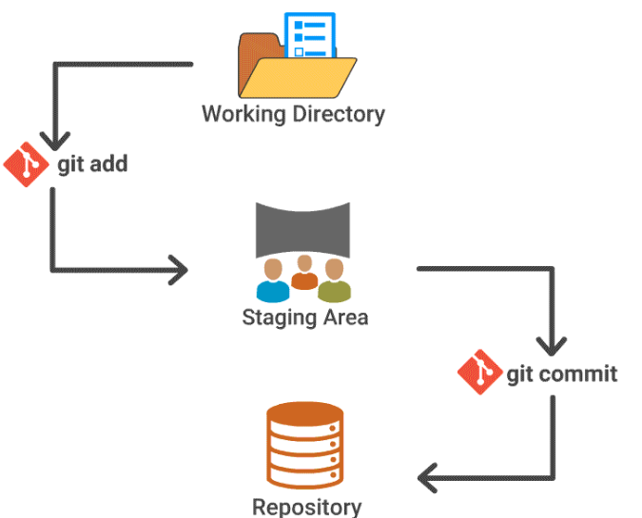
add and commit explained

Slide 6
Basic Git commands
git init is used for creating an empty repository or for re-initializing an existing repository
git status displays the current status of the staging area and the working directory
git add prepares the new and existing files for staging . It adds all the new and existing file/directories to the staging area
git commit will take a snapshot and record all the changes into the repository
Git commit –amend -m “comment” -> to change the comments
git reset HEAD <file-name> - To take out from staging
Git revert <commit id> - To completely delete the commit
Git reset –soft <commit id> | git reset –hard <commit id>
git rm --cached <file-name> - To take out from commit
git remote -v -> To see the remote repositories
git remote add name <>
git remote rm name

Slide 7
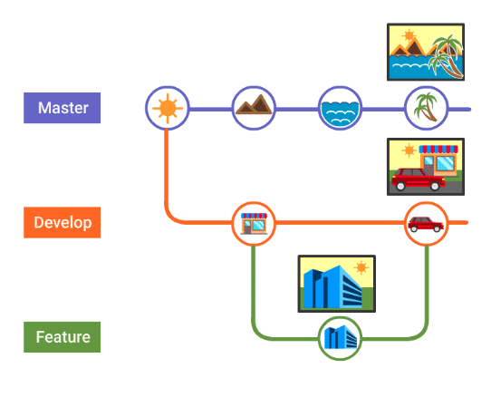
Feature Branching

Slide 8
Git Branch
git branch featureA; git checkout featureA -> This will careate the branch and moves to that branch
git chekcout -b featureA -> Shortcut to create and move to it
Git merge master
Git merge conflicts
git branch -d featureA - > To delete the branch
git brench -D freatureA -> To delete permenantly
git branch -v
git branch --no-merged
git branch –merged
Git stash save “name” | git stash pop <stash id> | git stash drop

Slide 9
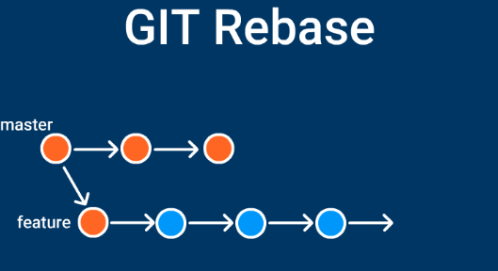
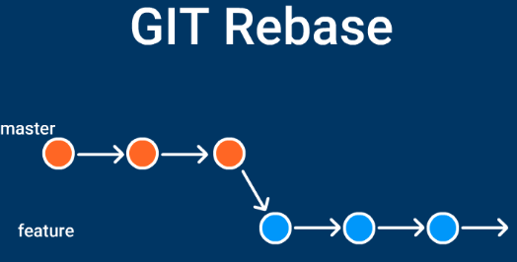
Rebase

