Slide 1

AWS CloudTrail

Slide 2

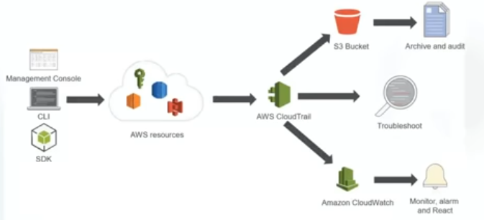
What Is AWS CloudTrail?
Who did what on AWS
AWS CloudTrail is an AWS service that helps you enable governance, compliance, and operational and risk auditing of your AWS account. Actions taken by a user, role, or an AWS service are recorded as events in CloudTrail. Events include actions taken in the AWS Management Console, AWS Command Line Interface, and AWS SDKs and APIs.
CloudTrail is enabled on your AWS account when you create it. When activity occurs in your AWS account, that activity is recorded in a CloudTrail event. You can easily view recent events in the CloudTrail console by going to Event history.
You can identify who or what took which action, what resources were acted upon, when the event occurred, and other details to help you analyze and respond to activity in your AWS account. Optionally, you can enable AWS CloudTrail Insights on a trail to help you identify and respond to unusual activity.

Slide 3
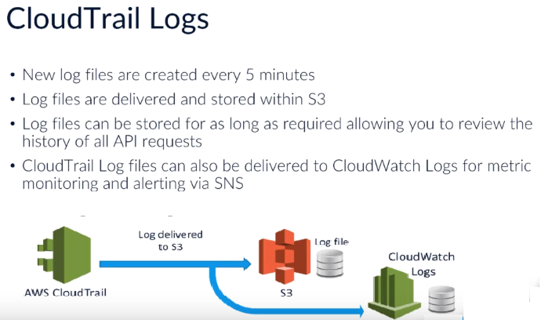
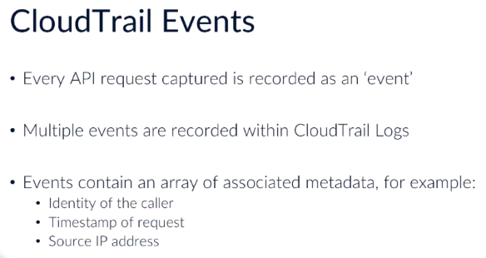

Slide 4
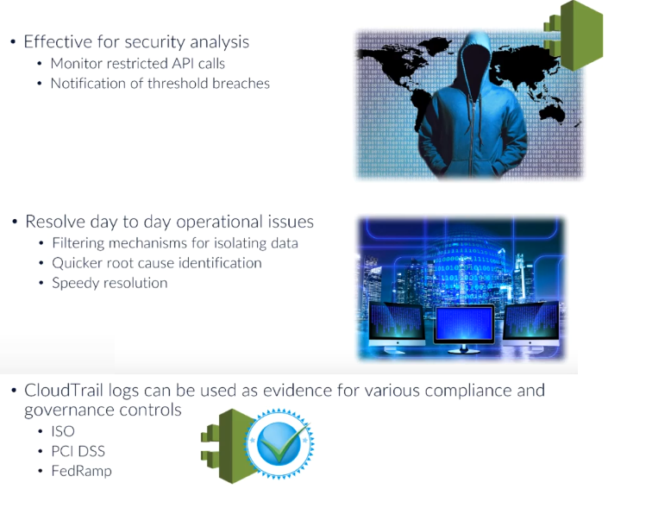
Use cases for captured data

Slide 5
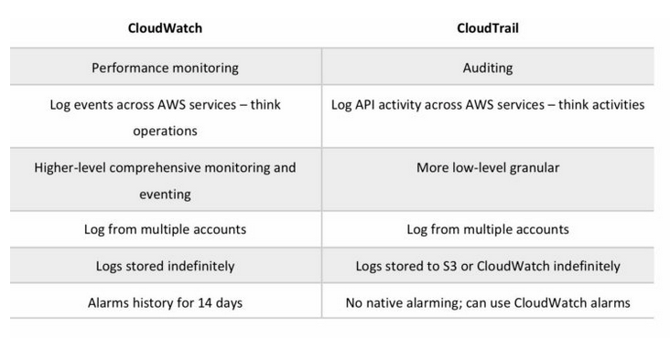
CloudWatch vs CloudTrail

