Slide 1

Chef
Infrastructure Automation Tool

Slide 2
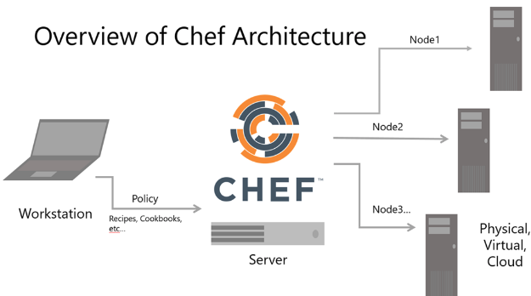
Out Fit

Slide 3
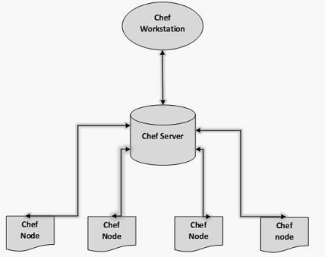
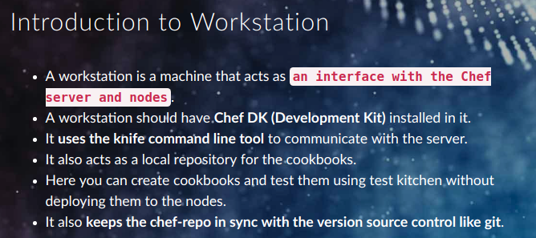
Chef-Workstation

Slide 4

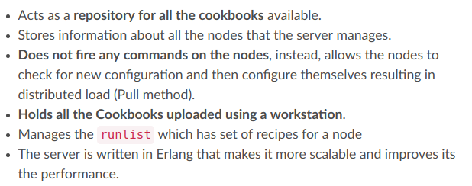
Chef-Server

Slide 5
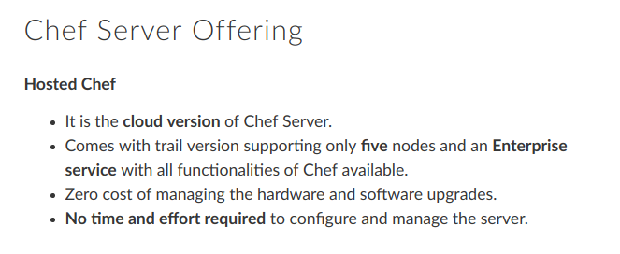
Hosted Chef Server

Slide 6
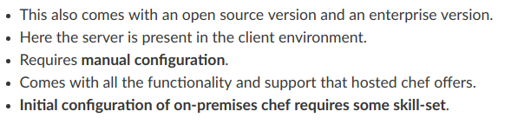
On Premises chef

Slide 7
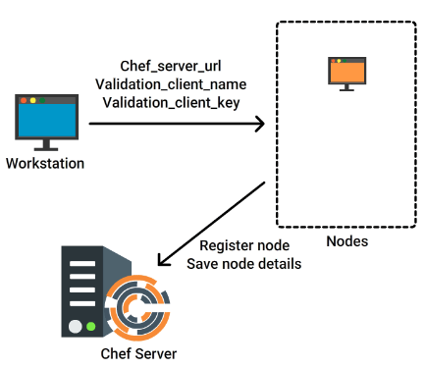
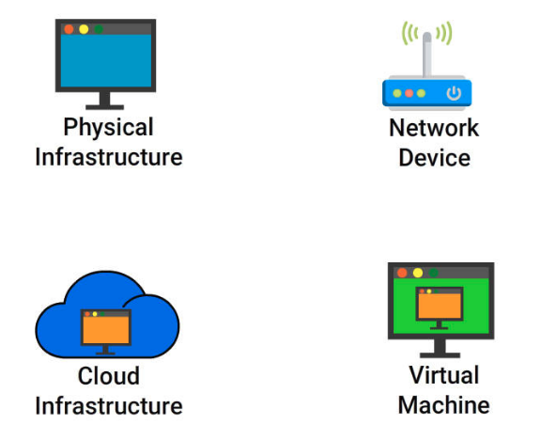
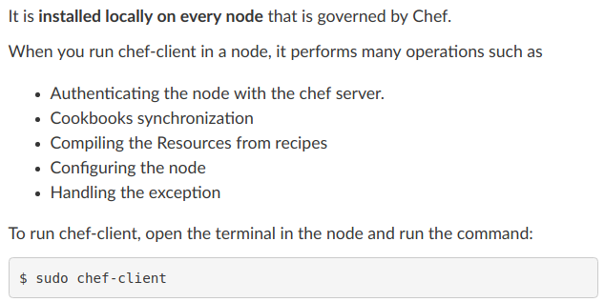
Node - Client
Bootstrap
Types of Nodes

Slide 8
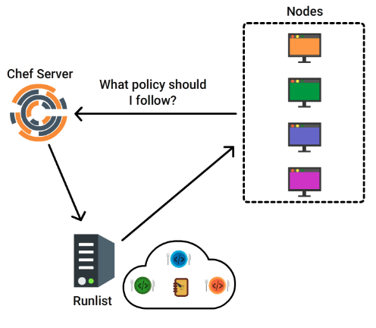
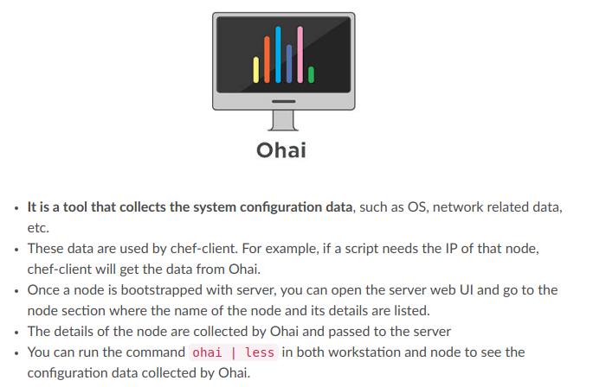
Ohai & Runlist

Slide 9
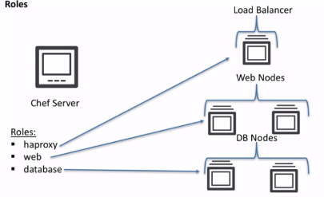
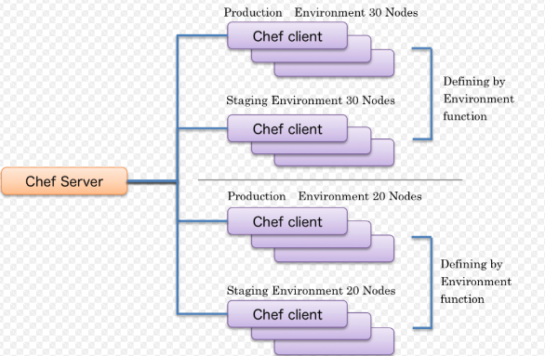
Role | Environment
A role is a way to define certain patterns and processes that exist across nodes in an organization as belonging to a single job function
An environment is a way to map an organization's real-life workflow to what can be configured and managed when using Chef server.

